Slide 1
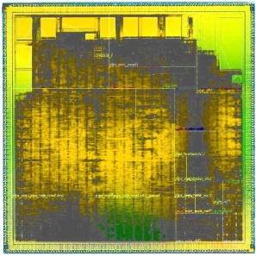
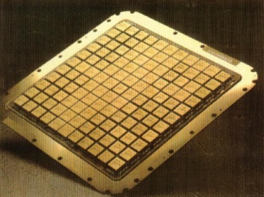
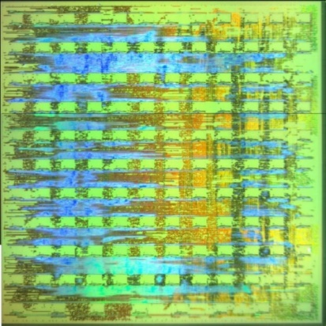
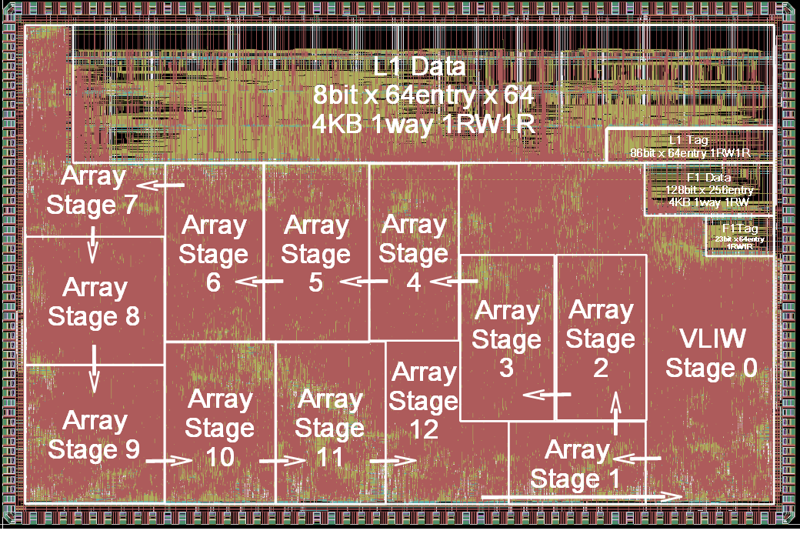
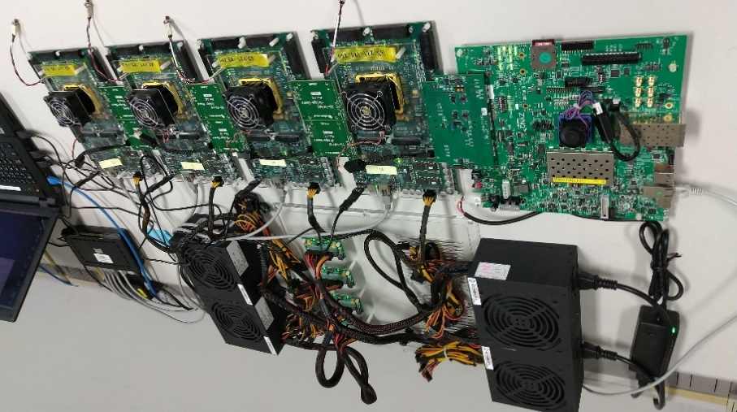
F
D
E
C
M
M
M
M
W
HW Mapper
E
F
D
D
D
M
M
M
M
D
E
E
E
E
D
M
M
M
M
E
E
E
E
B
B
B
B
B
B
B
B
E
M
M
M
M
E
E
E
E
M
M
M
M
F
D
B
B
B
B
B
B
B
B
E
W
E
E
E
E
B
B
B
B
B
B
B
B
E
M
M
M
M
E
E
E
E
M
M
M
M
B
B
B
B
B
B
B
B
E
E
E
E
E
B
B
B
B
B
B
B
B
C
M
M
M
M
M
M
M
E
E
E
E
M
M
M
M
E
E
E
E
Load pipe
FPU pipe
Store pipe
(b) 2006年OROCHI: 9列VLIW+5wayスーパースカラ
(a) 1988年VPP: 4列VLIW+8並列Vector
F
D
D
HW Mapper
E
LM
E
LM
E
LM
E
LM
E
LM
E
LM
E
LM
E
LM
E
LM
E
LM
E
E
E
E
E
E
E
E
E
E
E
LM
E
LM
E
LM
E
LM
E
LM
E
E
E
E
E
E
E
E
E
E
E
LM
E
LM
E
LM
E
LM
E
LM
E
E
E
E
E
E
E
E
E
E
HOST AXI
E
E
LD
LD
E
ST
LD
LD
E
ST
(d) 2012年EMAX: 4列x16行CGRA
C0
C1
C2
C3
M
M
(c) 2008年LAPP: 8列VLIW+32行CGRA
TB
Tandem Buffer
E
LM
E
LM
E
LM
E
LM
E
LM
E
LM
E
LM
E
LM
E
LM
E
LM
TB
E
LM
E
LM
E
LM
E
LM
E
LM
TB
E
LM
E
LM
E
LM
E
LM
E
LM
TB
E
LM
E
LM
E
LM
E
LM
E
LM
TB
E
LM
E
LM
E
LM
E
LM
E
LM
TB
E
LM
E
LM
E
LM
E
LM
E
LM
HOST
確率的多入力積和演算
(e) 2017年IMAX: 1列x64行CGRA
(f) 2022年IMAX3: 1列x64行x2N TandemCGRA
Notes:
I was an architect of a vector supercomputer, and designed several processors based on VLIW.
----
In 2006, OROCHI had ARM decoder and VLIW backend for heterogeneous multithreading.
The ARM instructions are decomposed and mixed with VLIW stream by hardware.
----
Then in 2008, I started my first CGRA what we call LAPP inspired by VPP and OROCHI.
LAPP does not need compilers. The VLIW stream are dynamically mapped on the CGRA, and the network is initialized based on the register dependency.
By passing data from cache ways every cycle, all of location free load and store instructions can access valid address in a small memory window.

