Slide 1
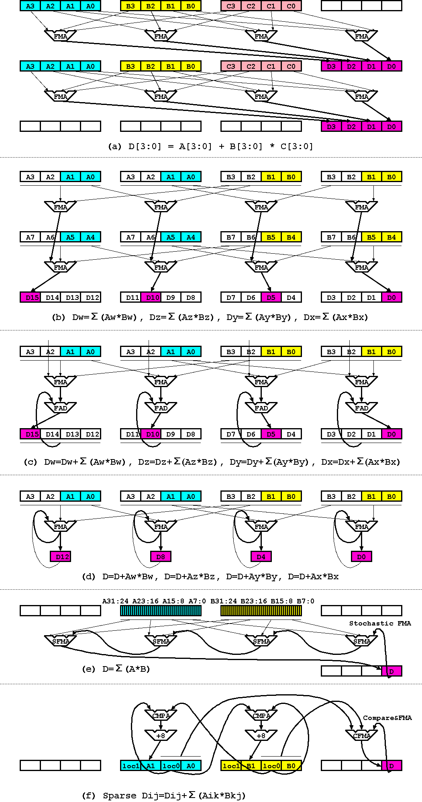
Octa ld
A
Octa ld
B
Octa ld
C
Dual ld A1,A2
Dual ld A3,A4
Dual ld B1,B2
Dual ld B3,B4
Octa A+B*C
Dual ld A5,A6
Dual ld A7,A8
Dual ld B5,B6
Dual ld B7,B8
Octa st D
(b) Random access
(a) SIMD dense matrix
A = A + B[i] * C[i]
A[i] = A[i] + B[i] * C[i]
(d) Accumulation
(c) Sequential updates
(e) 32 elements stochastic FMA
(f) Sparse matrix multiplication/Merge sort
Notes:
And also FPU should be equipped for HPC and AI applications.
In case of dense and sparse matrix, just pipelining is enough for getting high frequency.
----
But in case of floating point accumulation, just putting feedback paths brings significant performance drop in CGRAs.
So, IMAX2 has column multithreading for eliminating pipeline stall.

