Slide 1


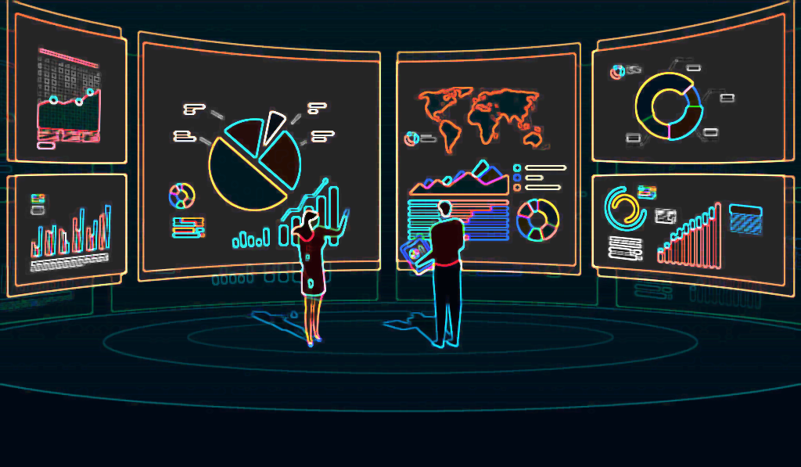
SENG 352 TERM PROJECT PRESENTATION Customer BEHAVIOR ANALYSIS ACCORDING TO ATTRIBUTES (MARKETING CAMPAIGN)
YASMİN ÇINAR
201928009

Slide 2
In this project we will observe customers features and relation between their expenses. (Features such as marital status , education level,age etc.)
ID -> Customer’s unique identifier
Year_Birth -> Customer's birth year
Education -> Education Qualification of customer
Marital_Status -> Marital Status of customer
Income -> Customer's yearly household income
Kidhome -> Number of children in customer's household
Teenhome -> Number of teenagers in customer's household
Dt_Customer -> Date of customer's enrollment with the company
Recency -> Number of days since customer's last purchase
MntWines -> Amount spent on wine

Slide 3

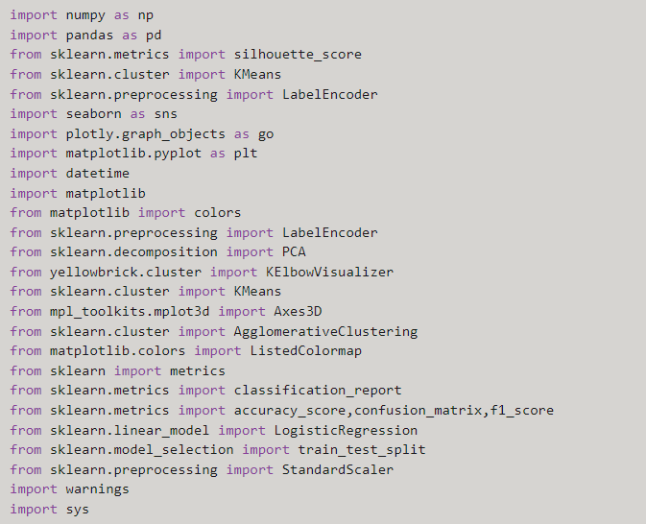
We import the required libraries for our project.

Slide 4

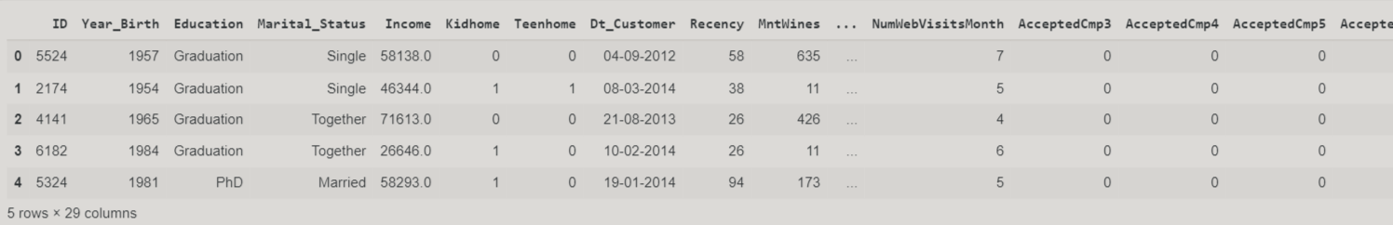
Lets read our csv file using pandas function and look at our first 5 data.

Slide 5
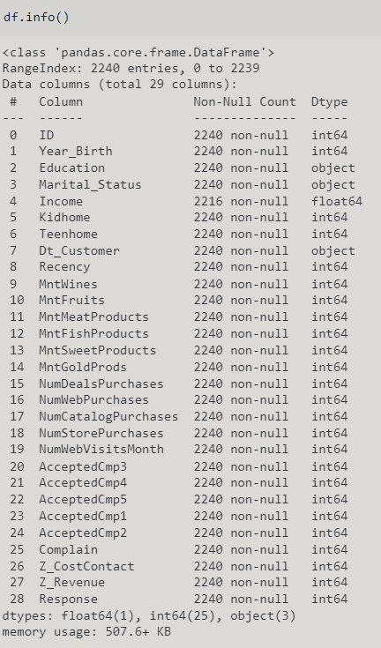
This method prints information about a DataFrame including the index dtype and columns, non-null values and memory usage.

Slide 6
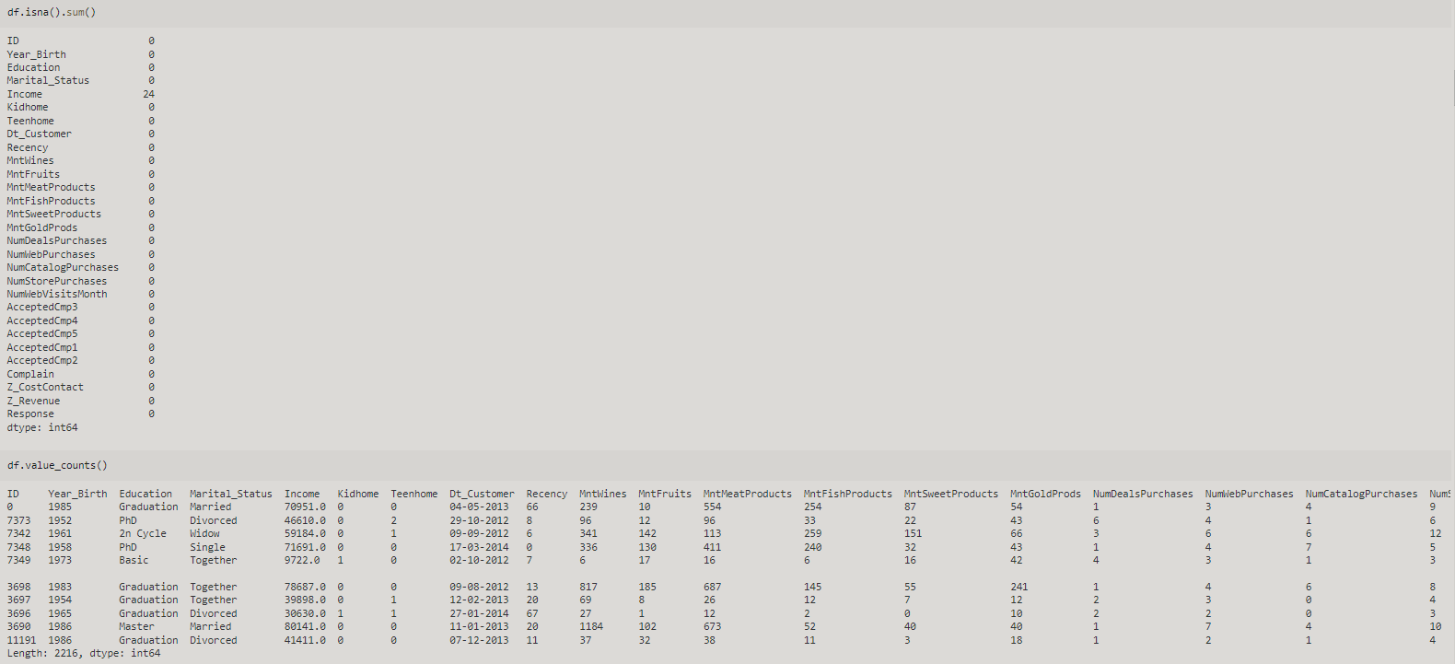
Count missing values for each column of the dataframe df and with value_counts method we get counts of unique values.

Slide 7
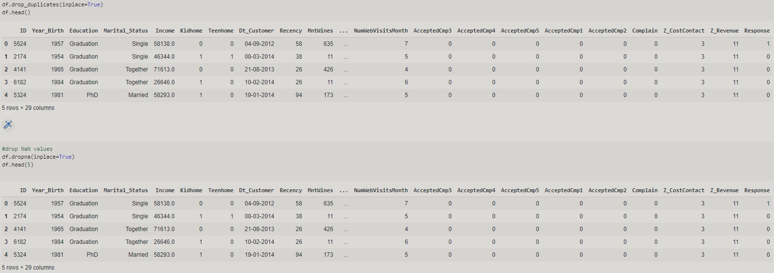
We drop the duplicates and NaN values.

Slide 8
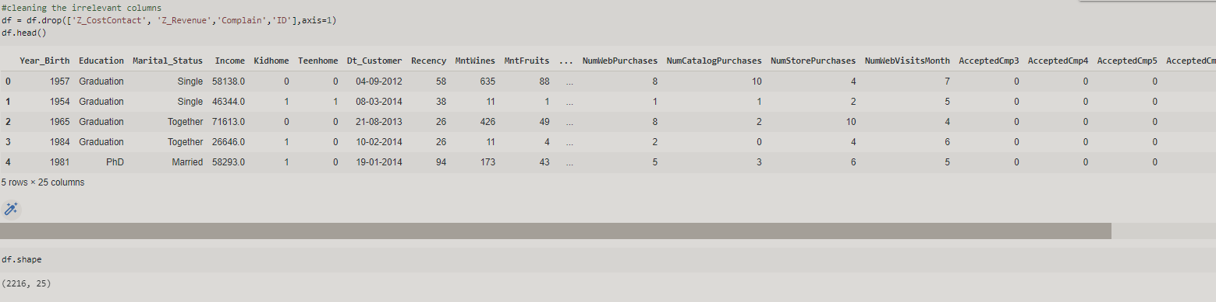
Again we drop the irrelevant features . Then lets look our df’s shape.
Shape method shows how many rows and columns our data consists of.

Slide 9
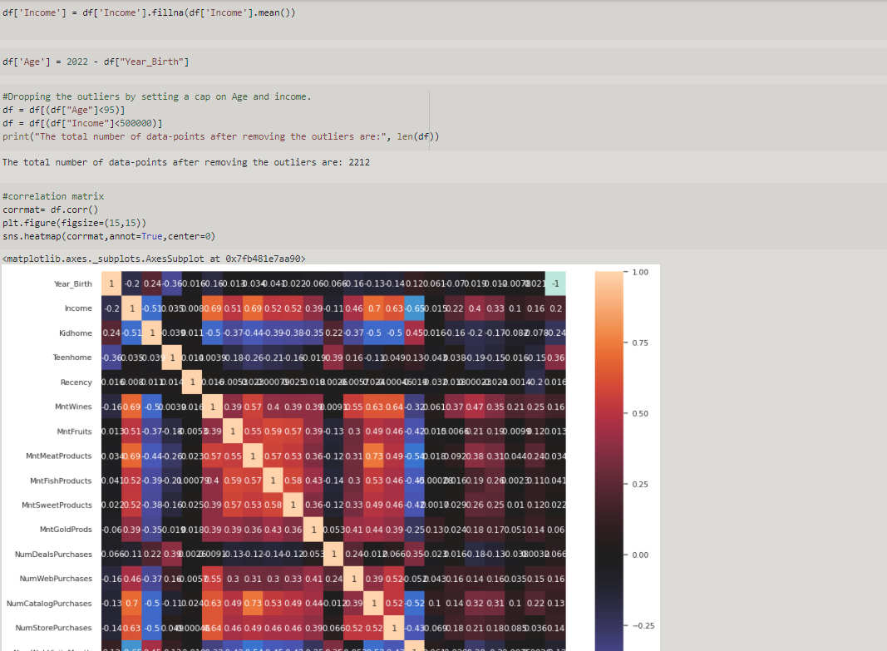
Instead of NaN expressions, we fill in with the average of the income values.
We calculate the current Ages of our customers.
Drop the outliers which can direct us wrongly.
Lets see our correlatin matrix and try to understand correlation beetween variables.

Slide 10
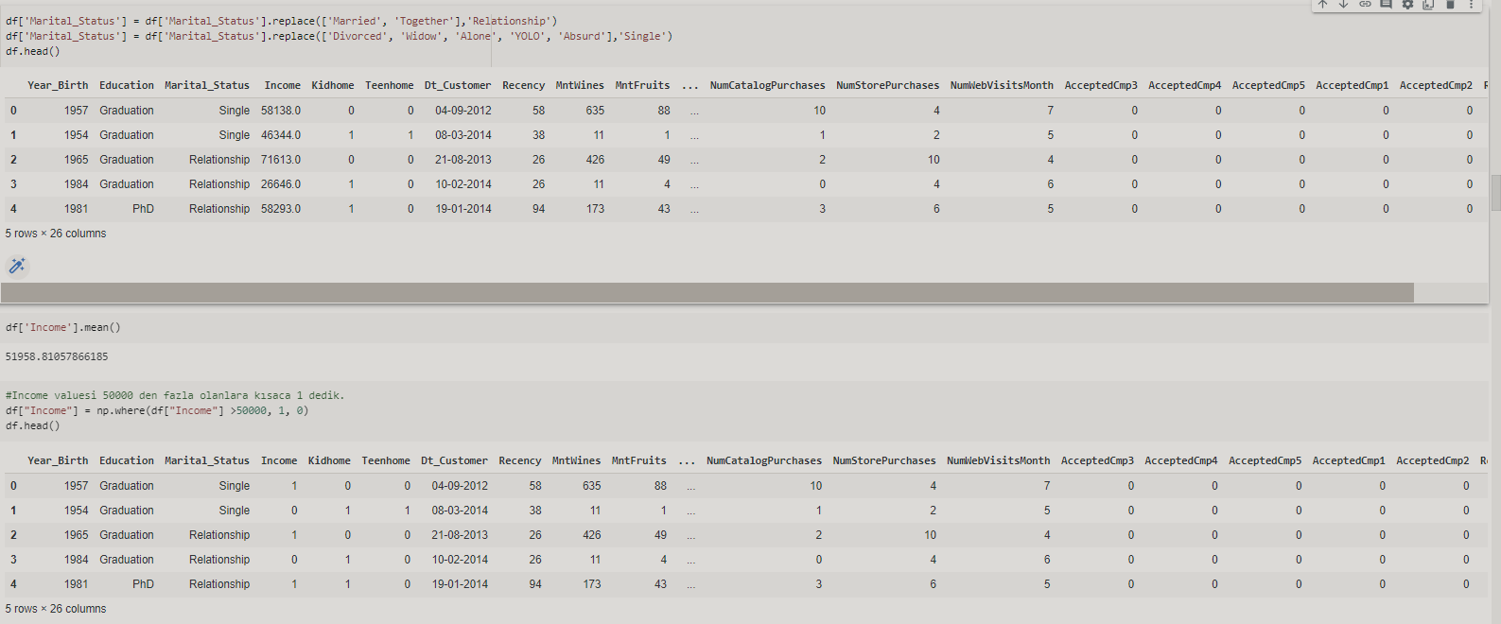
Lets simplify our Marial Status as Relationship and Single.
Also calculate the Incomes average and replace values which are greater than 50000 with 1.

Slide 11
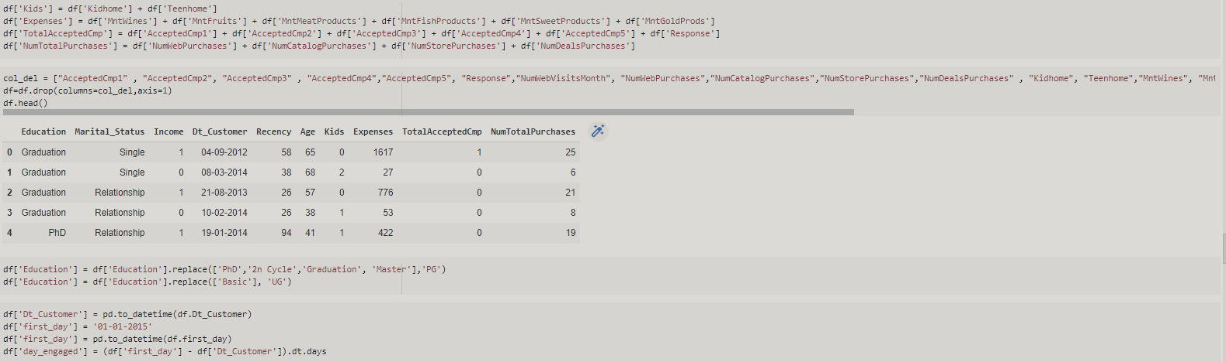
We join Kidhome and Teenhome as Kids. Also, apply the same thing for Expenses, TotalAcceptedCampaigns,NumberofTotalPurchases.
After joining these columns, we can drop others because we already grouped them in a column.
Changing Dt_customer into timestamp format and calculate the day engaged.

Slide 12
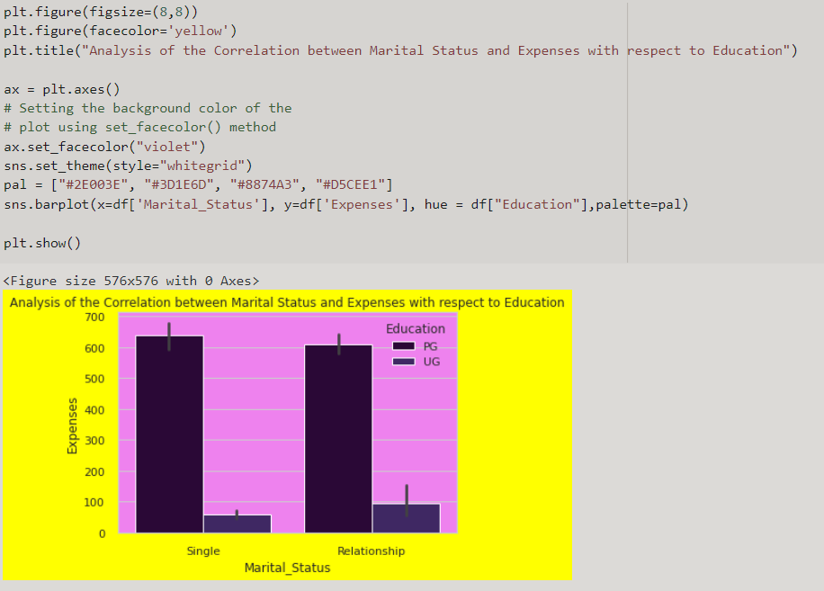
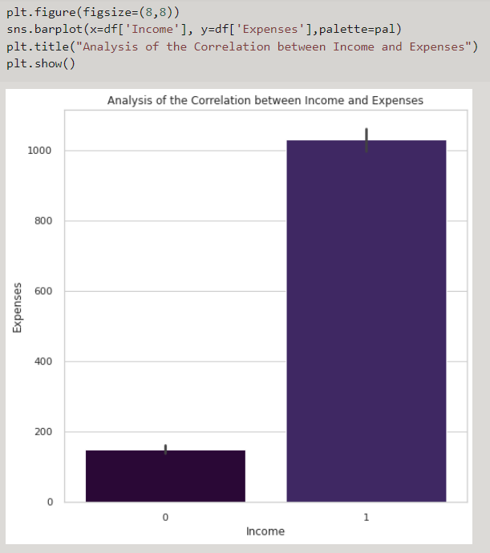
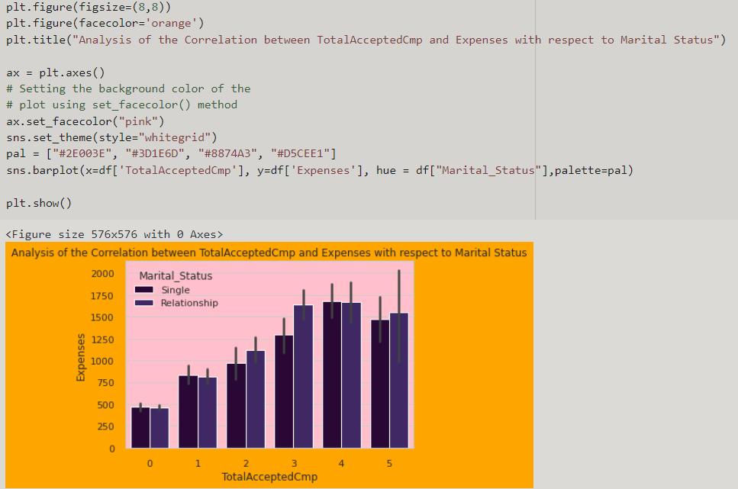
Here, we observe rome relations between variables such as how marial status is effective on expenses according to their education level ,
relation between expenses and income etc.

Slide 13
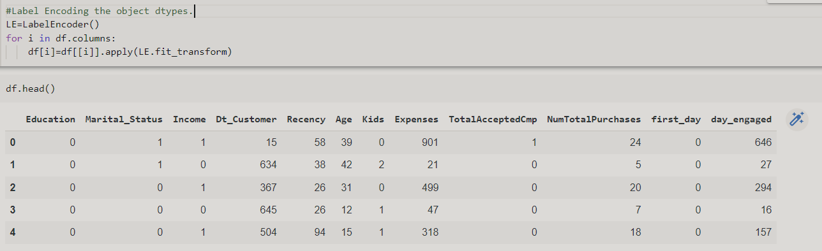
We apply label encoding method and convert to the unique numerical values.

Slide 14
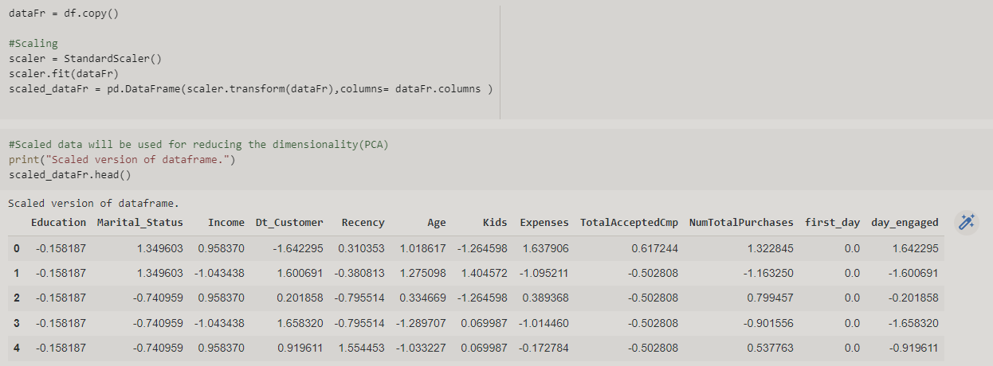
We scale our data for making data points generalized so that the distance between them will be lower.
As a result of this ,certainty in the results of the model will be increased.

Slide 15
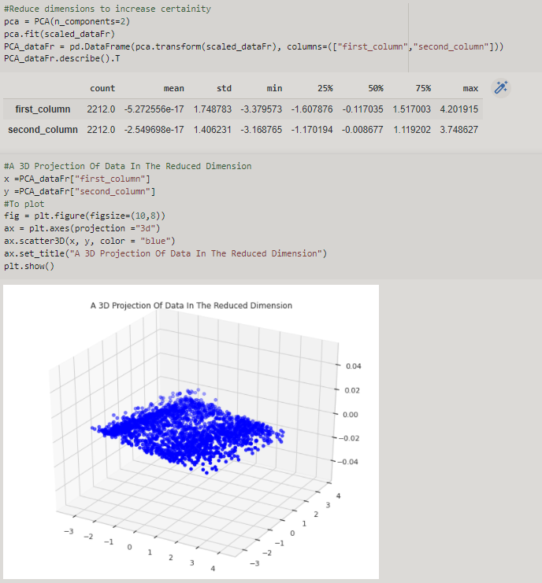
It becomes more difficult to work with as the number of features increases. Many of these features are linked together, making them redundant.
This is why, before putting the selected features through a classifier, We will perform dimensionality reduction on them.

Slide 16
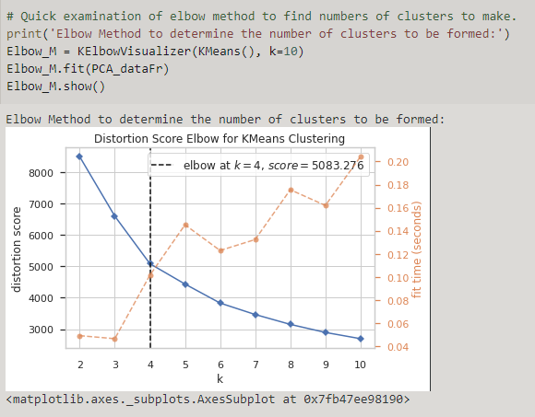
The Elbow method is a very popular technique and the idea is to run k-means clustering for a range of clusters k (let’s say from 1 to 10) and for each value,
we are calculating the sum of squared distances from each point to its assigned center

Slide 17
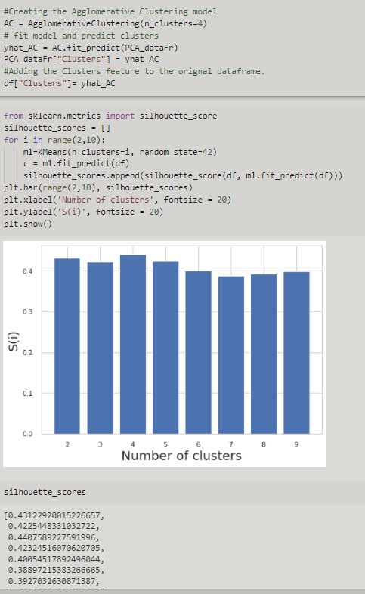
Silhouette score is used to evaluate the quality of clusters created using clustering algorithms
such as K-Means in terms of how well samples are clustered with other samples that are similar to each other.
The Silhouette score is calculated for each sample of different clusters.

Slide 18
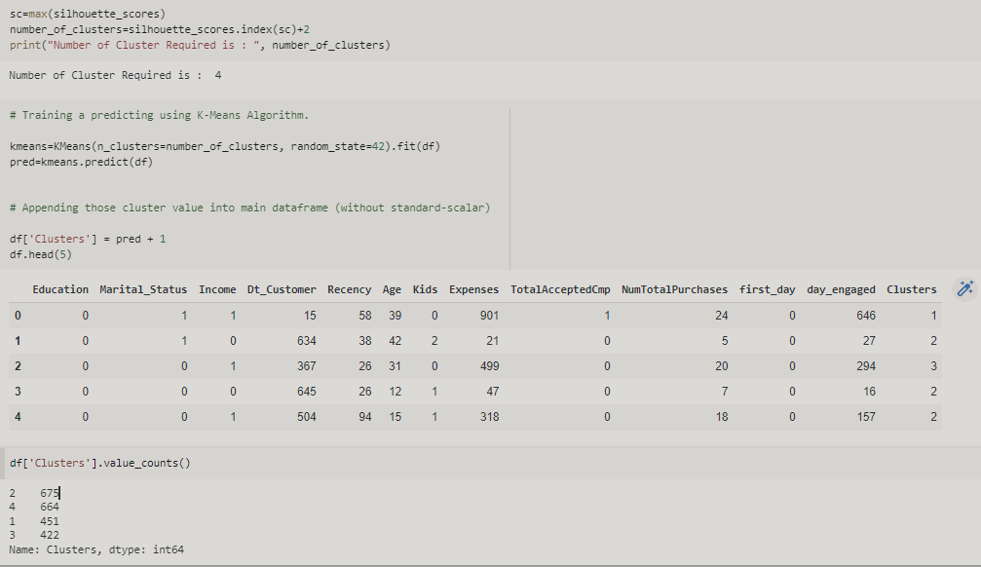
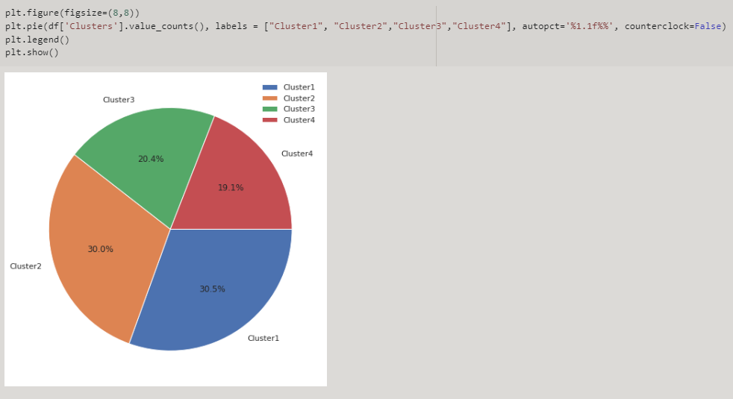
Getting the maximum value of silhouette score and adding 2 in index because index starts from 2.

Slide 19
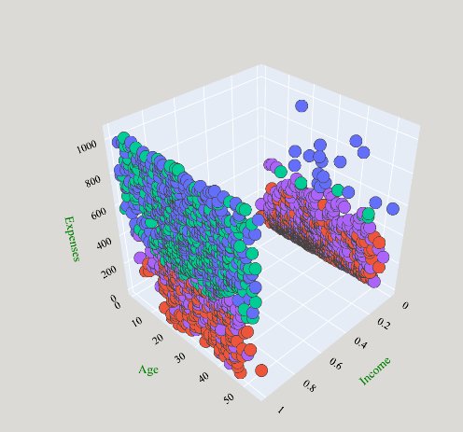
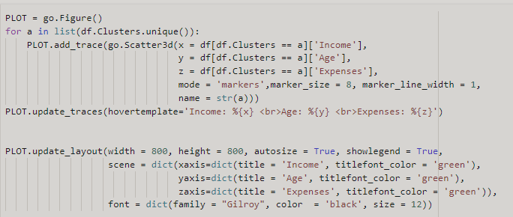

Slide 20
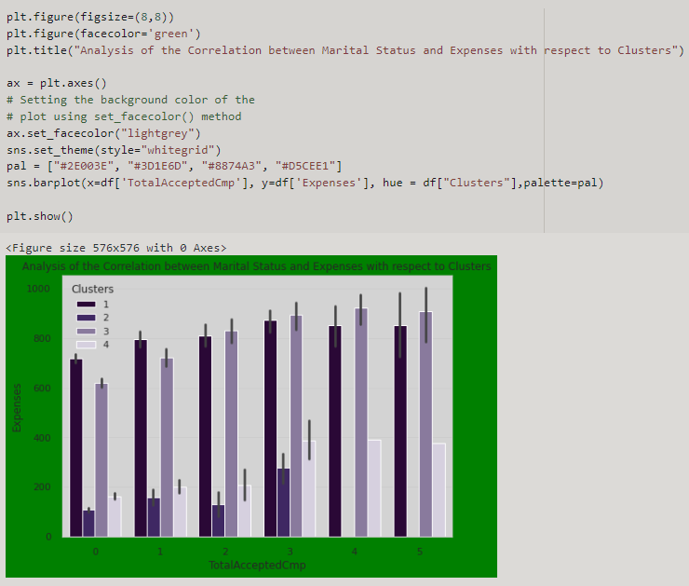
Analysis of the Correlation between Marital Status and Expenses with respect to Clusters

Slide 21
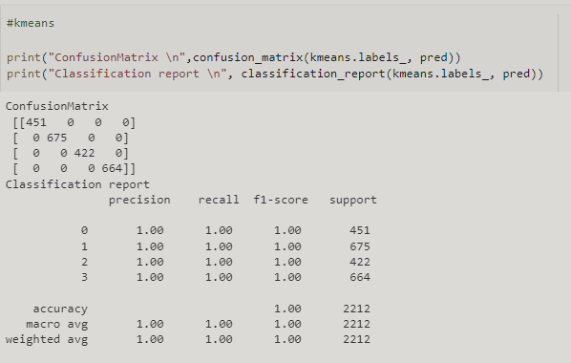

Slide 22
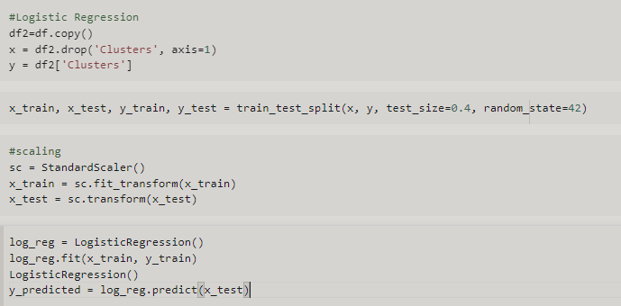

Slide 23
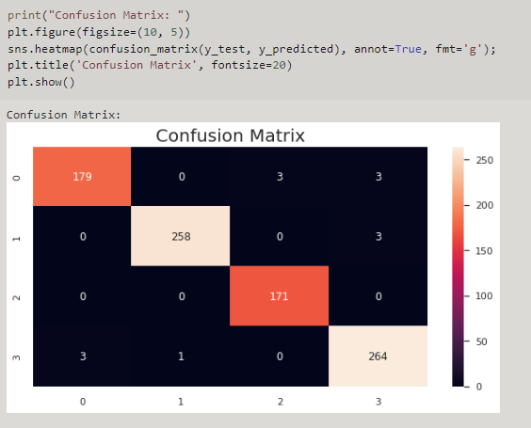

Slide 24
