Slide 1






MEDVAULT – A SECURE DIGITAL HEALTHCARE PORTAL
EmpOWERING PATIENT-CENTRIC DIGITAL HEALTH WITH CLOUD & DEVOPS
BY-
NAME: YASVANTH RAJAN E
DEPARTMENT: AML
COLLEGE: ST.JOSEPH’S COLLEGE OF ENGINEERING
DOMAIN: CLOUD & DEVOPS

Slide 2
PROBLEM STATEMENT
Title: Challenges in Traditional Healthcare Data Handling
In the traditional healthcare setup, patients often depend on physical medical reports, which are vulnerable to being lost, misplaced, or damaged over time. During emergencies, this lack of accessible medical history makes it difficult for doctors to provide timely and accurate treatment. Additionally, there is no unified digital system where patient records, prescriptions, emergency alerts, and appointment details are centrally stored and easily retrievable. Most appointments are still booked manually, leading to delays, confusion, and poor time management. As a result, patients frequently miss follow-up checkups or fail to receive proper medication instructions, affecting their recovery and continuity of care.

Slide 3
OBJECTIVE OF THE PROJECT
Title: What Does MedVault Aim to Solve?
MedVault creates a centralized platform that allows for uploading, storing, and easy access to medical reports.
It enables doctors to send digital prescriptions, including motivational messages and links to purchase the prescribed medicines.
The platform sends emergency alerts to family members and doctors through SMS and fallback voice calls.
It provides patients with the ability to book appointments and receive important updates via notifications.
MedVault integrates secure authentication using AWS Cognito for safe login and data access.
The entire system is deployed on the AWS cloud, utilizing Docker for containerization and CI/CD via GitHub Actions for continuous integration and deployment.

Slide 4
TECHNOLOGY STACK
FRONTEND:
HTML, CSS, JavaScript
Responsive layout and dashboards for patient/doctor
BACKEND:
Python Flask REST API
Routes for login, uploads, prescriptions, and emergency alerts
CLOUD SERVICES (AWS):
EC2: Hosting backend
S3: Store patient reports
RDS (MySQL): Store prescriptions
Cognito: Authentication for login/signup
OTHERS:
Twilio API: WhatsApp/SMS messages
Docker: Backend containerization
GitHub Actions: CI/CD pipeline for deployment

Slide 5
KEY FEATURES – PATIENT SIDE
Upload medical reports (PDF) and store securely in AWS S3
Trigger emergency alerts that send SMS + voice call to a doctor
Book appointments with available doctors
View past prescriptions, quotes, and doctor feedback
Receive WhatsApp messages for prescriptions and follow-ups
View all notifications & appointments in a single dashboard

Slide 6
KEY FEATURES – DOCTOR SIDE
View uploaded reports of individual patients (PDFs from S3)
Send prescription with:
1.Medicine name
2.Instructions (e.g., after meals)
3.Motivational quote
System auto-generates medicine link (e.g., MedPlus Chennai)
Message delivered via Twilio WhatsApp API
Prescriptions stored in RDS for later access
Search and track patients by phone number, history, BP/Sugar readings

Slide 7
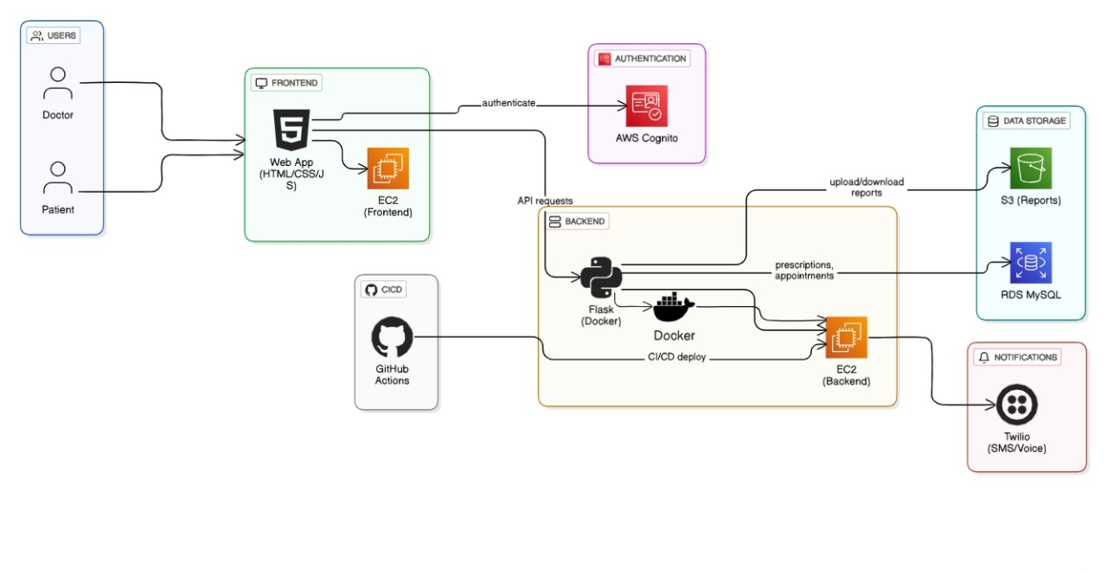
ARCHITECTURE DIAGRAM

Slide 8
DEVOPS & CLOUD DEPLOYMENT
Title: CI/CD + Cloud Hosting Strategy
Backend containerized using
DockerPush code to GitHub → GitHub Actions triggers:
1. Build Docker image
2. SSH into EC2 instance
3. Pull image and restart container
AWS EC2 hosts backend with app.py and NGINX
Frontend HTML/CSS/JS pages served on the same EC2
SSL certificate (optional) via Let’s Encrypt
Cloud-native, secure, and scalable setup

Slide 9
FUTURE SCOPE
Title: What's Next for MedVault?
Build mobile app (React Native/Flutter) for real-time access
Integrate AI for health report analysis and suggestions
Add doctor-to-doctor network for referrals and shared treatment plans
Include AWS SNS/Pinpoint for large-scale notifications
Support video consultations using Amazon Chime or Jitsi
Enable multi-language support for patient accessibility

Slide 10
CHALLENGES FACED
AWS Cognito user session handling was tricky
Formatting dynamic prescription message with WhatsApp
Saving data consistently in RDS after WhatsApp delivery
Handling file uploads securely to S3 with Flask
Docker image size and EC2 port management
Time management across frontend, backend, and DevOps flow

Slide 11
KEY LEARNINGS
Title: Skills Gained from the MedVault Project
Full-stack web app development with real-world healthcare use case
Deep knowledge in AWS services – EC2, S3, RDS, SNS, Cognito
REST API design & JSON data flow
Practical CI/CD with GitHub Actions & Docker deployment
Hands-on with Twilio API (WhatsApp, SMS, voice call)
Understood how to build secure, scalable & cloud-native apps

Slide 12
THANK
YOU
Project by: Yasvanth Rajan E
LinkedIn: www.linkedin.com/in/yasvanthrajan
GitHub:https://github.com/yasvanthrajan/MedVault

