Slide 1

From utility meter to device intelligence
Sustainable Energy Consumption & Smart Home Optimization Dashboard
AI & IOT
ENERGY MONITORING
SMART CONTROL
OPTIMIZATION
SUSTAINABILITY
Notes:
Introduce the platform: transforming static monthly utility billing into real-time, device-level intelligence and autonomous optimization across the home.

Slide 2







THE VISIBILITY PROBLEM
The bill shows the cost, not the cause
Households receive a monthly total without granular visibility. Without room- and device-level breakdown, decisions stay purely reactive.
Unseen standby loads
Phantom draws and forgotten appliances run unmeasured 24/7.
Unpredictable peak spikes
Simultaneous heavy appliance draws trigger punitive demand tariffs.
Missing telemetry hierarchy
Total kWh tells you what you owe, never which switch box or device caused it.
Notes:
Frame the core friction: monthly bills only reveal historical cost after the fact. Householders lack the circuit-level hierarchy required to diagnose and prevent waste.

Slide 3





SYSTEM ARCHITECTURE
One platform turns energy data into action
Continuous closed-loop intelligence from physical telemetry to automated conservation
01
02
03
04
05
Configure
Monitor
Analyze
Control
Verify
Map houses, rooms, smart switch boxes, and load channels.
Capture real-time kW, kWh, V, and A reconciled to the main meter.
AI models detect anomalies, forecast load, and isolate standby waste.
Automate smart energy modes, load shifting, and device schedules.
Validate measured kilowatt-hour reductions directly on utility bills.
AI Energy Copilot continuously explains consumption spikes and delivers tailored optimization actions.
Notes:
Walk through the five-phase closed loop: Configure, Monitor, Analyze, Control, and Verify. The AI Copilot guides the homeowner at each step.

Slide 4
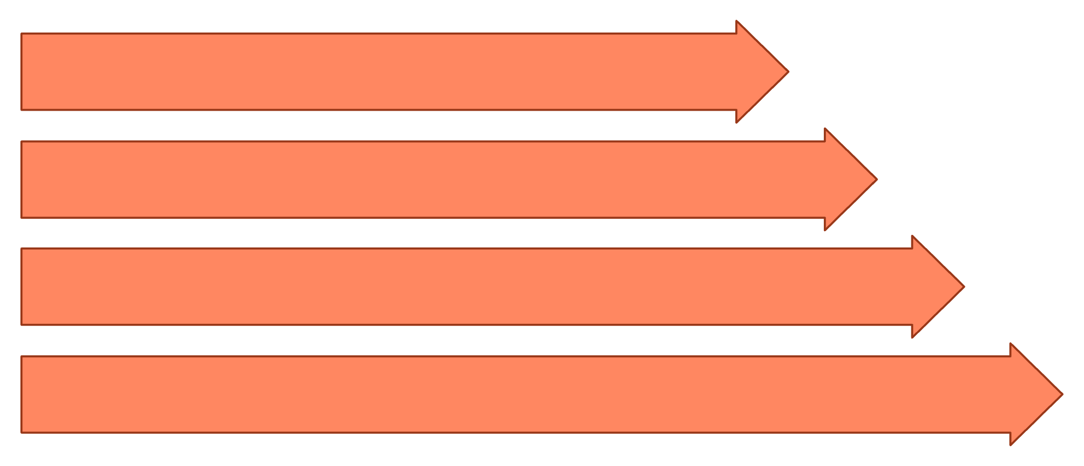
END-TO-END TOPOLOGY
Utility-to-device energy intelligence
Utility / government power meter
Main supply → distribution board → house
Rooms → smart switch boxes
Switch channels → connected devices
Power and energy data
Analytics engine → anomaly detection → forecasting
Optimization and automation
Savings measurement → utility verification
Anchor hierarchy: house → room → switch box → channel → device. The utility meter remains the household-level reference.
Notes:
Explain the structural anchor hierarchy: utility meter to main supply, down to rooms, smart switch boxes, load channels, and individual devices.

Slide 5
HIERARCHICAL AGGREGATION
Every reading rolls up to one household view
Configure the house; add rooms.
Add switch boxes, channels, and connected devices.
Collect voltage, current, power, and energy readings.
Aggregate device → channel → switch box → room → house.
Compare monitored consumption with utility-meter readings.
Detect anomalies, apply automation, measure change, and verify savings.
BEDROOM 1 → B1-SB01
Connected devices · illustrative readings
AC
Fan
1.82 kW
0.32 kW
Light
TV
0.12 kW
0.08 kW
2.34 kW
When TV turns off, total becomes 2.26 kW; the change propagates to room and house totals.
Notes:
Present the cascading aggregation flow from the brief: AC (1.82 kW), Fan (0.32 kW), Light (0.12 kW), and TV (0.08 kW) sum to 2.34 kW. When TV turns off, the total becomes 2.26 kW and the change propagates to room and house totals.

Slide 6
OPERATING CAPABILITIES
Monitor, analyze, control, learn
Monitor
Analyze
Power, energy, voltage, current, power factor, temperature, peak demand.
Room trends, switch-box analytics, device comparison, cost, utility reconciliation.
AI
Control
Anomaly detection, consumption forecasting, peak-demand forecasting, recommendations, Energy Copilot.
On/off, device modes, schedules, automations, smart energy modes.
Modes: ECO · COMFORT · SLEEP · NIGHT · AWAY · HOME · WORK · ENERGY SAVING · PEAK AVOIDANCE · CUSTOM
Notes:
Detail the four operational pillars: Monitor, Analyze, AI, and Control, supported by ten dedicated household energy modes.

Slide 7
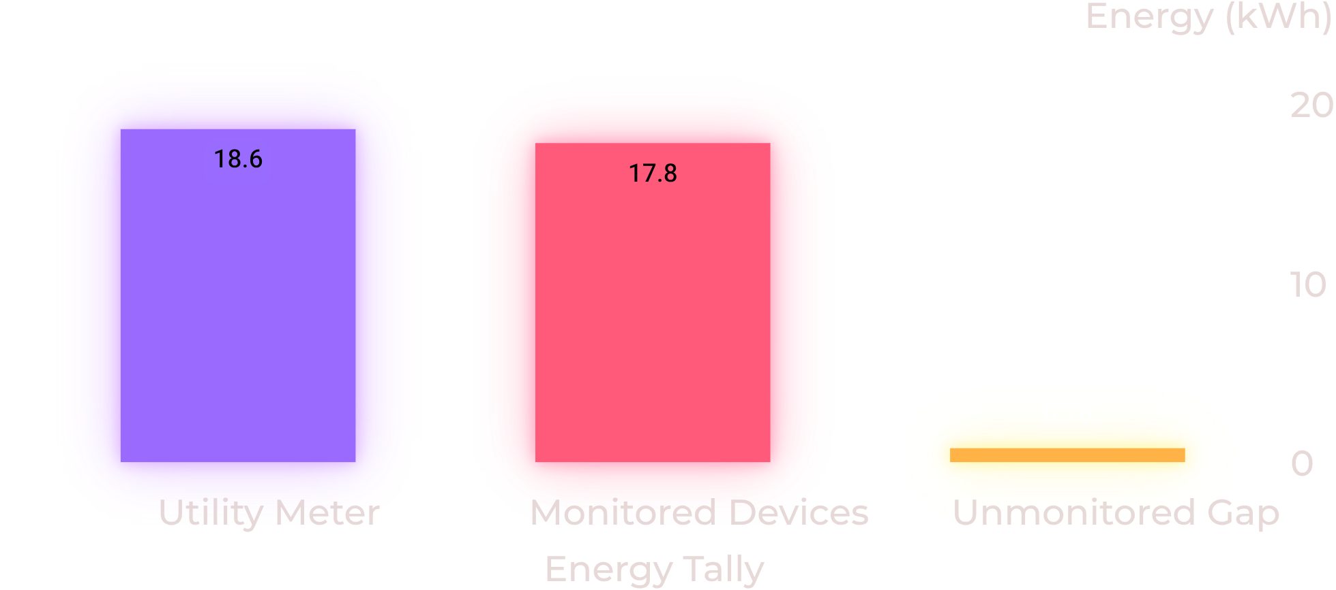
AUDIT & OPTIMIZATION
Measure the gap, then optimize it
SAFETY OVERLOAD ALERT
3.65 kW
Current household demand exceeds safe limit threshold of 3.50 kW.
ECO MODE RESPONSE
Dynamic Trim Active
Adjusts AC setpoints, cycles fans, dims lighting, and cuts standby draws to shed 0.65 kW instantly.
Reconciliation audit: 95.8% coverage. Unmonitored gap stems from standby loads, unmonitored circuits, and sensor sync timing.
Notes:
Present the verified data tally: Utility meter 18.60 kWh vs monitored 17.82 kWh (0.78 kWh unmonitored gap, 95.8% coverage). Show real-time safety overload alerts and dynamic ECO mode shaving.

Slide 8
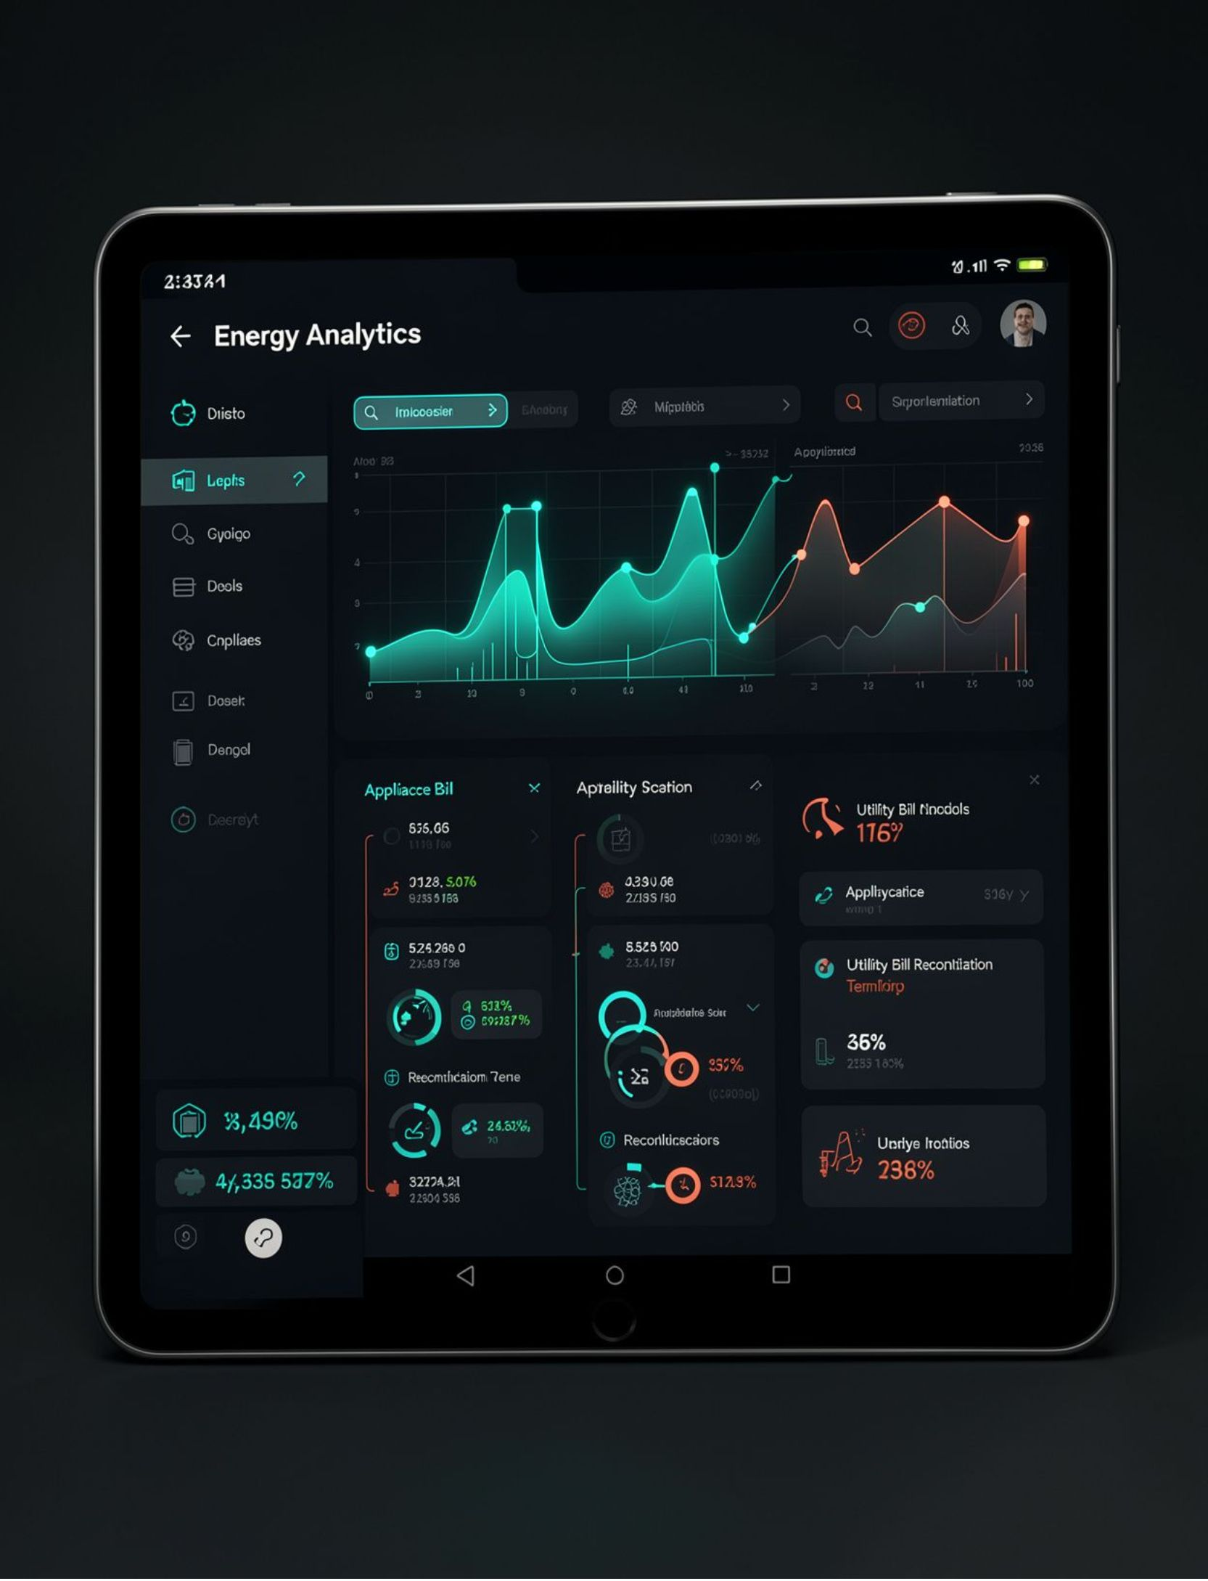



One dashboard makes the invisible visible
Hero dashboard
Total household load, energy today, monthly energy, estimated cost, peak demand, CO₂, savings, active devices, alerts, and energy goal.
Meter reconciliation & hierarchy
Reconcile utility consumption, monitored consumption, and meter difference. Navigate house → room → switch box → channel → device.
Analytics & AI Copilot
Energy, cost, peak demand, CO₂, savings, and meter difference. “Why is my bill high?” grounded in application data.
Notes:
Detail the dashboard experience: navigating from whole house to room, switch box, channel, and appliance with natural-language AI insights grounded in real telemetry.

Slide 9



Visibility creates better energy behavior
SOCIAL
ECONOMIC
ENVIRONMENTAL
Build appliance-level awareness and support data-driven household decisions.
Expose high-consumption devices, standby waste, costs, and planning opportunities.
Encourage conservation, track estimated CO₂ impact, and support solar, EV charging, and peak avoidance.
Impact chain: energy visibility → better decisions → reduced waste → efficient use → potential cost and environmental benefits.
Users: households, apartments, hostels, schools, small offices, commercial and smart buildings.
Notes:
Connect visibility to outcomes: Social, Economic, and Environmental impacts across households, apartments, hostels, schools, small offices, commercial and smart buildings.

Slide 10
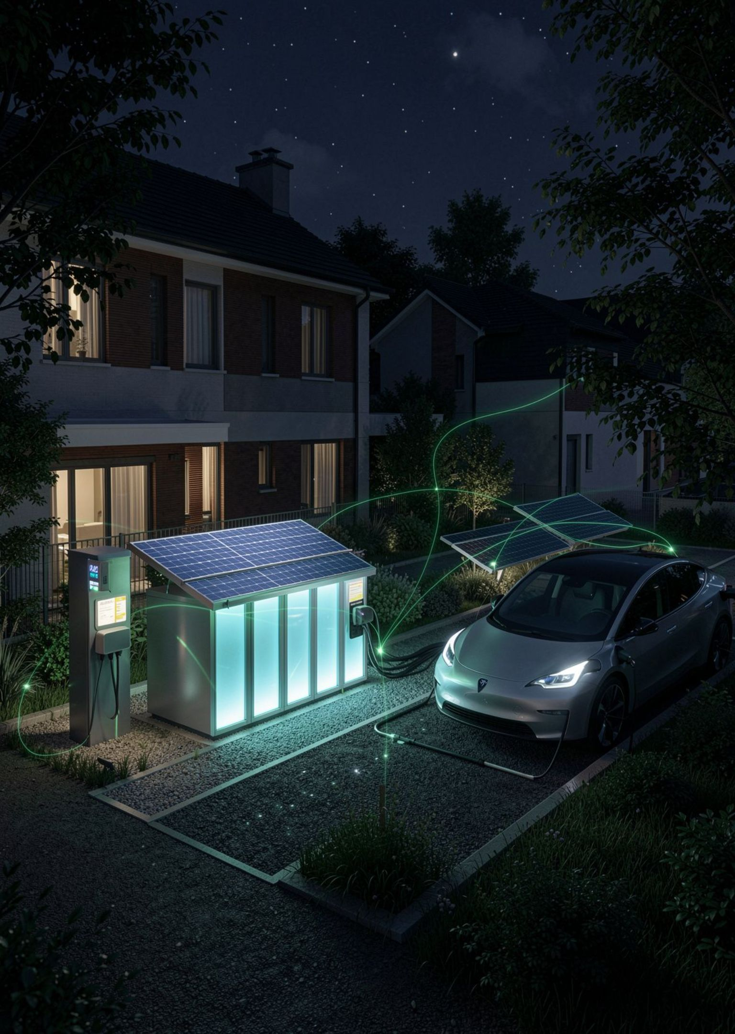
THE NEXT HORIZON
From smart home to smart energy
Our platform transforms raw household electricity data into actionable intelligence for sustainable, resilient consumption.
Smart grid & dynamic tariffs
01
Automated demand response with direct utility API interop.
Solar, battery & EV dispatch
02
Carbon-aware scheduling aligned to local renewable peaks.
Edge AI & community mesh
03
On-device inference with privacy-preserving peer analytics.
Monitor · Understand · Control · Optimize · Verify
Notes:
Conclude with the forward-looking vision: utility-to-device intelligence moving from home automation into grid flexibility, dynamic tariffs, and verified decarbonization.

