Slide 1
QUIZ GAME
DHULIPALLA YASWANTH-AP21110010023
RITHIKA NAMPALLY-AP21110010030
PURNAJEAR KESAVAPATNAM-AP21110010035
PONVITHA NERUSU-AP21110010065

Slide 2
PROBLEM STATEMENT(AIM):
Setup of the Quiz Application Using PYTHON GUI TKINTER method.

Slide 3
ABSTRACT:
Our quiz game will offer the player questions to which the player must respond
with the correct answer. Each question will be having four choices, in that
player should choose correct choice. If the player does not correctly answer
the question then the player will earn no points. However, if the player
correctly answers the question, he will get score according to his performance.
The total points scored and the number of corrects and wrongs done by the
player are shown at the conclusion of the game.

Slide 4
OBJECTIVE:
The quiz games can be conducted for different age groups and over varying
cultures Quizzes improve or expanding one’s knowledge of things, either
general or in specific area Quizzes are designed to promote, a fun way to study
and in the process help improve one’s general knowledge. And main our aim is
to develop and conduct Online quizzes which makes people to think in more
technical way.

Slide 5


Slide 6


Slide 7
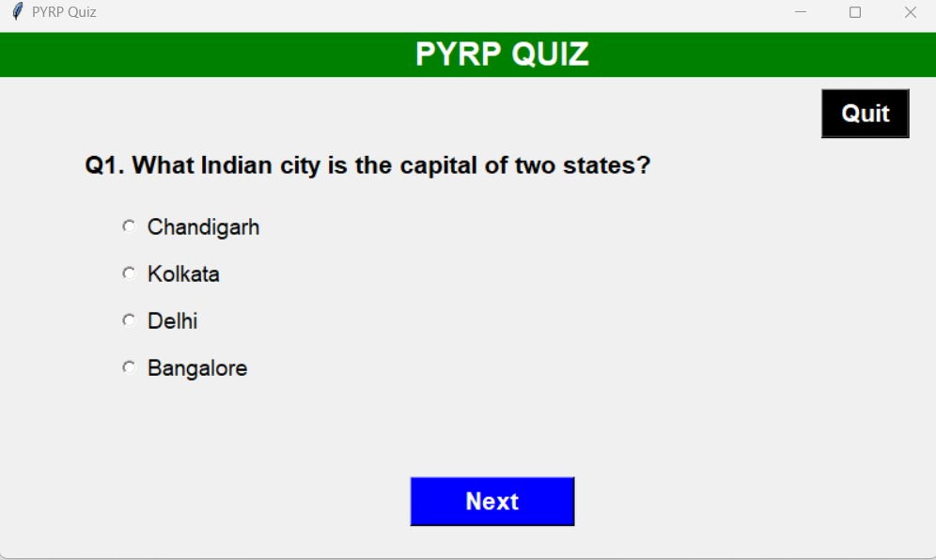
OUTPUT:

Slide 8
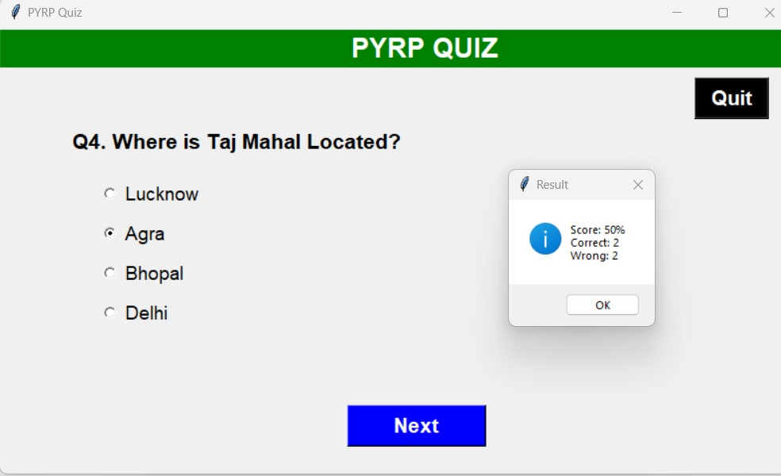
OUTPUT:

Slide 9
THANK YOU

