Slide 1
CDACL-006 PROJECT
63,100+
Market Analysis
using SQL & Power BI
Customers
32,000+
Products
CDACL-006 Market Analysis Project
3M+
MySQL
Power BI
Microsoft Excel
Transactions
Prepared For: Datamites / CDAC
Created By: Priyanaka H N
Notes:
Welcome slide. Introduce yourself, the project title, tools used, and the dataset scale.

Slide 2
Problem Statement
Business Challenges
🎯 Goal
Understanding customer purchasing behavior
Analyze customer purchasing behavior and product performance to improve customer satisfaction and business growth.
Identifying top-performing products
Measuring customer loyalty & retention
Optimizing inventory management
Improving marketing effectiveness
Retail businesses generate large volumes of transactional data that require systematic analysis.

Slide 3
Project Objectives
✅
Identify top-performing products
✅
Analyze customer ordering patterns
✅
Measure reorder behavior
✅
Discover peak purchase periods
✅
Analyze department and aisle performance
✅
Generate actionable business insights
✅
✅
Improve marketing strategy
Improve marketing strategy

Slide 4
Dataset Overview
Table | Description
Orders | Customer orders with timing info
Products | Product name, department, aisle
Departments | 21 product categories
Aisles | 134 product subcategories
Order Products Prior | Purchase history (3M+ records)
63,100+
32,000+
Customers
Products
21
134
Departments
Aisles
3M+
3M+
Transactions
Transactions

Slide 5
SQL Analysis
Analytical Techniques
20
Business Questions
Solved with SQL
1
INNER JOIN / LEFT JOIN
2
GROUP BY + ORDER BY
3
COUNT() / DISTINCTCOUNT()
Sample Questions Analyzed
4
AVG() / SUM() / MIN() / MAX()
→ Top 10 most ordered products
5
Subqueries & Nested Queries
→ Customers with highest reorder rate
6
Window Functions
→ Peak ordering hours & days
7
Aggregate Functions
→ Department-wise product count
→ Average days between orders per user

Slide 6
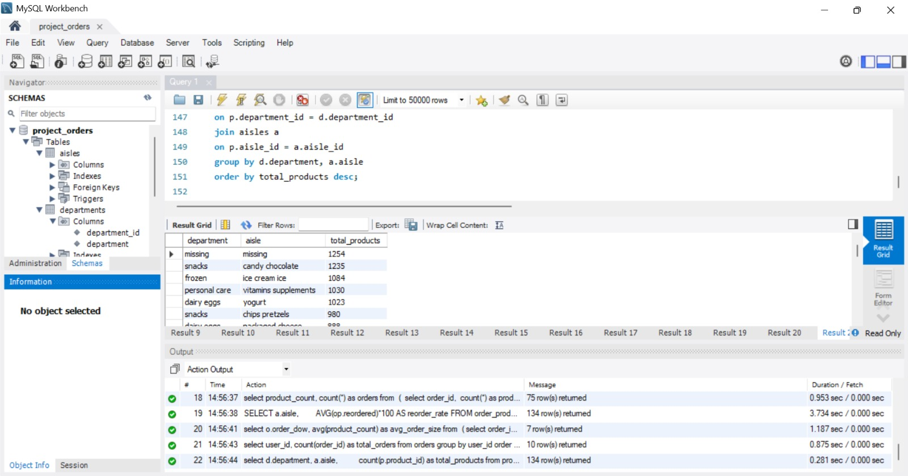

Slide 7
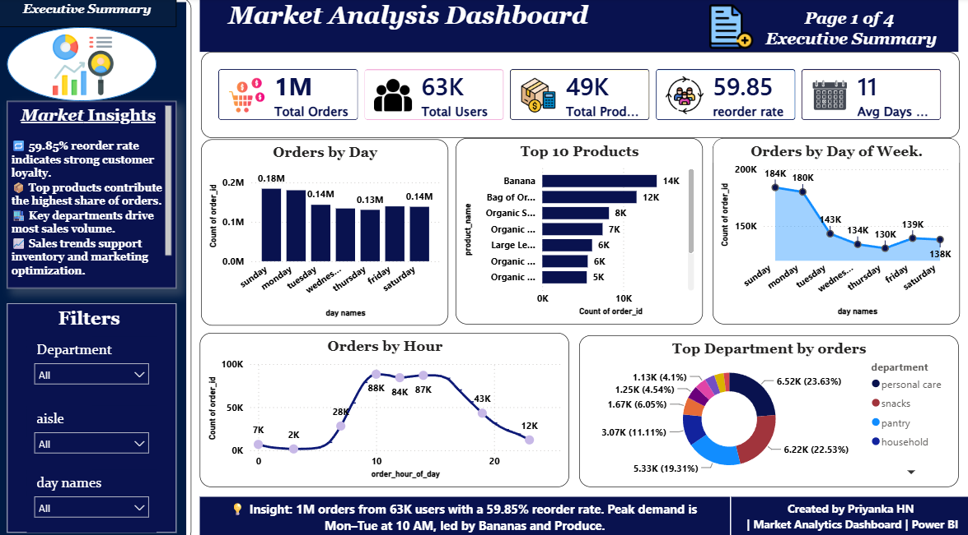
Executive Summary Dashboard
[ Insert Power BI
Executive Summary
Dashboard Screenshot ]
📦 Total Orders
~3M+
👥 Total Users
63,100+
🛒 Total Products
32,000+
🏢 Departments
21
🏬 Aisles
134
📅 Avg Days Between Orders
~11 days
Insight: Strong engagement, high transaction volume, and large product catalog demonstrate healthy retail operations.

Slide 8
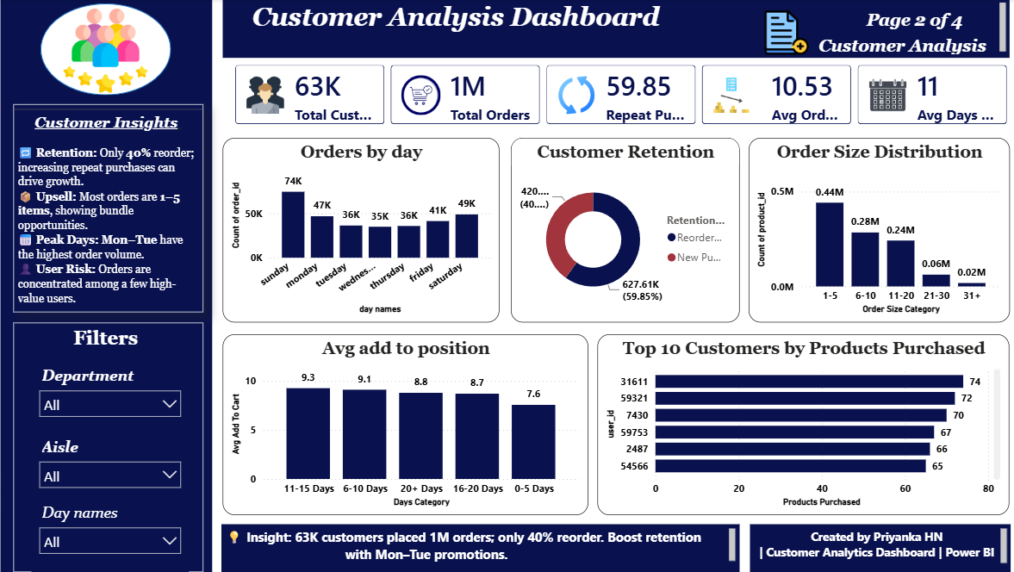
Customer Analysis Dashboard
[ Insert Power BI
Customer Analysis
Dashboard Screenshot ]
🔄 59.5% Repeat Purchase Rate
📦 Average Order Size ≈ 10 products
📅 Most customers reorder within 11 days
💪 Customer loyalty is strong
💰 Repeat purchases drive revenue

Slide 9
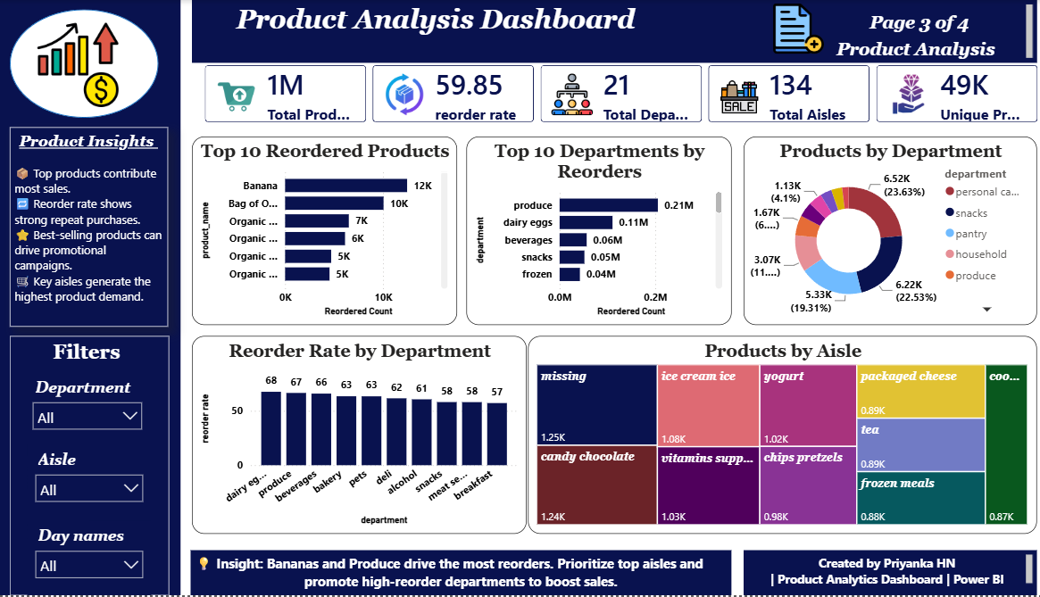
Product Analysis Dashboard
[ Insert Power BI
Product Analysis
Dashboard Screenshot ]
🥬 Produce dept. dominates inventory
🍌 Fresh fruits & vegetables are top aisles
🔄 Frequently reordered = strong demand
📊 Small product groups drive most orders
Reorder Rate: 59.5%

Slide 10
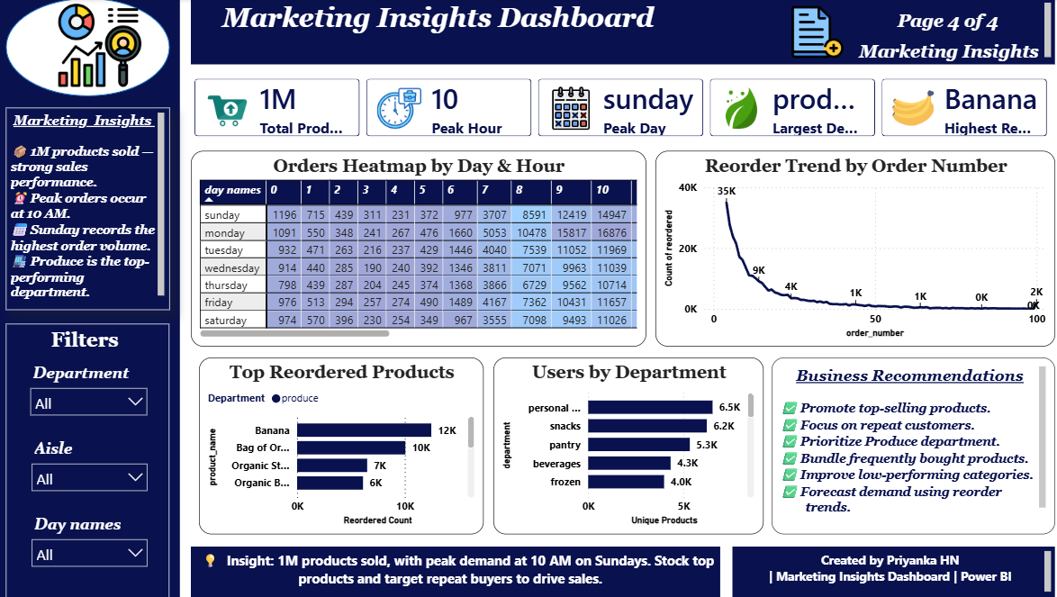
Marketing Insights Dashboard
[ Insert Power I
Marketing Insights
Dashboard Screenshot ]
⏰ Peak Hour
10 AM
📅 Peak Day
Saturday
🥇 Top Reordered Product
Banana
🏢 Largest Department
Produce

Slide 11
Key Findings
👥 Customer Findings
🥬 Product Findings
→ Customers reorder frequently
→ Produce department performs best
→ Reorder Rate = 59.5%
→ Banana is the most reordered product
→ Average Order Size ≈ 10 products
→ Fresh produce dominates top aisles
→ Orders concentrated within 2 weeks
→ Product loyalty is high (59.5%)
→ High customer loyalty observed
→ Small product groups = most orders

Slide 12
Business Recommendations
🎯 Marketing Strategy
📦 Inventory Strategy
Target promotions between 10 AM–2 PM
Maintain stock for top-selling products
Launch customer loyalty programs
Improve demand forecasting accuracy
Personalize offers using reorder history
Reduce stock-outs in Produce dept.
Focus marketing on high-demand items
Prioritize Banana & fresh produce
Run Saturday weekend campaigns
Build early warning for supply gaps

Slide 13
Challenges Faced
🔧 Technical Challenges
💼 Business Challenges
⚠ Large dataset handling (3M+ rows)
💡 Understanding customer behavior
⚠ Complex multi-table JOIN queries
💡 Translating business questions to KPIs
⚠ DAX measure creation in Power BI
💡 Creating actionable data insights
⚠ Data cleaning & normalization
💡 Choosing the right visualizations
⚠ Dashboard performance optimization

Slide 14
Future Scope
👥
Customer Segmentation
🤖
Recommendation System
📈
Sales Forecasting
RFM analysis to classify customers by behavior
Suggest products based on purchase history
Time-series prediction for future demand
📦
Inventory Optimization
🚨
Customer Churn Prediction
⚡
Real-Time Dashboard
Reduce overstock & prevent stock-outs
Identify at-risk customers early
Live Power BI streaming with live data feeds

Slide 15
Conclusion
Successfully analyzed customer purchasing behavior across 3M+ transactions
Identified top-performing products and departments driving revenue
Measured customer loyalty using reorder analysis (59.5% rate)
Built interactive Power BI dashboards with key KPIs
Generated actionable recommendations to improve customer satisfaction
Thank You
Notes:
Summarize the project. Invite questions. Mention tools: MySQL, Power BI, Excel.

