Slide 1

Basic Details of the Team and Problem Statement
Ministry/Organization Name/Student Innovation: Ministry of AYUSH
PS Code: 1347
Problem Statement Title:
A software that suggests drugs and formulations for a disease/pharmacological property based on the Ayurvedic classical books/Repositories.
Team Name: Charka Samhita
Team Leader Name: Naga Venkata Yaswanth Lankadasu
Institute Code (AISHE): U-0379
Institute Name: Lovely Professional University
Theme Name: AyurBharat - Arogya Bharat

Slide 2
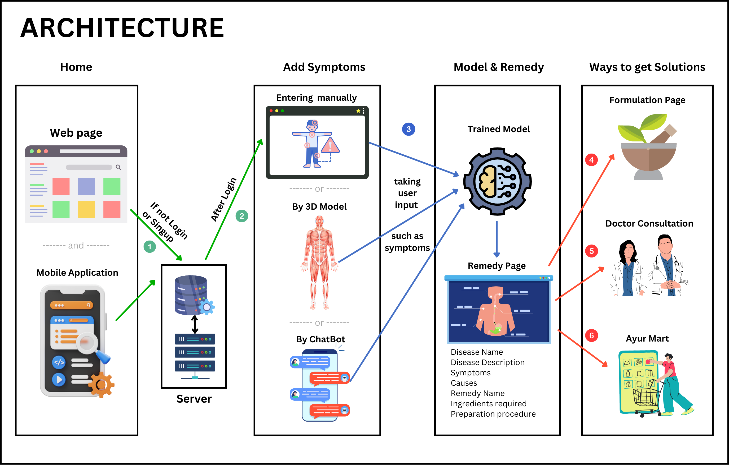














Idea/Approach Details
IDEA / SOLUTION / PROTOTYPE:
Ayur Bharat: Your own Ayurvedic expert in your pocket for boosting health.
Personalized health tips, authentic Ayurvedic remedies and formulations, expert consultations, and an E-store.
ML-driven system to analyze user-provided diseases and suggest remedies from Ayurvedic texts.
Dive into disease details, what's causing it, all the symptoms, and Ayurvedic remedies from ancient texts – all for free!
Want the full wellness package? Go premium for detailed remedy formulation, ingredients, personalized diet plans, lifestyle tips, and yoga guidance – for a small fee.
Premium members can easily book teleconsultations, video calls, or in-person meetings with certified Ayurvedic experts.
Explore and shop for Ayurvedic remedies at Ayur Mart. If you're a certified seller, set up shop here too!
TECHNOLOGY STACK:
USER EXPERIENCE:
SERVER SIDE:
Feature Extraction and Text Analysis
Machine Learning Algorithms
Cloud Services

Slide 3
Idea/Approach Details
USE CASES:
DEPENDENCIES / SHOWSTOPPER:
Disease Analysis and Remedies: Users input symptoms, receive a 100% accurate diagnosis, and access best-in-class Ayurvedic formulations.
Expand Your Practice: Practitioners access a broader user base seeking Ayurvedic expertise through consultation services.
Talk to health experts: Users can seek expert advice through remote, video, and in-person consultations at AyurBharat.
Search and Purchase: Users shop for Ayurvedic remedies and wellness products at Ayur Mart.
Connect with Buyers: Vendors reach users seeking Ayurvedic solutions by listing their products at Ayur Mart.
Learn about Ayurveda: Students and researchers in Ayurveda can use the platform to access classical texts and historical knowledge.
Authentic Ayurvedic Texts: If we can't access these texts or the expertise we need, the quality of our advice and remedies could be compromised.
Partnership with Certified Practitioners: If it's tough to build and maintain these partnerships, it might slow down or limit our consultation services.
Regulatory Compliance: If we stumble in meeting these regulations, we could face legal trouble, fines, or even closing the shop.
Revenue Streams :
PRO EDGE :
1. Freemium Model
2. Subscription-based
3. E-Store/commerce
4. Advertising
5. Licensing the software to healthcare institutions.
Our software is 100% ready and is portable to be deployed in the AYUSH portal and the AROGYASETU citizen’s app.

Slide 4
Team Member Details
Team Leader Name: Naga Venkata Yaswanth Lankadasu
Branch (Btech/Mtech/PhD etc): Btech Stream (ECE, CSE etc): CSE Year (I,II,III,IV): III
Team Member 1 Name: Satya Reddy Satti
Branch (Btech/Mtech/PhD etc): Btech Stream (ECE, CSE etc): CSE Year (I,II,III,IV): III
Team Member 2 Name: Jaswanth Singh Kumar Lankadasu
Branch (Btech/Mtech/PhD etc): Btech Stream (ECE, CSE etc): CSE Year (I,II,III,IV): III
Team Member 3 Name: Navya Ramani Gona
Branch (Btech/Mtech/PhD etc): Btech Stream (ECE, CSE etc): CSE Year (I,II,III,IV): I
Team Member 4 Name: Komal Pasumarthy
Branch (Btech/Mtech/PhD etc): Btech Stream (ECE, CSE etc): CSE Year (I,II,III,IV): III
Team Member 5 Name: Pranav
Branch (Btech/Mtech/PhD etc): MCA Stream (ECE, CSE etc): Data Science Year (I,II,III,IV): I
Team Mentor 1 Name: Ajay Sharma
Category (Academic/Industry): Academic Expertise (AI/ML/Blockchain etc): Bioinformatics Domain Experience (in years): 13
Team Mentor 2 Name: Aman Kumar
Category (Academic/Industry): Industry Expertise (AI/ML/Blockchain etc): ML and SQL Domain Experience (in years): 10

