Slide 1
TRACK AND TRACE SUPPLY CHAIN
PIP2001 Capstone Project
Review-0
Batch Number: 31
Under the Supervision of,
Ms. Ayesha Taranum
Assistant Professor
School of Computer Science and Engineering
Presidency University
ROLL NUMBERS
STUDENT NAMES
K V BRAMHANANDA REEDY
20211CSE0148
THOTA YASWANTH RAM
20211CSE0093
20211CSE0121
D GURUVARDHAN REDDY
20211CSE0097
K CHARAN SAI
Name of the Program: Computer Science and Engineering(CSE)
Name of the HoD: Dr. Asif Mohammed
Name of the Program Project Coordinator: Mr. Amarnath J L
Name of the School Project Coordinators: Dr. Sampath A K / Dr. Abdul Khadar A / Mr. Md Ziaur Rahman

Slide 2
Content
Problem Statement
Analysis of Problem Statement
Timeline of the Project
GITHUB Link
References

Slide 3
Problem Statement Number: PSCS92
Organization: Hindustan Unilever Ltd
Category (Hardware / Software / Both) :Software
Problem Description: Every year Millions of units of consumer products are transported from farms to factories to distributors to retailers and finally the end consumer. To deliver Quality and transparency, Organizations need to be able to trace each product to its origin. The challenge is to design a solution to track each of the millions of units from point of origin to retailer. Traditional bar code based solutions becomes difficult to manage beyond the distributors. The design should need minimal human effort.
Difficulty Level: complex

Slide 4
Analysis of Problem Statement
1.High Volume of Products: Millions of consumer product units are transported through various stages—from farms to factories, distributors, retailers, and eventually consumers.
2.Need for Traceability: There is a growing demand for organizations to track each product unit from its point of origin to the retailer, ensuring quality and transparency.
3.Challenge of Traditional Systems: Barcode-based tracking systems become difficult to manage beyond the distributor stage, especially given the high volume of products.
4.Automation Requirement: The proposed solution should minimize human effort to handle the vast number of units and ensure efficient tracking throughout the supply chain.
5.End-to-End Visibility: The solution should offer complete traceability across all stages of the product lifecycle, from origin to the end consumer.

Slide 5
Analysis of Problem Statement (contd...)
Technology Components
Frontend:React.js, Next.js, Flutter,D3.js, GoogleMaps API,Css, bootstrap, HTML5 Web APIs, Firebase Cloud Messaging, JSON Web Tokens
Backend:Node.js,MongoDB,Cassandra,MySQL,,ApacheSpark,AmazonWeb Services , GraphQL.

Slide 6
Analysis of Problem Statement (contd...)
.
Software Components
. Google Cloud
. Power BI
. Oracle
. Blockchain Platforms
. Cloud Services

Slide 7
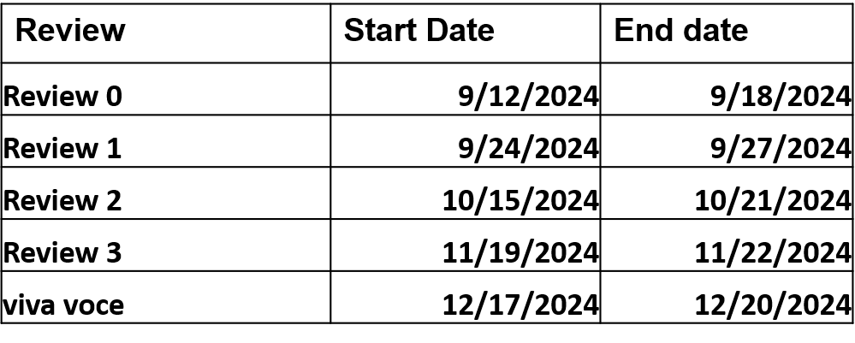
Timeline of the Project

Slide 8
GITHUB Link
https://github.com/Bramha2982/trackandtracesupplychain

Slide 9
References (IEEE Paper format)
. https://www.sciencedirect.com/science/article/pii/S2212827122015049
. https://www.scitepress.org/Papers/2021/105154/105154.pdf
.https://www.researchgate.net/publication/275834182_Tracking_and_Tracing_of_Global_Supply_Chain_Network_Case_Study_from_a_Finnish_Company
. https://developer.dhl.com/api-reference/track-and-trace-supply-chain?language_content_entity=en
.

Slide 10


