Slide 1

SIDDHARTH INSTITUTE OF ENGINEERING & TECHNOLOGY
(AUTONOMOUS)
(Approved by AICTE, New Delhi & Affiliated to JNTUA, Ananthapuramu)
(Accredited by NBA for Civil, EEE, Mech., ECE & CSE
Accredited by NAAC with ‘A+’ Grade)
Puttur -517583,Tirupathi District, A.P. (India)
DEPARTMENT OF COMPUTER SCIENCE AND ENGINEERING
CSE (ARTIFICIAL INTELLIGENCE AND DATA SCIENCE)
Academic Year 2025-26
Project Zeroth Review
Title of Project : Multi stage neural network based ensemble learning for
Wheat leaf disease classification.
Batch Details
S.NO: | REG NO | NAME | INTERNAL GUIDE
1 | 22F61A47I3 | G.YASWASREE | Dr.N.BABU
2 | 23F65A4718 | P.THARUN KUMAR
3 | 22F61A47I0 | M.YASWANTH VARMA
4 | 22F61A47D4 | S.SANDHYA

Slide 2
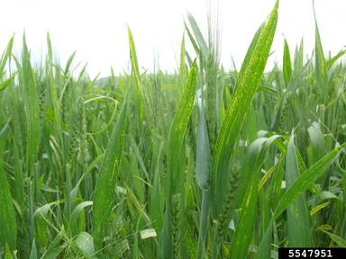
OBJECTIVE
To accurately classify wheat leaf diseases using deep learning.
To design a multi-stage CNN model for effective feature extraction.
To apply ensemble learning to improve prediction accuracy.
To handle real-world variations through preprocessing and augmentation.
To build a robust system suitable for agricultural disease detection.

Slide 3
ABSTRACT
Wheat is a globally important food crop and is highly affected by foliar diseases such as leaf rust, yellow rust, septoria, and powdery mildew. Manual identification of these diseases is time-consuming, requires domain experts, and is unsuitable for large-scale farming.To address this, the project proposes a Multi-Stage Neural Network–based Ensemble Learning Approach for wheat leaf disease classification. The method combines multiple deep learning models at different stages to extract hierarchical and discriminative features from leaf images. Through ensemble learning, predictions from various CNN models are integrated to improve accuracy, robustness, and generalization.The dataset undergoes preprocessing and augmentation to handle variations such as illumination, background noise, and image angles. Experiments show that the ensemble model significantly outperforms single CNN models, achieving higher precision and recall.This system can assist farmers and agricultural experts with early disease detection, supporting timely intervention, reducing crop loss, and improving wheat productivity.

Slide 4
Literature Survey
Sno | Title of the Paper | Year of publication | Author | Comments
1 | Multi-Stage Neural Network-Based Ensemble Learning Approach for Wheat Leaf Disease Classification | 2025 | Samia Nawaz Yousafzai et al. | Introduces multi-stage CNN with ensemble learning for high-accuracy wheat disease detection.
2 | Wheat Leaf Disease Detection Using Inception-ResNet | 2022 | Li et al. | Uses UAV images; good accuracy but computationally heavy.

Slide 5
Sno | Title of the Paper | Year of publication | Author | Comments
3 | VGG-Based Wheat Disease Classification | 2019 | Zhang et al. | Traditional deep learning; high training time and overfitting issues.
4 | EfficientNet for Wheat Fungal Disease Classification | 2020 | Gao et al. | Lightweight model; good precision but struggles with multiple disease types.

Slide 6
Inferences from Literature Survey
CNN-based models are highly effective for plant disease classification.
Single-model architectures fail to generalize across different datasets.
Most models suffer from overfitting due to limited or imbalanced data.
Ensemble learning improves overall prediction reliability and accuracy.
There's a need for a multi-stage approach to handle varying backgrounds, lighting, and image noise in real-world farm conditions.
The proposed system fills these gaps using multi-stage CNN + Ensemble Bagging.

Slide 7
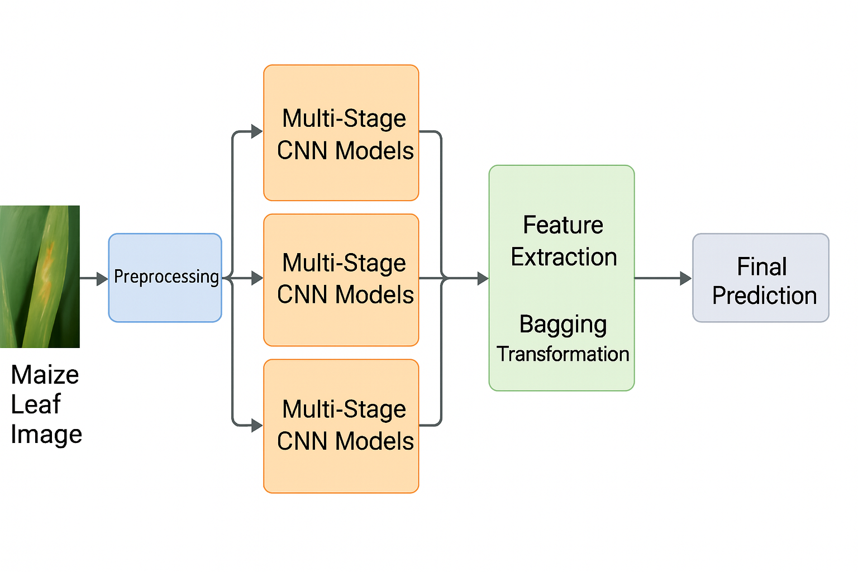
Architectural Diagram

Slide 8
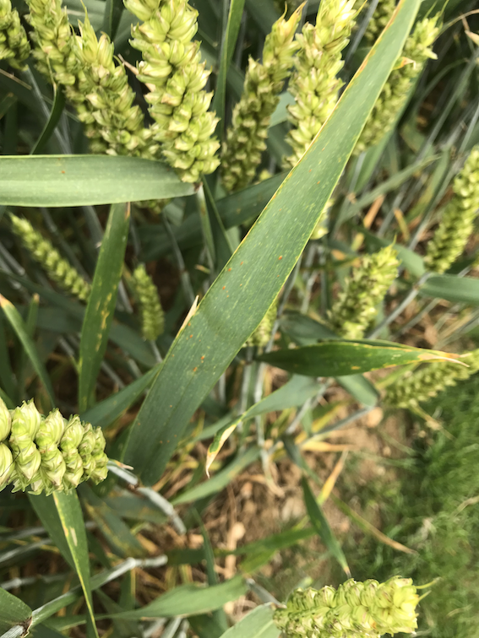
Existing System
Manual Disease Identification
Requires expert knowledge
Time-consuming
Not scalable for large fields
Prone to human error
Traditional Machine Learning
Needs manual feature extraction
Low accuracy
Fails under variable environmental conditions

Slide 9
Proposed Methodology
Multi-Stage Neural Network + Ensemble Learning
Uses multiple pretrained CNN models (DenseNet201, MobileNetV2, Custom CNN).
Bagging technique used to generate diverse training subsets.
Ensemble integrates predictions using reliability scoring.
High accuracy across multiple datasets (up to 99.16%).
Key Steps
Data collection
Preprocessing & augmentation
Feature extraction using CNN models
Ensemble integration
Final disease classification

Slide 10
Requirement specification
Software Requirements
Python 3.11
TensorFlow / Keras
NumPy, Pandas, Matplotlib
OpenCV
GPU Support (CUDA recommended)
Jupyter / Google Colab
Hardware Requirements
8GB RAM (minimum)
NVIDIA GPU (Recommended: 4GB+)
i5/i7 Processor
250GB Storage

Slide 11
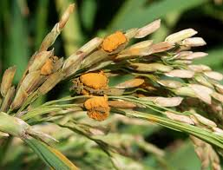
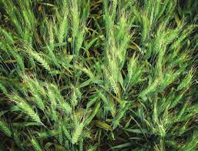
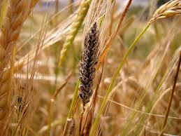
Conclusion
The proposed multi-stage neural network–based ensemble learning framework provides a highly accurate and robust solution for wheat leaf disease classification. By combining multiple CNN architectures with ensemble strategies, the system effectively addresses limitations of earlier models such as overfitting, dataset dependency, and environmental variability. The method achieves superior cross-dataset performance and demonstrates strong potential for real-world deployment in agriculture. Future work includes optimizing the model for mobile devices, enhancing dataset diversity, and adding disease severity estimation.

