Slide 1
Telecom Customer Churn Analysis
End-to-end: SQL, ML, Explainability, Segmentation, Reporting

Slide 2
Model Performance Summary
Two models trained:
• Logistic Regression with class_weight=balanced
• Random Forest with class_weight=balanced_subsample
Metrics saved: Confusion Matrix + ROC for both

Slide 3
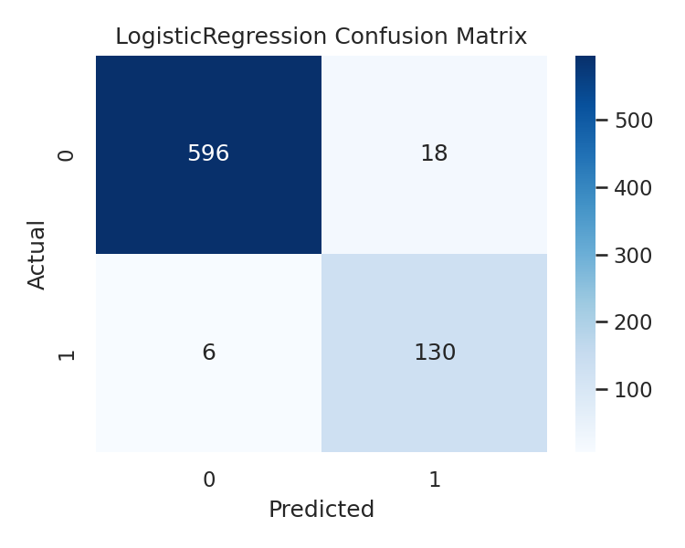
LogisticRegression confusion matrix

Slide 4
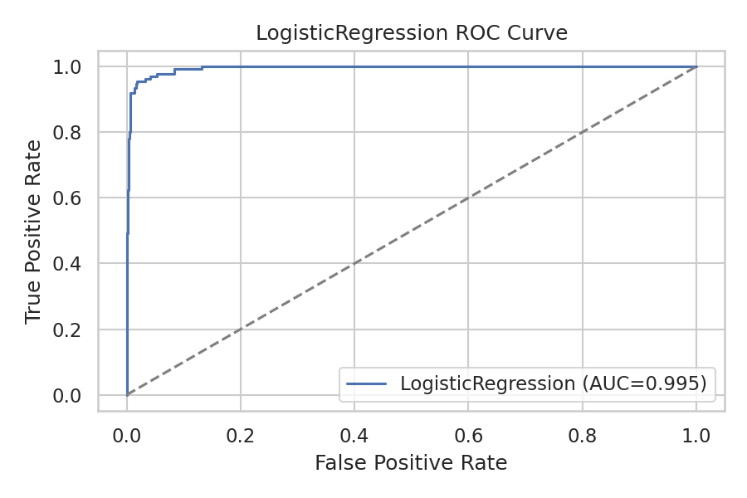
LogisticRegression roc

Slide 5
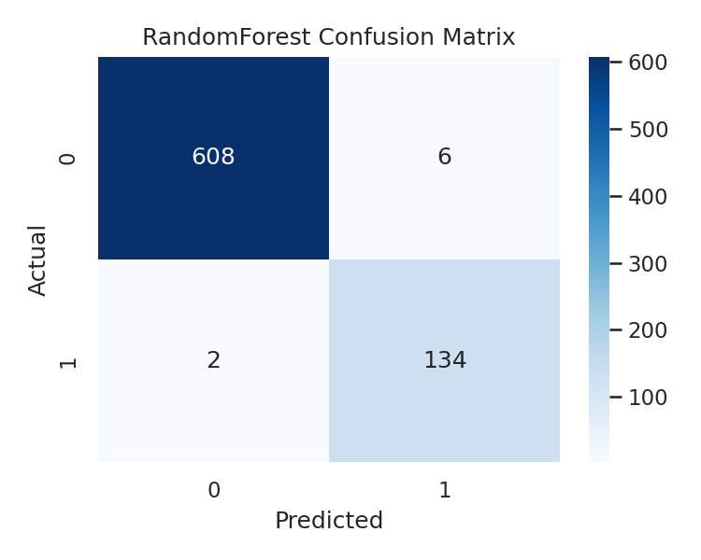
RandomForest confusion matrix

Slide 6
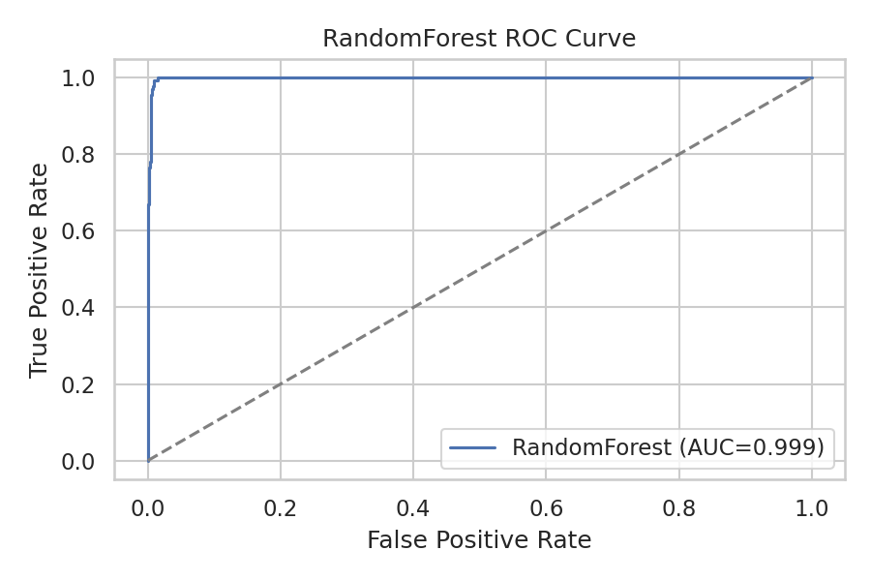
RandomForest roc

Slide 7
Explainability: Key Drivers of Churn
Drivers observed across models:
• High complaints per month
• Low recharge frequency and low recharge amount
• Short tenure and low usage consistency
Refer: outputs/eli5_lr.html and outputs/shap_summary_rf.png

Slide 8
Customer Segments
Segments:
• At Risk: churn_prob ≥ 0.60 or high complaints + low recharge
• Loyal: churn_prob ≤ 0.30 + consistent usage
• Dormant: low activity and low recharge
• Neutral: others

Slide 9
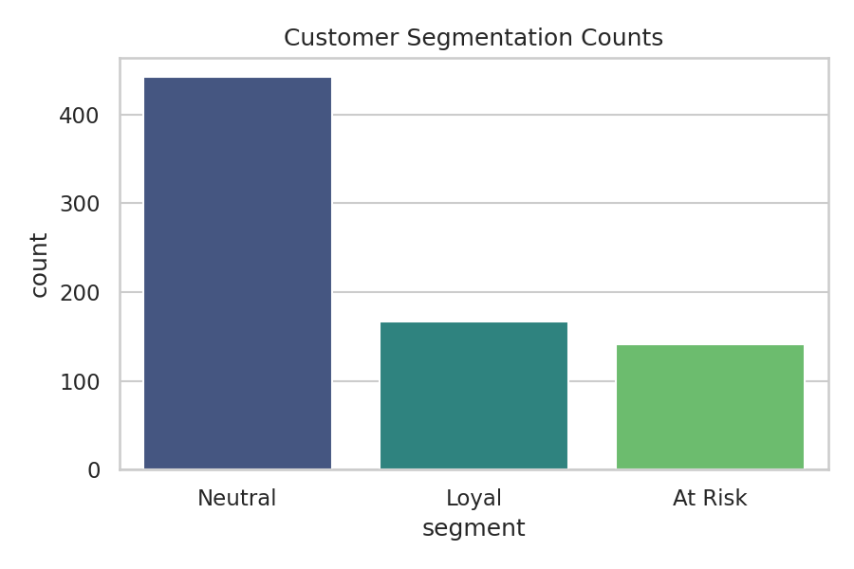
Segmentation Counts

Slide 10
Final Recommendations
Retention strategies:
• Proactive complaint resolution and fast SLA for high-risk customers
• Personalized recharge bundles for low-frequency and low-amount segments
• Loyalty rewards for long-tenure and high-usage customers
• Win-back campaigns for dormant users with targeted incentives
• Monitor churn probability weekly and prioritize outreach

