Slide 1




AUTOMATION TESTING ON
MAGENTO LUMA STORE
Team Members :
Datla Sai Yashwanth Varma
Naima Khatoon
Saifullah Ansari
Shraddha Kshatriya
Srivalli NagaveniChelikani
Shashani Akanksha
Guide:
Anand

Slide 2

INTRODUCTION :
Luma Store is a well-crafted e-commerce solution showcased as a Magento demo site. It demonstrates Magento's capabilities, offering a comprehensive shopping experience with a variety of products, shopping options, and a user-friendly interface. The demo includes various functionalities such as product browsing, shopping cart management, and order processing.
OBJECTIVE :
The primary goal of this project is to develop a robust and efficient test automation framework for evaluating the Luma Store e-commerce site. This framework integrates tools such as Selenium, TestNG, Cucumber, and Apache POI, leveraging Rest Assured and Extent Reports for comprehensive testing and reporting.

Slide 3

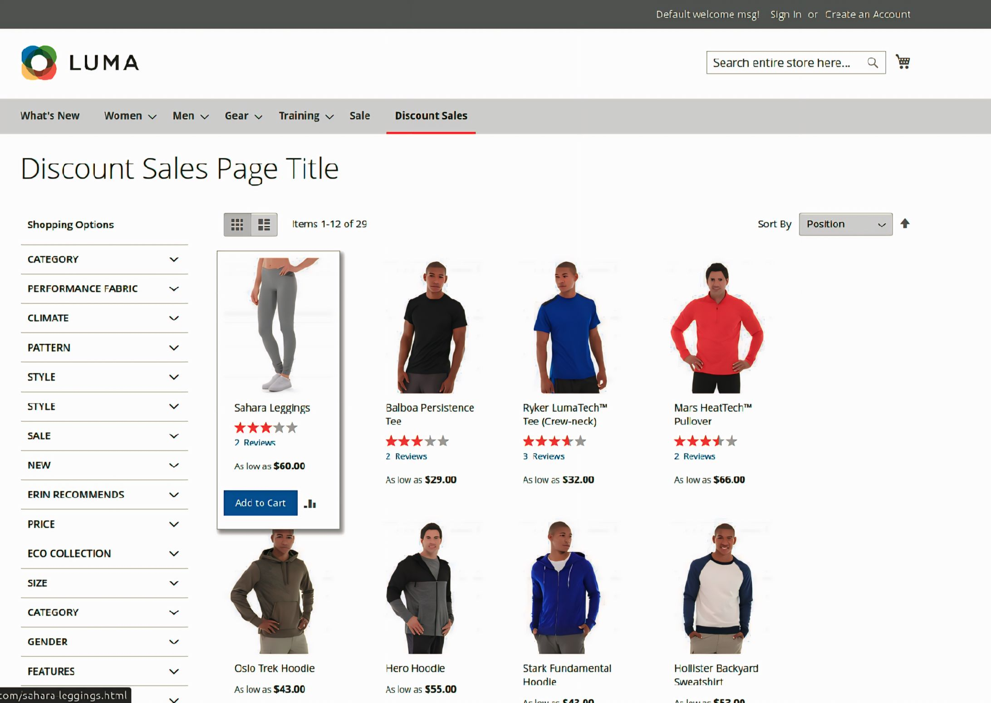
PROBLEM STATEMENT :
PROBLEM STATEMENT :
Luma Store, as an virtual Gym Apparel shopping portal, enables users to browse, search for, and purchase products. Users can add items to their cart or favorites, edit orders, and remove items from the cart. They can proceed to payment by clicking the checkout button, entering shipping details, and submitting the order. Users can later download the receipt and track their orders. The automation framework aims to streamline the testing process for these functionalities, ensuring a seamless and reliable user experience.

Slide 4

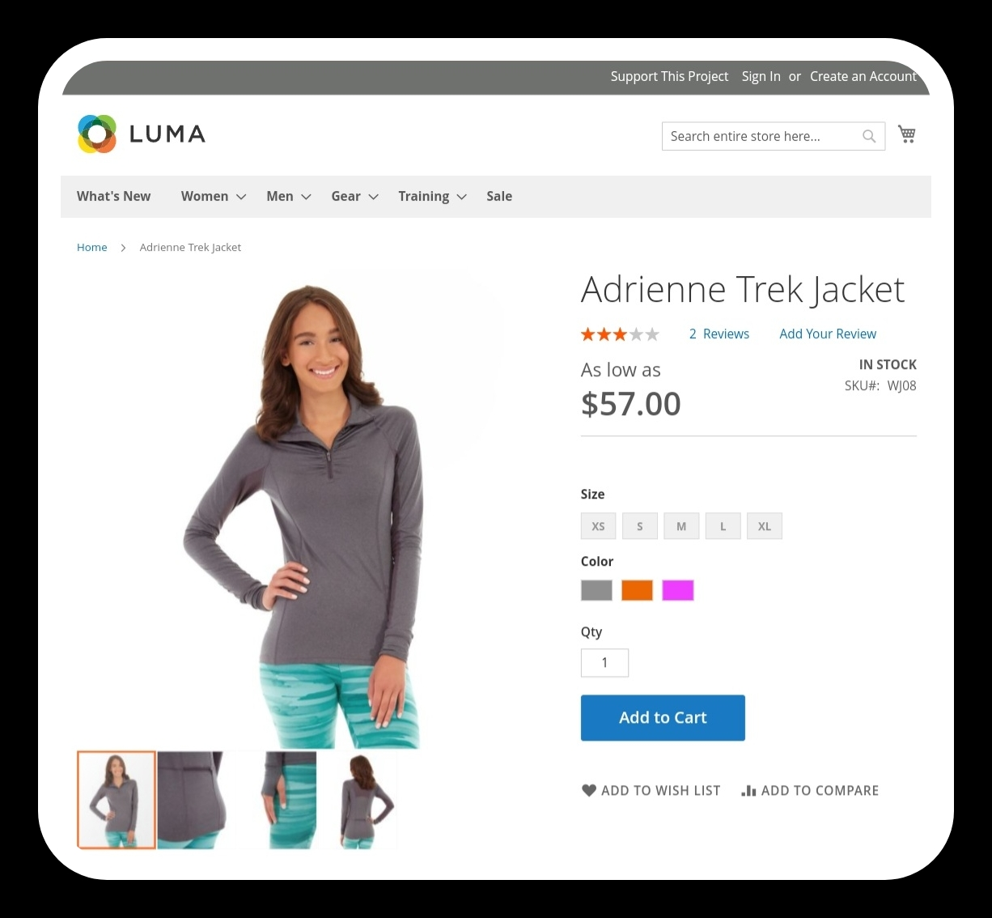
LUMA STORE DEMO
(Virtual Gym Apparel Purchase Site)
• Simulated Gym Apparel Store Experience
• Explore and interact with a variety of gym dresses
• Virtual Purchases
SIGNIFICANCE
• Practical and Controlled Testing Environment
• Demonstrate Automation Efficiency and Accuracy
• Real-World Challenges and Solutions

Slide 5


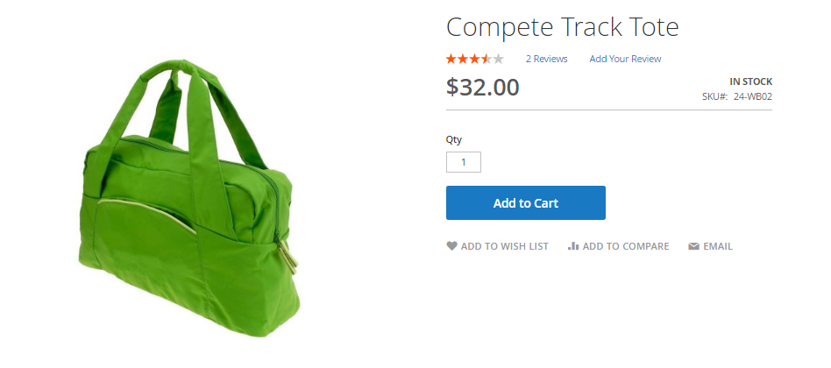
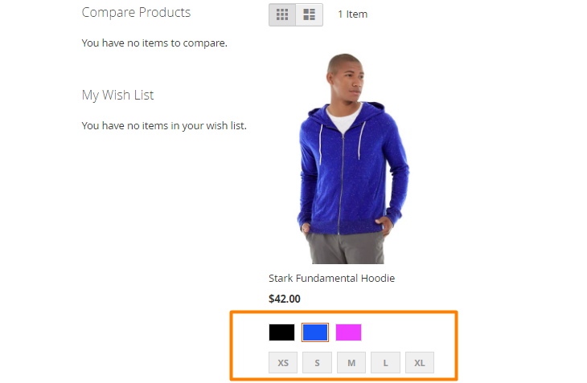

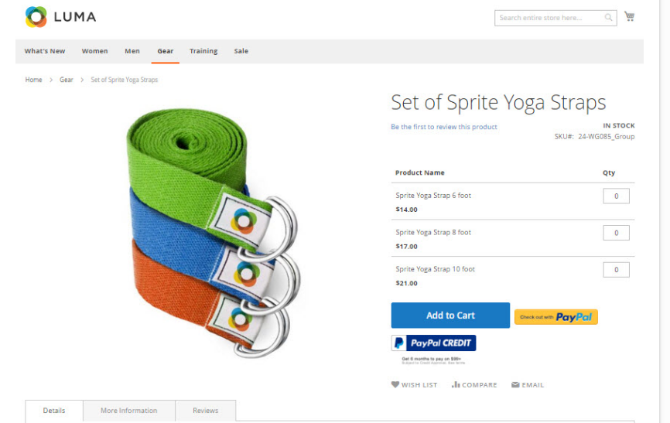
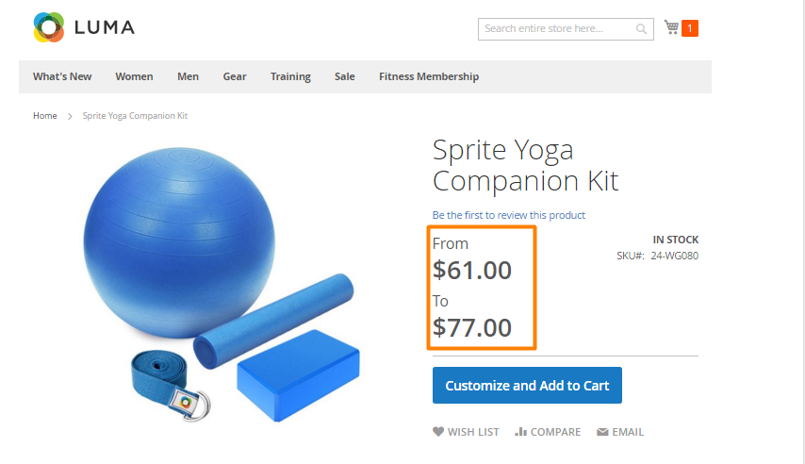
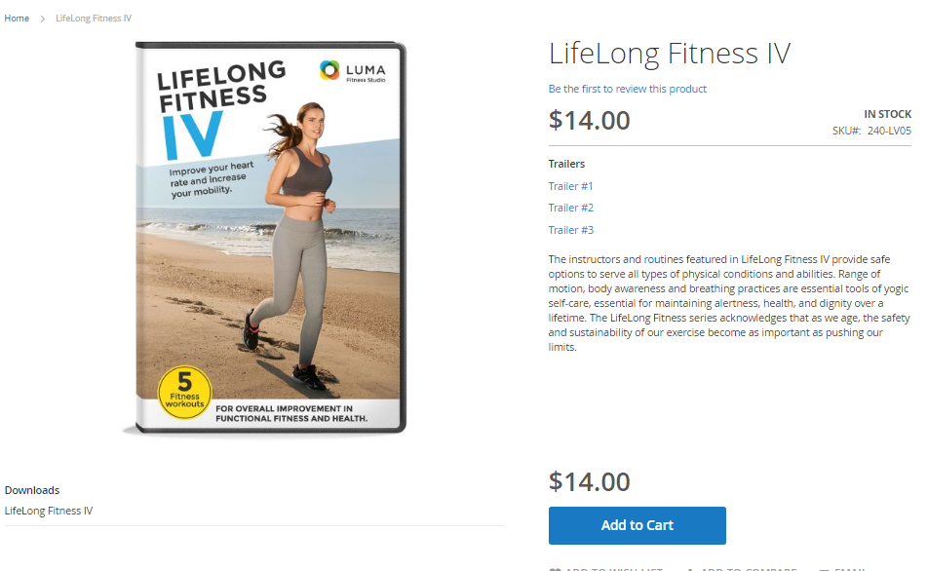
Product Types in Luma Store Explained & Examples
Type 1:
Simple Product Explanation: Versatile and stylish bags for carrying personal items.
Type 2:
Configurable Product Explanation: Comfortable and fashionable clothing for workouts. A gym dress available in multiple colors and sizes.
Type 3:
Grouped Product Explanation: A Grouped Product is a collection of Simple or Virtual Products that share characteristics or are related. It offers the option to buy individually or as a group. Example: A set of gym accessories like water bottles, towels, and gym bags.
Type 4:
Bundle Product Explanation: A Bundle Product is customizable and includes various Simple or Virtual Products. All items in the bundle must be purchased together. Example: A complete gym kit containing a yoga mat, dumbbells, and resistance bands.
Type 5:
Downloadable Product Explanation: Digital resources providing fitness tips and routines.These are products that can be downloaded, such as software, eBooks, or videos. Example: A downloadable workout video for gym enthusiasts.

Slide 6


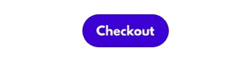

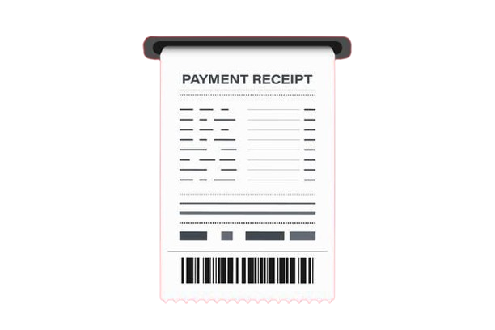
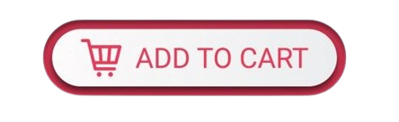
Test Scenarios for Luma Store
SIGN IN: Verify user can navigate to the sign-in page.
LOGIN: Verify user can log in with valid credentials.
LOGOUT: Verify user can log out and session ends.
CHECKOUT
SHIPPING DETAILS
SELECT PRODUCTS
SELECT BY ORDER
SELECT BY VENDORS
SELECT FAVORITE BUTTON
PRODUCT DETAILS VIEW PRODUCT DETAILS: Verify product details are displayed correctly.
INVOICE
DOWNLOAD RECEIPT
MY ORDERS
ADD TO CART: Verify user can add items to the cart.
UPDATE CART: Verify user can update item
quantities in the cart.

Slide 7

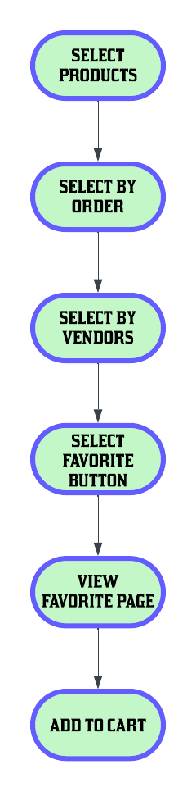
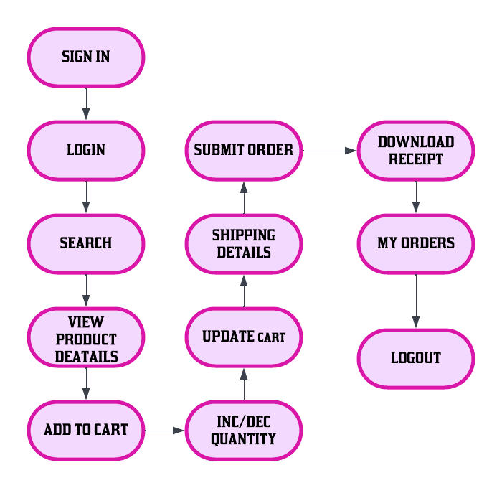
TEST FLOW
PRODUCT SELECTIOFLOW

Slide 8

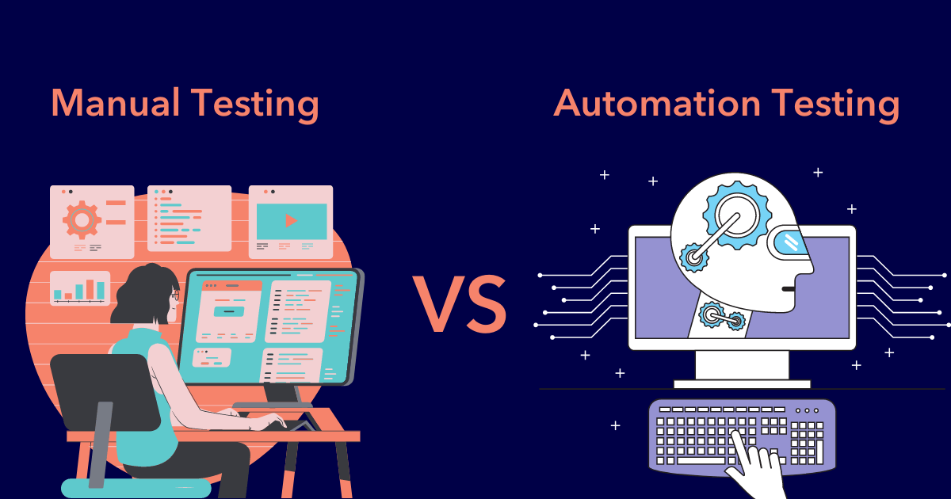
AUTOMATION OVER
MANUAL TESTING
**Efficiency and Speed :
- Tests run quickly and repeatedly
**Cost-Effectiveness :
- Less manual work needed over time
- Saves money in the long run
**Consistency and Repeatability :
- No human errors
- Same tests run the same way every time
**Comprehensive Testing :
- Tests all different parts of the store
- Makes sure everything works properly
**Scalability :
- Can grow with the project
- Handles lots of tests easily
**Performance Testing :
- Checks how the system performs under
heavy use
- Finds any slowdowns or issues
**Reusability and Maintenance :
- Uses the same test scripts again and again
- Easy to update and fix tests

Slide 9






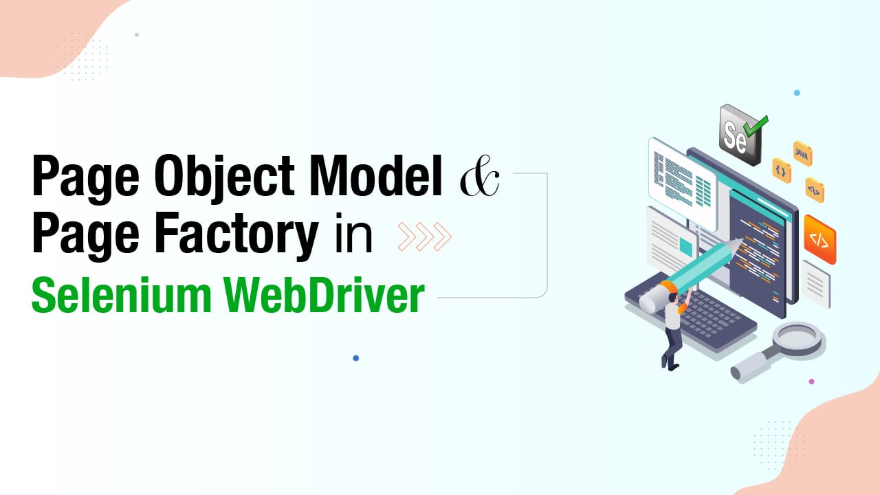
OUR JOURNEY WITH AUTOMATION
Cucumber
Selenium

Slide 10

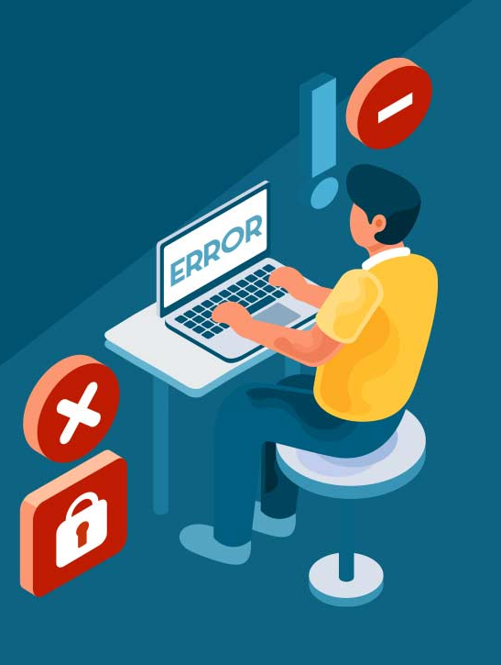
TEST EXECUTION
Test Execution is the process of performing test cases to identify bugs, errors, and other potential issues that a software could have.
Test Execution Phases
Test Execution Cycle
Test Execution State

Slide 11

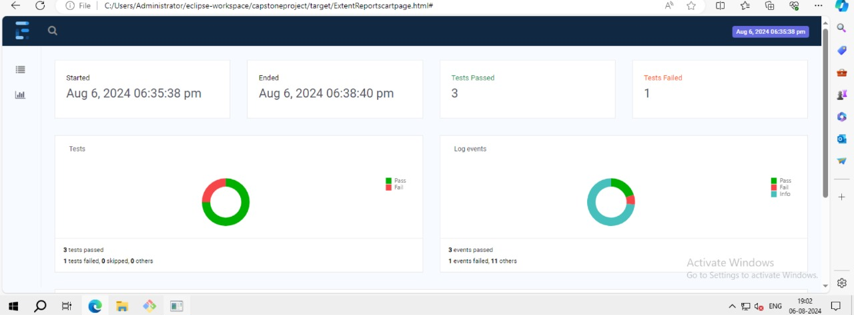
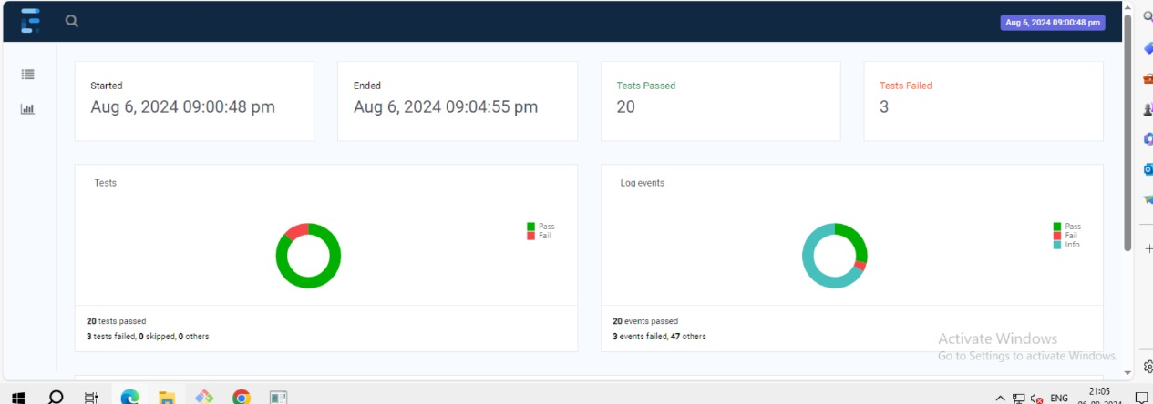
EXTENT REPORTS FOR LUMA STORE
Our Extent Reports :
Open-source reporting library useful for test automation.
Easily integrates with major testing frameworks like JUnit, TestNG, etc.
Advantages of Extent Reports :
Provides pie chart representations of test results.
Generates detailed step-by-step test reports.
Allows adding screenshots for better analysis.
Offers better visual representation compared to built-in reports of JUnit and TestNG.

Slide 12
CONCLUSION
Quality Assurance
Efficiency
Improvement
Customer Satisfaction
Consistency in Testing
Long-Term Cost
Savings

Slide 13


