Slide 1

Restaurant and Consumer Data

Slide 2
Restaurant &
Consumer Data
Analysis using SQL & MYSQL
From raw CSV data into relational database analysis
Presented by Yaswanth
SQL | DATABASE DESIGN | DATA ANALYSIS

Slide 3
Project Introduction
A relational analysis of consumers, restaurants, cuisines and ratings
PROJECT FLOW
Raw CSV Data
My SQL DataBase
SQL Analysis
Verified Results
What the project contains
Consumer profiles and demographics
Consumer cuisine preferences
Restaurant information and characteristics
Consumer ratings for restaurants

Slide 4
Objective of the Project
What the project was designed to accomplish
Structure
2. Validate
3. Analyze
Convert raw CSV files into relational MY SQL database with meaningful entities and relationships.
Clean duplicate preference records and validate primary-key/foreign-key relationships.
Use SQL filtering, joins, aggregation and subqueries to answer analytical questions.
4. Go advanced
5. Reuse
6. Interpret
Apply CTEs, derived tables and window functions for ranking and row-level comparisons.
Create Views and stored procedures for repeatable analytical logic.
Translate query results into careful, data supported observations without overclaiming causation.

Slide 5
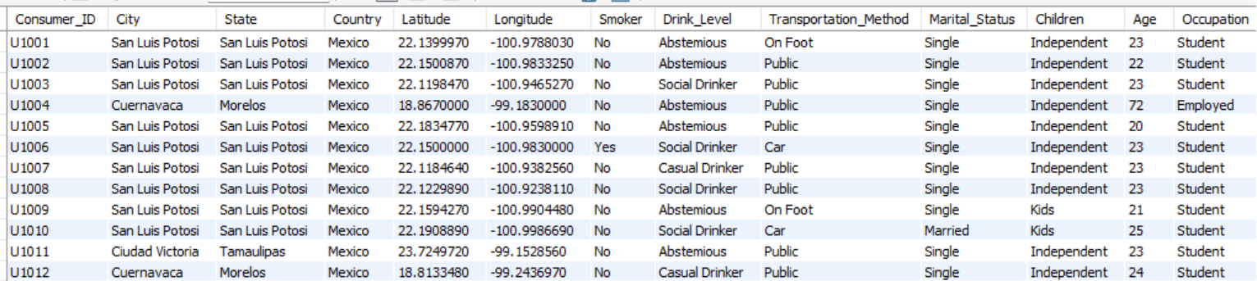
Tables
Consumers Table

Slide 6
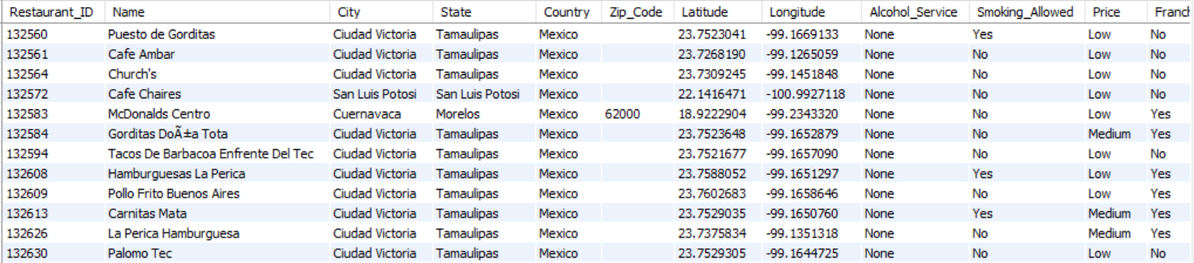
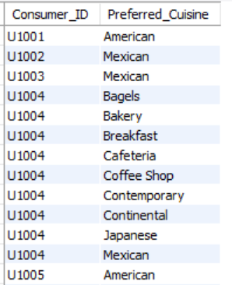
Tables
Restaurants Table
Consumer Preferences Table

Slide 7
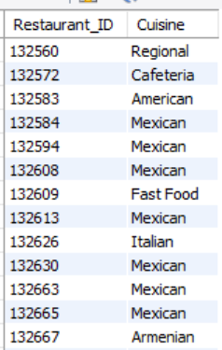
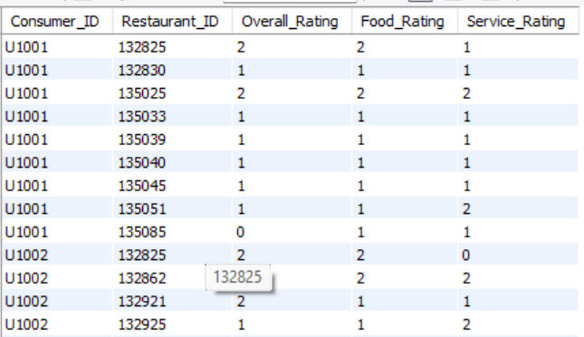
Tables
Restaurants cuisines Table
Ratings Table

Slide 8
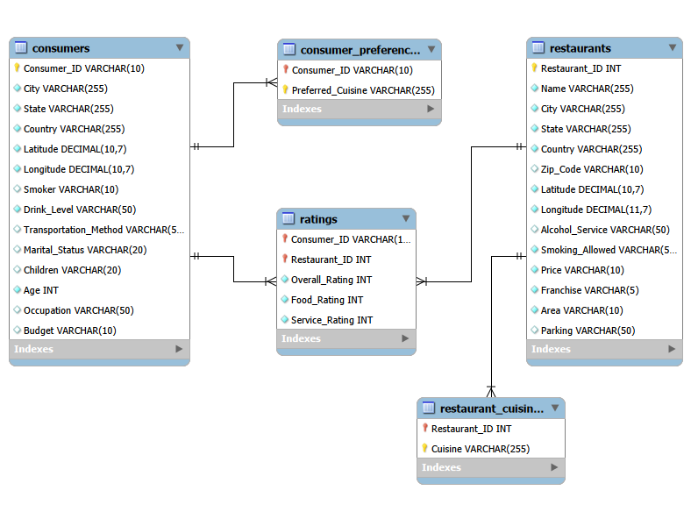
ER Diagram

Slide 9
Problem Statement
Restaurant and consumer information is distributed across multiple related datasets covering consumers, preferences, restaurants, cuisines, and ratings.
Analyzing these datasets independently makes it difficult to connect consumer characteristics, cuisine preferences, restaurant attributes, locations, and rating behavior.
A structured relational database is required to maintain relationships between consumers and restaurants and support reliable analysis.
The project uses MySQL and SQL to integrate, filter, aggregate, compare, and rank the data.
The analysis produces data-supported insights into consumer behavior, restaurant characteristics, cuisine preferences, and rating patterns.

Slide 10
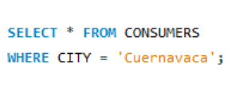
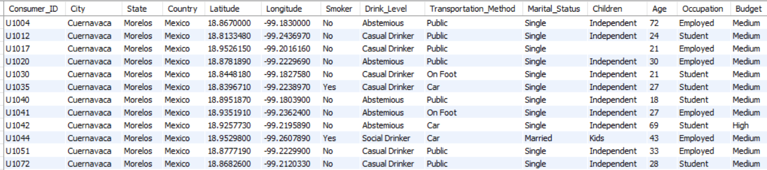
List all details of consumers who live in the city of 'Cuernavaca'.

Slide 11
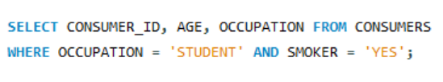
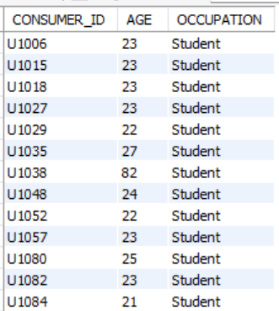
2. Find the Consumer_ID, Age, and Occupation of all consumers who are 'Students' AND are 'Smokers'.

Slide 12
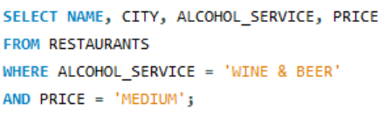
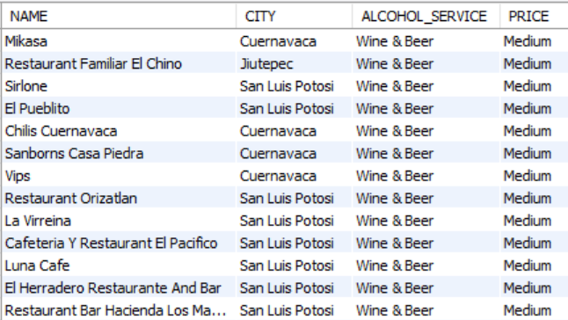
3. List the Name, City, Alcohol_Service, and Price of all restaurants that serve 'Wine & Beer' and have a 'Medium' price level.

Slide 13
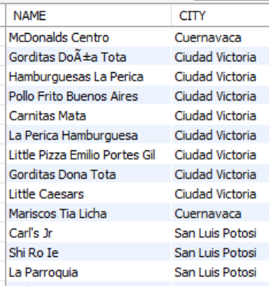
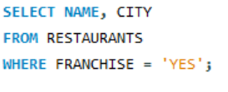
4. Find the names and cities of all restaurants that are part of a 'Franchise'.

Slide 14

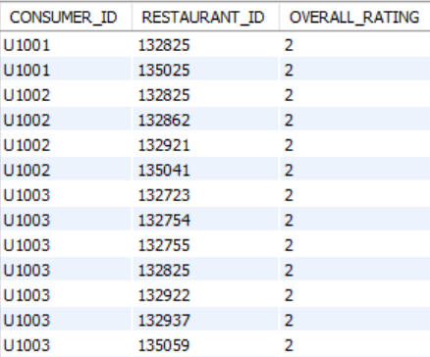
5. Show the Consumer_ID, Restaurant_ID, and Overall_Rating for all ratings where the Overall_Rating was 'Highly Satisfactory' (which corresponds to a value of 2, according to the data dictionary).

Slide 15
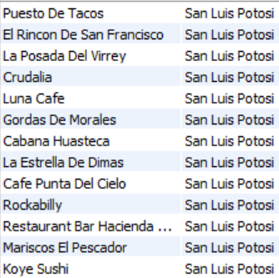
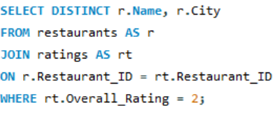
6. List the names and cities of all restaurants that have an Overall_Rating of 2 (Highly Satisfactory) from at least one consumer.

Slide 16
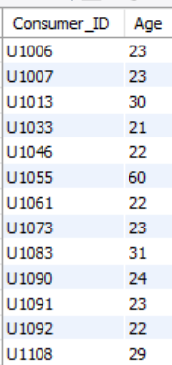
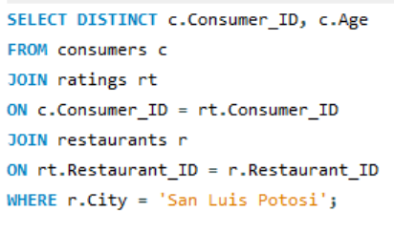
7.Find the Consumer_ID and Age of consumers who have rated restaurants located in 'San Luis Potosi'.

Slide 17
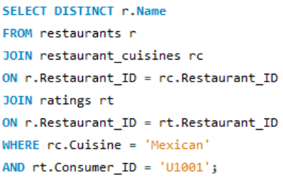
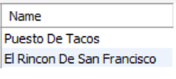
8. List the names of restaurants that serve 'Mexican' cuisine and have been rated by consumer 'U1001'.

Slide 18
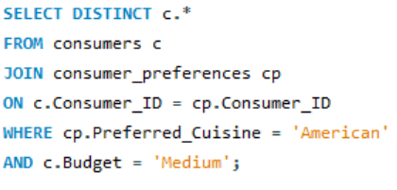
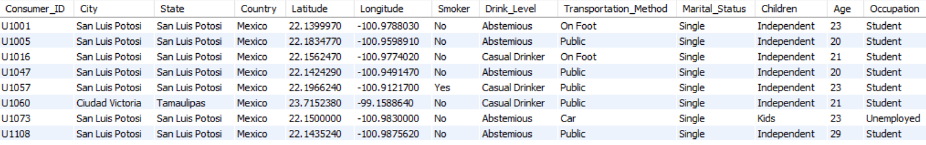
9. Find all details of consumers who prefer 'American' cuisine AND have a 'Medium' budget.

Slide 19
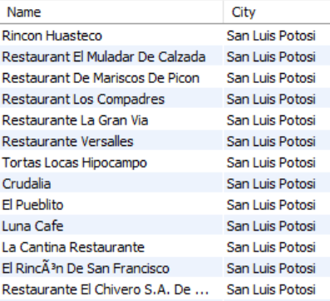
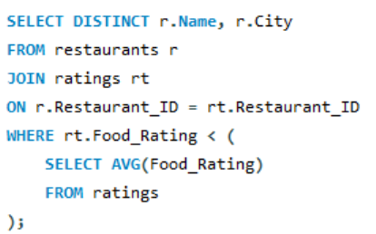
10.List restaurants (Name, City) that have received a Food_Rating lower than the average Food_Rating across all rated restaurants.

Slide 20
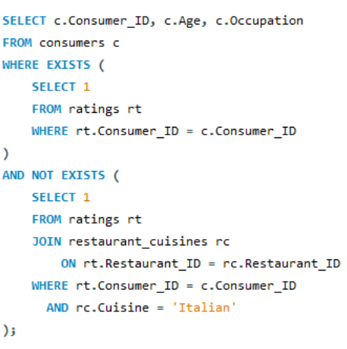
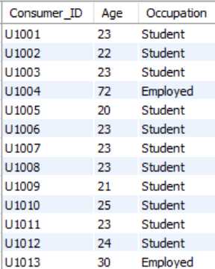
11. Find consumers (Consumer_ID, Age, Occupation) who have rated at least one restaurant but have NOT rated any restaurant that serves 'Italian' cuisine.

Slide 21
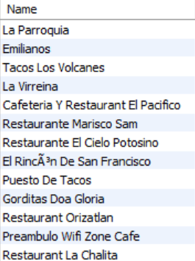
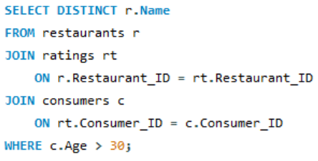
12. List restaurants (Name) that have received ratings from consumers older than 30.

Slide 22
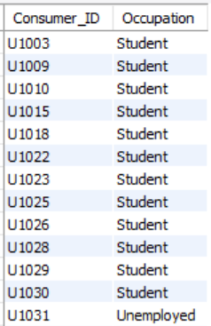
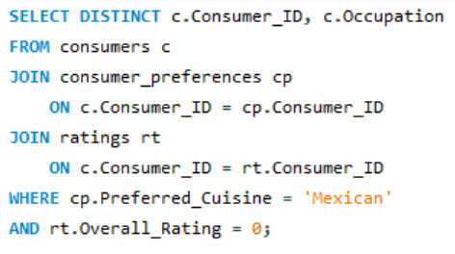
13. Find the Consumer_ID and Occupation of consumers whose preferred cuisine is 'Mexican' and who have given an Overall_Rating of 0 to at least one restaurant (any restaurant).

Slide 23
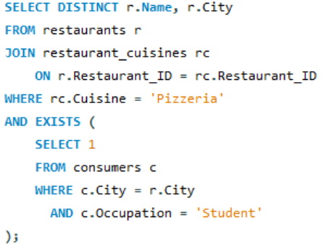
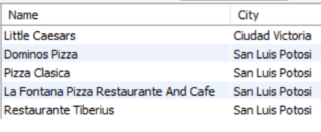
14. List the names and cities of restaurants that serve 'Pizzeria' cuisine and are located in a city where at least one 'Student' consumer lives.

Slide 24
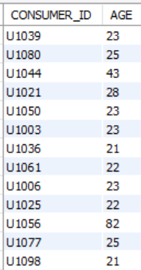
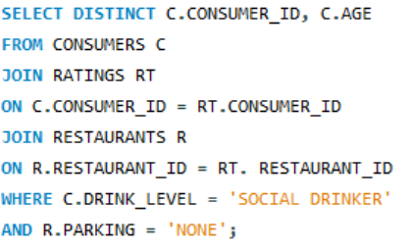
15. Find consumers (Consumer_ID, Age) who are 'Social Drinkers' and have rated a restaurant that has 'No' parking.

Slide 25
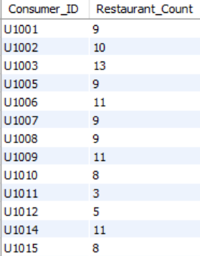
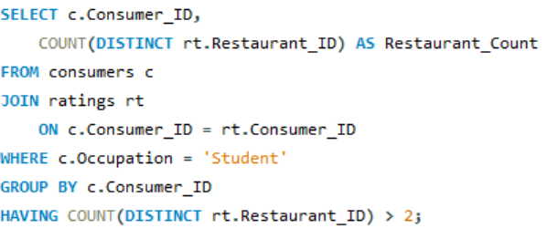
16. List Consumer_IDs and the count of restaurants they've rated, but only for consumers who are 'Students'. Show only students who have rated more than 2 restaurants.

Slide 26
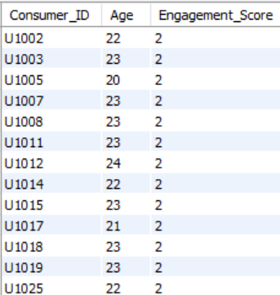
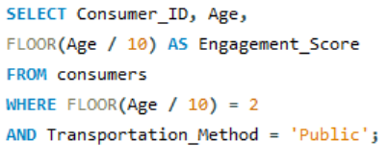
17. We want to categorize consumers by an 'Engagement_Score' which is their Age divided by 10 (integer division). List the Consumer_ID, Age, and this calculated Engagement_Score, but only for consumers whose Engagement_Score would be exactly 2 and who use 'Public' transportation.

Slide 27
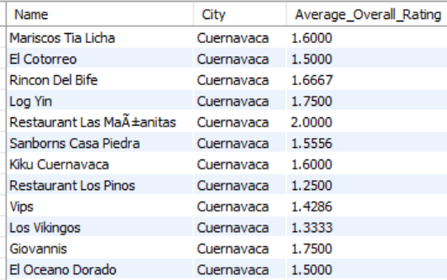
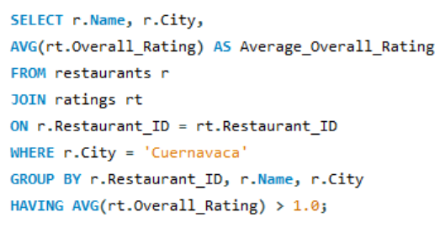
18. For each restaurant, calculate its average Overall_Rating. Then, list the restaurant Name, City, and its calculated average Overall_Rating, but only for restaurants located in 'Cuernavaca' AND whose calculated average Overall_Rating is greater than 1.0.

Slide 28
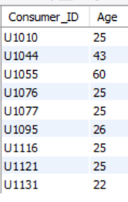
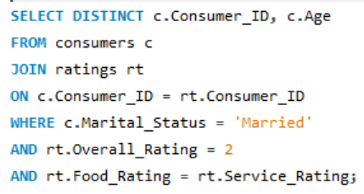
19. Find consumers (Consumer_ID, Age) who are 'Married' and whose Food_Rating for any restaurant is equal to their Service_Rating for that same restaurant, but only consider ratings where the Overall_Rating was 2.

Slide 29
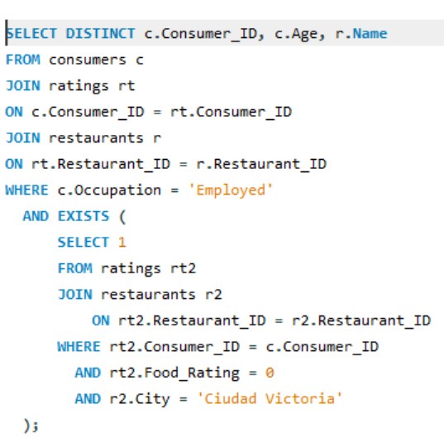
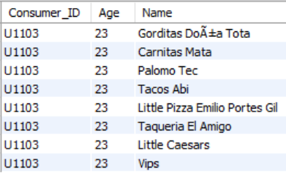
20. List Consumer_ID, Age, and the Name of any restaurant they rated, but only for consumers who are 'Employed' and have given a Food_Rating of 0 to at least one restaurant located in 'Ciudad Victoria'.

Slide 30
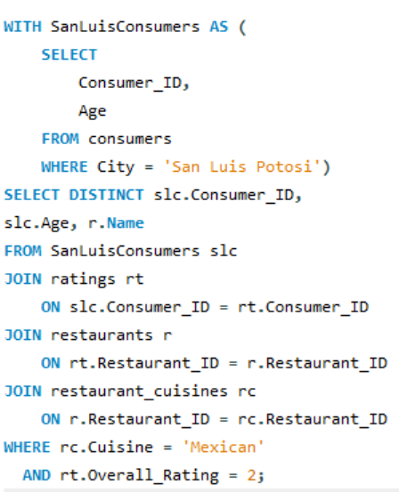
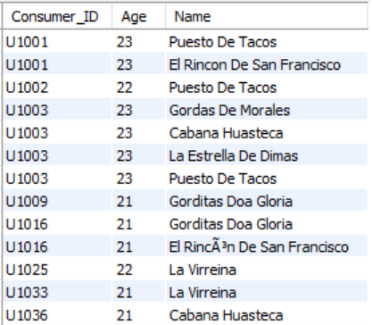
21. Using a CTE, find all consumers who live in 'San Luis Potosi'. Then, list their Consumer_ID, Age, and the Name of any Mexican restaurant they have rated with an Overall_Rating of 2.

Slide 31
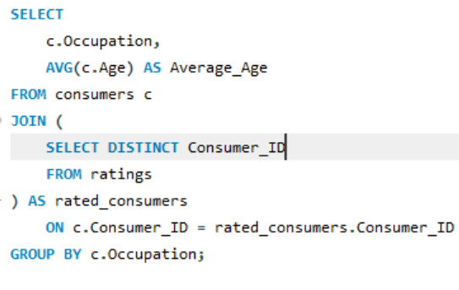
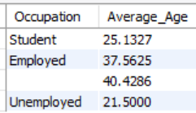
22. For each Occupation, find the average age of consumers. Only consider consumers who have made at least one rating. (Use a derived table to get consumers who have rated).

Slide 32
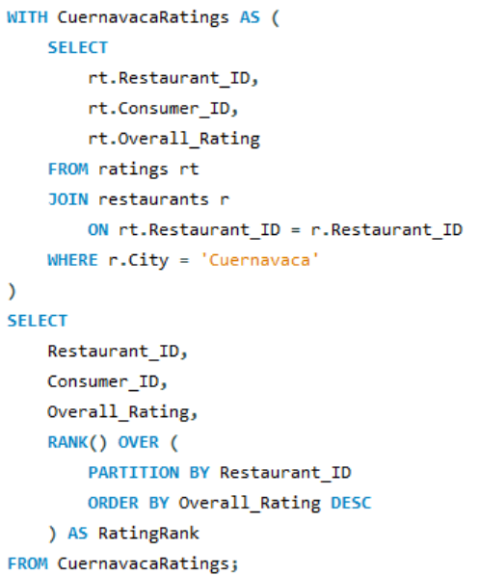

23. Using a CTE to get all ratings for restaurants in 'Cuernavaca', rank these ratings within each restaurant based on Overall_Rating (highest first). Display Restaurant_ID, Consumer_ID, Overall_Rating, and the RatingRank.

Slide 33


24. For each rating, show the Consumer_ID, Restaurant_ID, Overall_Rating, and also display the average Overall_Rating given by that specific consumer across all their ratings.

Slide 34


25. Using a CTE, identify students who have a 'Low' budget. Then, for each of these students, list their top 3 most preferred cuisines based on the order they appear in the Consumer_Preferences table (assuming no explicit preference order, use Consumer_ID, Preferred_Cuisine to define order for ROW_NUMBER).

Slide 35


26. Consider all ratings made by 'Consumer_ID' = 'U1008'. For each rating, show the Restaurant_ID, Overall_Rating, and the Overall_Rating of the next restaurant they rated (if any), ordered by Restaurant_ID (as a proxy for time if rating time isn't available). Use a derived table to filter for the consumer's ratings first.

Slide 36


27. Create a VIEW named HighlyRatedMexicanRestaurants that shows the Restaurant_ID, Name, and City of all Mexican restaurants that have an average Overall_Rating greater than 1.5.

Slide 37


28. First, ensure the HighlyRatedMexicanRestaurants view from Q7 exists. Then, using a CTE to find consumers who prefer 'Mexican' cuisine, list those consumers (Consumer_ID) who have not rated any restaurant listed in the HighlyRatedMexicanRestaurants view.

Slide 38



29. Create a stored procedure GetRestaurantRatingsAboveThreshold that accepts a Restaurant_ID and a minimum Overall_Rating as input. It should return the Consumer_ID, Overall_Rating, Food_Rating, and Service_Rating for that restaurant where the Overall_Rating meets or exceeds the threshold.

Slide 39



30. Identify the top 2 highest-rated (by Overall_Rating) restaurants for each cuisine type. If there are ties in rating, include all tied restaurants. Display Cuisine, Restaurant_Name, City, and Overall_Rating.

Slide 40



31. First, create a VIEW named ConsumerAverageRatings that lists Consumer_ID and their average Overall_Rating. Then, using this view and a CTE, find the top 5 consumers by their average overall rating. For these top 5 consumers, list their Consumer_ID, their average rating, and the number of 'Mexican' restaurants they have rated.

Slide 41





32. Create a stored procedure named GetConsumerSegmentAndRestaurantPerformance that accepts a Consumer_ID as input.

Slide 42
What I Learned & Conclusion
From raw data to a complete SQL analysis
Database skills
SQL skills
Advanced skills
Relational design, primary keys, foreign keys and relationship validation.
Filtering, joins, aggregation, subqueries, CTEs and window functions.
Views, stored procedures, ranking and sequential row comparisions.
Data quality
Analytical thinking
Practical capability
Duplicate detection, consistency checks and actual value validation.
Translate questions into SQL logic and interpret results without overclaiming.
Connect raw data. Database structures, SQL analysis and evidence-based observations.
Conclusion
This project demonstrates practical SQL and data analysis capability across database design, data quality, relational querying, advanced SQL and reusable database objects.

Slide 43
Questions?
Restaurant & Consumer Data Analysis
Using SQL & MYSQL
Thank You
Yaswanth Reddy

