Slide 1

CaterConnect: An Agentic AI-Powered Catering Booking
and Surplus Food Redistribution System
SOA Project Review-1
18 August 2026
Team Members Names Roll Numbers
Under the Guidance of
Guide name: K. Venkateswari
Y. Paavana Pranavasri — 2420030554
A. Divya Sree — 2420030416
B. Yaswanth — 2420030392

Slide 2
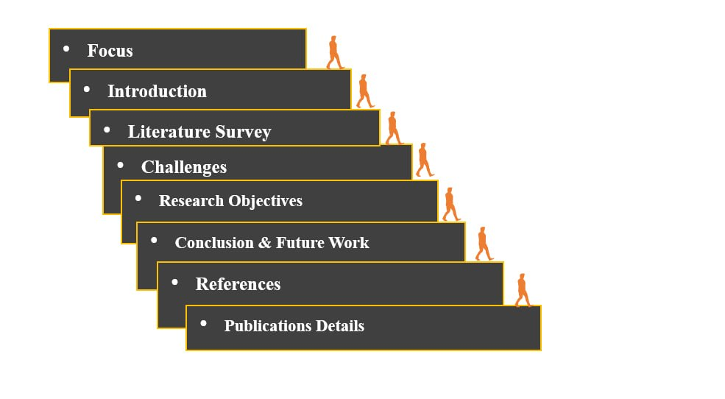
Outline of Project Work

Slide 3
Problem Statement
Existing catering platforms mainly provide basic caterer search, menu selection, package checking, booking, and payment.
Customers often have to manually compare multiple caterers based on event type, number of guests, budget, cuisine preferences, date, location, and availability.
The booking process is therefore time-consuming and requires multiple decisions from the customer.
Most existing platforms do not provide an intelligent system that understands customer requirements and automatically recommends suitable catering options.
Caterers also need better support for managing bookings, event requirements, package details, and real-time changes through an integrated system.
CaterConnect addresses these limitations through an Agentic AI-powered catering booking system that understands customer requirements, searches available catering options, compares packages, and assists in making suitable booking decisions.
The system is supported by independent SOA services for catering management, booking, payment, and event-related operations, while surplus-food management and NGO matching are provided as an additional sustainability feature.

Slide 4
Objectives
• To develop a conversational Agentic AI-powered catering booking system that understands natural-language requirements and recommends suitable catering options.
• To analyze event type, guest count, budget, cuisine preferences, date, ratings, and availability to provide personalized caterer, menu, and package recommendations.
• To implement independent SOA services for caterer management, menu management, availability, booking, payment, and notification management.
• To integrate surplus-food management as an additional sustainability feature, enabling suitable surplus food to be matched with registered organizations and supporting timely donation notifications.

Slide 5
Literature Survey
Authors | Title of the Paper | Methodology | Inferences | Limitation / Future Work
Iovine, Narducci & Semeraro (2020) | Conversational Recommender Systems and Natural Language: A Study through the ConveRSE Framework | The ConveRSE framework studies conversational recommendation using natural language, buttons, or a combination of interaction modes to evaluate how users interact with recommendation systems. | Conversational systems can collect user preferences interactively and provide personalized recommendations. Natural-language interaction can improve usability and make the recommendation process easier for users. | Natural-language-only interaction may face limitations such as cold-start and dialogue disambiguation. Domain-specific integration and service integration are required.ok give
Letchumanan & Mat Nawi [2] (2024) | The Development of VGL Catering Booking System: VGL Cate using Object-Oriented Approach | A web-based catering booking system developed using an object-oriented approach and Waterfall model. The system provides customer login, food ordering, date reservation, online deposit/payment, booking management, and data management. | The study demonstrates that an online catering booking system can simplify date reservation, food ordering, payment, and booking management for both customers and catering providers. | The system mainly focuses on booking management for a single catering provider. It does not provide Agentic AI-based personalized recommendations, multi-caterer comparison, intelligent decision-making, or surplus-food redistribution.
Dalal [3] (2022) | Food Donation Management under Supply and Demand Uncertainties: A Robust Optimization Approach | Uses a robust optimization model to determine donor selection, beneficiary allocation, and food-donation flows while handling uncertainty in supply and demand. | Demonstrates that intelligent computational methods can improve food-donation allocation and resource utilization under uncertain conditions. | Focuses on food-donation allocation rather than an integrated catering application. It does not combine AI-assisted booking, caterer recommendation, automated notifications, or SOA services.
[1] Iovine et al. (2020) | [2] Dalal (2022) | [3] Bhardwaj et al. (2025)

Slide 6
Problem Gap Identification
Gap 1: Manual comparison of catering options makes the selection process time-consuming and less personalized.
Gap 2: Conventional catering booking platforms mainly focus on booking and transactions, with limited intelligent decision support for selecting the most suitable caterer.
Gap 3: Existing catering booking systems generally do not integrate post-event surplus-food management with the booking lifecycle.
Gap 4: Intelligent surplus-food matching needs to consider multiple factors such as food type, quantity, location, collection deadline, NGO requirements, capacity, and pickup constraints.

Slide 7
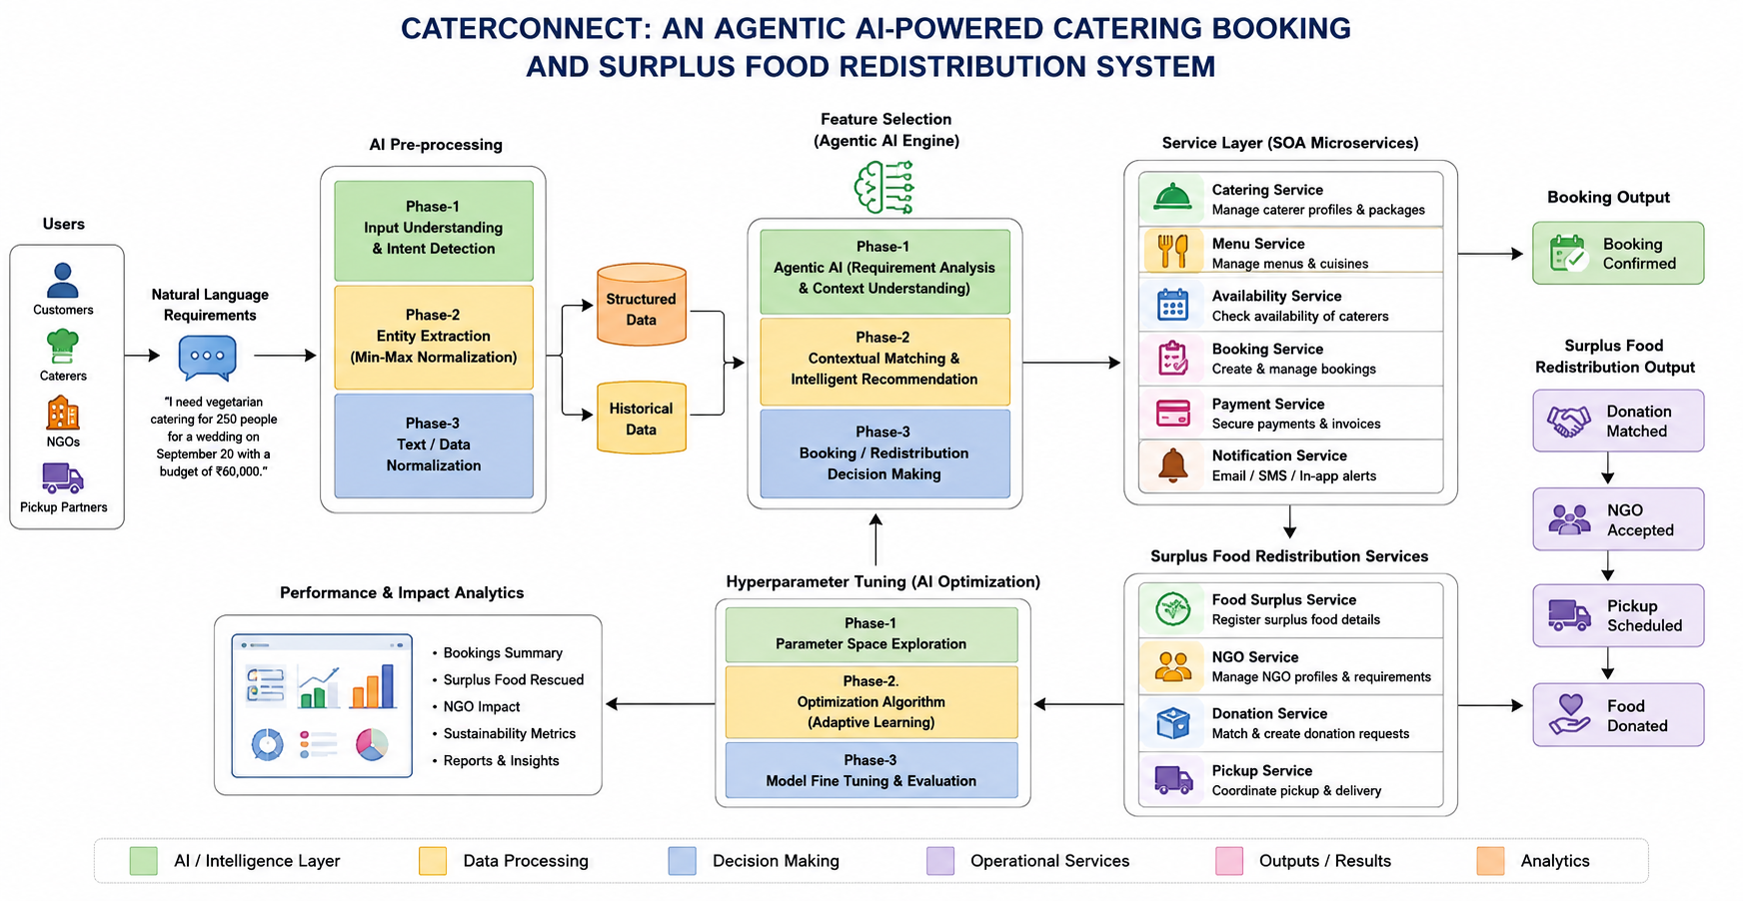
Innovation, Creativity, and Novelty
1. Conversational Booking
Agentic AI understands natural-language catering requirements and recommends suitable options through SOA services.
2. Intelligent Surplus Matching
AI matches surplus food with suitable NGOs using multiple constraints instead of only showing nearby organizations.
3. Automated Food-Rescue Workflow
Donation notification and pickup coordination connect matching, acceptance, collection, and donation completion.

Slide 8
Feasibility and Project Plan
Proposed project phases based on the workflows and services described in the abstract
Phase 1
Requirements
& Literature
Phase 2
Architecture
& API Design
Phase 3
Core SOA
Services
Phase 4
Agentic AI
Integration
Phase 5
Surplus Food
Matching
Phase 6
Testing &
Evaluation
Technical feasibility: Agentic AI communicates with independent SOA services through APIs.
Operational feasibility: the workflow covers booking, donation matching, notification, NGO acceptance, and pickup.
Evaluation focus: booking summary, surplus food rescued, NGO impact, sustainability metrics, and reports/insights.

Slide 9
Dataset Details
CaterConnect uses four structured datasets to support catering management, recommendation, booking, and surplus-food redistribution.
Dataset | Purpose
Caterers.csv | Caterer information
menu_pricing.csv | Menu, package & pricing
food_surplus.csv | Surplus food information
organizations.csv | Organization matching

Slide 10
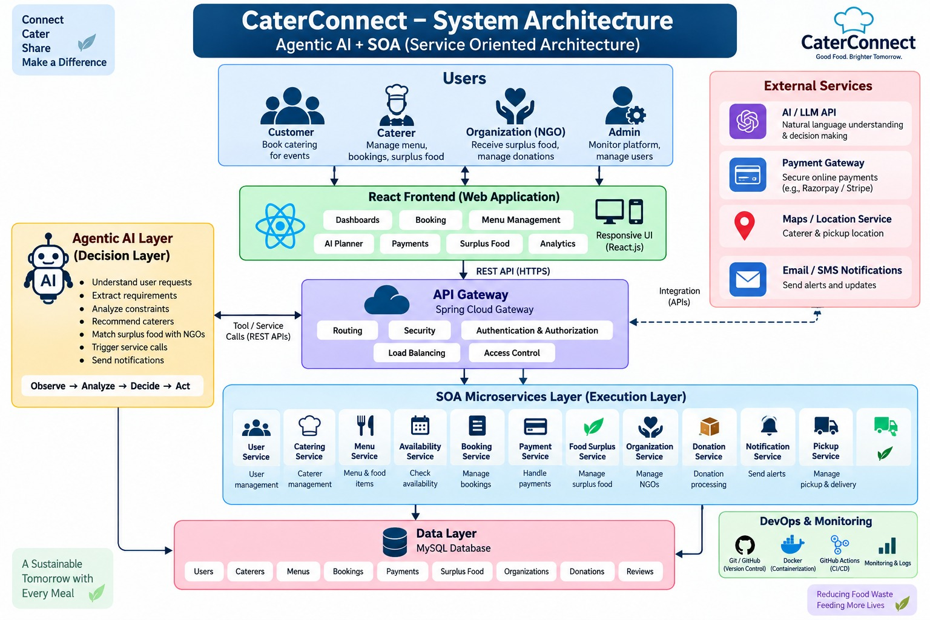
System Architecture

Slide 11
SOA SERVICES
Service | Responsibility
Caterer Management Service | Manages caterer profiles, speciality, ratings and capacity
Menu Management Service | Manages menus, food items, packages and pricing
Availability Service | Checks caterer availability
Booking Service | Creates and manages customer bookings
Payment Service | Handles payment-related booking information
Notification Service | Provides booking and status notifications
Surplus Food Service | Records and manages surplus food
Organization Matching Service | Matches surplus food with suitable organizations

Slide 12
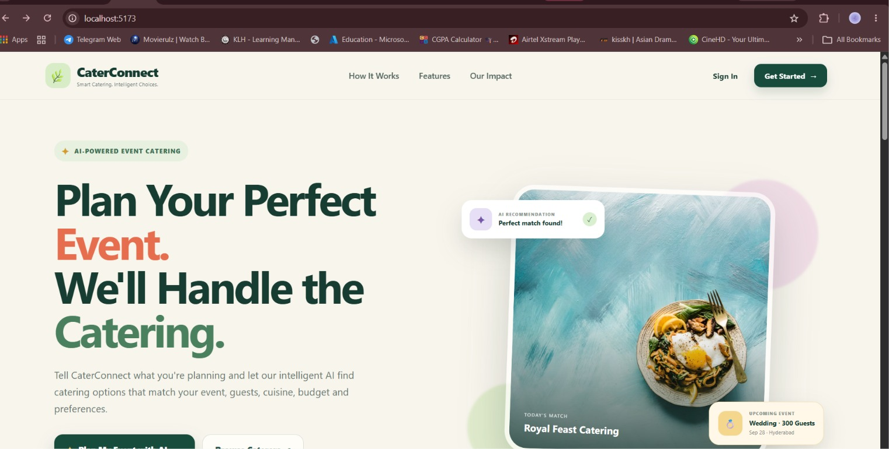
OUTPUTS – LOGIN PAGE

Slide 13
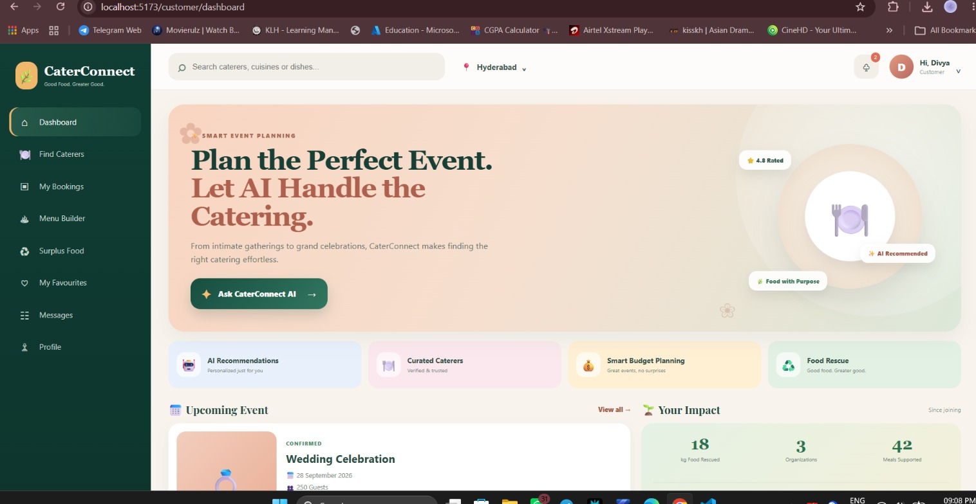
OUTPUT – CUSTOMER DASHBOARD

Slide 14
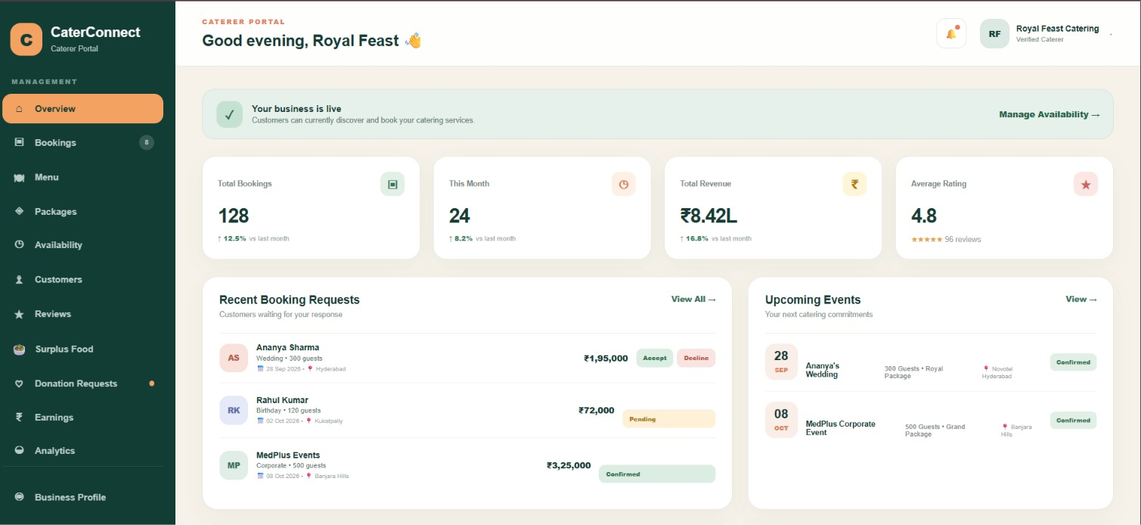
OUTPUT – CATERER DASHBOARD

Slide 15
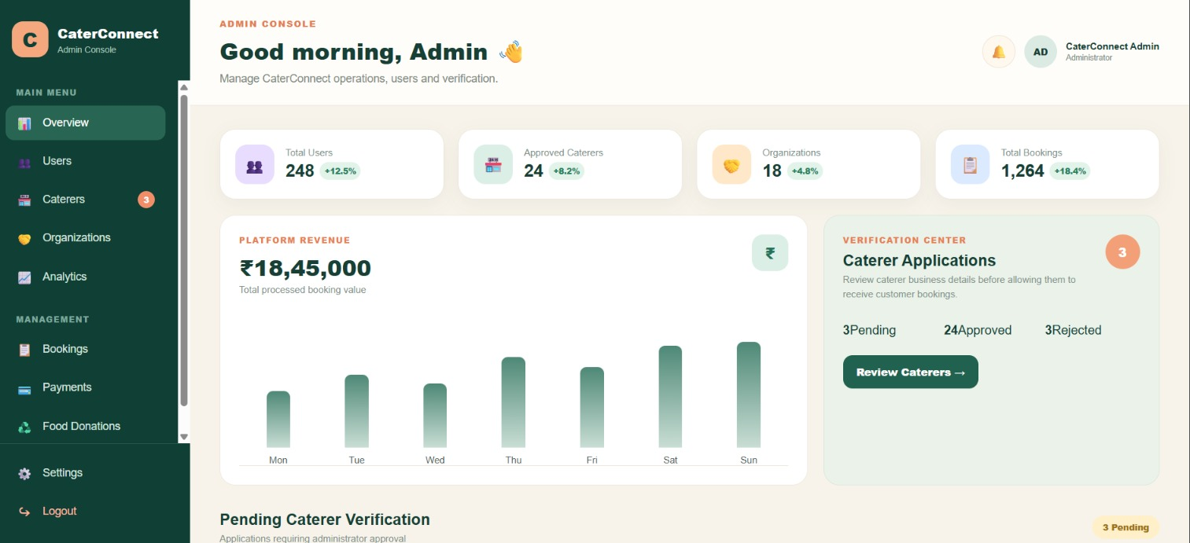
OUTPUT – ADMIN DASHBAORD

Slide 16
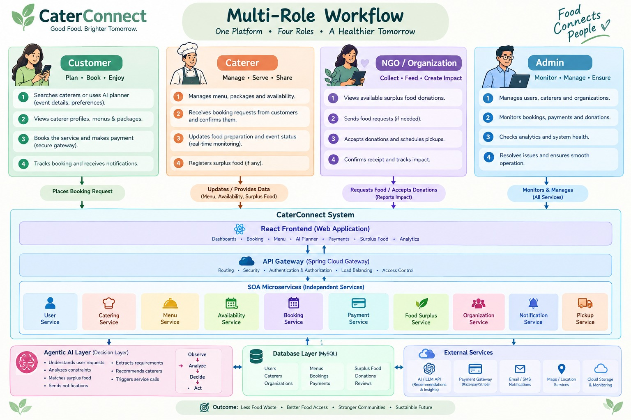
MULTI – ROLE WORKFLOW

Slide 17
CONCLUSION & FUTURE IMPLEMENTATION
CaterConnect is an Agentic AI-powered catering management system designed to simplify catering selection, booking, and management through a service-oriented architecture. The system includes structured datasets for caterers, menus, surplus food, and organizations, along with role-based Customer, Caterer, and Admin dashboards. The current implementation establishes the foundation for intelligent catering recommendations, booking management, and surplus-food redistribution.
In the future, the system will focus on completing the integration of all SOA services with the frontend and datasets, and completing the end-to-end booking and payment workflow. The surplus-food module will be enhanced to automatically match surplus food with suitable organizations and generate notifications. Finally, system testing, performance evaluation, and overall workflow validation will be conducted to complete the CaterConnect platform.

