Slide 1

Coffee Shop Expansion Analysis
Yaswanth Kundurthi

Slide 3
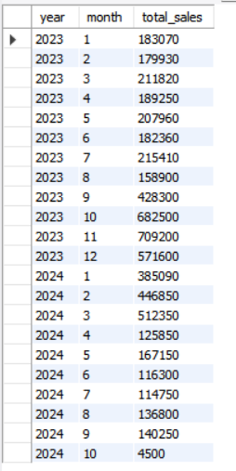
-- Overall Sales Performance: -- What is the overall trend of sales over time
SELECT YEAR(sale_date) AS year,
MONTH(sale_date) AS month,
SUM(total) AS total_salesFROM sales
GROUP BY year, month
ORDER BY year, month;

Slide 4
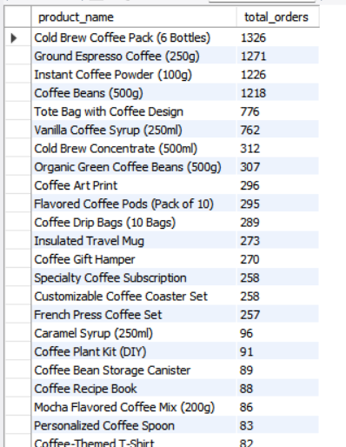
-- Sales Count for Each Product -- How many units of each coffee product have been sold?
SELECT p.product_name,
COUNT(s.sale_id) as total_orders
FROM products as p
LEFT JOIN
sales as s
ON s.product_id = p.product_id
GROUP BY p.product_name
ORDER BY total_orders DESC

Slide 5
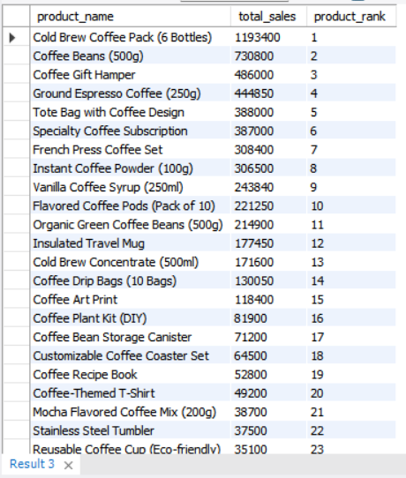
-- Product Popularity and Ranking: -- Which products are the most popular based on sales volume and revenue
WITH ProductSales AS (
SELECT
p.product_name,
SUM(s.total) AS total_sales,
ROW_NUMBER() OVER (ORDER BY SUM(s.total) DESC) AS product_rank
FROM
sales s
JOIN products p ON s.product_id = p.product_id
GROUP BY
p.product_name
)
SELECT
product_name,
total_sales,
product_rank
FROM
ProductSales;

Slide 6
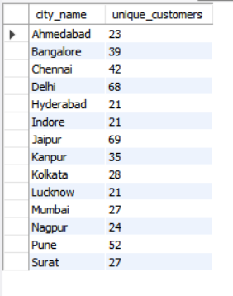
SELECT ct.city_name, COUNT(DISTINCT c.customer_id) as unique_customers FROM city as ct LEFT JOIN customers as c ON c.city_id = ct.city_id JOIN sales as s ON s.customer_id = c.customer_id WHERE s.product_id IN (1, 2, 3, 4, 5, 6, 7, 8, 9, 10, 11, 12, 13, 14) GROUP BY ct.city_name
-- Customer Segmentation by city
-- How many unique customers are there in each city who have purchased coffee products?

Slide 7
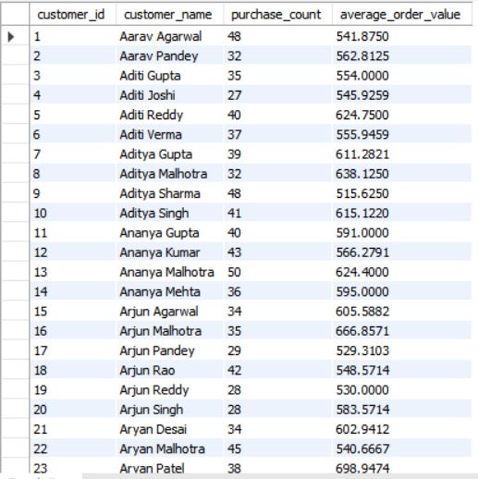
-- segmentation by purchase count
WITH CustomerPurchases AS (
SELECT
c.customer_id,
c.customer_name,
COUNT(*) AS purchase_count,
AVG(s.total) AS average_order_value
FROM
sales s
JOIN customers c ON s.customer_id = c.customer_id
GROUP BY
c.customer_id,
c.customer_name
)
SELECT
customer_id,
customer_name,
purchase_count,
average_order_value
FROM
CustomerPurchases;

Slide 8
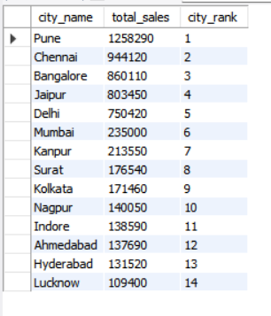
WITH CitySales AS ( SELECT ct.city_name, SUM(s.total) AS total_sales, ROW_NUMBER() OVER (ORDER BY SUM(s.total) DESC) AS city_rank FROM sales s JOIN customers c ON s.customer_id = c.customer_id JOIN city ct ON c.city_id=ct.city_id GROUP BY ct.city_name ) SELECT city_name, total_sales, city_rank FROM CitySales;
-- City-wise Performance and Ranking: -- Which cities have the highest sales volume and revenue

Slide 9
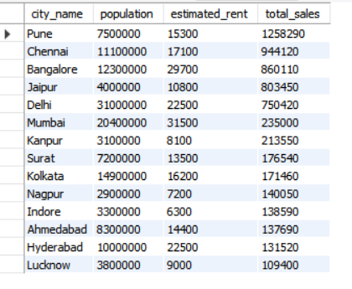
SELECT ct.city_name, ct.population, ct.estimated_rent, SUM(s.total) AS total_sales FROM sales s INNER JOIN customers c ON s.customer_id = c.customer_id INNER JOIN city ct ON c.city_id = ct.city_id GROUP BY ct.city_name, ct.population, ct.estimated_rent ORDER BY total_sales DESC;
-- Population and Economic Factors: -- How does the population and estimated rent of a city correlate with its sales performance

Slide 10
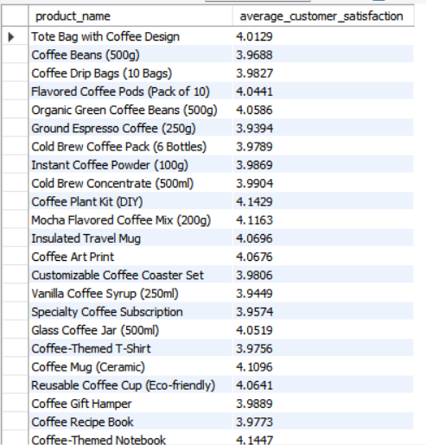
SELECT p.product_name, AVG(s.rating) AS average_customer_satisfaction FROM sales s JOIN products p ON s.product_id = p.product_id GROUP BY p.product_name;
-- Average rating breakdown by -- product:

Slide 11
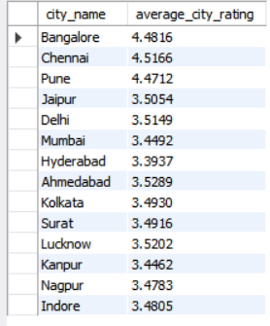
-- Average rating breakdown by -- City:
SELECT
ct.city_name,
AVG(s.rating) AS average_city_rating
FROM
sales s
JOIN customers c ON s.customer_id = c.customer_id
JOIN city ct ON c.city_id=ct.city_id
GROUP BY
ct.city_name;

Slide 12
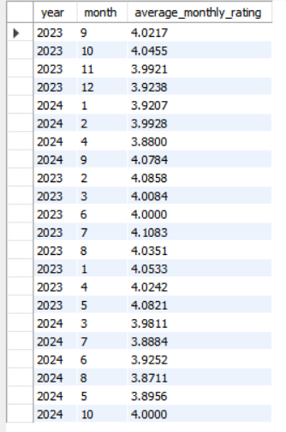
-- Average rating breakdown by -- Time Period:
SELECT
YEAR(sale_date) AS year,
MONTH(sale_date) AS month,
AVG(rating) AS average_monthly_rating
FROM
sales
GROUP BY
YEAR(sale_date),
MONTH(sale_date);

Slide 13
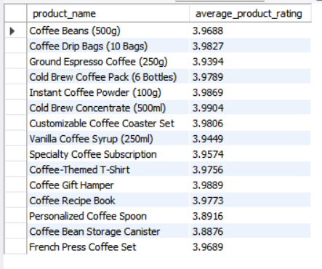
-- Low-rated products or cities: -- Low-rated products:
SELECT
p.product_name,
AVG(s.rating) AS average_product_rating
FROM
sales s
JOIN products p ON s.product_id = p.product_id
GROUP BY
p.product_name
HAVING
AVG(s.rating) < (SELECT AVG(rating) FROM sales);

Slide 14
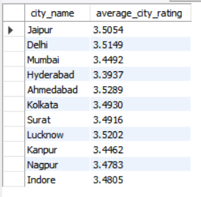
-- Low-rated cities:
SELECT
ct.city_name,
AVG(s.rating) AS average_city_rating
FROM
sales s
JOIN customers c ON s.customer_id = c.customer_id
JOIN city ct ON c.city_id=ct.city_id
GROUP BY
ct.city_name
HAVING
AVG(s.rating) < (SELECT AVG(rating) FROM sales);

Slide 15
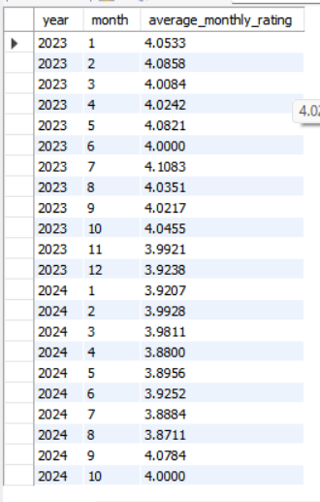
-- Trends in customer satisfaction over time:
SELECT
YEAR(sale_date) AS year,
MONTH(sale_date) AS month,
AVG(rating) AS average_monthly_rating
FROM
sales
GROUP BY
YEAR(sale_date),
MONTH(sale_date)
ORDER BY
YEAR(sale_date),
MONTH(sale_date);

Slide 16
-- Recommendation of Top Three Cities for Coffee Shop Expansion: -- Consider factors like total sales, customer satisfaction, city rank, and estimated rent to make recommendations.
WITH CityPerformance AS (
SELECT
ct.city_name,
SUM(s.total) AS total_sales,
AVG(s.rating) AS average_rating,
ct.city_rank,
ct.estimated_rent
FROM
sales s
JOIN customers c ON s.customer_id = c.customer_id
JOIN city ct ON c.city_id = ct.city_id
GROUP BY
ct.city_name, ct.city_rank, ct.estimated_rent
)

Slide 17
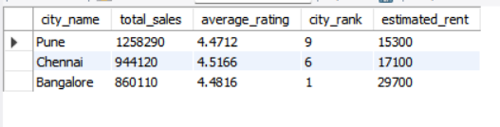
SELECT
city_name,
total_sales,
average_rating,
city_rank,
estimated_rent
FROM
CityPerformance
ORDER BY
total_sales DESC,
average_rating DESC,
city_rank ASC,
estimated_rent ASC
LIMIT 3;

Slide 18
Recommendations
City 1: Pune
1.Estimated rent is very low
2.Total sales are very high
3.The average rating/customer satisfaction is also good
4.City rank is also under 10
City 2: Chennai
1.Estimated rent is reasonably low
2.Total sales are also high
3.The average ratig/customer satisfaction is High
4.City rank is also acceptable
City 3: Bangalore
1.Having 1st city rank
2.Average rating/customer rating is good
3.Total sales are good
4.Estimated rent is also okey for 1st ranked city

