Slide 1

Coffee Shop Chain Expansion Recommendation
This document analyzes sales performance, product popularity, customer segmentation, and city-wise performance to provide recommendations for the top three cities for coffee shop chain expansion. Key factors considered include total sales, customer satisfaction, city rank, and estimated rent. The analysis aims to guide strategic decisions for expanding the coffee shop chain to maximize profitability and customer satisfaction.

Slide 2
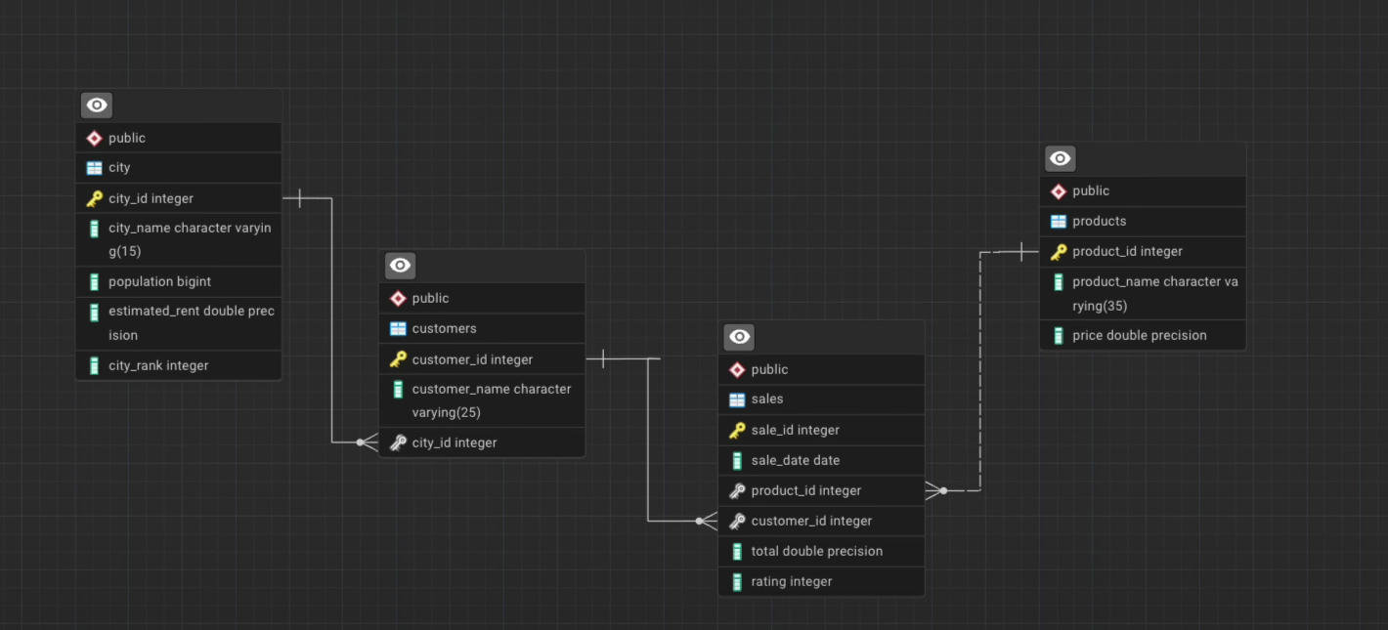
ER DIAGRAM

Slide 3
Overall Sales Performance Analysis
To understand the overall trend of sales over time, the following SQL query was executed:
SELECT YEAR(sale_date) AS year,
MONTH(sale_date) AS month,
SUM(total) AS total_sales
FROM sales
GROUP BY year, month
ORDER BY year, month;
This query groups sales data by year and month to reveal the total sales for each period. Analyzing the results of this query provides insights into the seasonality of sales, identifying peak months and potential slow periods. Understanding these trends is crucial for inventory management, staffing, and marketing strategies. For instance, if sales consistently peak during the winter months, the coffee shop can prepare seasonal offerings and promotions to capitalize on this trend.
Moreover, long-term sales trends can be identified to assess the overall growth of the coffee shop chain. This information is vital for making informed decisions about expansion plans, investment strategies, and overall business development. By tracking sales performance over time, the company can adapt its strategies to changing market conditions and customer preferences, ensuring sustainable growth and profitability.

Slide 4
Product Popularity and Ranking
The most popular products based on sales volume and revenue are identified using the following query:
WITH ProductSales AS (
SELECT
p.product_name,
SUM(s.total) AS total_sales,
ROW_NUMBER() OVER (ORDER BY SUM(s.total) DESC) AS product_rank
FROM
sales s
JOIN products p ON s.product_id = p.product_id
GROUP BY
p.product_name
)
SELECT
product_name,
total_sales,
product_rank
FROM
ProductSales;
This query ranks products based on their total sales, providing a clear understanding of which items are most popular among customers. Knowing the best-selling products allows the coffee shop to optimize its menu, focusing on items that drive the most revenue. This can involve increasing marketing efforts for popular items, ensuring adequate stock levels, and potentially introducing variations or complementary products.
Additionally, identifying less popular products can help the coffee shop make informed decisions about menu adjustments. This could involve reformulating the product, offering it at a discounted price, or removing it from the menu altogether. By regularly analyzing product popularity, the coffee shop can ensure that its menu remains relevant and appealing to customers, maximizing sales and profitability.

Slide 5
Customer Segmentation by City and Purchase Count
To understand customer distribution across different cities, the following query is used:
SELECT ct.city_name,COUNT(DISTINCT c.customer_id) as unique_customers
FROM city as ct
LEFT JOINcustomers as c
ON c.city_id = ct.city_id
JOIN sales as s
ON s.customer_id = c.customer_id
WHERE s.product_id IN (1, 2, 3, 4, 5, 6, 7, 8, 9, 10, 11, 12, 13, 14)
GROUP BY ct.city_name
This query counts the number of unique customers in each city who have purchased coffee products. Understanding customer distribution is crucial for targeting marketing efforts and expansion plans. Cities with a high number of unique customers represent potential markets for new coffee shop locations.
Additionally, customer segmentation by purchase count is performed using the following query:
WITH CustomerPurchases AS (
SELECT
c.customer_id,
c.customer_name,
COUNT(*) AS purchase_count,
AVG(s.total) AS average_order_value
FROM
sales s
JOIN customers c ON s.customer_id = c.customer_id
GROUP BY
c.customer_id,
c.customer_name
)
SELECT
customer_id,
customer_name,
purchase_count,
average_order_value
FROM
CustomerPurchases;
This query analyzes customer purchase behavior, including purchase count and average order value. This information helps identify high-value customers who contribute significantly to the coffee shop's revenue. Targeted marketing campaigns can be designed to retain these customers and encourage repeat purchases.

Slide 6
City-wise Performance and Ranking
The performance of each city is evaluated using the following query:
WITH CitySales AS (
SELECT
ct.city_name,
SUM(s.total) AS total_sales,
ROW_NUMBER() OVER (ORDER BY SUM(s.total) DESC) AS city_rank
FROM
sales s
JOIN customers c ON s.customer_id = c.customer_id
JOIN city ct ON c.city_id=ct.city_id
GROUP BY
ct.city_name
)
SELECT
city_name,
total_sales,
city_rank
FROM
CitySales;
This query ranks cities based on their total sales, providing a clear understanding of which cities are the most profitable. High-performing cities are prime candidates for expansion, as they demonstrate a strong demand for coffee products. Analyzing city-wise performance helps the coffee shop prioritize its expansion efforts, focusing on markets with the greatest potential for success.
By combining city-wise performance data with customer segmentation data, the coffee shop can gain a comprehensive understanding of its customer base in each city. This information can be used to tailor marketing campaigns, optimize product offerings, and improve customer satisfaction, ultimately driving sales and profitability.

Slide 7
Correlation with Population and Economic Factors
The relationship between population, estimated rent, and sales performance is analyzed using the following query:
SELECT
ct.city_name,
ct.population,
ct.estimated_rent,
SUM(s.total) AS total_sales
FROM
sales s
INNER JOIN
customers c ON s.customer_id = c.customer_id
INNER JOIN
city ct ON c.city_id = ct.city_id
GROUP BY
ct.city_name, ct.population, ct.estimated_rent
ORDER BY
total_sales DESC;
This query explores the correlation between city population, estimated rent, and total sales. Understanding these relationships is crucial for making informed decisions about expansion plans. Cities with a large population and reasonable rent may represent attractive markets for new coffee shop locations.
Analyzing economic factors, such as estimated rent, helps assess the affordability of operating a coffee shop in a particular city. High-rent cities may require higher sales volumes to achieve profitability, while low-rent cities may offer more favorable conditions for expansion. By considering both population and economic factors, the coffee shop can identify markets with the greatest potential for long-term success.

Slide 8
Customer Satisfaction Analysis
Customer satisfaction is measured by analyzing average ratings for products, cities, and time periods. The following queries are used:
12
SELECT p.product_name, AVG(s.rating) AS average_customer_satisfaction
FROM sales s
JOIN products p ON s.product_id = p.product_id
GROUP BY p.product_name;
City Rating:
SELECT
ct.city_name,
AVG(s.rating) AS average_city_rating
FROM
sales s
JOIN customers c ON s.customer_id = c.customer_id
JOIN city ct ON c.city_id=ct.city_id
GROUP BY
ct.city_name;
Time Period Rating:
SELECT
YEAR(sale_date) AS year,
MONTH(sale_date) AS month,
AVG(rating) AS average_monthly_rating
FROM
sales
GROUP BY
YEAR(sale_date),
MONTH(sale_date);
This information helps identify areas for improvement, such as product quality or service delivery. Addressing customer concerns and improving satisfaction levels is crucial for retaining customers and driving long-term growth.

Slide 9
These queries provide insights into customer satisfaction levels for different products, cities, and time periods. Low-rated products or cities are identified using the following queries:
Low-Rated Products:
SELECT
p.product_name,
AVG(s.rating) AS average_product_rating
FROM
sales s
JOIN products p ON s.product_id = p.product_id
GROUP BY
p.product_name
HAVING
AVG(s.rating) < (SELECT AVG(rating) FROM sales);
Low-Rated Cities:
SELECT
ct.city_name,
AVG(s.rating) AS average_city_rating
FROM
sales s
JOIN customers c ON s.customer_id = c.customer_id
JOIN city ct ON c.city_id=ct.city_id
GROUP BY
ct.city_name
HAVING
AVG(s.rating) < (SELECT AVG(rating) FROM sales);

Slide 10
Top Three Cities for Expansion and Conclusion
Based on the analysis of total sales, customer satisfaction, city rank, and estimated rent, the top three cities for coffee shop chain expansion are recommended as follows:
Pune: Low estimated rent, high total sales, good customer satisfaction, and a city rank under 10.
Chennai: Reasonably low estimated rent, high total sales, high customer satisfaction, and an acceptable city rank.
Bangalore: First city rank, good customer satisfaction, good total sales, and a reasonable estimated rent for a top-ranked city.
These recommendations are based on a comprehensive analysis of various factors, including sales performance, customer feedback, and economic indicators. By expanding to these cities, the coffee shop chain can capitalize on existing demand, improve customer satisfaction, and achieve sustainable growth. Further investigation and on-the-ground market research are recommended before making final decisions. A COLUMNS block highlighting the different variables for each city would be appropriate here. However, this concludes our analysis and recommendation report.

Slide 11
Thank you
If you are hiring or know someone who is - Let’s Connect !

