Slide 1
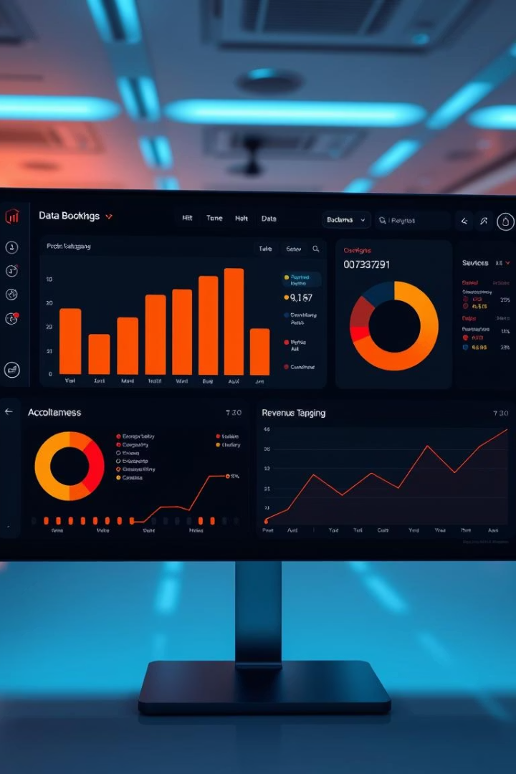
Multi-Service Booking Analysis
An end-to-end project transforming raw booking data into actionable business insights through data cleaning, EDA, and interactive Power BI dashboards.

Slide 2
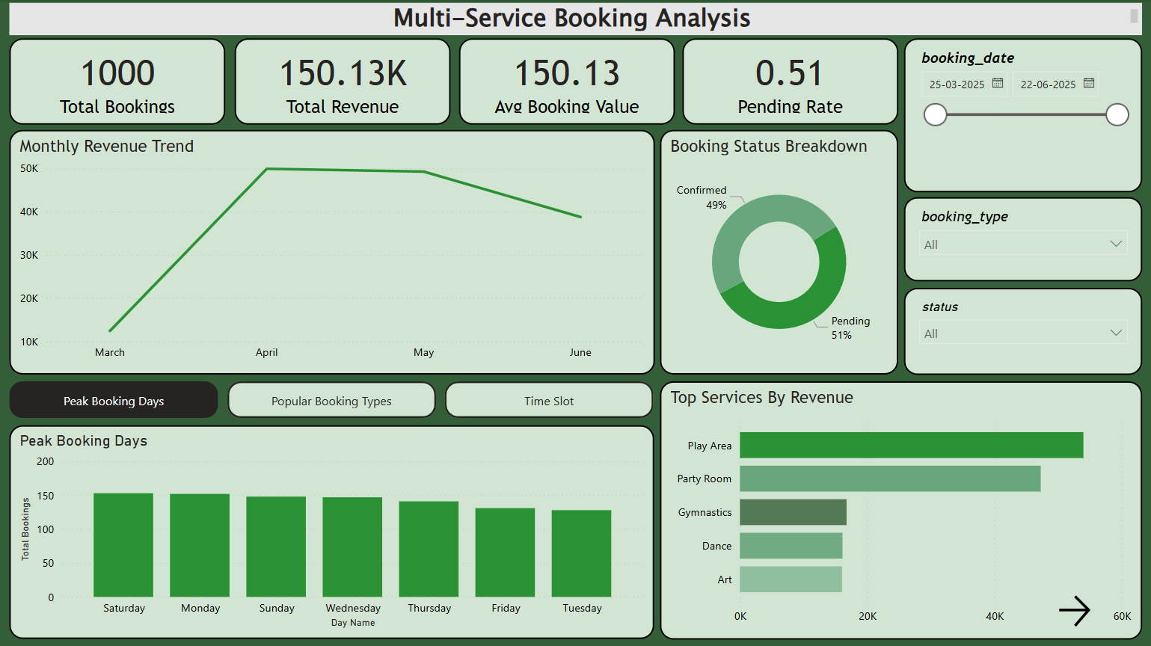
DASHBOARD

Slide 3




Project Objective
Clean Dataset
Interactive Dashboard
Business Insights
Transform raw, inconsistent data into a well-structured format.
Create visually appealing Power BI visualizations.
Deliver actionable recommendations to decision-makers.

Slide 4





Tools & Skills Utilized
SQL (PostgreSQL)
Power BI
Excel
Data cleaning with COALESCE(), removing duplicates, formatting dates.
KPI cards, slicers, drill-throughs, and Bookmarks.
Initial review, pivoting, exploratory data analysis.
Data Storytelling
Converting numbers into actionable management insights.

Slide 5
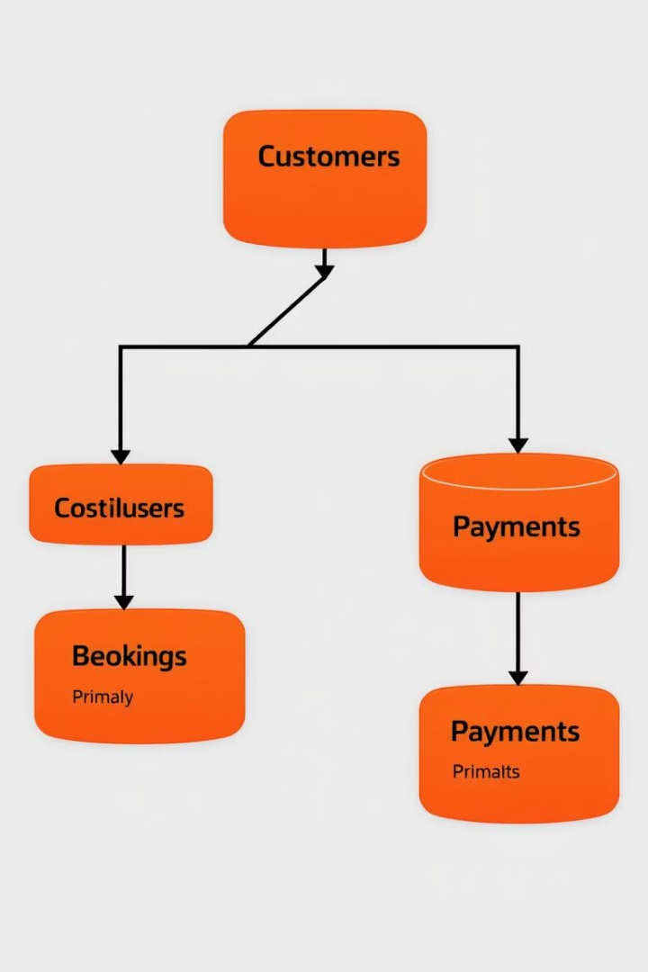
Dataset Overview
Volume
Data Fields
Over 1,000 booking records analyzed.
Booking type, date, price, facility, class type, customer contact, status.
Data Types
Mix of dates, numeric values, and categorical fields.

Slide 6
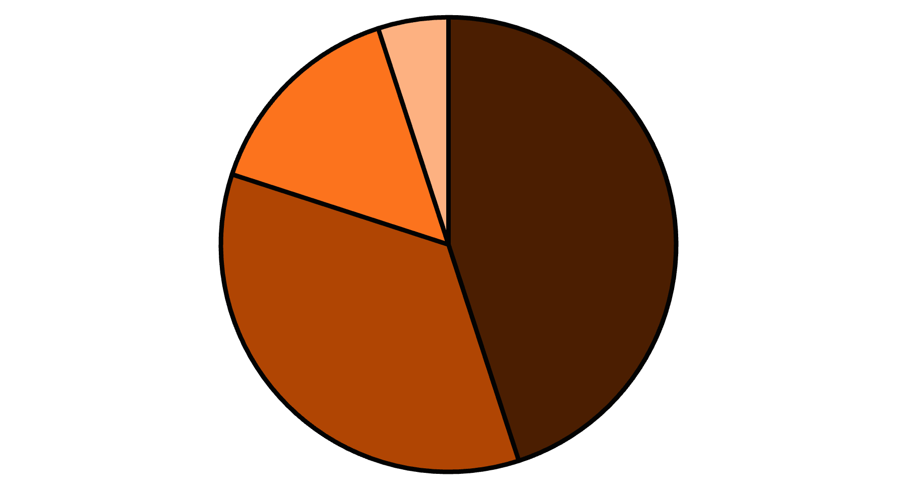
Revenue Drivers
Facility Bookings
Class Bookings
Service Bookings
Other
Facility and Class bookings drive the majority of revenue. Repeat customers contribute significantly, highlighting the importance of retention.

Slide 7
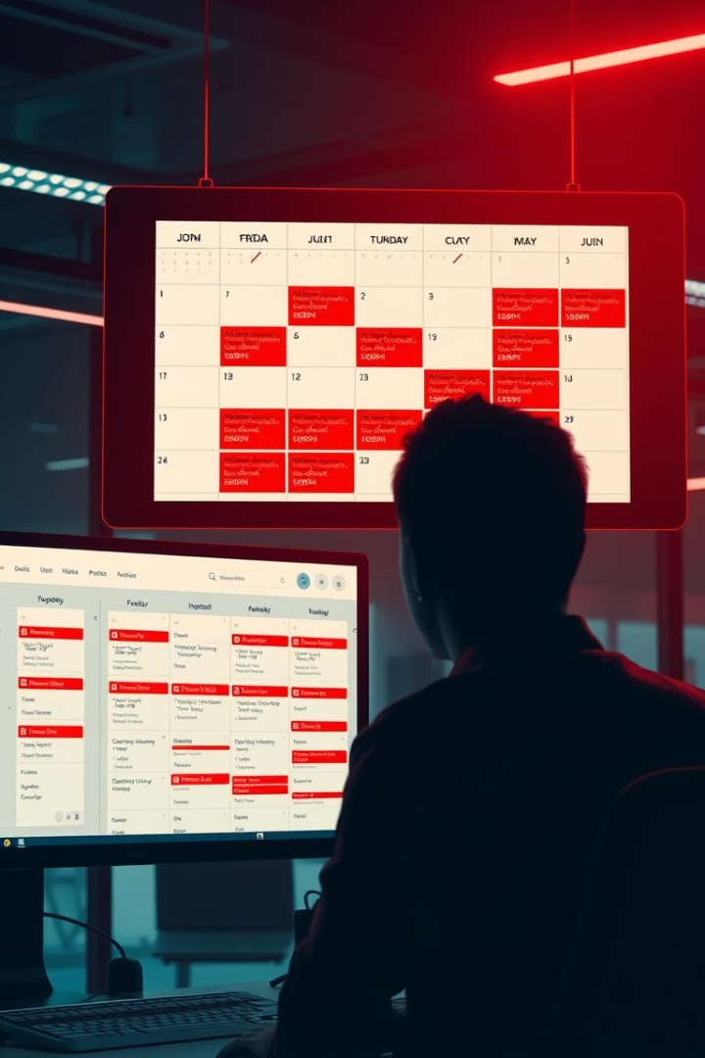



Cancellation Patterns
Peak Hours
Highest cancellation rates during busiest times.
Last-Minute
Many cancellations occur close to booking time.
New Customers
First-time bookers cancel more frequently than regulars.

Slide 8
Performance Variations
Facility Performance
Instructor Impact
Duration Efficiency
Certain facilities consistently outperform others in both bookings and revenue.
Popular instructors show lower cancellation rates and higher rebooking.
Long-duration bookings show lower revenue per minute.
This presents a clear optimization opportunity.
Top performers generate 3x more revenue than bottom performers.
Instructor retention directly correlates with customer retention.

Slide 9





Key Recommendations
Optimize Scheduling
Promote booking during underutilized time slots to reduce cancellations.
Targeted Marketing
Focus efforts on high-retention customer segments.
Loyalty Program
Offer rewards to repeat customers to enhance retention.
Service Evaluation
Investigate low-performing services to improve or replace them.

Slide 10








Future Directions
Predictive Churn Analysis
Customer Segmentation
Identify at-risk bookings before cancellation.
Develop deeper insights into customer behavior patterns.
Pricing Optimization
Automated Reporting
Implement dynamic pricing based on demand patterns.
Create real-time dashboards for ongoing monitoring.

Slide 11






Project Takeaways
Business Impact
Delivered actionable insights for decision-making.
Data Storytelling
Transformed complex data into compelling business narratives.
Technical Skills
Demonstrated proficiency in SQL, Power BI, and Excel.
This project showcased the ability to clean messy real-world data and model it effectively.
Looking for exciting internship and entry-level roles in data analytics!

