Slide 1
FACEBOOK DATA ANALYSIS USING HADOOP AND HIVE
SUBMITED BY
YASWANTH VUPPALAPATI

Slide 2
DESCRIPTION
The user data is collected from Facebook based on their activities.
User behavior, number of likes ,friends ,friends_initiated ,mobile likes, website likes,etc. are stored by the database server.
The dataset is uploaded into Hadoop
Now the table is created in hive and load data into the table from Hadoop
So Hadoop, hive big data concepts used in this project to analyze the data.

Slide 3
Applications used
HDFS: for storing large web-series dataset and provides easier access to hive tables.
Hive: Hive is used to facilitates easy data summarization, ad-hoc queries, and the analysis of web-seires datasets stored in Hadoop compatible file systems.

Slide 4
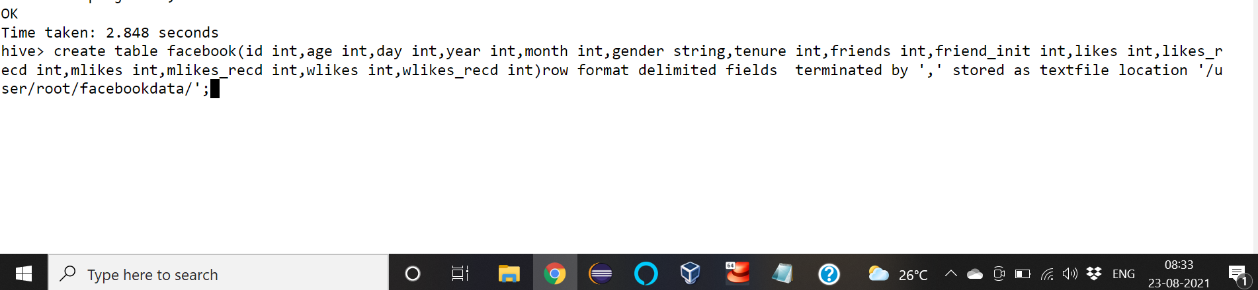
Output with Screenshots
Create database facebookdb;
Use database facebookdb
Now create a table
SYNTAX:

Slide 5
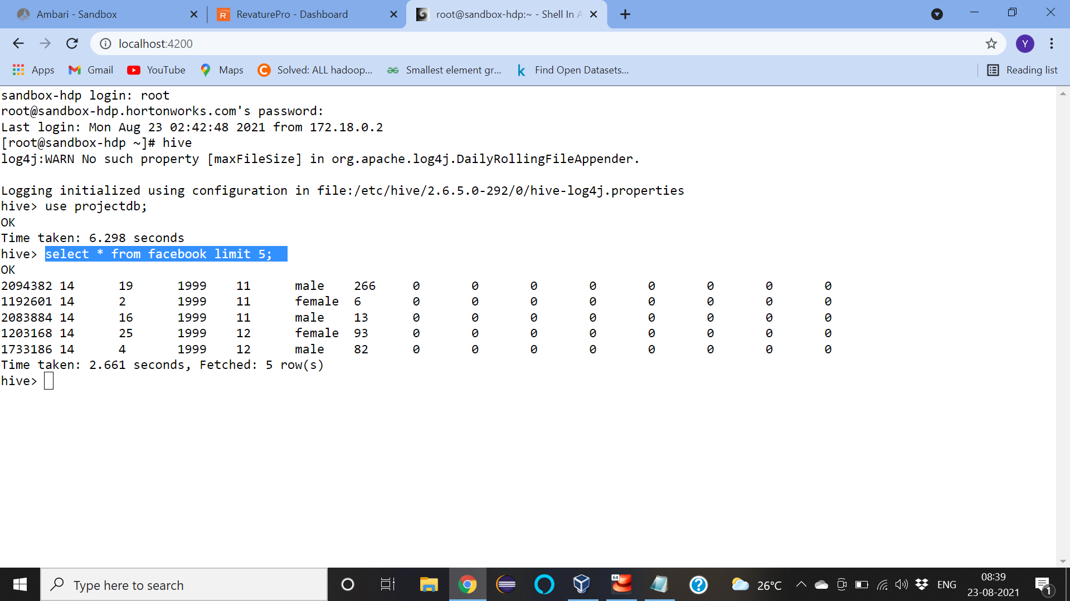
GETTING THE FIRST FIVE RECORDS IN THE DATABASE USING LIMIT:
select * from facebook limit 5;

Slide 6
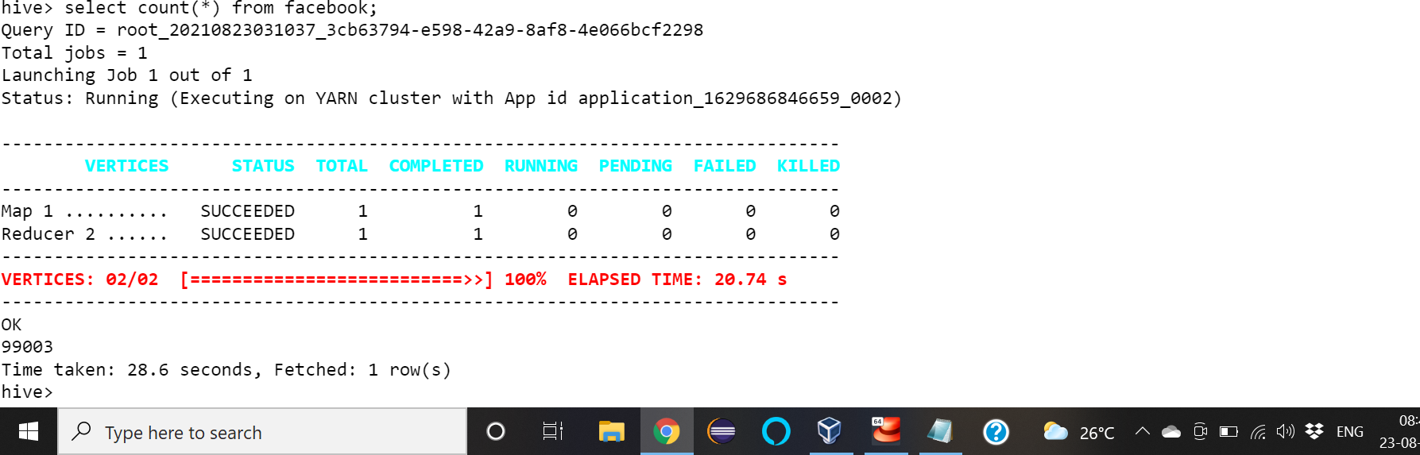
QUERY TO DISPLAY THE TOTAL NUMBER OF USERS IN DATASET:
select count(*) from facebook;

Slide 7

TOTAL NUMBER OF FACEBOOK USERS ABOVE AGE 25:
select count(*) from facebook where age>25;

Slide 8
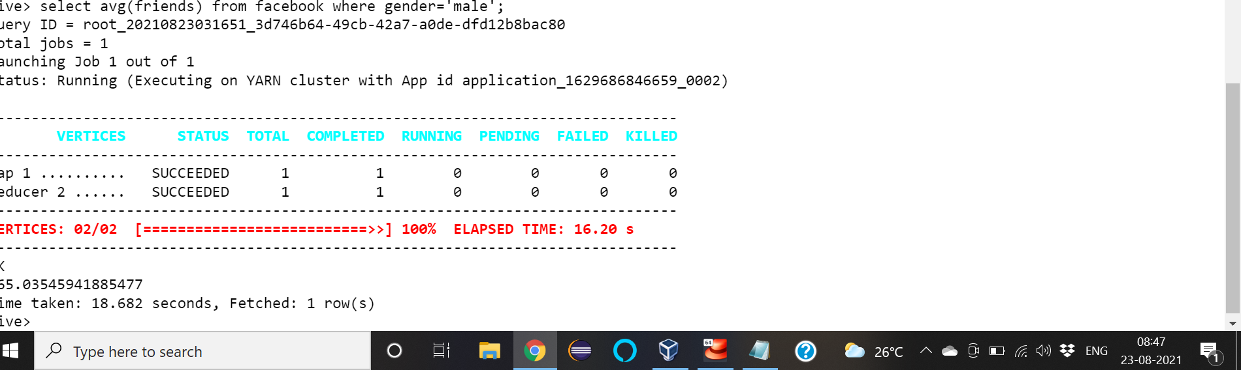
AVERAGE FACEBOOK FRIENDS FOR MALES:
select avg(friends) from facebook where gender='male’;

Slide 9
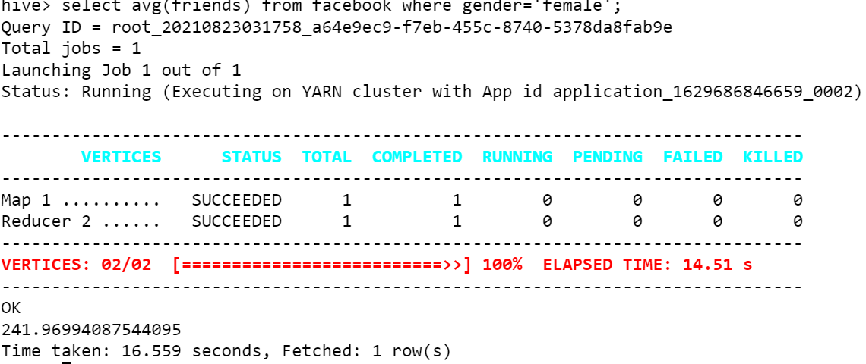
AVERAGE FACEBOOK FRIENDS FOR FEMALES: select avg(friends) from facebook where gender='female';

Slide 10
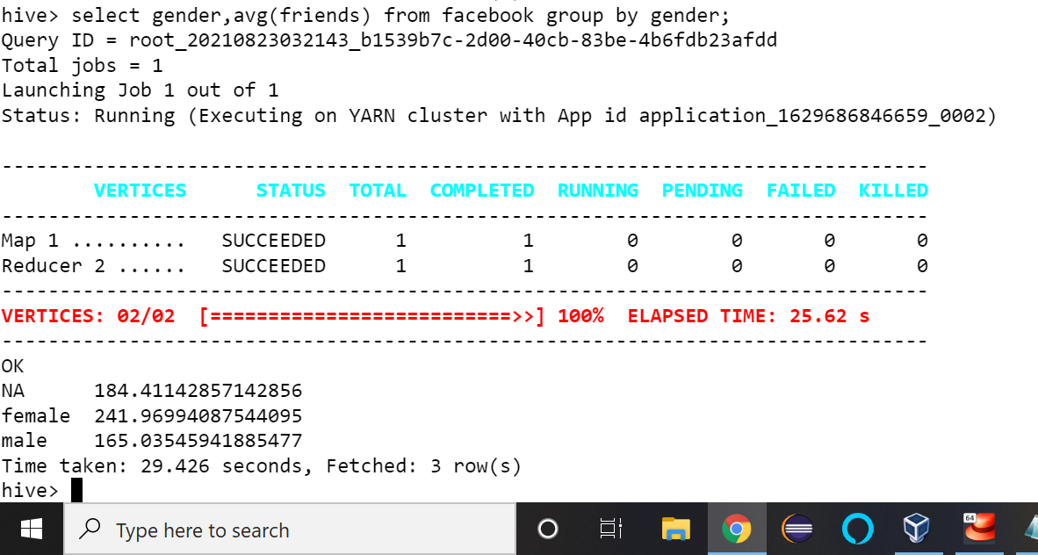
FINDING THE WHICH GENDER HAS MORE FRIENDS:
select gender,avg(friends) from facebook group by gender;

Slide 11
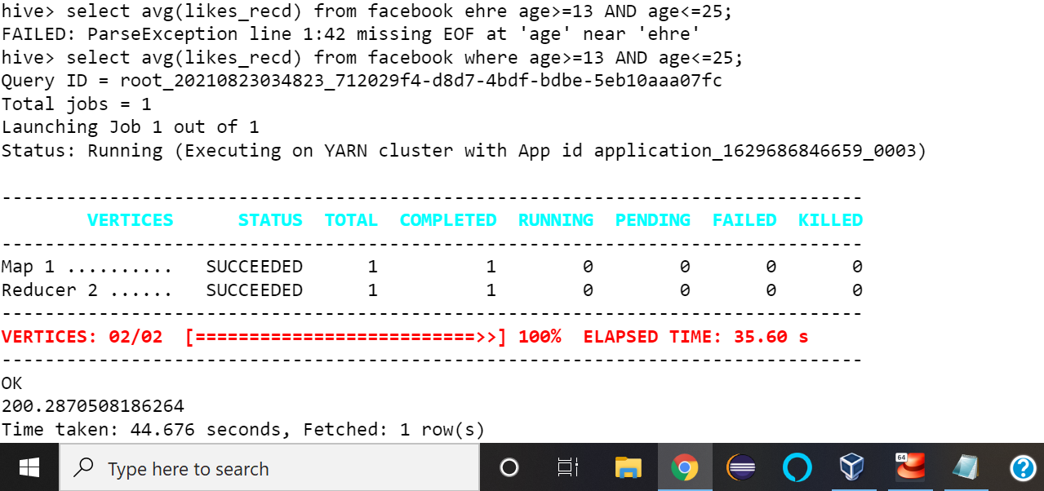
LIKES RECEIVED BY YOUNG PEOPLE:
select avg(likes_recd) from facebook where age>=13 AND age<=25;

Slide 12
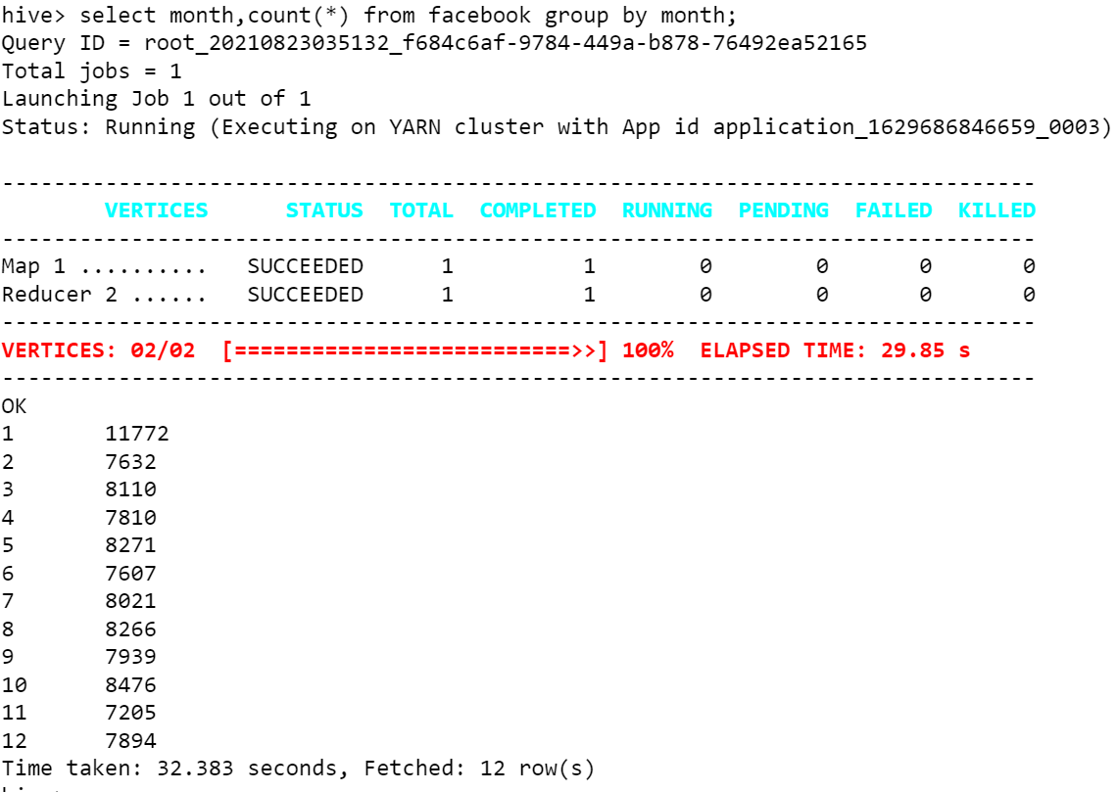
COUNT OF THE USERS BASED ON BIRTHDAY MONTH:
select month,count(*) from facebook group by month;

Slide 13
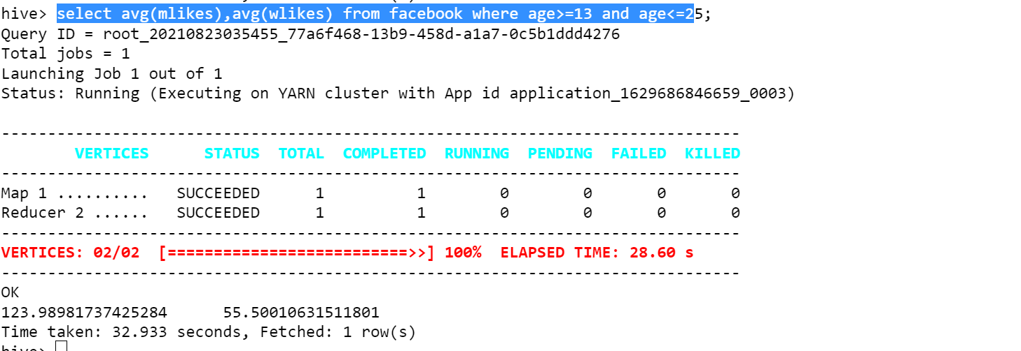
FINDING THE BROWSING OF FACEBOOK IN MOBILES AND COMPUTERS BASED ON LIKES:
select avg(mlikes),avg(wlikes) from facebook where age>=13 and age<=25;

Slide 14
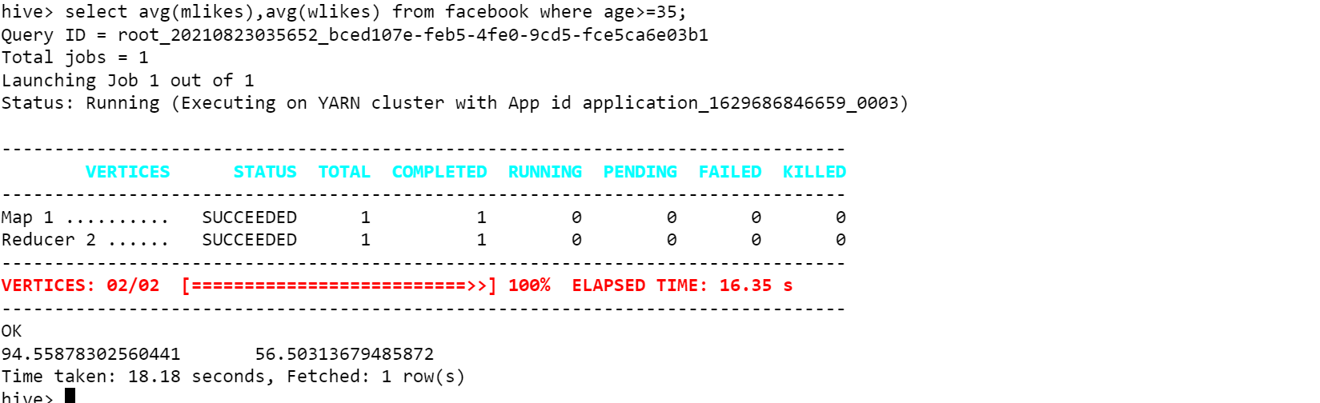
select avg(mlikes),avg(wlikes) from facebook where age>=35;

Slide 15
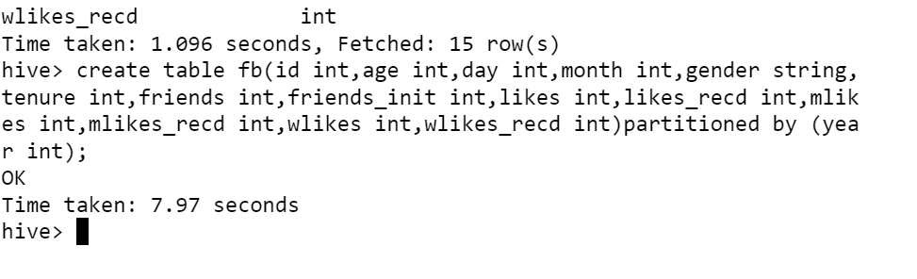
Partition the records based on year:
Step1: create a partition table
hive> create table fb(id int,age int,day int,month int,gender string,tenure int,friends int,friends_init int,likes int,likes_recd int,mlikes int,mlikes_recd int,wlikes int,wlikes_recd int)partitioned by (year int);

Slide 16
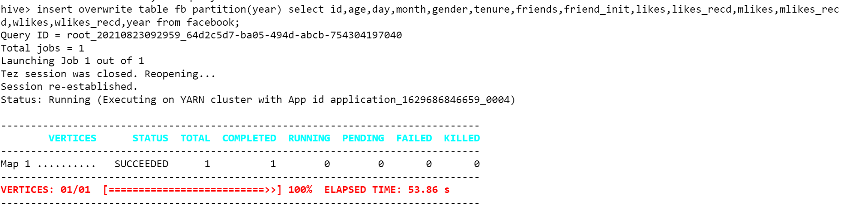
Inserting data into partition table:
insert overwrite table fb partition(year) select id,age,day,year,month,gender,tenure,friends,friend_init,likes,likes_recd,mlikes,mlikes_recd,wlikes,wlikes_recd,year from facebook;

Slide 17
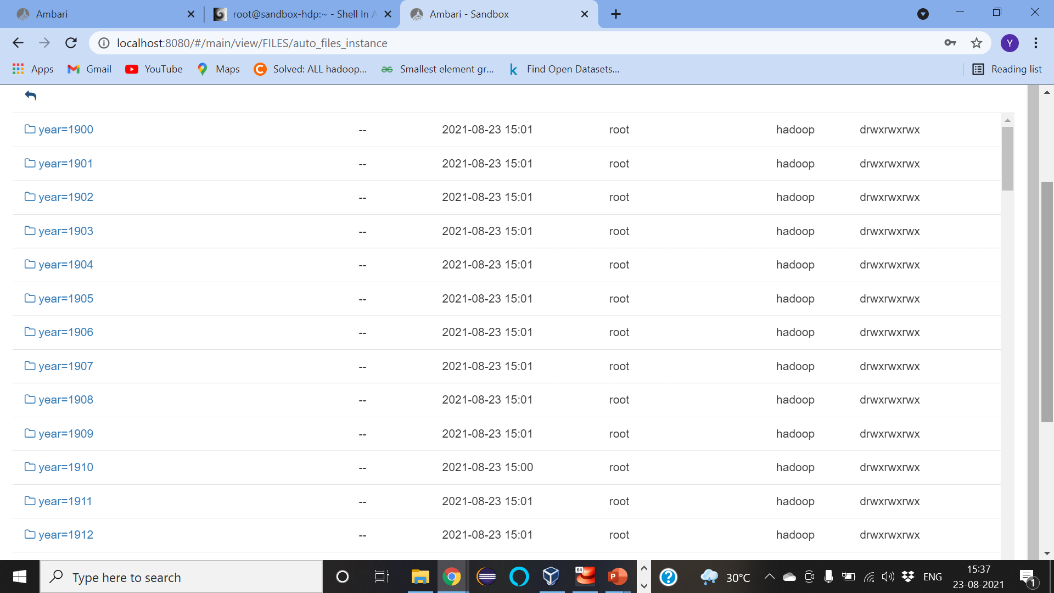
Partition table in hive warehouse:

Slide 18
THANK YOU

