Slide 1
FACEBOOK DATA ANALYSIS USING HADOOP AND HIVE
SUBMITED BY
YASWANTH VUPPALAPATI

Slide 2
DESCRIPTION
The user data is collected from Facebook based on their activities.
User behavior, number of likes,friends etc. are stored by the database server.
So Hadoop, hive big data concepts used in this project to analyze the data.

Slide 3
Applications used
HDFS: for storing large web-series dataset and provides easier access to hive tables.
Hive: Hive is used to facilitates easy data summarization, ad-hoc queries, and the analysis of web-seires datasets stored in Hadoop compatible file systems.

Slide 4
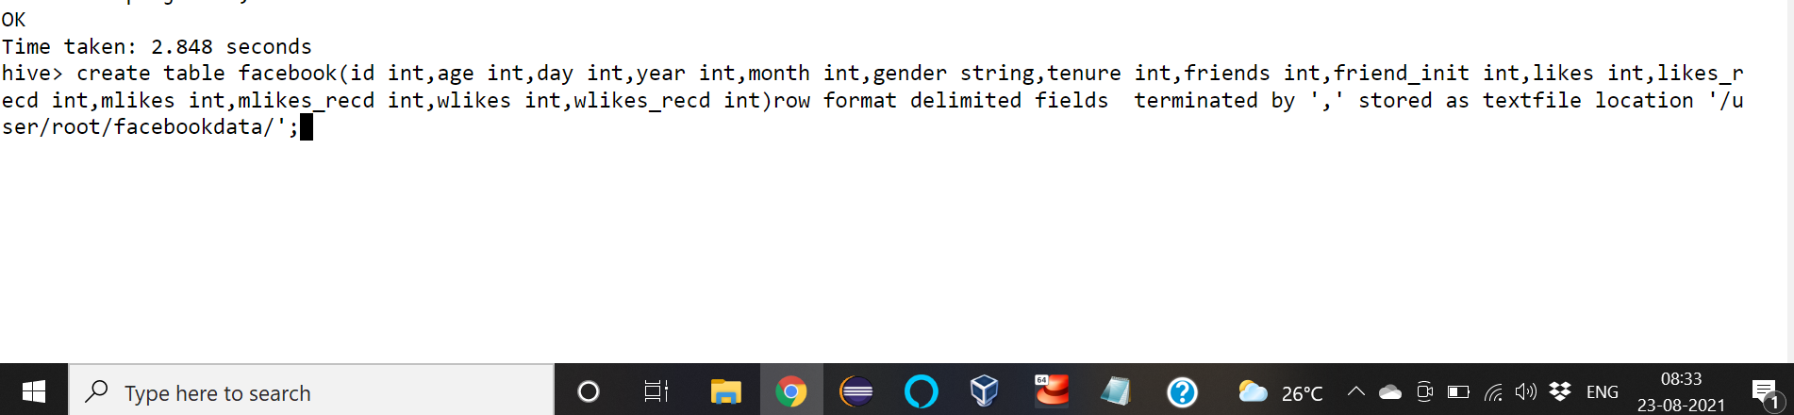
Output with Screenshots
Create database facebookdb;
Use database facebookdb
Now create a table
SYNTAX:

Slide 5
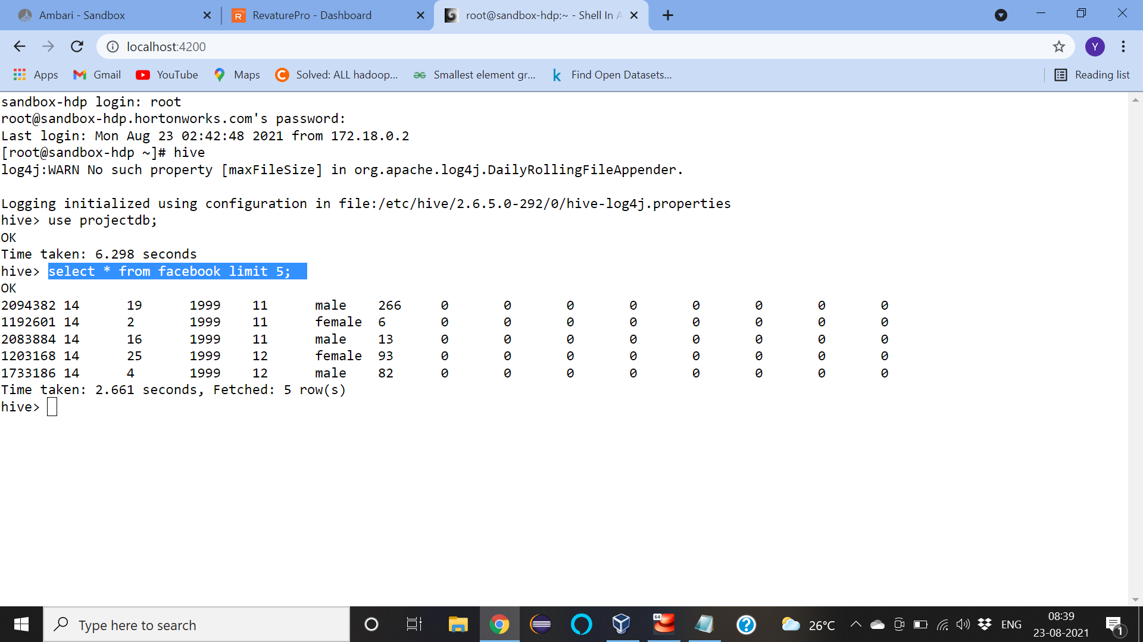
GETTING THE FIRST FIVE RECORDS IN THE DATABASE USING LIMIT:
select * from facebook limit 5;

Slide 6
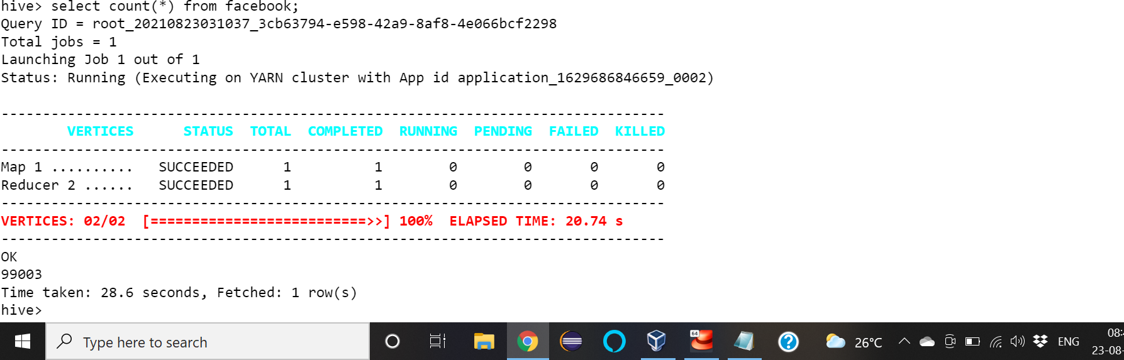
select count(*) from facebook;

Slide 7

select count(*) from facebook where age>25;

Slide 8
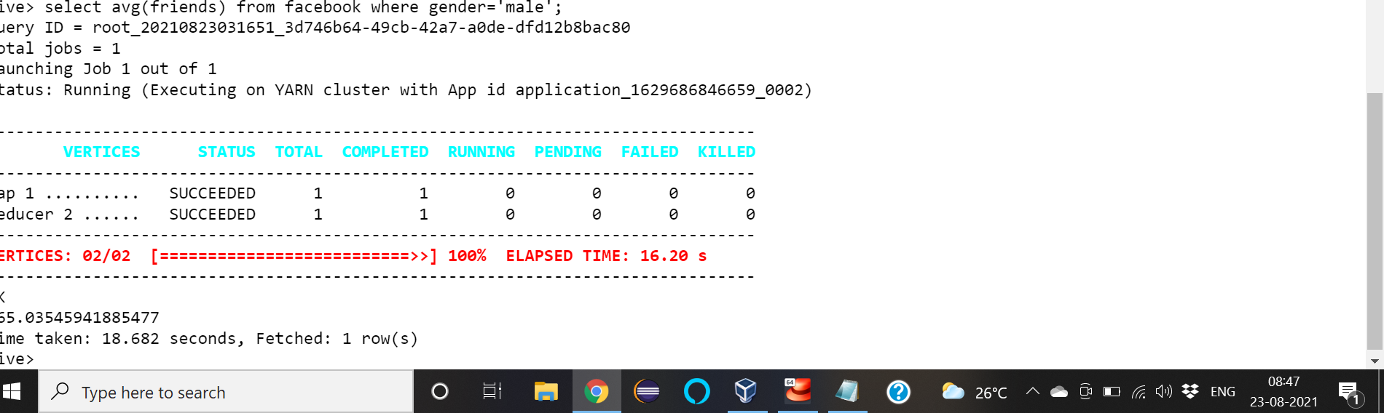
select avg(friends) from facebook where gender='male’;

Slide 9
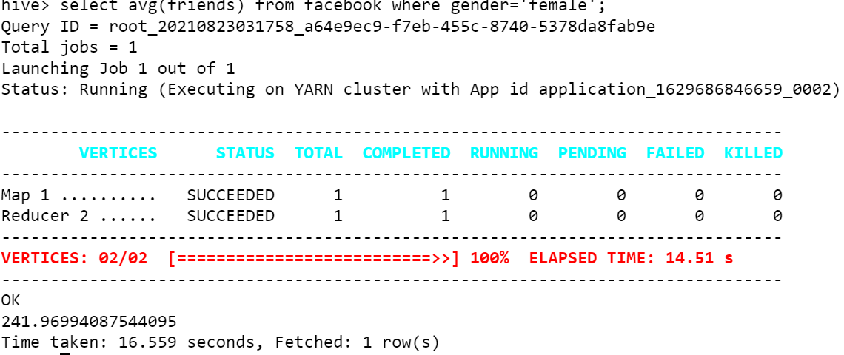
select avg(friends) from facebook where gender='female';

Slide 10
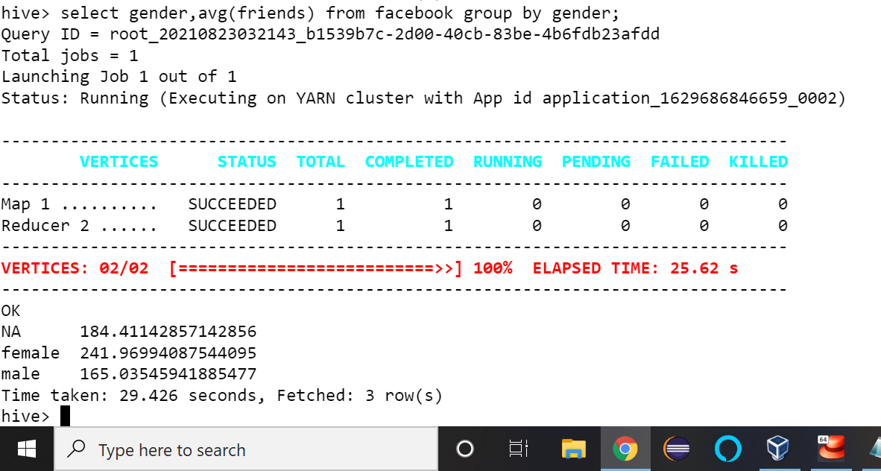
select gender,avg(friends) from facebook group by gender;

Slide 11
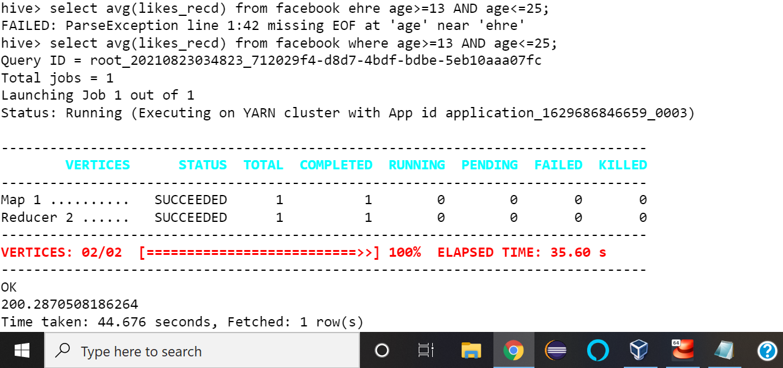
select avg(likes_recd) from facebook where age>=13 AND age<=25;

Slide 12
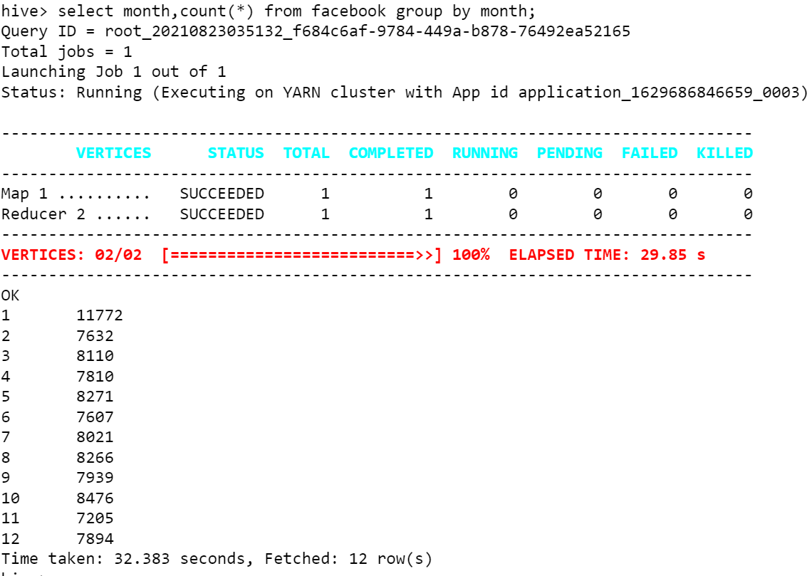
select month,count(*) from facebook group by month;

Slide 13
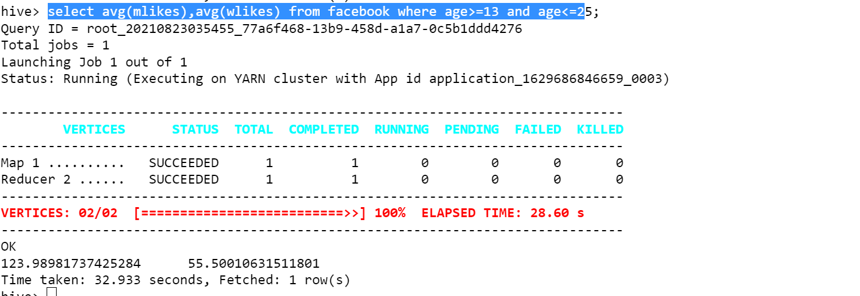
select avg(mlikes),avg(wlikes) from facebook where age>=13 and age<=25;

Slide 14
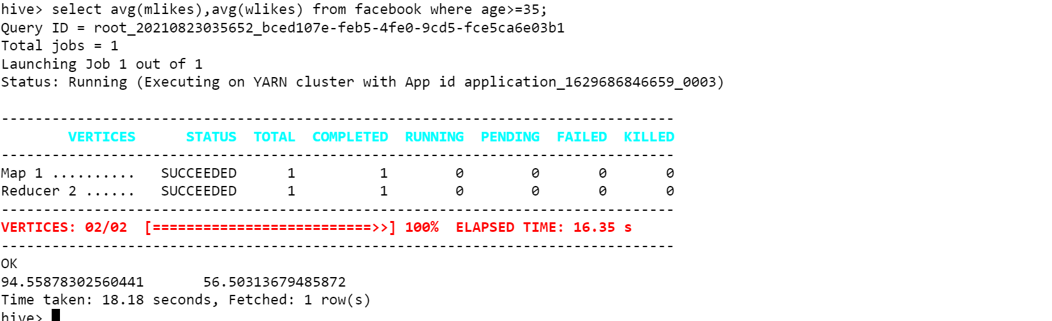
select avg(mlikes),avg(wlikes) from facebook where age>=35;

Slide 15
THANK YOU

