Slide 1
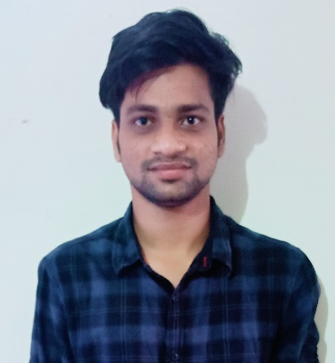

YASWANTH KUMAR DATTI
Analyst/Software Engineer
Gayatri vidya parishad school of Engineering , Mechanical Engineering : 2016- 2020
Bangalore
Skills
TECHNICAL | Core Java Spring Boot, Advance Java.
DATABASE | SQL database – Oracle, MySQL Postgre SQL, MSSQL
UI Tech | HTML 5 & CSS 3,JavaScript and Bootstrap, Angular 4, TypeScript
Tools | Postman, STS, Visual studio Code,Git, Squirrel client
Add On skills | Basic knowledge of AWS servers, Databases, Aws Tools
Additional Skills: | Project Management, Team Building, Project Management, Team Leader, Strategic/Tactical Planning, Business Analysis and Development, Excellent Communication and Interpretation skills
Yaswanth.kumar-d@capgemini.com
+91 7036128907
A4
Working Experience In Projects
Worked on Spring Boot Development Project , On creating projects For GET,POST,DELETE, UPDATE using Rest Api Services.
Worked on MsSql Database , PostGre Sql Database
Worked on creation of Test Cases using Mockito And Wire Mock For component Test Cases
Worked on Feign Client Implementation
Hands on experience in developing web pages using HTML5, CSS3, JavaScript, TypeScript
Hands on experience in creating microservices with Spring boot, Post Man, Swagger API
Certified By Microsoft Azure
Certified in Agile
Certified Level 1 & 2 java Entry Developer
JAVA PROJECT:-
Bus Reservation System
(Based on Java Spring boot and Angular) (Front-end-Angular, Back-end Spring boot):- A bus reservation system is a mobile or web software solution

