Slide 1



EcoLoop
AI-Assisted E-Waste Reuse & Recovery Marketplace
AI-powered digital platform for sustainable electronics diagnostics, recovery, and circular recycling.
TEAM MEMBERS
23261A3259 — V Sushan Reddy
23261A3260 — Manoj
23261A3261 — V Nohith Kumar
23261A3262 — V Aditya
23261A3263 — Y Akshitha
23261A3264 — Yaksha V
23261A3265 — Y Kavya
Reuse
Repair
Recycle
Notes:
Introduce EcoCycle as a proposed AI-powered marketplace for sustainable waste management. The project connects waste generators with collection agents and recycling businesses through one coordinated platform.

Slide 2
01 · PLATFORM CONCEPT
About EcoLoop
PROBLEM
SOLUTION
E-waste is hazardous, complex, and difficult to route responsibly.
One intelligent marketplace coordinates circular recovery.
Electronics contain valuable parts yet pose severe hazards (Lithium, Lead, Mercury). Users lack guidance on repairability, salvage, and safe recycling.
EcoLoop integrates MobileNetV2 vision for component detection, a deterministic decision engine, safety interlocks, and verified EcoImpact guidance.
HOW THE PROJECT WORKS
User uploads device photo and specifies basic condition.
MobileNetV2 AI detects device category and key internal/external components.
Interactive diagnostic questions evaluate power, screen, and battery safety.
Deterministic engine recommends optimal recovery route (Reuse, Repair, Refurbish, Parts, or Recycle).
Listed on marketplace connecting residents with verified repairers and certified recyclers.
Notes:
Frame the challenge first: recyclable material is often discarded because access to suitable recyclers, fair pricing, and collection is unclear. EcoCycle is a digital marketplace that connects waste generators, collection agents, and recycling businesses, and helps track waste and environmental impact.

Slide 3
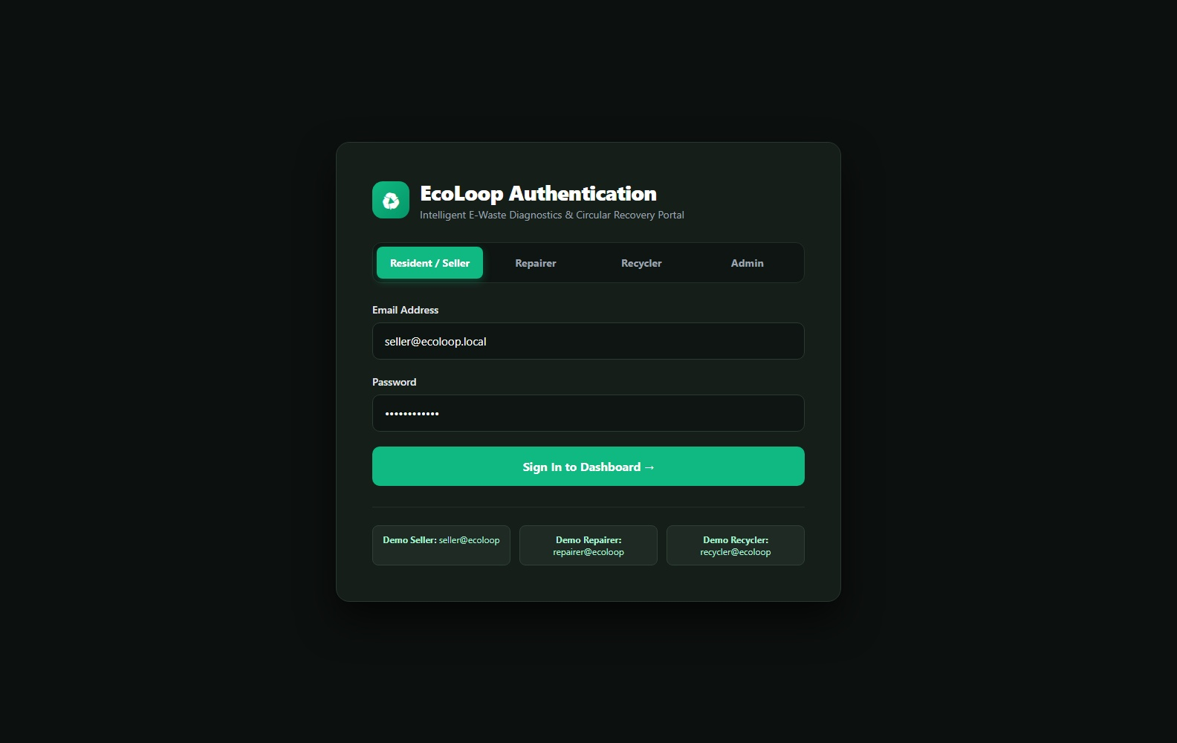
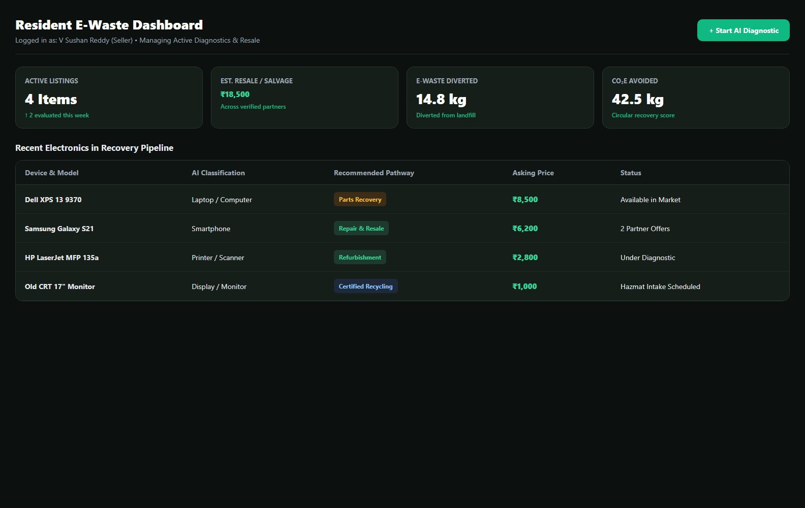
MODULE 1 · ACCESS AND USER OVERVIEW
Access and User Overview
User Authentication / Role-Based Access
Member Dashboard / Overview
Secure registration, login, and dedicated role portals for Residents/Sellers, Repairers, Recyclers, and Admins.
Active listings, residual valuations in ₹, recovery status tracking, and positive environmental impact footprint.
Entry and overview screens for managing a member's circular e-waste recovery journey. EcoLoop — E-Waste Marketplace.
Notes:
Walk through sign-in and the member dashboard, showing how a member sees their waste diverted, eco points, and pickup connections.

Slide 4
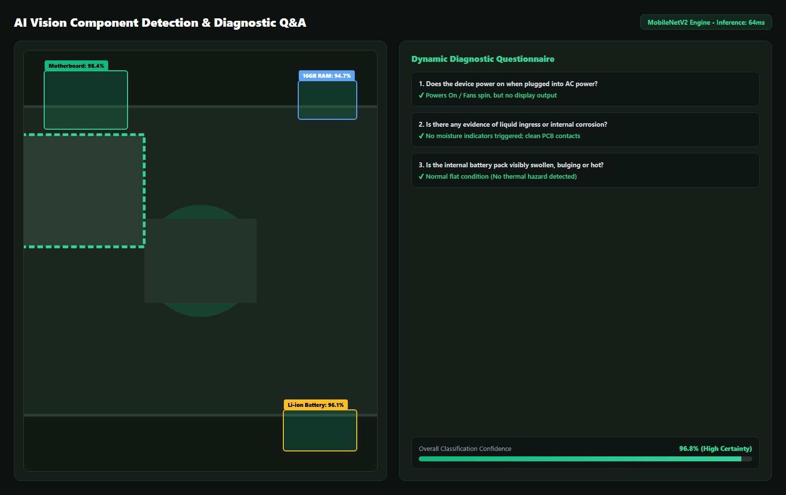
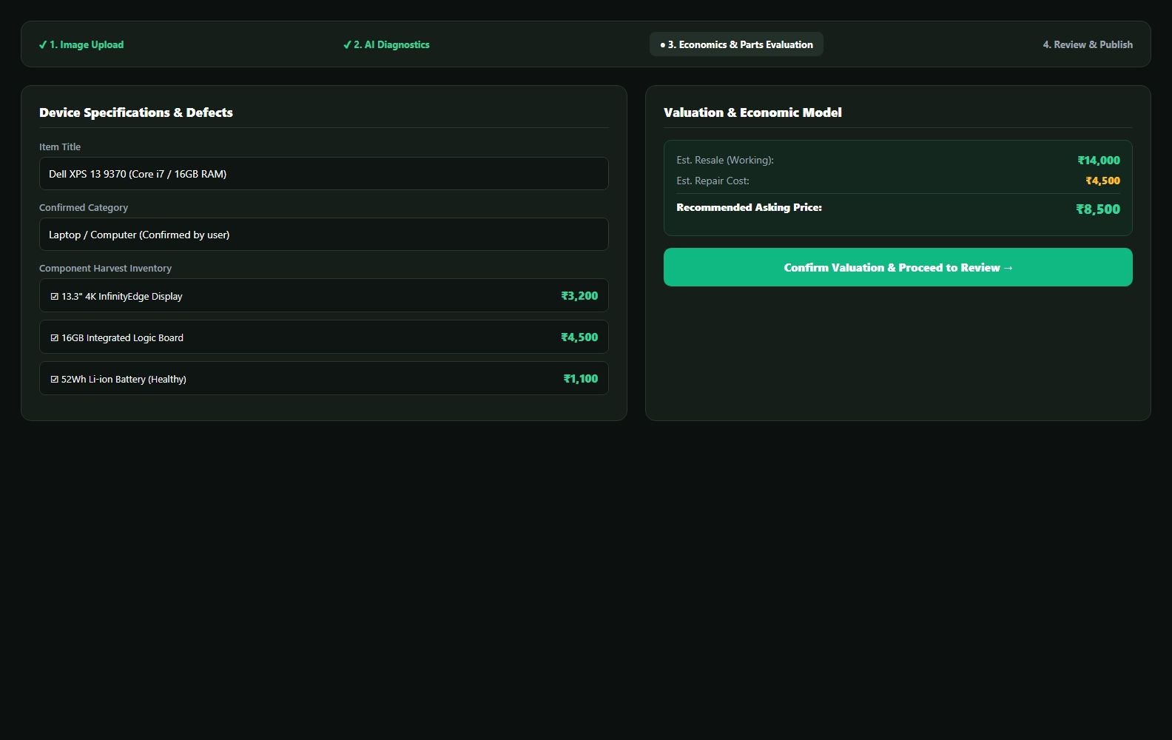
MODULE 2 · AI COMPONENT DETECTION & LISTING WIZARD
AI Component Detection & Listing Wizard
AI Vision & Component Diagnostics
Multi-Step Listing Creation Wizard
MobileNetV2 deep learning classifier, automated component recognition, and interactive diagnostic Q&A.
Physical defect evaluation, parts breakdown, asking price in ₹, economic repair estimation, and instant review.
Members evaluate electronics with AI and publish verified listings. EcoLoop — E-Waste Marketplace.
Notes:
Show how members manage their material listings and compare recycling partners before requesting a pickup.

Slide 5
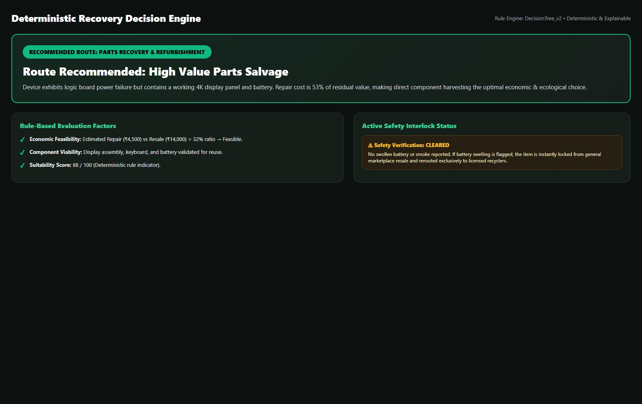
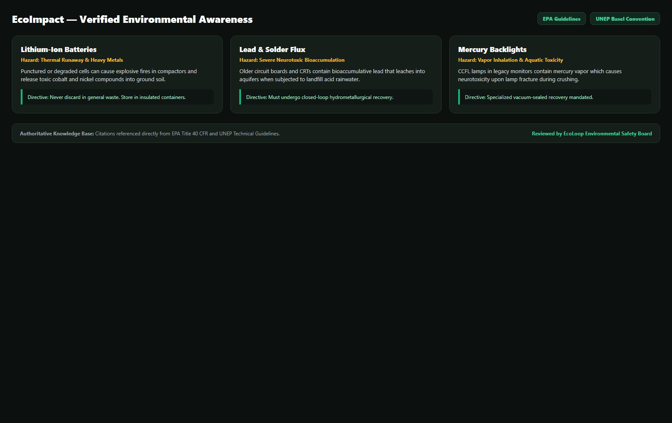
MODULE 3 · DETERMINISTIC RECOVERY ENGINE & ECOIMPACT
Deterministic Recovery Engine & EcoImpact Hub
EcoImpact Environmental Knowledge Hub
Recovery Decision Engine & Safety Interlock
Verified toxic substance hazards (Lithium, Lead, Mercury, BFRs), EPA/UNEP citations, and safe handling directives.
Multi-tier economic feasibility rules, residual value evaluation, and immediate lockdown for hazardous batteries.
Deterministic recovery routing paired with verified environmental awareness. EcoLoop — E-Waste Marketplace.
Notes:
Track collection progress through pickup timelines, then connect completed activity to rewards and impact.

Slide 6
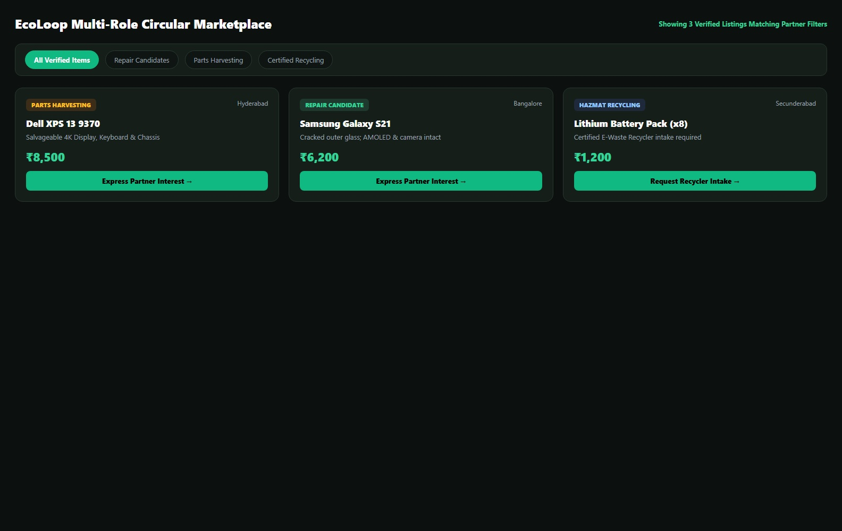
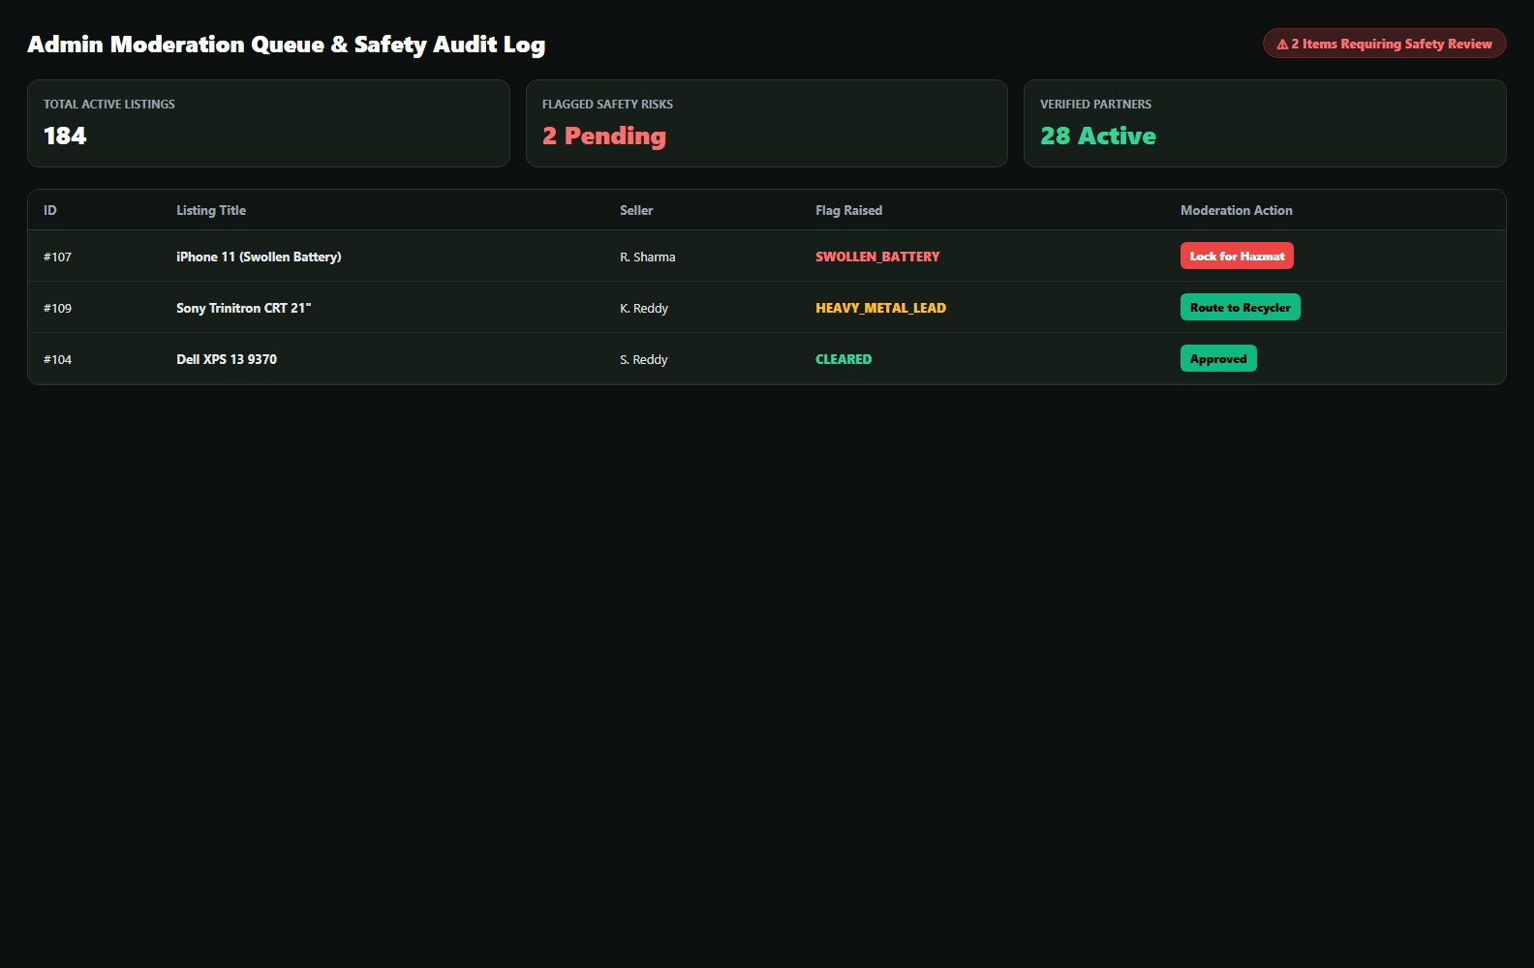
MODULE 4 · PARTNER OPERATIONS AND ADMINISTRATION
Partner Operations and Administration
Admin Dashboard & Moderation Queue
Repairer & Recycler Marketplace
Moderation queue for flagged safety risks, status change audit trail, user governance, and visual analytics.
Filter listings by route (Repair Candidates, Parts Harvesting, Certified Recycling), inspect component specs, and express partner interest.
Partner workflows and administrator governance for circular operations. EcoLoop — E-Waste Marketplace.
Notes:
Close with the partner and administrator views that keep marketplace operations running.

Slide 7
ECOLOOP
Thank You
Turning electronic waste into value, one recovery at a time.

