Slide 1
House Rental Management System
Team ID: LTVIP2025TMID54144
Team Size: 4
Team Leader: S Krishna Priya
Team Member: Setty Sridivya
Team Member: Shaik Mustaq
Team Member: Yaswanth Angajala

Slide 2
Introduction
HouseHunt is a full-stack web application that enables smooth rental property management by connecting renters, owners, and admins via one digital platform.

Slide 3
Project Objective
1. Let owners list/manage properties.
2. Help renters discover and book.
3. Allow admins to approve/verify users.
4. Ensure secure, scalable, responsive UI.

Slide 4
Key Features
• Admin/Owner/Renter roles
• Property listing with images
• Filter-based search
• Booking system
• JWT Authentication

Slide 5
Technological Stack
Frontend: React.js, Bootstrap, MUI
Backend: Node.js, Express.js
Database: MongoDB
Security: JWT, Multer
Communication: Axios

Slide 6
System Architecture
Frontend (React) → Axios → Express.js (Backend) → MongoDB
File uploads handled using Multer

Slide 7
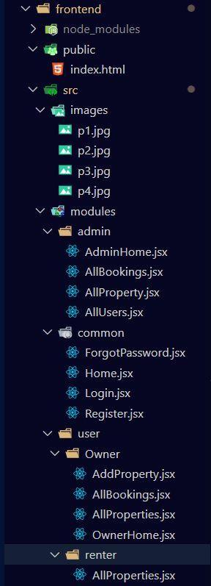
Frontend Folder Structure

Slide 8
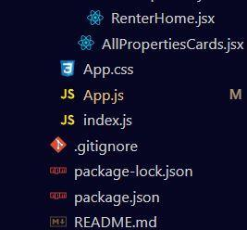
App.js & Component Files

Slide 9
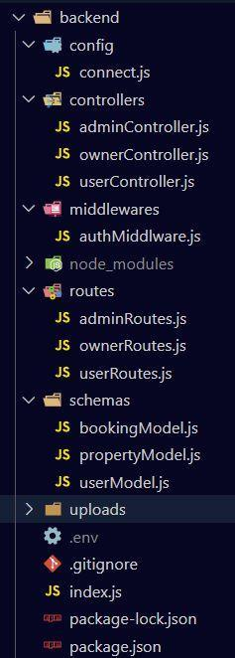
Backend Folder Structure

Slide 10
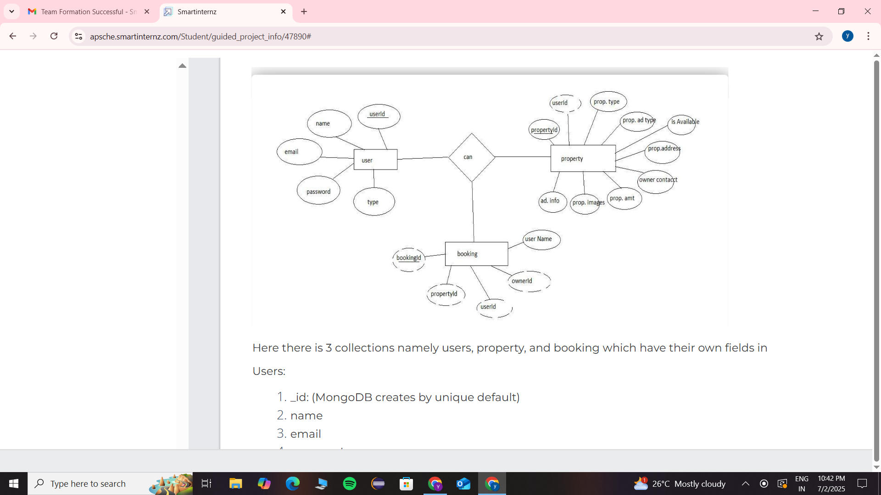
ER Diagram

