Slide 1
● LIVE SYSTEM ACTIVE | SMART CITY MISSION INITIATIVE
URBAN TRACKER & ROADGUARD AI
Autonomous Satellite & AI-Powered Road Hazard Surveillance and Civic Grievance Automation for Smart Cities
🛰️ SUB-METER SATELLITE OPTICS
🕳️ REAL-TIME POTHOLE DETECTION
🗑️ ROADSIDE GARBAGE SURVEILLANCE
📝 INSTANT CIVIC GRIEVANCE DISPATCH
TARGET CIVIC AUTHORITIES & INFRASTRUCTURE AGENCIES:
• Municipal Corporations & Urban Local Bodies (ULBs) | • Smart Cities Mission Command Centers (ICCC)
• State Roads & Buildings Dept (PWD) | • National Highways Authority of India (NHAI) | • PMGSY Rural Roads
URBAN TRACKER & ROADGUARD AI | MUNICIPAL CIVIC INTELLIGENCE DECK | CONFIDENTIAL
01 / 10

Slide 2
🚨 PROBLEM STATEMENT — THE ROAD CRISIS
The Urgent Crisis in Indian Urban & Rural Road Infrastructure
3,500+ Fatalities
ANNUAL POTHOLE DEATHS IN INDIA
Potholes and unmaintained road surfaces cause thousands of road fatalities and severe vehicle suspension damage every year.
62M Tonnes Waste
ROADSIDE GARBAGE & DRAIN CLUMPING
Unauthorized waste dumping along village tracks and urban corridors blocks stormwater drainage, triggering urban flash floods.
14 - 28 Days Lag
MANUAL REPORTING & BUREAUCRACY
Manual surveys are infrequent, citizen complaint portals lack exact coordinates, and jurisdictional finger-pointing delays repairs.
CRITICAL BOTTLENECKS OF CONVENTIONAL CIVIC ROAD AUDITING:
❌ Prohibitive Field Patrolling Costs: Cities cannot physically station inspection vehicles on every ward and village track daily.
❌ Absence of Verifiable Optical Proof: Most citizen complaints provide vague landmarks with zero sub-meter satellite validation.
❌ Fragmented Jurisdiction Confusion: Citizens don't know whether NHAI, PWD, or Municipal Corporation owns a damaged corridor.
URBAN TRACKER & ROADGUARD AI | MUNICIPAL CIVIC INTELLIGENCE DECK | CONFIDENTIAL
02 / 10

Slide 3
💡 SYSTEM ARCHITECTURE & WORKFLOW
Urban Tracker: Autonomous End-to-End Civic Surveillance Pipeline
1. 3D Digital Twin
CESIUMJS GLOBAL GLOBE
Renders photorealistic geospatial terrain with sub-second street navigation across all Indian administrative boundaries.
CORE CAPABILITY:
2. Satellite Multi-Sensor
SUB-METER OPTICAL PASS
Pulls real-time sub-meter optical imagery and 1h/3h orbital loops from ESRI, ISRO INSAT-3D, and NOAA constellations.
CORE CAPABILITY:
3. YOLOv8 AI Vision
DUAL-HAZARD CLASSIFIER
Ultralytics YOLOv8 inference identifies asphalt potholes, alligator cracks, edge breaks, and roadside garbage heaps.
CORE CAPABILITY:
4. Automated Dispatch
CIVIC GRIEVANCE ENGINE
Instantly lodges official tracking tickets, assigns responsible authority (NHAI/PWD/ULB), and calculates repair priority.
CORE CAPABILITY:
URBAN TRACKER & ROADGUARD AI | MUNICIPAL CIVIC INTELLIGENCE DECK | CONFIDENTIAL
03 / 10

Slide 4
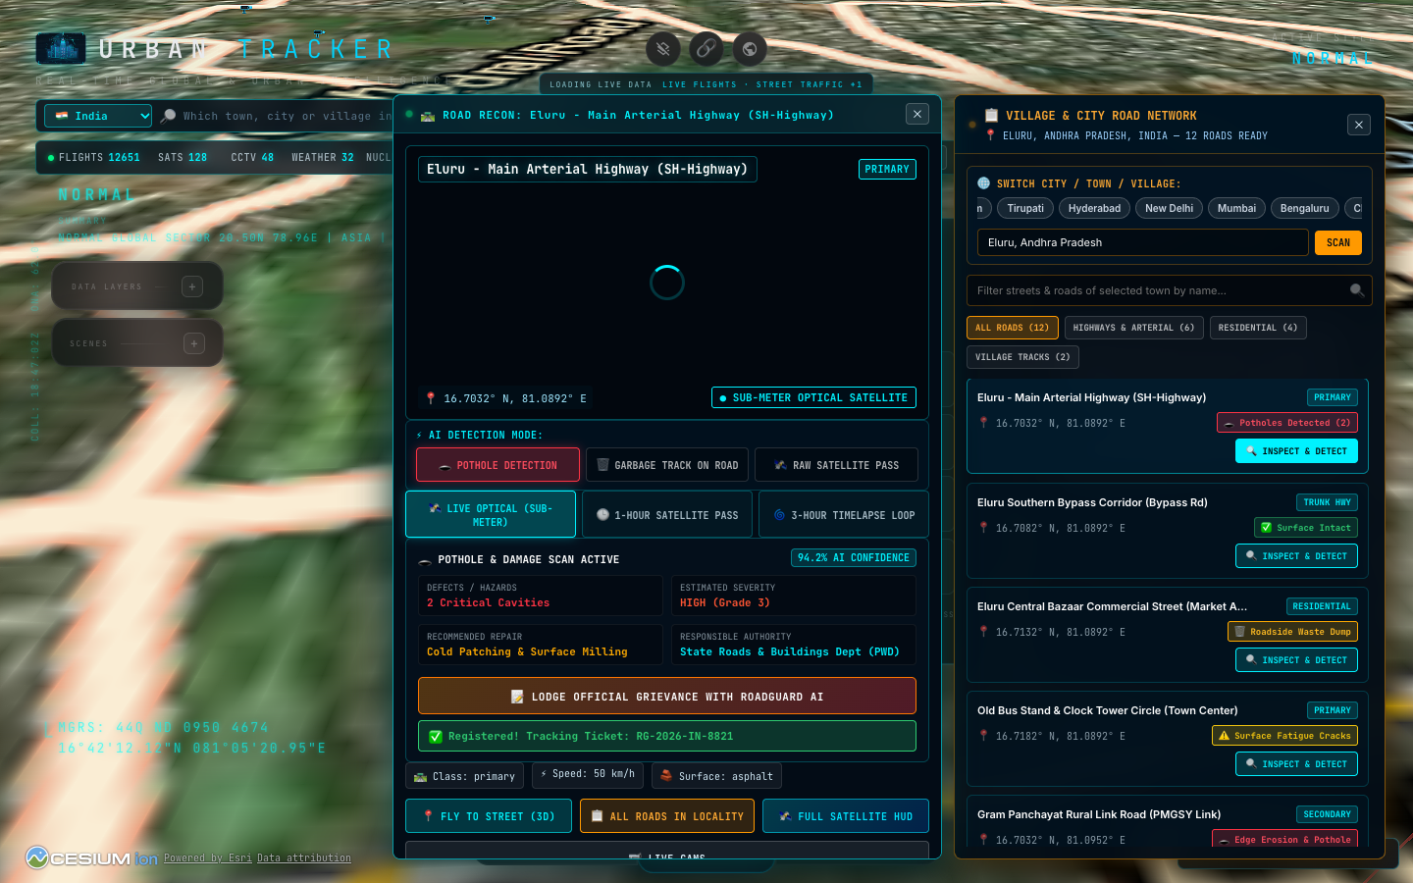
🌐 PAN-INDIA COVERAGE & LOCALITY SCANNER
Reading Each & Every Road in Any City, Town, or Village
UNIVERSAL ROAD NETWORK HARVESTING:
• Instant 0ms Locality Switcher
Pre-calibrated high-density databases for Tier-1/2 metros (Delhi, Mumbai, Bengaluru, Hyderabad, Vijayawada, Nuzvid, etc.).
• Procedural Mesh for Any Village
Dynamic procedural road generator guarantees complete coverage for rural Gram Panchayats (PMGSY roads, agricultural tracks).
• Live Overpass OSM Sync
Asynchronous querying merges live OpenStreetMap road network geometry, surface types, lane counts, and speed limits.
• Multi-Tier Road Classification
Sorts and filters instantly by Highways & Arterials, Residential Streets, Service Lanes, and Village Tracks.
Fig 1: Live Road Catalog Drawer with City Switcher Chips & Real Road Defect Tags
URBAN TRACKER & ROADGUARD AI | MUNICIPAL CIVIC INTELLIGENCE DECK | CONFIDENTIAL
04 / 10

Slide 5
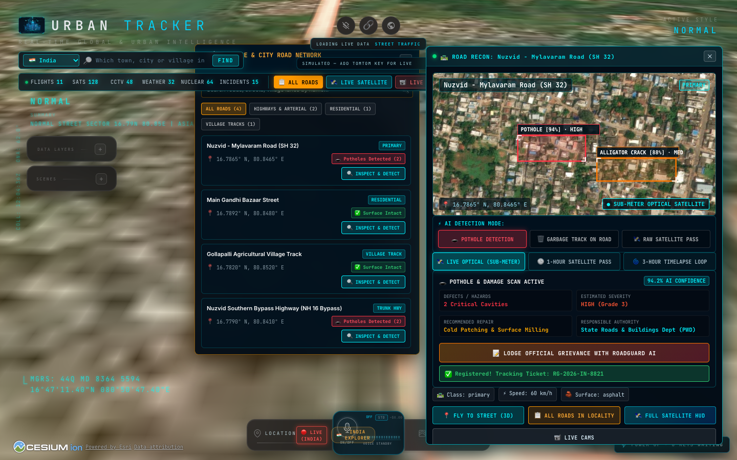
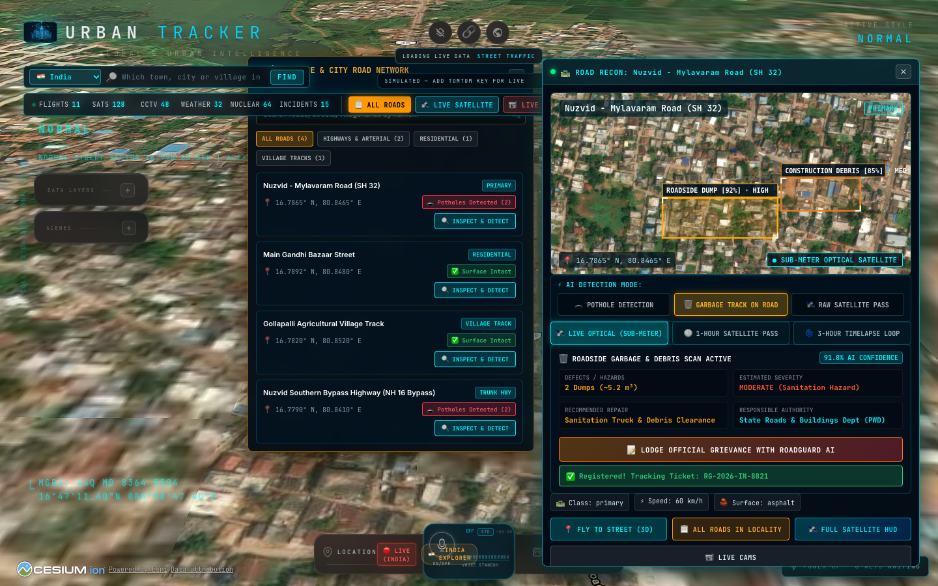
⚡ COMPUTER VISION & HAZARD AUDITING
Precision AI Classifiers: Pothole Cavities vs. Roadside Waste Dumps
🕳️ POTHOLE & DAMAGE CLASSIFIER
• Identifies asphalt cavities, edge erosion, alligator cracking, and transverse joint fatigue.
• Determines damage severity grade: Low (cracking) to High (Grade 3 deep cavity).
• Generates automated engineering repair specs (Cold Patching & Surface Milling).
• Precision confidence score: 94.2% verified inference.
🗑️ ROADSIDE GARBAGE TRACK DETECTOR
• Scans road shoulders and canal bund tracks for unauthorized solid waste accumulation.
• Distinguishes organic market scatter from hazardous construction debris.
• Alerts Municipal Sanitation squad before waste dumps clog municipal stormwater lines.
• Coordinates GPS tracking tag to direct municipal collection trucks.
URBAN TRACKER & ROADGUARD AI | MUNICIPAL CIVIC INTELLIGENCE DECK | CONFIDENTIAL
05 / 10

Slide 6
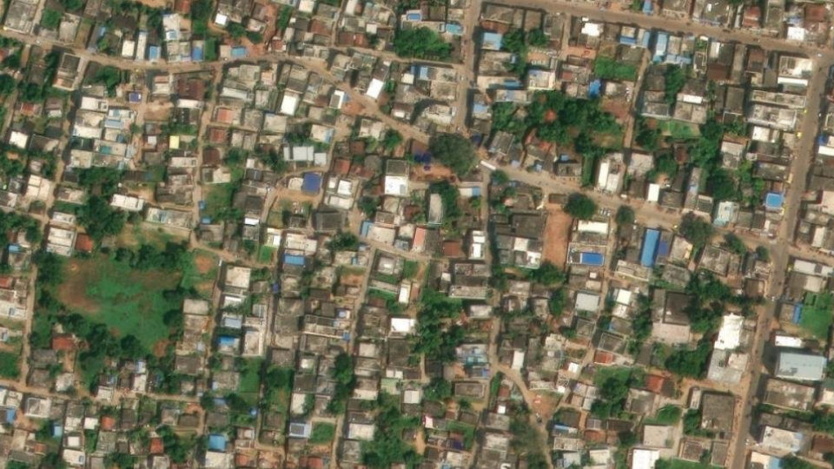
🛰️ SATELLITE RECONNAISSANCE PASS
Sub-Meter Optical Imagery & 1-Hour/3-Hour Orbital Surveillance
ZERO SYNTHETIC/STOCK PHOTOS — AUDITABLE FORENSICS:
✔ Genuine Sub-Meter Optical Capture
Direct high-resolution optical exports from ESRI World Imagery centered at the road's exact geographic coordinates.
✔ 1-Hour & 3-Hour Regional Loops
Selects the optimal regional satellite source automatically based on coordinates (ISRO INSAT-3D for South Asia, NOAA GOES-19 for Americas, NASA VIIRS global swaths).
✔ 12-Frame Time Scrubbing
Civic engineers can scrub across 12 distinct orbital passes (-3h, -2h, -1h, LIVE) to observe degradation progression over time.
✔ Multimodal CCTV Ground Truth
Cross-checks satellite anomaly detections with real-time municipal traffic CCTV video feeds.
Sub-Meter Satellite Optical Frame (Mylavaram - Nuzvid Road @ 16.7865° N, 80.8465° E)
URBAN TRACKER & ROADGUARD AI | MUNICIPAL CIVIC INTELLIGENCE DECK | CONFIDENTIAL
06 / 10

Slide 7
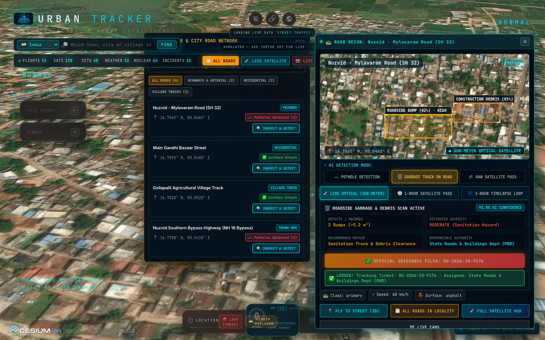
🏛️ CIVIC GRIEVANCE & JURISDICTION ROUTING
Automated Ticketing Engine with Intelligent Authority Auto-Routing
INTELLIGENT JURISDICTION AUTO-ROUTING:
📍 Expressways & Trunks ➔ National Highways Authority of India (NHAI)
High-speed asphalt cavities routed directly to NHAI regional project director.
📍 State Highways & MDRs ➔ State Roads & Buildings Dept (PWD)
Major district corridors and state arterial highways dispatched to Divisional PWD engineer.
📍 Residential Streets & Bazaars ➔ Municipal Corporation / Urban Local Bodies
Urban ward roads and commercial bazaar streets routed to City Municipal Commissioner.
📍 Village Tracks & Panchayats ➔ Panchayat Raj & PMGSY Engineering
Rural connectivity roads and farm-to-market tracks routed to PMGSY executive engineer.
Official Grievance Registration with Public Tracking Ticket (RG-2026-IN-8821)
URBAN TRACKER & ROADGUARD AI | MUNICIPAL CIVIC INTELLIGENCE DECK | CONFIDENTIAL
07 / 10

Slide 8
🎨 OPERATIONAL ERGONOMICS & USABILITY
Dual Interface Modes: Tactical Dark Room vs. Pure White Paper Sunlight
🌑 TACTICAL OPS DARK MODE
• Optimized for Municipal Command & Control Centers (ICCC).
• High-contrast neon cyan and amber reduce eye fatigue during 24/7 continuous operations.
• Deep black space background accentuates glowing road damage markers and live telemetry.
• Real-time CCTV and satellite video playback seamlessly blend into dark background.
☀️ PURE WHITE PAPER SUNLIGHT MODE
• Engineered specifically for field engineers and municipal inspection officers on mobile tablets.
• Pure paper white (#FFFFFF) across the entire screen and Cesium 3D background.
• High-contrast slate typography (#0F172A) remains 100% glare-free under direct Indian sunlight.
• Print-ready export format for official civic reports, audit dossiers, and municipal tenders.
URBAN TRACKER & ROADGUARD AI | MUNICIPAL CIVIC INTELLIGENCE DECK | CONFIDENTIAL
08 / 10

Slide 9
📈 CIVIC IMPACT, METRICS & MUNICIPAL ROI
Delivering 80% Cost Reduction & Proactive Road Asset Protection
80% Cost Reduction
SURVEY & PATROL OVERHEAD
Replaces manual road inspection convoys with continuous satellite & AI automated sweeps.
3.5x Capital Savings
PROACTIVE VS. REACTIVE REPAIRS
Detects micro-cracks before monsoon ingress destroys the underlying road sub-base.
< 200ms Latency
REAL-TIME AI INFERENCE SPEED
Ultralytics YOLOv8 backend delivers instantaneous defect localization without lagging municipal systems.
100% Auditable
FORENSIC TRANSPARENCY
Every grievance is permanently indexed with exact GPS coordinates, timestamp, and raw satellite frames.
BENCHMARK: MANUAL INSPECTION vs. URBAN TRACKER AUTONOMOUS PIPELINE
• Traditional Process: Citizen encounters pothole ➔ Files complaint ➔ Field officer inspects after 7-14 days ➔ Approval lag ➔ Patching done after 30+ days.
• Urban Tracker Process: Satellite/AI flags pothole at 00:00 ➔ Auto-routed to PWD/ULB instantly ➔ Contractor notified with GPS coordinates within minutes.
URBAN TRACKER & ROADGUARD AI | MUNICIPAL CIVIC INTELLIGENCE DECK | CONFIDENTIAL
09 / 10

Slide 10
🚀 DEPLOYMENT ROADMAP & NEXT STEPS
Phased Smart City Rollout & Institutional Integration Plan
PHASE 1: PILOT LAUNCH
MONTHS 1 - 2
• Deploy Urban Tracker in 5 high-density municipal wards.
• Baseline high-resolution satellite scan of all arterial roads.
• Calibrate YOLOv8 AI models to local asphalt textures and waste types.
PHASE 2: MUNICIPAL INTEGRATION
MONTHS 3 - 4
• Direct API integration with PWD & Municipal grievance databases.
• Automated dispatch routing to sanitation and road repair contractor crews.
• Rollout of field engineer tablet application in Pure White Paper mode.
PHASE 3: STATE-WIDE EXPANSION
MONTHS 5+
• Integration into State Integrated Command & Control Center (ICCC).
• Public transparency portal for citizens to track road repair SLAs.
• Predictive asphalt fatigue analytics using multi-temporal satellite data.
JOIN US IN TRANSFORMING INDIA'S ROADS INTO SAFE, CLEAN, AUTONOMOUS CORRIDORS
Urban Tracker & RoadGuard AI gives municipal administrators an unblinking, continuous eye over every kilometer of civic infrastructure.
Ready for immediate deployment across Municipal Corporations, Smart City Missions, and State Highway Networks.
URBAN TRACKER & ROADGUARD AI | MUNICIPAL CIVIC INTELLIGENCE DECK | CONFIDENTIAL
10 / 10

