Slide 1
DATA 690-05 - NLP
Chatbot - Healthcare Assistant for COVID-19
Professor: Dr. Antonio Diana
Team Members:
Anudeep Kollipara
Harsh Bhanderi
Pushyami Reddy
Vineeta Opulla
Yaswanth Kaushal Rayani Veera

Slide 2
Abstract
Since the Coronavirus (COVID-19) outbreak, there has been an unprecedented increase in the number of patients that have been hospitalized and the hospitals and healthcare staff are finding it difficult to manage the situation. The people are unable to access the hospitals and are not knowledgeable about the symptoms of the Coronavirus. This makes it very difficult for the people to get a clear idea about their symptoms and leaves them in a place where their questions are unanswered. If we could have an interface that could answer the questions related to coronavirus, this would help the users and the hospital staff to reduce the number of patients visiting the hospitals. With the help of a chatbot, a user can get his/her questions answered about the coronavirus and its symptoms. The chatbot can be deployed through a website and users can access it through the internet to get their questions answered.

Slide 3
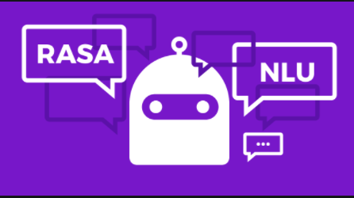
What is Rasa?
RASA stack is an open-source AI tool and being an open source framework, It is easy to customize.
Rasa comes up with two components —
Rasa NLU — a library for natural language understanding (NLU) which does the classification of intent and extracts the entity from the user input and helps bot to understand what the user is saying.
Rasa Core — a chatbot framework with machine learning-based dialogue management which takes the structured input from the NLU and predicts the next best action using a probabilistic model like LSTM neural network.

Slide 4
Components of a Chatbot
NLU and Core are independent and one can use NLU without Core, and vice versa, although Rasa recommends using both. It used few keywords which would be used repeatedly here and in the future posts.
Intent — Intent is nothing but what the user is aiming for. For example — if the user says “Reserve a table at Cliff House tonight” the intent can be classified as to book the table.
Entity — Entity is to extract the useful information from the user input. From the example above “Reserve a table at Cliff House tonight” the entities extracted would be place and time. Place — Cliff House and Time — tonight.
Stories — Stories define the sample interaction between the user and chatbot in terms of intent and action taken by the bot. Like in the example above bot got the intent of booking the table and entities like place and time but still, there is an entity missing — no of people and that would make the next action from the bot.
Actions — Actions are basically the operations performed by the bot either asking for some more details to get all the entities or integrating with some APIs or querying the database to get/save some information.

Slide 5
Project Hypothesis
There are a lot of existing chatbots for healthcare domain serving different functionalities, but this chatbot mainly focuses on answering questions regarding the coronavirus.
Many healthcare agencies like CDC, WHO provides answers to frequently asked questions regarding the coronavirus on their website.
However, we may have to search for a while before we have found the right answer to the question.
This healthcare chatbot facilities the timely and quick access to the answers to questions related to COVID-19. It is implemented using Rasa.
Notes:
Harsh:

Slide 6
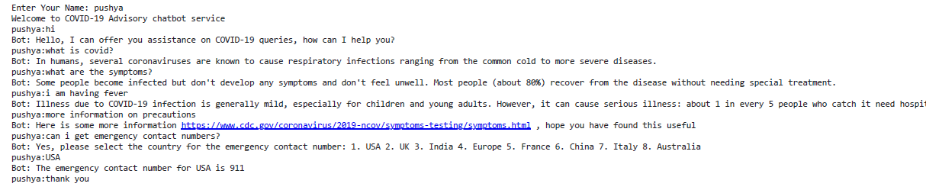
DEMO

Slide 7
Results
The backend functionalities performed by the Rasa UI bot with some additional features has been explained in three parts.
(i) Installation
(ii) Natural Language Understanding
(iii) Integration
(iv) Handling Dialogue
(v) Communication
Notes:
Harsh

Slide 8
Future Aspects
Creating an UI replicating the Rasa UI
Displaying few real time operations viz., statistics of Covid-19, nearby relief centers.
Voice interaction (response in voice format)
Patients engagement
Research and Treatment options
Billings and insurance claims
Connect to the doctor
Notes:
Harsh

Slide 9
References
https://github.com/RasaHQ/rasa-workshop-pydata-berlin/blob/master/rasa-workshop-completed-executed.ipynb
https://github.com/eliseboyd/rasa_nlu
https://itsromiljain.medium.com/build-a-conversational-chatbot-with-rasa-stack-and-python-rasa-nlu-b79dfbe59491

