Slide 1
STUDENT DROPOUT PREDICTION
PROJECT NUMBER : 16

Slide 2
TEAM MEMBERS :
Apurva Siruvolu 2018900022
Yaswanth koravi 2018202011
Sarat Chandra 2018202013
Gauravdeep Singh Bindra 2018201027
TEAM NUMBER 40

Slide 3
CONTRIBUTIONS
Name | Task
Apurva Siruvolu | Data analysis and SVM (dataset2)
Gauravdeep Singh Bindra | Data analysis,KNN and logistic regression (dataset 2)
Yaswanth koravi | KNN, SVM, Logistic regression (dataset1) and Gradient Boosting, neural networks (dataset 2)
Sarat Chandra | Neural Networks, Gradient Boosting ( dataset 1)

Slide 4
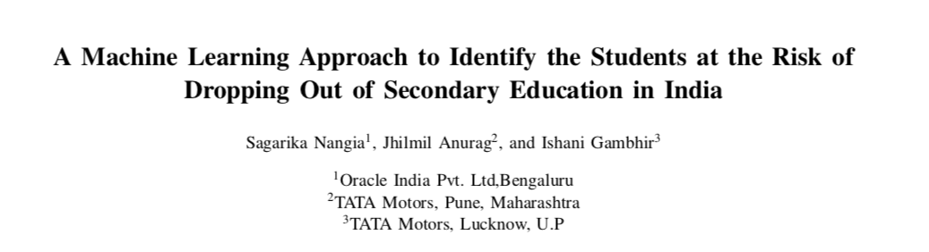
BASED ON THE RESEARCH PAPER :

Slide 5

DATASET
They collected the data from U-DISE (Unified District Information System for Education) is a database about schools in India. The database was developed at the National University for Educational Planning and Administration.

Slide 6
1. GENDER
2. SOCIAL CATEGORY
3. RELIGION
4. BELOW POVERTY LINE
5. DISADVANTAGED
6. SCHOLARSHIP
7. ATTENDANCE
8. HOMELESS
9. EXAM-MARKS
10.DISABILITY
ATTRIBUTES

Slide 7
Attributes Explanation

Slide 8
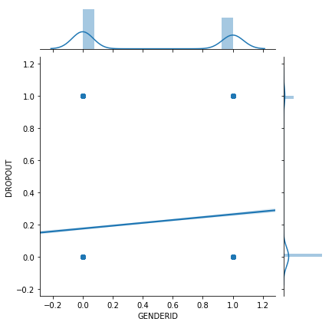
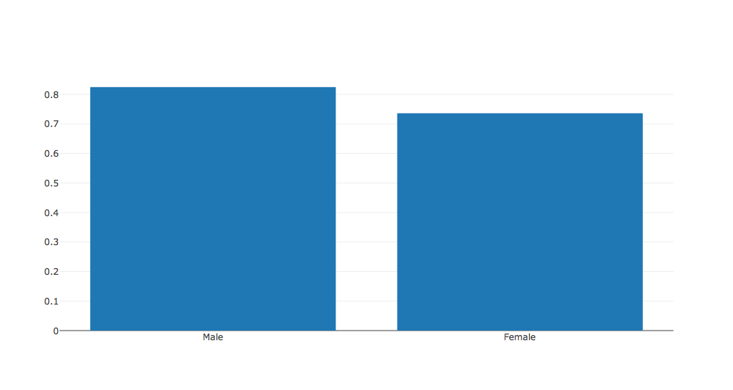
GENDER ID
As seen from the graph, there is a correlation between the gender of students and dropout rate. Which is expected since unfortunately there is still gender bias against girls and women in india. (17.6 vs 26.4)

Slide 9
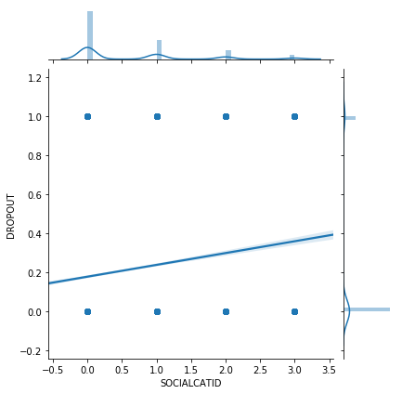
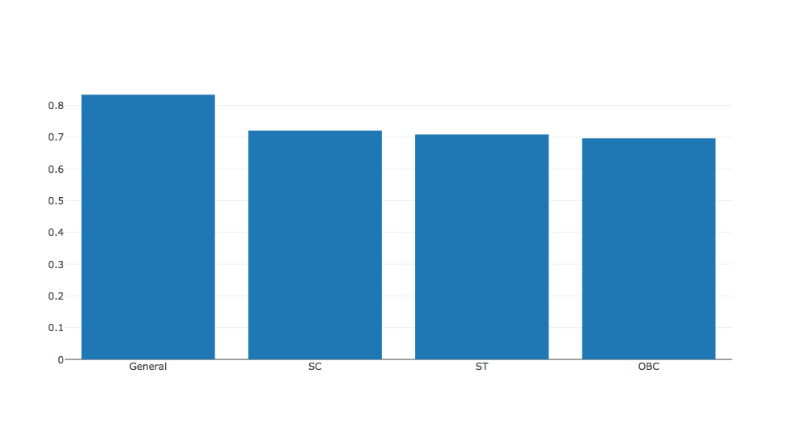
2. SOCIAL CATEGORY
GENERAL : 16.6
SCHEDULED CASTE : 27.9
SCHEDULED TRIBES : 29.1
OBC’S : 30.3

Slide 10
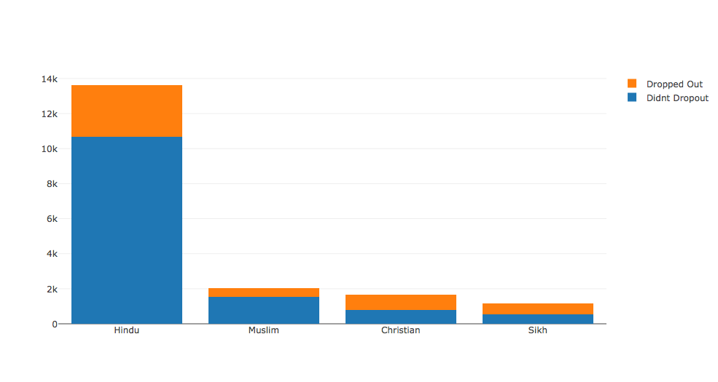
3. Religion
This is a categorical therefore the correlation doesn't have any significance.
HINDU : .21
MUSLIM : .23
CHRISTIAN : .5
SIKH : .5

Slide 11
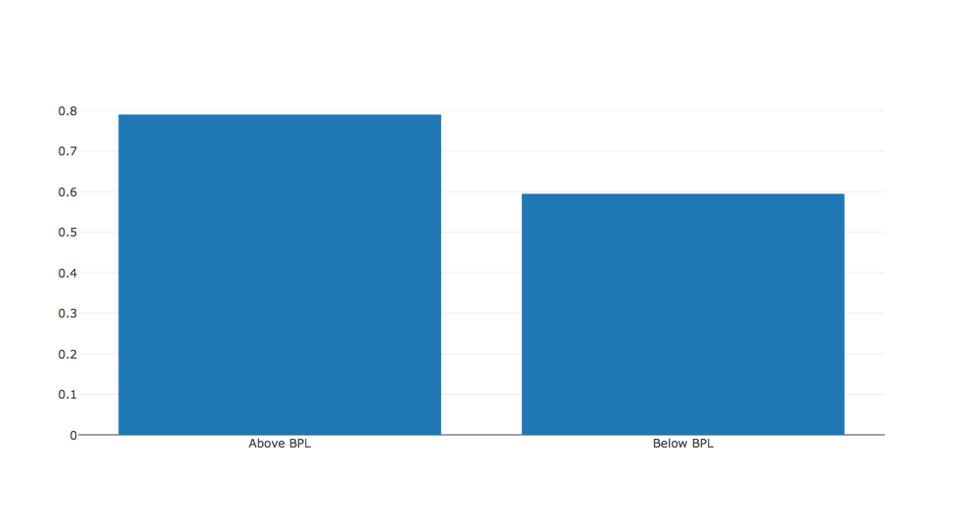
4. BELOW POVERTY LINE
This is a binary attribute telling whether the student belongs to a family which has income is below poverty line. As expected students facing financial difficulty are more prone to dropping out.
Not Below Poverty line : 20.1
Below Poverty Line : 40.5

Slide 12
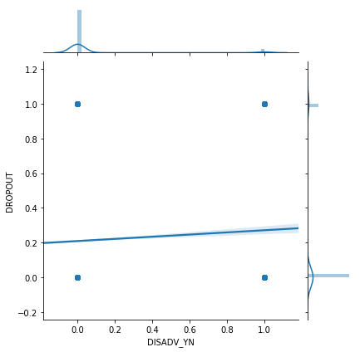
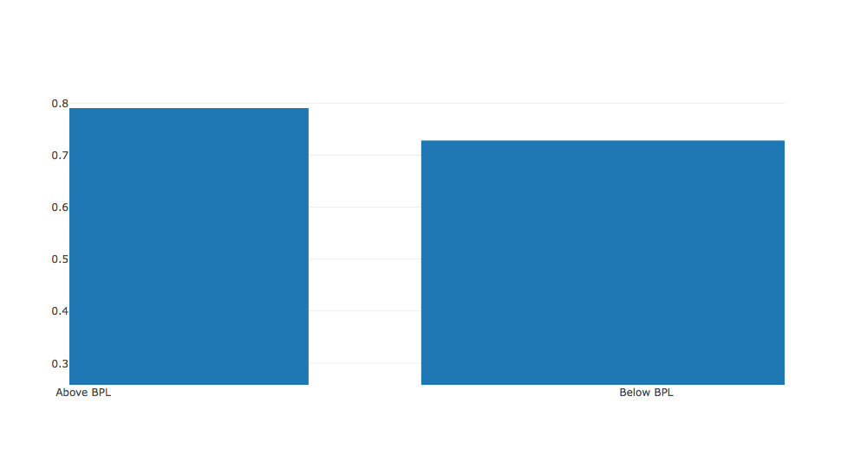
5. DISADVANTAGED

Slide 13
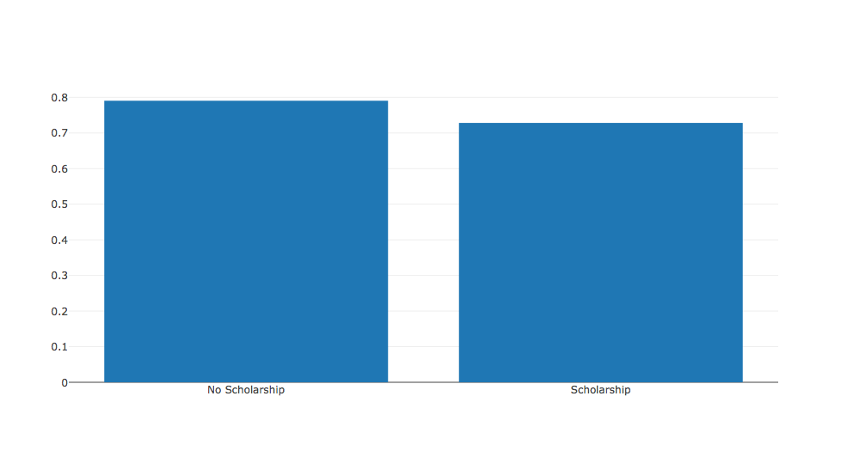
6. SCHOLARSHIP
This attribute shows if a student is getting free education.
No Scholarship : 20.9
Scholarship : 27.1

Slide 14
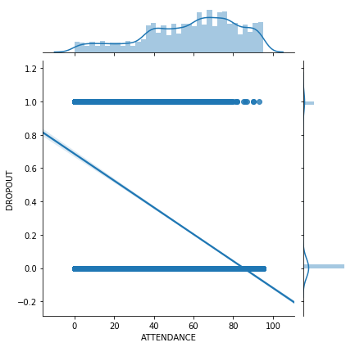
7. ATTENDANCE
Attendance is a very important attribute as there is a high negative correlation of attendance with the dropout rate. Students who attend more classes are much less likely to drop out.

Slide 15
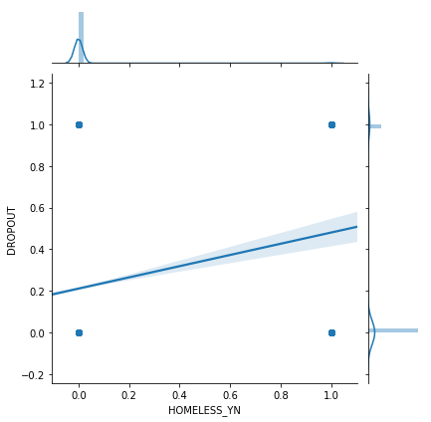
8. HOMELESS
Binary attribute for if a students is homeless or not
Not homeless : 21.1
Homeless : 48.05

Slide 16
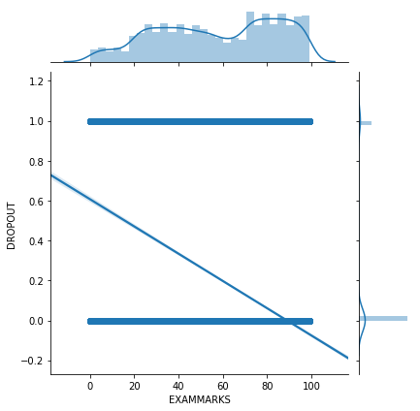
9. Exam-marks
Numerical attribute representing the marks student scored in the last year.
The graph shows as expected that students scoring low marks are more likely to dropout.

Slide 17
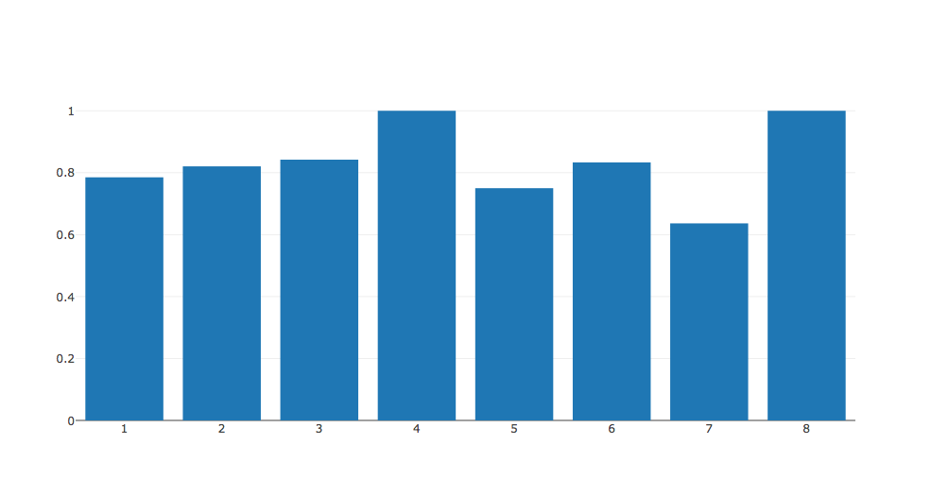
10. DISABILITY
Categorical variable. Various disabilities haven been giving numerical values.

Slide 18
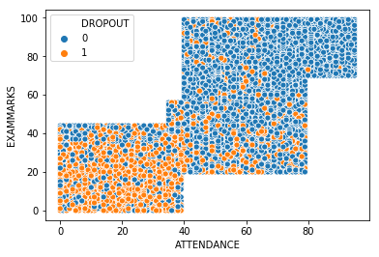
ATTENDANCE - MARKS show the most correlation

Slide 19
MOTIVATION FOR THIS PROJECT
The power of education in empowering an individual and the society at large cannot be understated.
While the enrollment in higher educational institutions has been rising steadily (from 10% in 2005 to 25% in 2015 -MHRD) the numbers are still abysmal.
There is also significant drop after 10th standard due to various factors. This is even more troublesome as the the droppers can’t really get any job these days without completing their schooling.
We analyse a dataset from BODWAD district of Maharashtra and try to analyze the various factors which are responsible.
#VoteModi if you want to see things improve

Slide 20
Data pre-processing
One hot encoder representation used in :
Social category
Gender
Religion
Standardization of data used in :
Attendance
Exam marks

Slide 21
Metric considered in model evaluation
Since, a student who is likely to drop out classified as ’retained’ is worse than vice-versa, the agenda is to select the model that provides sufficiently low false negatives with reasonable number of false positives. We use weighted accuracy in which the cost of True Positive Rate is higher than that of True Negative Rate.
so weighted accuracy = 0.7(TP/P) + 0.3(TN/N)
Train-test split
Training data=10415 (60%)
Testing data=6944 (40%)
Model is evaluated and optimal parameters are found using 10 fold cross validation

Slide 22
KNN
Parameters :
K values : 1 to 50
Results :
Optimal parameter values : k = 9
Confusion matrix :
Weighted accuracy formula : 0.7*(TP/P) + 0.3*(TN/N)
= 0.7*(827/1475) + 0.3*(5203/5469)
= 67.7%
 | Predicted negative | Predicted positive
Actual negative | 5203 | 266
Actual positive | 648 | 827

Slide 23
Logistic regression
Parameters :
C values : 0.01, 0.1, 1, 10, 100
Regularization : L1, L2
Results :
Optimal parameter values : C = 10
Regularization: L1
Confusion matrix :
Weighted accuracy formula : 0.7*(TP/P) + 0.3*(TN/N)
= 0.7*(777/1475) + 0.3*(5190/5469)
= 65.3%
 | Predicted negative | Predicted positive
Actual negative | 5190 | 279
Actual positive | 698 | 777

Slide 24
SVM
Parameters :
C values : 0.01, 0.1, 1, 10,100
Kernels : linear, rbf, poly
Results :
Optimal parameter values : C = 100, Kernel = rbf
Confusion matrix :
Weighted accuracy formula : 0.7*(TP/P) + 0.3*(TN/N)
= 0.7*(744/1475) + 0.3*(5298/5469)
= 64.3%
 | Predicted negative | Predicted positive
Actual negative | 5298 | 171
Actual positive | 731 | 744

Slide 25
Neural Networks
Parameters :
Hidden layers : 1, 2, 3
Neurons : 3, 6, 9
Activation : tanh, relu, sigmoid
Results :
Optimal parameter values : 2 layers with 9 Neurons with tanh activation function.
Confusion matrix :
Weighted accuracy formula : 0.7*(TP/P) + 0.3*(TN/N)
= 0.7*(875/1475) + 0.3*(5194/5469)
= 70%
 | Predicted negative | Predicted positive
Actual negative | 5194 | 275
Actual positive | 600 | 875

Slide 26
Gradient Boosting
Parameters :
Learning rates: 1, 1.5, 2
Estimators : 20, 40, 60 ,80
Max depth : 3, 4, 5, 6, 7, 8, 9, 10
Results :
Optimal parameter values : Learning rate = 1, max depth = 3, estimators = 20
Confusion matrix :
Weighted accuracy formula : 0.7*(TP/P) + 0.3*(TN/N)
= 0.7*(904/1475) + 0.3*(5167/5469)
= 71%
 | Predicted negative | Predicted positive
Actual negative | 5167 | 302
Actual positive | 571 | 904

Slide 27
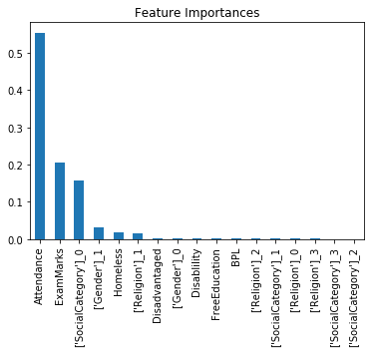
FEATURE IMPORTANCE

Slide 28
COMPARISON :
Model | Optimal parameters given in paper | Weighted accuracy (%) | Optimal parameters obtained | Weighted accuracy (%)
Knn | K = 7 | 67 | K = 9 | 67.7
Logistic regression |  | 63 | C = 10 Regularization = L1 | 65.3
SVM | kernel = linear | 63 | C = 100 kernel = rbf | 64.3
Neural networks | Number of hidden layers = 2 Number of neurons in each layer = 9 Activation function = sigmoid | 70 | Number of hidden layers = 2 Number of neurons in each layer = 9 Activation function = tanh | 70
Gradient boosting | Learning rate = 1 Estimators = 50 | 78 | Learning rate = 1 Max depth = 3 Estimators = 20 | 71

Slide 29
For dataset 2

Slide 30
Data analysis
Total number of students: 395
Number of features: 31
Number of students who were not left: 265
Number of students who left: 130
Attribute names : School, sex, age, address, famsize, Pstatus, Medu, Fedu, Mjob, Fjob, reason, guardian, traveltime, studytime, failures, schoolsup, famsup, paid, activities, nursery, higher, internet, romantic, famrel, freetime, goout, Dalc, Walc, health, absences.
Train-test split :
Training data = 316 (80%)
Testing data = 79 (20%)
Model is evaluated and optimal parameters are found using 10 fold cross validation

Slide 31
KNN
Parameters :
K values : 1 to 50
Results :
Optimal parameter values : k = 35
Confusion matrix :
Weighted accuracy formula : 0.7*(TP/P) + 0.3*(TN/N)
= 0.7*(55/55) + 0.3*(1/24)
= 71.3%
 | Predicted negative | Predicted positive
Actual negative | 1 | 23
Actual positive | 0 | 55

Slide 32
Logistic regression
Parameters :
C values : 0.01, 0.1, 1, 10, 100
Regularization : L1, L2
Results :
Optimal parameter values : C = 0.001
Regularization: L2
Confusion matrix :
Weighted accuracy formula : 0.7*(TP/P) + 0.3*(TN/N)
= 0.7*(55/55) + 0.3*(0/24)
= 70%
 | Predicted negative | Predicted positive
Actual negative | 0 | 24
Actual positive | 0 | 55

Slide 33
SVM
Parameters :
C values : 0.01, 0.1, 1, 10,100
Kernels : linear, rbf, poly
Results :
Optimal parameter values : C = 1, Kernel = rbf
Confusion matrix :
Weighted accuracy formula : 0.7*(TP/P) + 0.3*(TN/N)
= 0.7*(53/55) + 0.3*(5/24)
= 73.7%
 | Predicted negative | Predicted positive
Actual negative | 5 | 19
Actual positive | 2 | 53

Slide 34
Neural Networks
Parameters :
Hidden layers : 1, 2, 3
Neurons : 3, 6, 9
Activation : tanh, relu, sigmoid
Results :
Optimal parameter values : 2 layers with 6 Neurons each and relu activation function.
Confusion matrix :
Weighted accuracy formula : 0.7*(TP/P) + 0.3*(TN/N)
= 0.7*(54/55) + 0.3*(3/24)
= 72%
 | Predicted negative | Predicted positive
Actual negative | 3 | 21
Actual positive | 1 | 54

Slide 35
Gradient Boosting
Parameters :
Learning rates: 0.01, 0.1, 1
Estimators : 10, 20, 30, 40, 50
Results :
Optimal parameter values : Learning rate = 0.1, estimators = 28
Confusion matrix :
Weighted accuracy formula : 0.7*(TP/P) + 0.3*(TN/N)
= 0.7*(48/55) + 0.3*(10/24)
= 74%
 | Predicted negative | Predicted positive
Actual negative | 10 | 14
Actual positive | 7 | 48

Slide 36
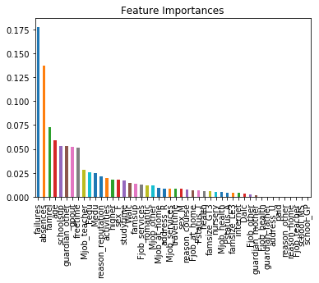
FEATURE COMPARISON

Slide 37
COMPARISON
Model | Optimal parameters | Accuracy (%)
Knn | K = 35 | 71.2
Logistic regression | C = 0.001 Regularization = L2 | 70
SVM | C = 1 kernel = rbf | 73.7
Neural networks | Number of hidden layers = 2 Number of neurons in each layer = 6 Activation function = relu | 72
Gradient boosting | Learning rate = 0.1 Estimators = 28 | 74

Slide 38
Questions?

