Slide 1

SMART AMBULANCE USING MQTT
PG-DESD –Sept 2023
CDAC Hyderabad.
Sumbitted By :-
Yaswanth kuna 230950330021
Meghana nikambe 230950330022
Mrinal patil 230950330023
Smitha mule 230950330024

Slide 2
Contents :
Abstract
Introduction
Objective
Software Requirements
Hardware Requirements
Architecture (Block-Diagram)
Flow-Chart
Code
Output
Conclusion

Slide 3
Abstract :
This project introduces a Smart Ambulance system utilizing MQTT protocol for enhanced emergency medical services. Integrated with RTOS, it features a Health Monitoring System and Traffic Management System. Employing an ESP32 microcontroller and sensors like GPS and heart rate sensor and temperature sensor it provides real-time health updates and GPS tracking. MQTT ensures efficient communication for timely updates to medical professionals. The Traffic Management System triggers traffic light changes, aiding ambulance navigation to avoid congestion. These advancements aim to improve emergency medical services effectively.

Slide 4
Introduction :
The Smart Ambulance System is a pioneering project designed to elevate emergency medical services.
This project introduces a Smart Ambulance system utilizing MQTT protocol for enhanced emergency medical services Utilizing the MQTT protocol and embedded with a Real-Time Operating System (RTOS), it boasts a comprehensive Health Monitoring System and Traffic Management System. Fueled by an ESP32 microcontroller and sensors including GPS, heart rate, and temperature sensors, the system ensures instantaneous health updates and GPS tracking. The efficiency of MQTT facilitates timely communication with medical professionals, while the Traffic Management System dynamically adjusts traffic lights to streamline ambulance navigation and mitigate congestion. These advancements aim to improve emergency medical services effectively.

Slide 5
Objective :
To enhance emergency medical services through the implementation of the Smart Ambulance System, leveraging MQTT protocol, RTOS, and advanced sensors for real-time health monitoring and efficient traffic navigation. This project aims to optimize communication, provide instant health updates, and mitigate congestion, ultimately improving the effectiveness of emergency medical responses.

Slide 6
Requirements :
Software Requirements :
Arduino IDE
Mosquito Broker
MQTT client dashboard on mobile or pc.

Slide 7
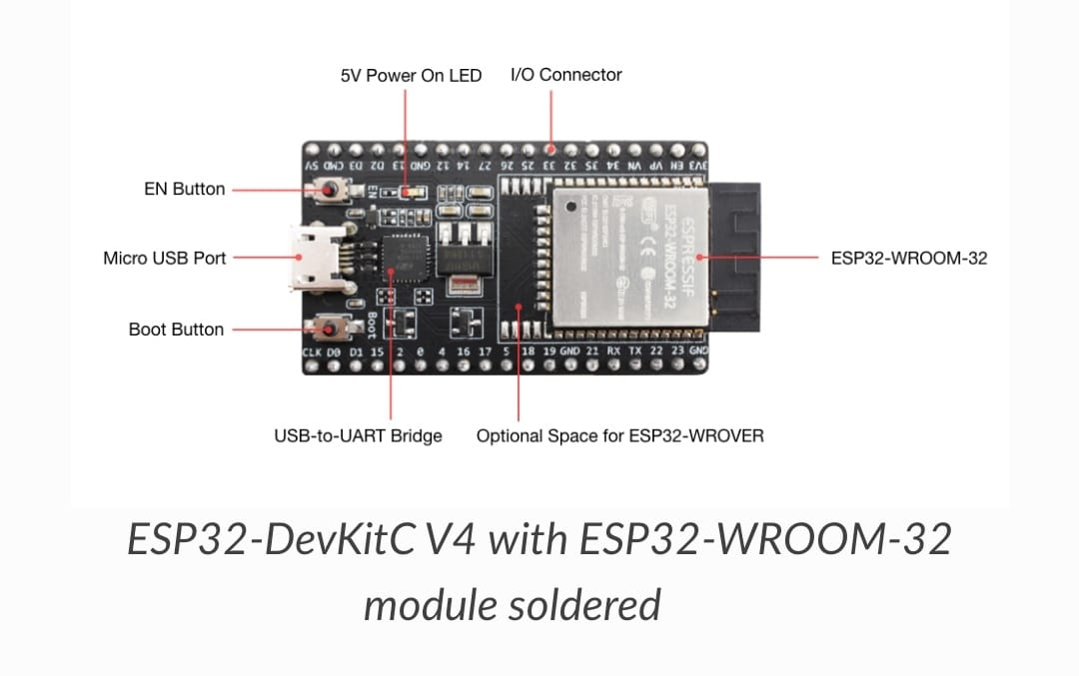
Requirements :
Hardware Requirements :
ESP32 -DevKitC v4 withESP32-WROOM-32:
Specifications:
Dual-Core Processor: dual-core Tensilica LX6 microcontroller
Wireless Connectivity: 2.4 GHz Wi-Fi 802.11 b/g/n and Bluetooth 4.2
Rich Peripheral Set: GPIO pins, analog-to-digital converters (ADCs),
Secure Boot and Flash Encryption: The ESP32-WROOM-3 2E includes secure boot and flash encryption features to protect your firmware and data.
Built-In Antenna and External Antenna Option: The board comes with an integrated antenna for both Wi-Fi and Bluetooth
USB-to-UART Bridge: communication interfaces, including UART, SPI, I2C, and more

Slide 8
MICROCONTROLLER – ESP32
Wireless Connectivity: The ESP32 is known for its built-in Wi-Fi and Bluetooth capabilities, making it suitable for IoT (Internet of Things) applications.
Dual-Core Processor: It features a dual-core Tensilica LX6 processor, providing enhanced processing power and multitasking capabilities.
Low Power Consumption: The ESP32 is designed for efficiency, with various power-saving modes to extend battery life in battery-operated devices.
Rich Peripheral Set
Integrated Sensors
Open-Source
Cost-effective

Slide 9
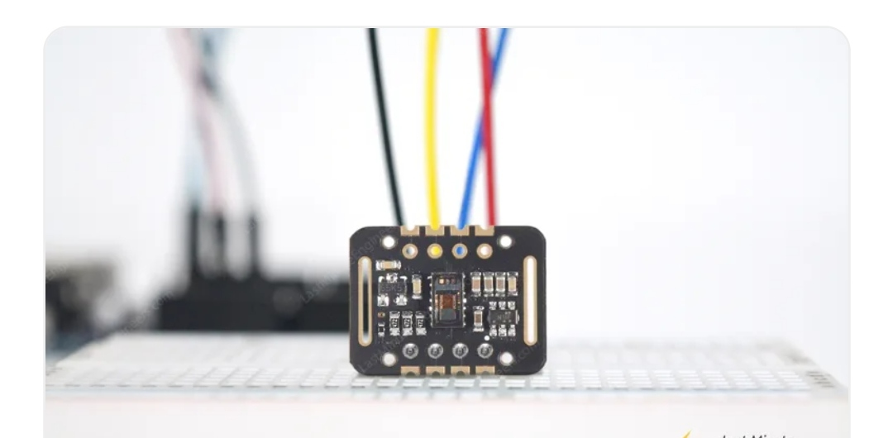
2. MAX30102 heart rate sensor
Benefits and Features
Heart-Rate Monitor and Pulse Oximeter Sensor in LED Reflective Solution
Tiny 5.6mm x 3.3mm x 1.55mm 14-Pin Optical Module
Integrated Cover Glass for Optimal, Robust
Performance
Ultra-Low Power Operation for Mobile Devices
Programmable Sample Rate and LED Current for
Power Savings
Low-Power Heart-Rate Monitor (< 1mW)
Ultra-Low Shutdown Current (0.7µA)
Fast Data Output Capability

Slide 10
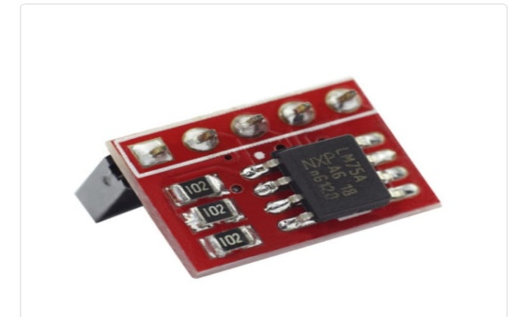
3. LM75 temperature sensor module
Features:-
Range in -25°C~100°C
Small Profile
Works with both 3.3V and 5V
Supported on Raspberry Pi and Arduino
LM75 IC
I2C port

Slide 11
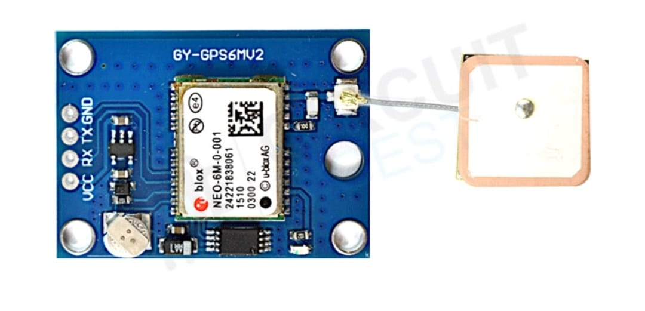
4. NEO-6M GPS Module
Features:
5Hz position update rate
Operating temperature range: -40 TO 85°CUART TTL socket
EEPROM to save configuration settings
Rechargeable battery for Backup
The cold start time of 38 s and Hot start time of 1 s
Supply voltage: 3.3 V
Configurable from 4800 Baud to 115200 Baud rates. (default 9600)
SuperSense Indoor GPS: -162 dBm tracking sensitivity
Support SBAS (WAAS, EGNOS, MSAS, GAGAN)
Separated 18X18mm GPS antenna

Slide 12
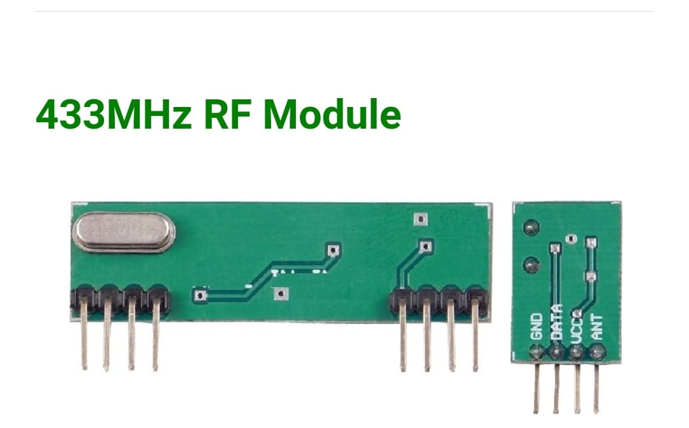
5. 433 MHz RF Module
Specifications of 433MHz RF Transmitter Receiver Wireless Module:-
Range in open space(Standard Conditions) : 100 Meters
RX Receiver Frequency : 433 MHz
RX Typical Sensitivity : 105 Dbm
RX Supply Current : 3.5 mA
RX IF Frequency : 1MHz
RX Operating Voltage : 5V
TX Frequency Range : 433.92 MHz
TX Supply Voltage : 3V ~ 6V
TX Out Put Power : 4 ~ 12 Dbm
ASK Modulation
Low Power Consumption
Easy For RF based Application
Transmit Range Up To 50m

Slide 13
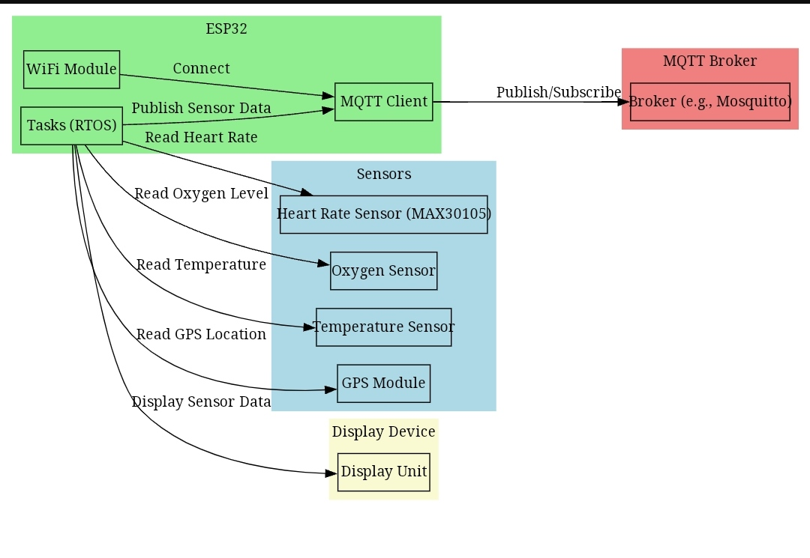
Block Diagram

Slide 14
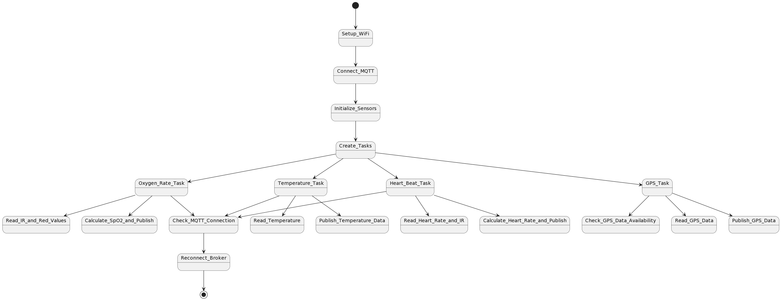
Flowchart

Slide 15
MQTT Protocol :
MQTT (Message Queuing Telemetry Transport) is a lightweight, publish-subscribe messaging protocol often used in IoT (Internet of Things) and mobile applications. It operates on the client-server or broker-based model.
Publish-Subscribe Model: Devices (clients) communicate through a central broker. Publishers send messages to specific topics, and subscribers receive messages from topics they are interested in.
QoS (Quality of Service) Levels: MQTT supports three QoS levels for message delivery: 0 (at most once), 1 (at least once), and 2 (exactly once), allowing flexibility based on the application's reliability requirements.
Retained Messages: Brokers can retain the last message sent on a specific topic. When a new subscriber joins, it immediately receives the most recent message for each topic.
Lightweight: Designed to be efficient, MQTT has a minimal overhead, making it suitable for resource-constrained devices and low-bandwidth networks.
Persistent Sessions: Clients can establish persistent sessions with the broker, allowing them to receive messages that were sent while they were offline.
Security: While MQTT itself does not prescribe security mechanisms, it can be implemented over secure protocols like TLS/SSL, ensuring data confidentiality and integrity.

Slide 16
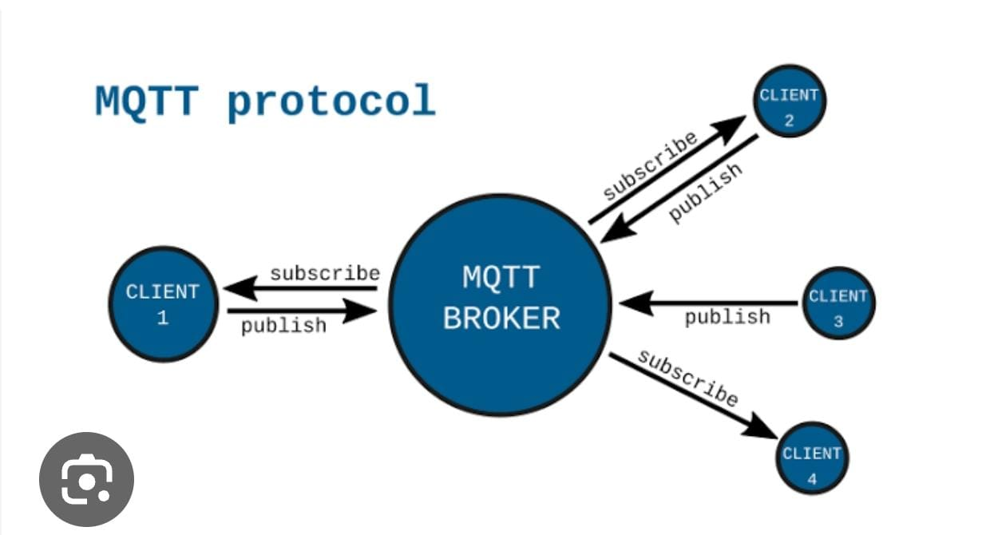
MQTT Protocol :

Slide 17
Why MQTT :
Low Overhead and Bandwidth Efficiency
Publish-Subscribe Model
Lightweight
Asynchronous Communication
Quality of Service (QoS) Levels
Retained Messages
Scalability
Security Integration
Open Standard

Slide 18
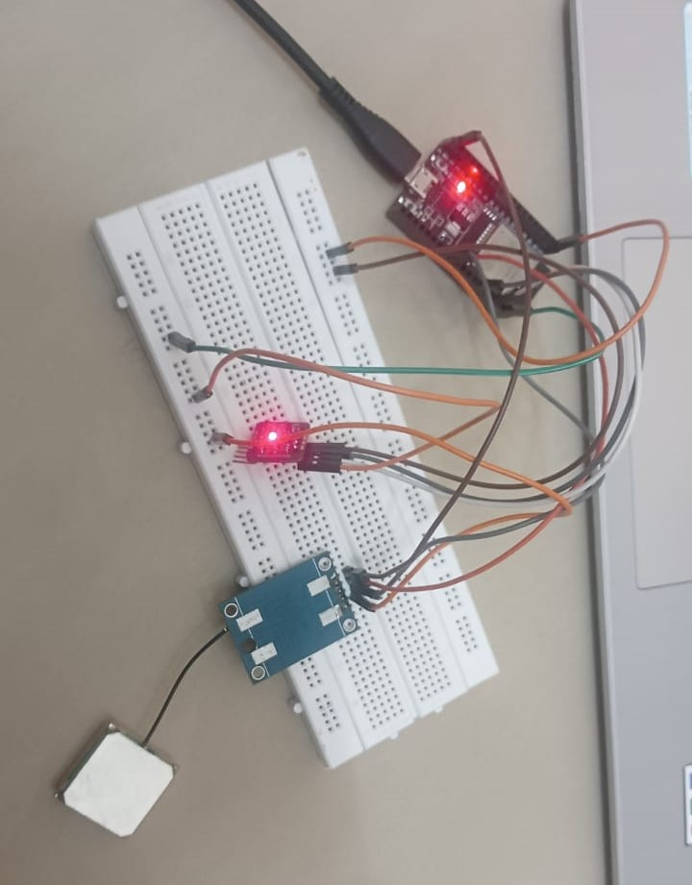
Interfacing :

Slide 19
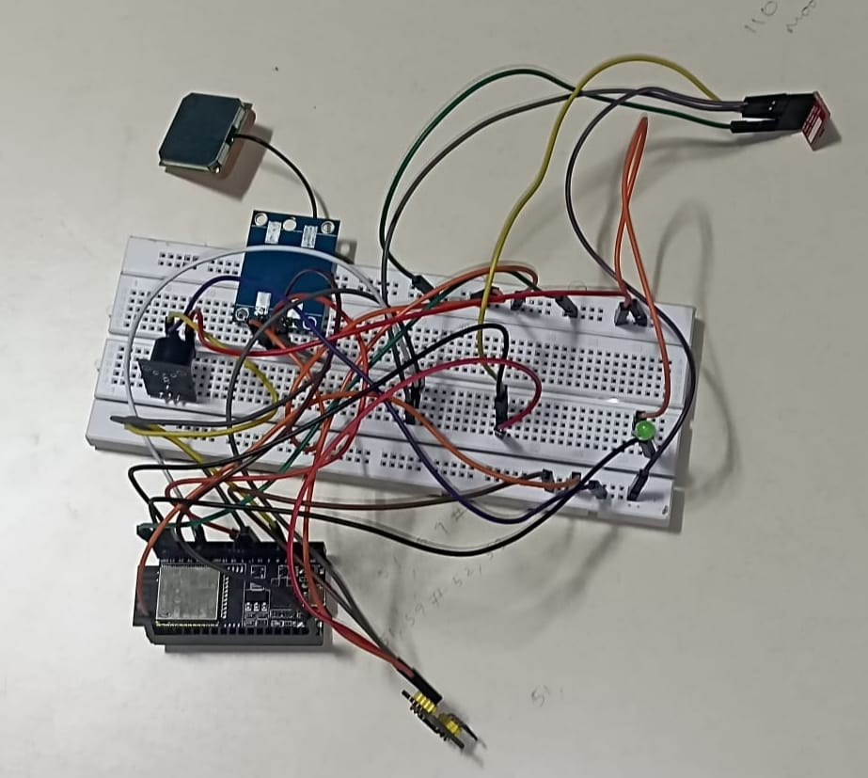
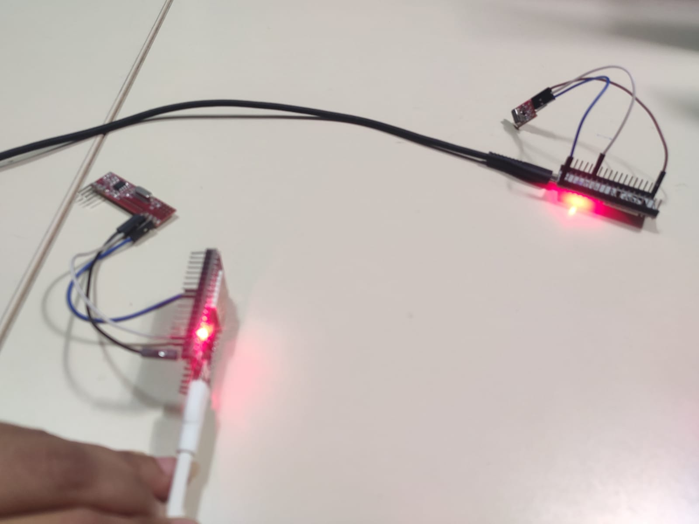
Interfacing

Slide 20
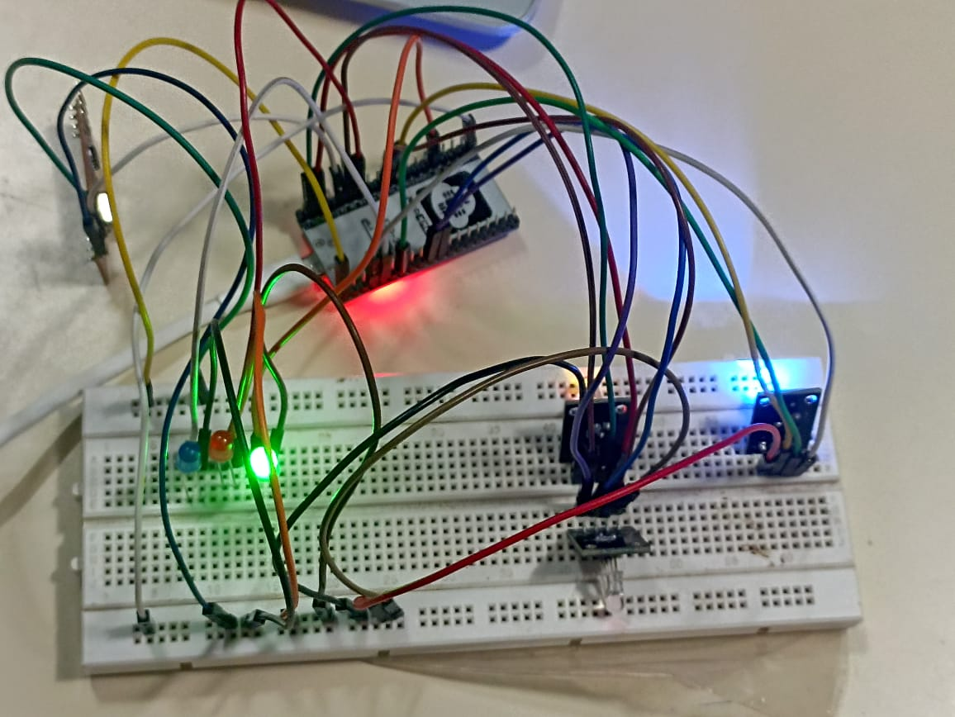

Slide 21
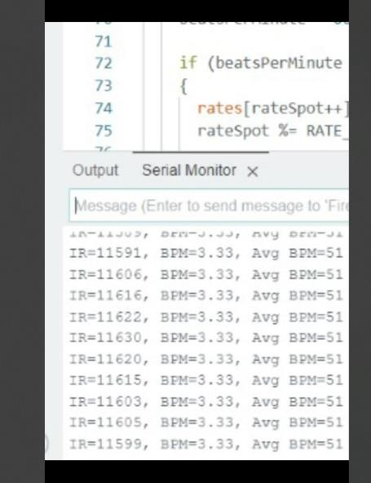
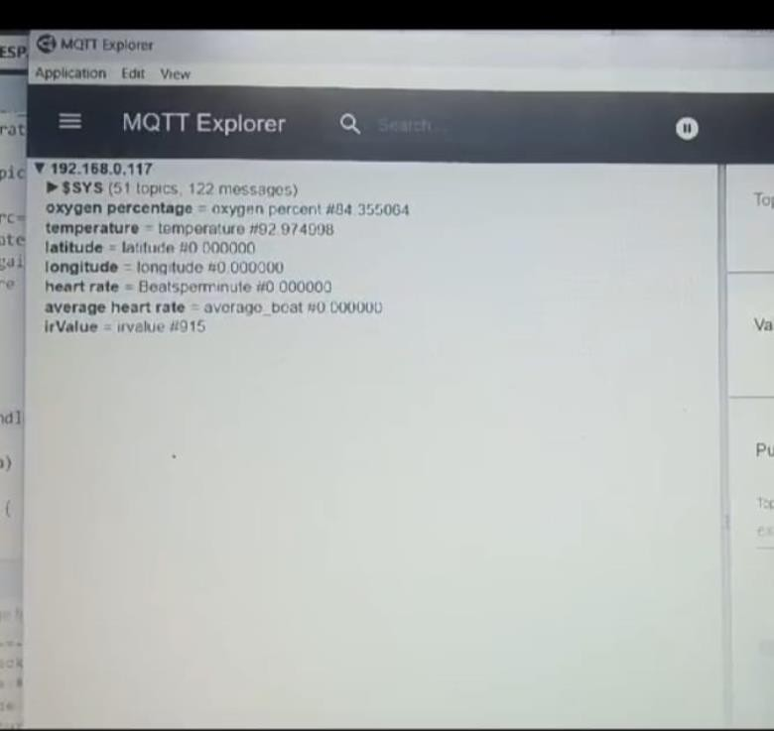
Results and outputs

Slide 22
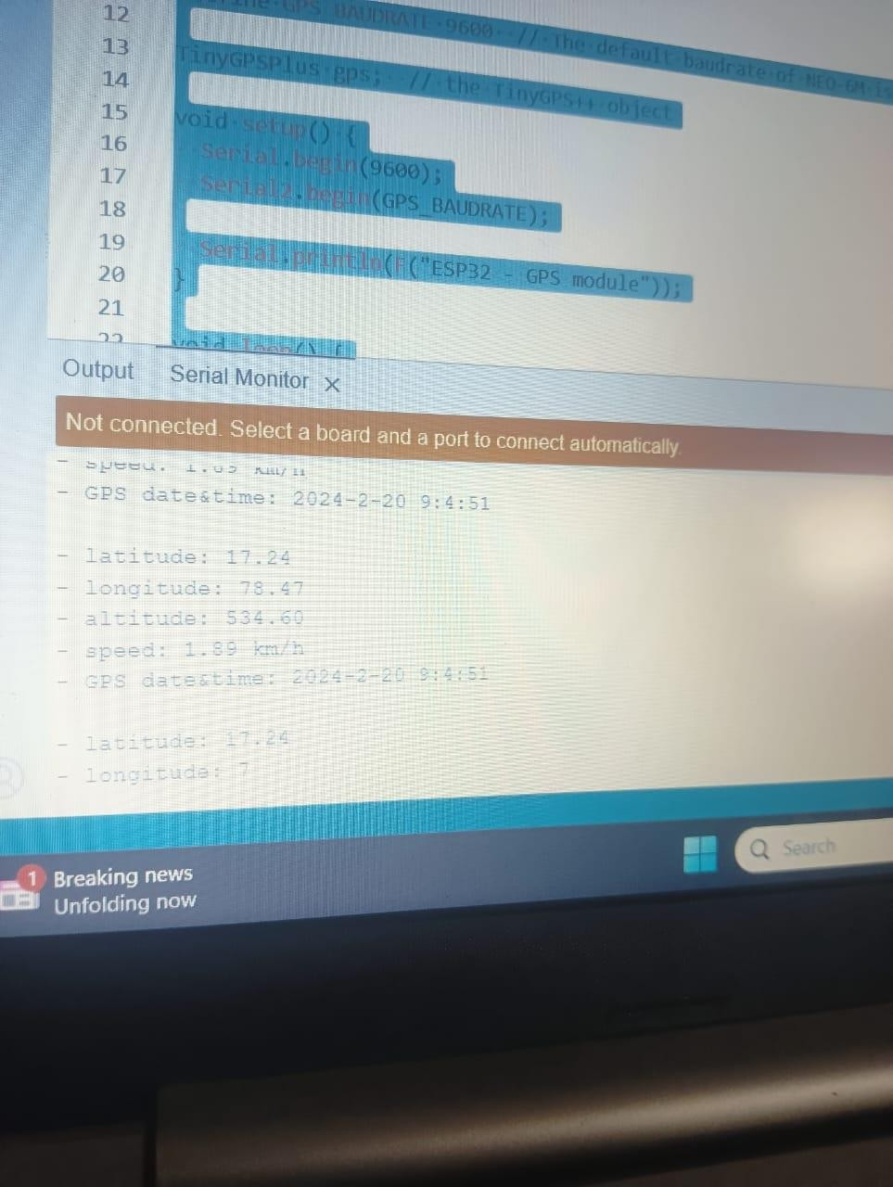
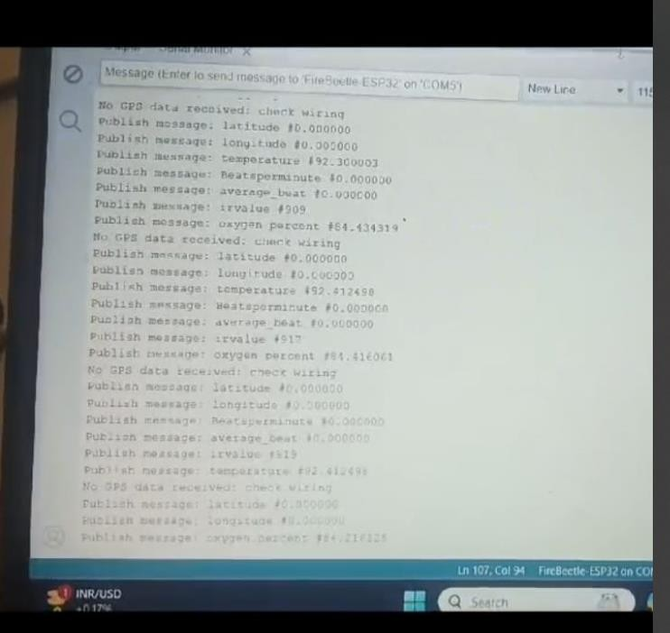

Slide 23
Conclusion :
In summary, the Smart Ambulance System's integration of MQTT, RTOS, and advanced sensors represents a major stride in improving emergency medical services.
With enhanced communication, real-time health monitoring, and traffic management, this project is poised to significantly elevate the efficiency and effectiveness of emergency responses, showcasing the potential for transformative impact in the field.

Slide 24
Thank You……

Slide 25
Any queries ???

