Slide 1
Chapter 5: CPU Scheduling
Notes:
‹#›

Slide 2
Chapter 5: CPU Scheduling
Basic Concepts
Scheduling Criteria
Scheduling Algorithms
Thread Scheduling
Multiple-Processor Scheduling
Operating Systems Examples
Algorithm Evaluation
Notes:
‹#›

Slide 3
Objectives
To introduce CPU scheduling, which is the basis for multiprogrammed operating systems
To describe various CPU-scheduling algorithms
To discuss evaluation criteria for selecting a CPU-scheduling algorithm for a particular system

Slide 4
Basic Concepts
Maximum CPU utilization obtained with multiprogramming
CPU–I/O Burst Cycle – Process execution consists of a cycle of CPU execution and I/O wait
CPU burst distribution
Notes:
‹#›

Slide 5
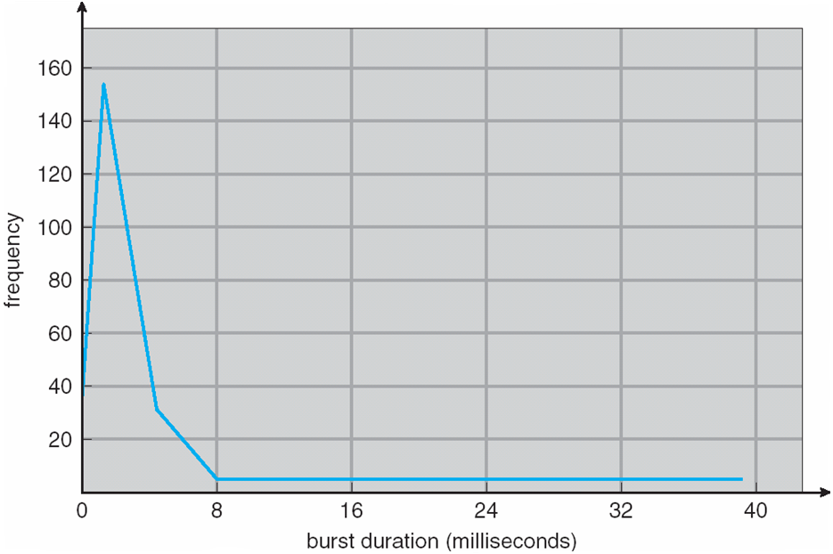
Histogram of CPU-burst Times
Notes:
‹#›

Slide 6
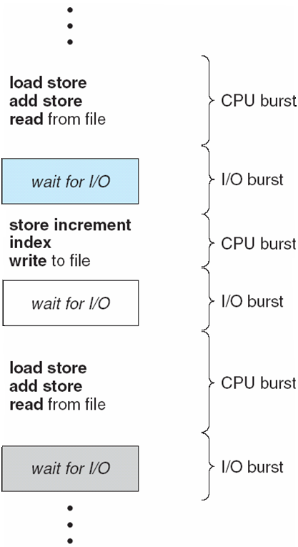
Alternating Sequence of CPU and I/O Bursts
Notes:
‹#›

Slide 7
CPU Scheduler
Selects from among the processes in memory that are ready to execute, and allocates the CPU to one of them
CPU scheduling decisions may take place when a process:
1. Switches from running to waiting state
2. Switches from running to ready state
3. Switches from waiting to ready
Terminates
Scheduling under 1 and 4 is non-preemptive
All other scheduling is preemptive – implications for data sharing between threads/processes
Notes:
‹#›

Slide 8
Dispatcher
Dispatcher module gives control of the CPU to the process selected by the scheduler; this involves:
switching context
switching to user mode
jumping to the proper location in the user program to restart that program
Dispatch latency – time it takes for the dispatcher to stop one process and start another running
Notes:
‹#›

Slide 9
Scheduling Criteria
CPU utilization – keep the CPU as busy as possible
Throughput – # of processes that complete their execution per time unit
Turnaround time – amount of time took to execute a particular process
Waiting time – amount of time a process has been waiting.
Response time – amount of time it takes from when a request was submitted until the first response is produced, not output (for time-sharing environment)
Notes:
‹#›

Slide 10
Scheduling Algorithm Optimization Criteria
Max CPU utilization
Max throughput
Min turnaround time
Min waiting time
Min response time
Notes:
‹#›

Slide 11
First-Come, First-Served (FCFS) Scheduling
Process Burst Time
P₁ 24
P₂ 3
P₃ 3
Suppose that the processes arrive in the order: P₁ , P₂ , P₃ The Gantt Chart for the schedule is:
Waiting time for P₁ = 0; P₂ = 24; P₃ = 27
Average waiting time: (0 + 24 + 27)/3 = 17
P₁
P₂
P₃
0
24
27
30
Notes:
‹#›

Slide 12
FCFS Scheduling (Cont.)
Suppose that the processes arrive in the order:
P₂ , P₃ , P₁
The Gantt chart for the schedule is:
Waiting time for P₁ = 6; P₂ = 0; P₃ = 3
Average waiting time: (6 + 0 + 3)/3 = 3
Much better than previous case
P₂
P₃
P₁
0
3
6
30
Notes:
‹#›

Slide 13
Shortest-Job-First (SJF) Scheduling
Associate with each process the length of its next CPU burst. Use these lengths to schedule the process with the shortest time.
SJF is optimal – gives minimum average waiting time for a given set of processes
The difficulty is knowing the length of the next CPU request.
Notes:
‹#›

Slide 14
Example of SJF
Process Arrival Time Burst Time
P₁ 0.0 6
P₂ 2.0 8
P₃ 4.0 7
P₄ 5.0 3
SJF scheduling chart
Average waiting time = (3 + 16 + 9 + 0) / 4 = 7
P₄
P₁
P₃
P₂
0
3
9
16
24
Notes:
‹#›

Slide 15
Priority Scheduling
A priority number (integer) is associated with each process
The CPU is allocated to the process with the highest priority (smallest integer ≡ highest priority)
Preemptive
Non-preemptive
Note that SJF is a priority scheduling where priority is the predicted next CPU burst time
Problem ≡ Starvation – low priority processes may never execute
Solution ≡ Aging – as time progresses increase the priority of the process
Notes:
‹#›

Slide 16
Round Robin (RR)
Each process gets a small unit of CPU time (time quantum), usually 10-100 milliseconds. After this time has elapsed, the process is preempted and added to the end of the ready queue.
We can predict wait time: If there are n processes in the ready queue and the time quantum is q, then each process gets 1/n of the CPU time in chunks of at most q time units at once. No process waits more than (n-1)q time units.
Performance
q large ⇒ FIFO
q small ⇒ may hit the context switch wall: q must be large with respect to context switch, otherwise overhead is too high
Notes:
‹#›

Slide 17
Example of RR with Time Quantum = 4
Process Burst Time
P₁ 24
P₂ 3
P₃ 3
The Gantt chart is:
Typically, higher average turnaround than SJF, but better response
P₁
P₂
P₃
P₁
P₁
P₁
P₁
P₁
0
4
7
10
14
18
22
26
30
Notes:
‹#›

Slide 18
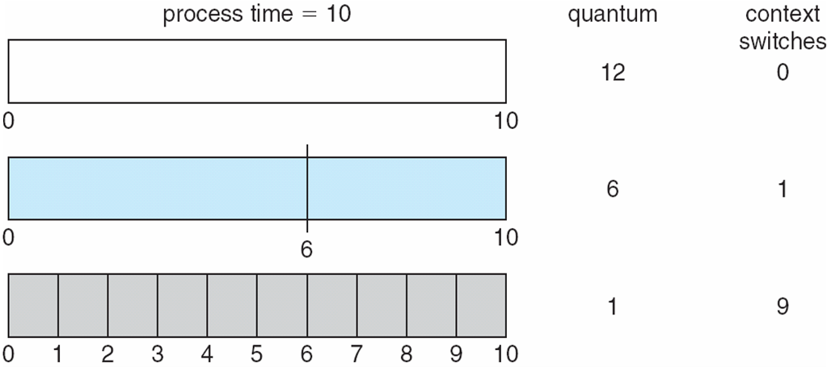
Time Quantum and Context Switch Time
Notes:
‹#›

Slide 19
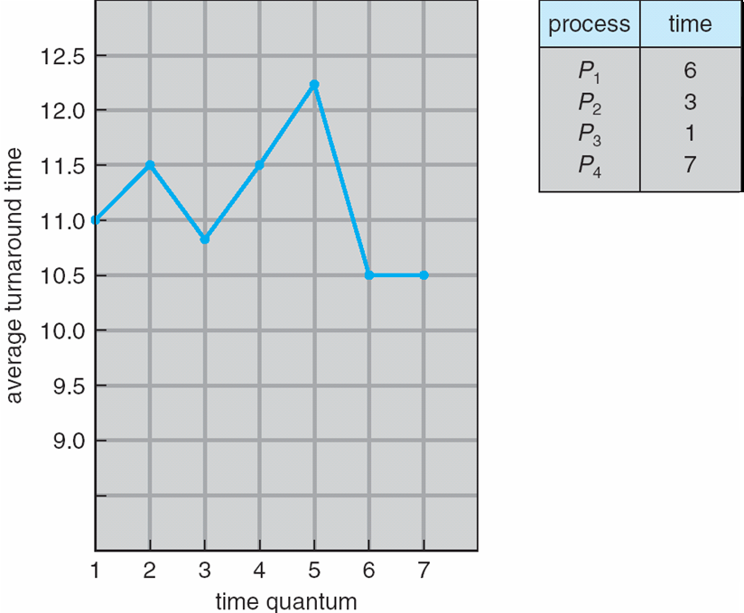
Turnaround Time Varies With The Time Quantum
Notes:
‹#›

Slide 20
Multilevel Queue
Ready queue is partitioned into separate queues:
foreground (interactive)
background (batch)
Each queue has its own scheduling algorithm:
foreground – RR
background – FCFS
Scheduling must be done between the queues:
Fixed priority scheduling; (i.e., serve all from foreground then from background). Possibility of starvation.
Time slice – each queue gets a certain amount of CPU time which it can schedule amongst its processes; i.e., 80% to foreground in RR
20% to background in FCFS
Notes:
‹#›

Slide 21
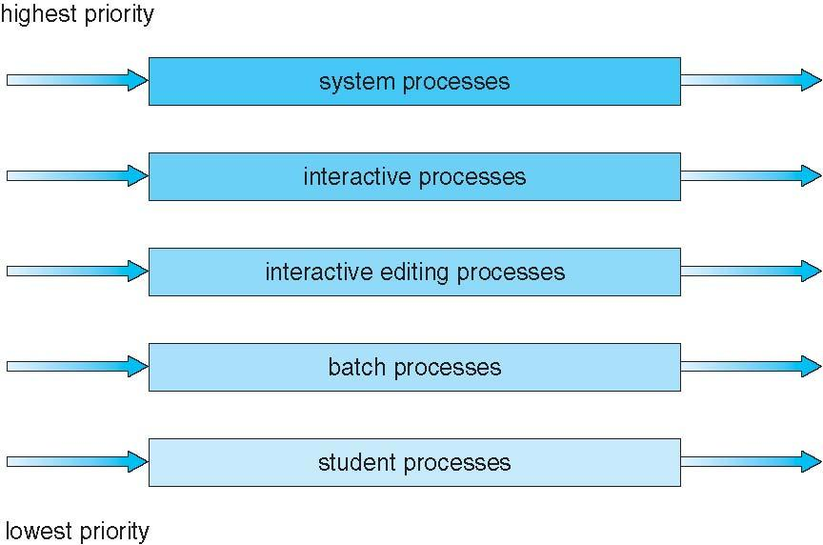
Multilevel Queue Scheduling
Notes:
‹#›

Slide 22
Multilevel Feedback Queue
A process can move between the various queues; aging can be implemented this way.
Multilevel-feedback-queue scheduler defined by the following parameters:
number of queues
scheduling algorithms for each queue
method used to determine when to upgrade a process
method used to determine when to demote a process
method used to determine which queue a process will enter when that process needs service
Notes:
‹#›

Slide 23
Example of Multilevel Feedback Queue
Three queues:
Q₀ – RR with time quantum 8 milliseconds
Q₁ – RR time quantum 16 milliseconds
Q₂ – FCFS
Scheduling
A new job enters queue Q₀ which is served FCFS. When it gains CPU, job receives 8 milliseconds. If it does not finish in 8 milliseconds, job is moved to queue Q₁.
At Q₁ job is again served FCFS and receives 16 additional milliseconds. If it still does not complete, it is preempted and moved to queue Q₂.
Notes:
‹#›

Slide 24
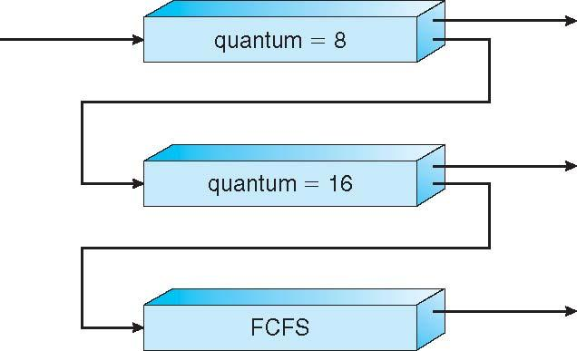
Multilevel Feedback Queues
Notes:
‹#›

Slide 25
End of Chapter 5
Notes:
‹#›

