Slide 1
Q
Q-FLOW
Quantum-inspired metaheuristic optimisation for intelligent traffic routing
Smart India Hackathon · Problem SIH26137
Team: add team name and members
Notes:
Introduce the team and the problem statement SIH26137.

Slide 2



The problem
Urban fleets must route many vehicles through congested roads, under tight constraints
Congestion
NP-hard routing
Quantum hardware is not ready
Travel times change with traffic load; a route that is short on a map can be slow at 6 pm.
Vehicle routing with capacity and time windows explodes combinatorially; exact methods only scale to small cases.
Quantum computers cannot yet run problems this size, so we use a quantum-inspired algorithm on classical CPUs.
Q-FLOW · SIH26137 2

Slide 3
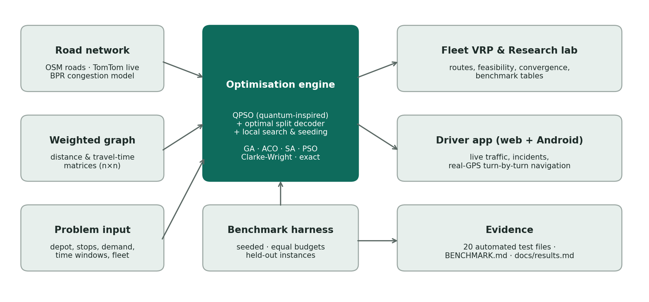
Our solution
One platform: network model, QPSO optimiser, benchmarking, and a real driver app
Q-FLOW · SIH26137 3

Slide 4



Network model and formulation
A weighted graph with travel-time and distance on every edge
Simulated traffic (BPR)
Objective (CVRPTW)
t = t₀ (1 + 0.15 (V/C)⁴) + incident delay; time-of-day and per-road variation
F = Σ distance + 0.4 · Σ route time
+ 1500 · capacity overload (kg)
+ 20 · lateness (min)
+ 10000 · extra vehicles
Live traffic (TomTom)
Real road distances and live travel times from TomTom Matrix Routing (verified)
Constraints: vehicle capacity, customer time windows, depot closing time, fleet size. Every plan is flagged feasible or infeasible with the reason.
Shortest path
Same weighted graph; QPSO compared with exact Dijkstra
Q-FLOW · SIH26137 4

Slide 5




QPSO design
Quantum-behaved particle swarm (Sun, Feng & Xu 2004) plus problem-specific operators
p = φ·pBest + (1−φ)·gBest x ← p ± α·|mBest − x|·ln(1/u)
Particles move in a "quantum potential well" around the attractor p; α falls from 0.95 to 0.50.
Optimal split decoder
Local search
Cuts each customer order into ≤ K routes at the cheapest break points (dynamic programming)
2-opt, or-opt and swap; Lamarckian, plus elite search on the global best
Heuristic seeding
Fair budget
Time-window-aware constructive tours start 15% of the swarm
All evaluations, including local search, count against the same budget
Q-FLOW · SIH26137 5

Slide 6
How we benchmark
Built so that the results can be trusted and reproduced
Equal budget
10 seeded runs
Held-out instances
Exact reference
Every algorithm gets the same number of objective evaluations
Per instance; mean, median, spread and feasibility reported
Tuned on seeds 101–110 only; tested on unseen seeds 1–10
At 8 customers: true optimum by enumeration + optimal split
Compared with: simulated annealing (also with the same split decoder, as a fairness check), genetic algorithm, ant colony, classical PSO, Clarke-Wright and an exact solver.
Q-FLOW · SIH26137 6

Slide 7
Results: 8 and 20 customers
Held-out instances, mean gap (lower is better)
0.1%
from the exact optimum at 8 customers; best on 9 of 10
8.9%
vs 18.0% for SA at 20 customers; wins 8 of 10 (> 2 SE)
SA + split = simulated annealing given the same decoder as QPSO.
Q-FLOW · SIH26137 7

Slide 8
Results: 50 to 200 customers
Mean route cost of QPSO relative to SA (= 100) on instances that can be served
What it shows
QPSO is 6–23% cheaper than SA on every serviceable instance shown.
50 customers overall: tie on mean gap (74.9% vs 73.7%); QPSO wins 3 of 5.
Over-capacity instances (demand > fleet): SA leaves less overload.
100/200 customers: 3 instances each, preliminary.
Q-FLOW · SIH26137 8

Slide 9
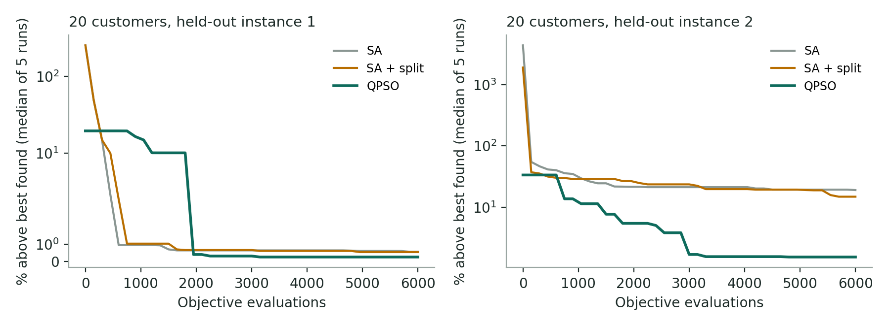
Convergence
QPSO keeps improving where simulated annealing stalls
68%
of QPSO runs get within 5% of the best known solution (SA: 18%)
3,000
evaluations of QPSO beat 12,000 of SA at 20 customers (10.2% vs 15.3% gap)
Trade-off: QPSO is slower per run in wall-clock time (0.1 s vs 0.01 s at 20 customers; 12 s vs 0.3 s at 200).
Q-FLOW · SIH26137 9

Slide 10





The platform
Web app and Android app, built on the same engine
Fleet VRP
Research lab
Live traffic
Pick stops on a Hyderabad map; compare 6 algorithms; feasibility and convergence
Formulation, exact comparison, shortest path, dynamic re-planning
TomTom traffic, incidents and live travel times (verified 6/6)
Real-GPS navigation
Dynamic re-planning
Tested
Turn-by-turn, heading-up camera, automatic rerouting, voice, arrival
QPSO warm start: a new plan is never worse than the old one
20 automated test files; every number labelled live, estimated or simulated
Q-FLOW · SIH26137 10

Slide 11
Honest limits and next steps
Limits today
Next steps
Slower per run than SA (quality per evaluation, not speed)
Behind SA on over-capacity and the tightest 50+ customer fleets
Exact solver up to 9 customers; no MILP yet
100/200-customer results are preliminary
Synthetic instances; lab uses straight-line distances unless live traffic is on
Faster split decoder and Web Workers to cut run time
Benchmark 100–500 customers on more instances, vs OR-Tools
Adaptive capacity penalty for over-capacity fleets
Pilot with real delivery data from a Hyderabad fleet
Q-FLOW · SIH26137 11

Slide 12
Everything is reproducible
npm test
20 automated test files
Deliverables
Software platform (web + Android)
QPSO framework + 5 baselines + exact
Formulation, constraints, convergence
Benchmark report + technical report
This presentation; demo video
npm run bench
Main benchmark (deterministic)
node scripts/extra-experiments.js
Convergence + scale
npm run android:apk
Android app build
Thank you

