Slide 1

AI Recruitment Pipeline
Welcome! Today, we'll explore a revolutionary approach to recruitment that utilizes AI to enhance efficiency and effectiveness. This presentation will delve into the key components of an automated recruitment pipeline, demonstrating how AI can streamline every stage of the process, from initial resume screening to final decision-making.
Yaswanth Kumar Yallapu

Slide 2
Objective:
1
3
Automates resume screening, interview process, and decision-making.
Final decision (Select/Reject) is made using resume, JD, and performance.
2
4
Uses AI to generate
interview questions
& conduct interviews.
Automated
Email Notifications

Slide 3
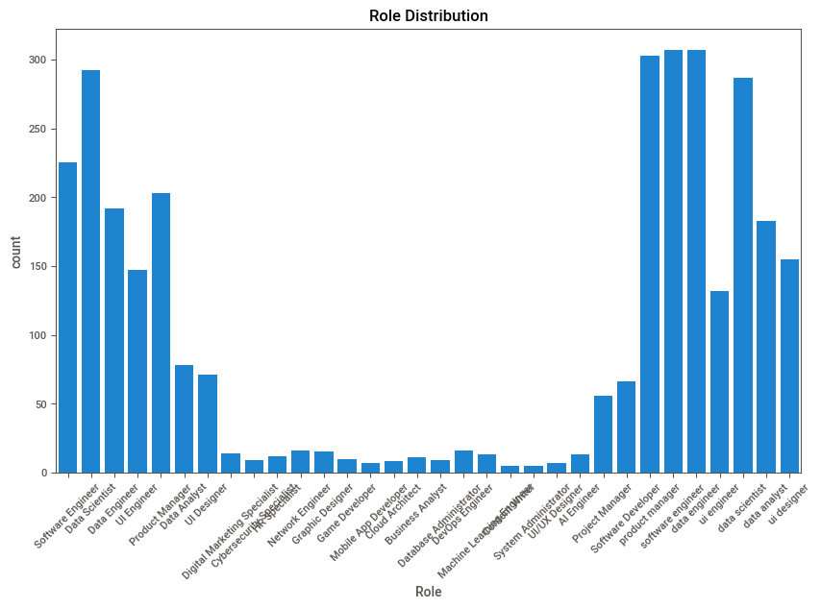
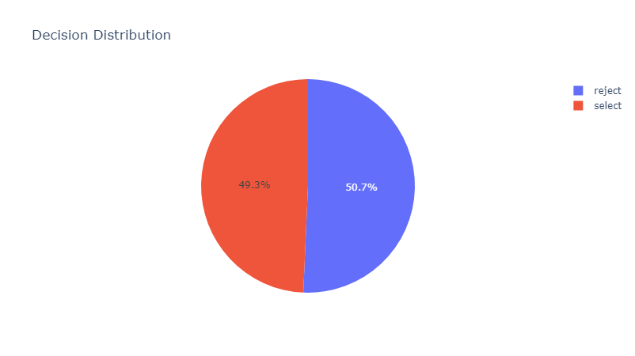
Exploratory Data Analysis - Candidate Insights
1
The top 3 roles with the highest applicant counts:
Software Engineer
Data Scientist
Data Engineer
2
Candidate Decision Distribution
The dataset has an almost equal distribution
betweenn selected and rejected candidates.

Slide 4
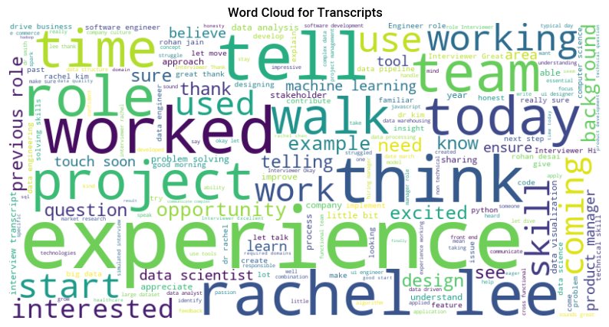
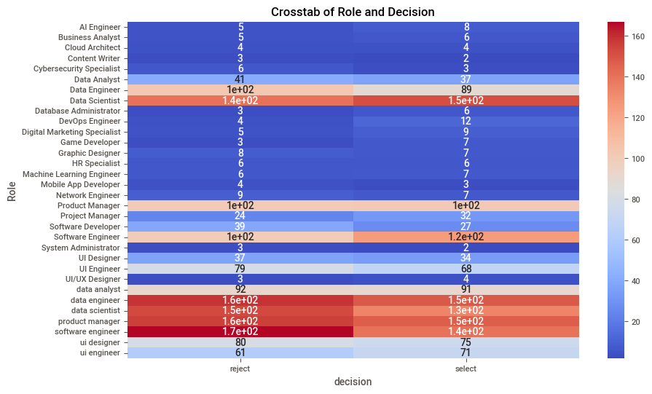
Exploratory Data Analysis – Resume, Transcript, Role Analysis
3
Insights from Word Cloud for Transcripts:
The most frequent words include "experience," "project," "worked," "team," and "role".
Highlights the focus on experience and teamwork, which are likely significant factors in the decision-making process.
4
Role vs. Decision Analysis
Top roles with high selections: Software Engineer, Data Scientist, Data Engineer, and Product Manager.
The heatmap highlights the role-specific competition and may indicate how candidates perform in interviews or align with JD’s.

Slide 5

Model Training:
1
Classical Machine Learning Models: Overview & Features
📌Models used:
Logistic Regression
XG Booost
Random Forest
Gradient Boosting
CatBoost
MLP
AdaBoost
Decision Tree
📌 Key Features Extracted:
num_words_in_transcript
job_fit_score
Sentiment
num_words_in_transcript
resume_transcript_similarity
resume_jd_similarity
role_transcript_similarity
Lexical_diversity

Slide 6
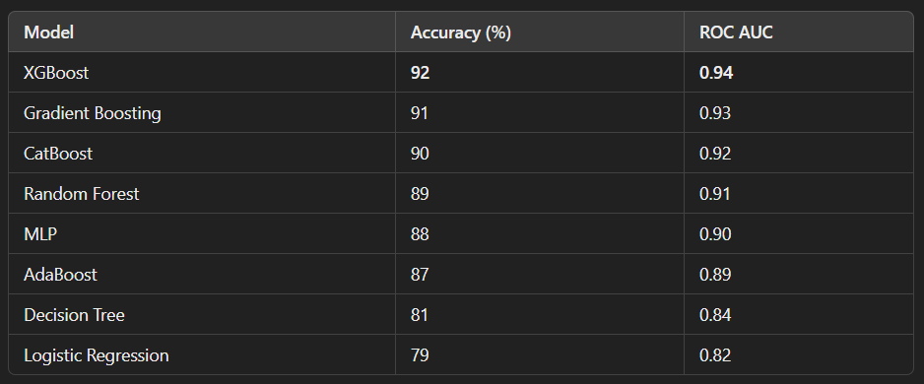
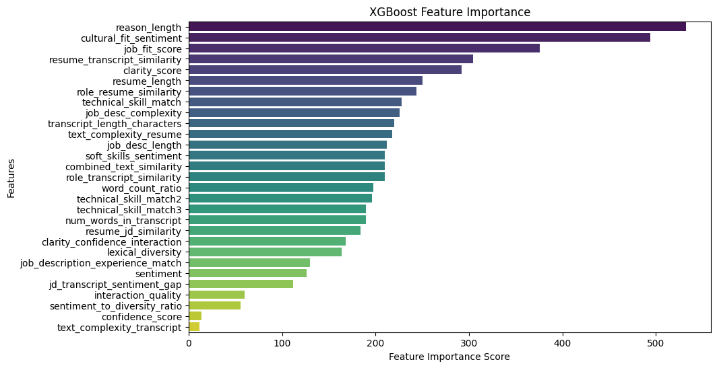
Model Training:
2
What is the best model?
XGBoost is the Best model and the top performer with the highest accuracy (92%) and ROC AUC (0.94)
Top 5 Features
Reason Length
Cultural Fit Sentiment
Job Fit Score
Resume-Transcript Similarity
Clarity Score

Slide 7
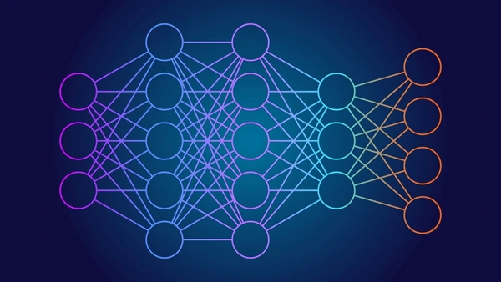
Model Training:
3
Deep Learning Model: BERT + Neural Network
Approach
Text Embeddings: Leveraged BERT embeddings to extract contextual representations for:
Transcripts
Resumes
Job Descriptions (JDs)
Model Architecture:
A fully connected neural network trained on BERT embeddings to
perform classification (select/reject).
Optimized using Adam optimizer and categorical cross-entropy loss.
Results
Achieved superior performance compared to classical ML models.
Demonstrated better contextual understanding of text-based data.

Slide 8
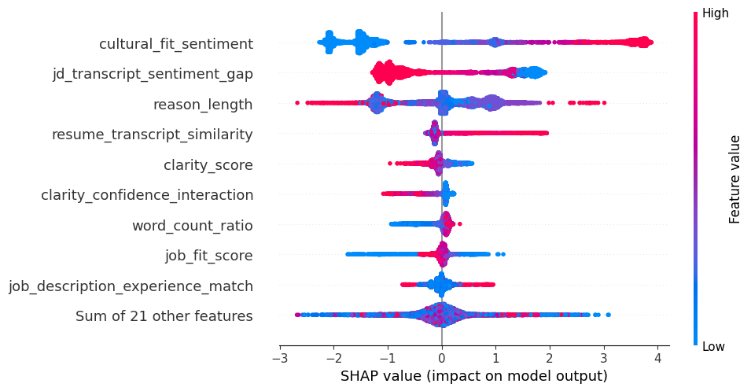
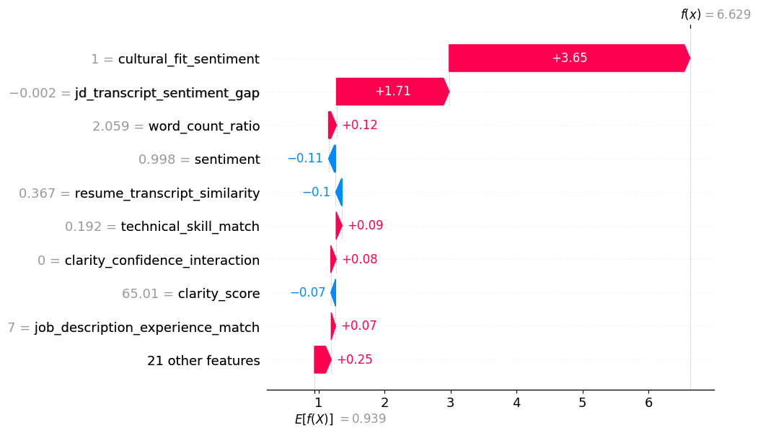
Post Model Analysis:
SHAP Analysis:
Plot 1: SHAP Summary plot of feature importance.
Plot 2: SHAP Waterfall Plot for Instance 1
Key Insights:
Cultural Fit Sentiment and JD Transcript Sentiment Gap are the most impactful features.
Features like Reason Length and Resume Transcript Similarity also significantly influence outcomes.
Key Insights:
Cultural Fit Sentiment is the most impactful feature, contributing significantly to the model's prediction.
Negative contributions from features such as Sentiment and Clarity Score slightly offset the positive impacts.

Slide 9
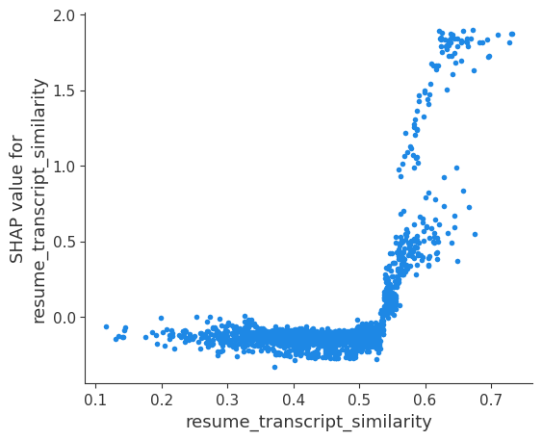
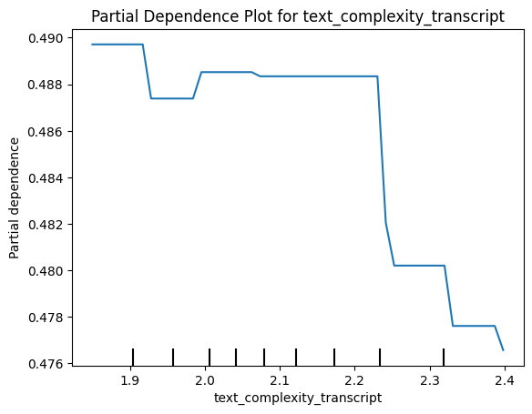
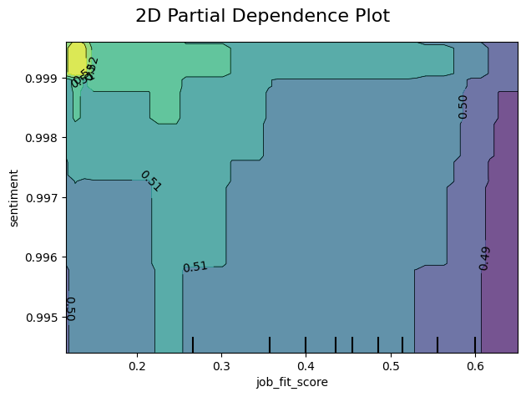
Post Model Analysis:
Plot 3: Dependence Plot
The SHAP value for resume_transcript_similarity demonstrates a positive correlation with the feature value.
When resume_transcript_similarity exceeds approximately 0.5, its SHAP value increases sharply, indicating a stronger contribution to the model's prediction.
This suggests that a higher similarity between the resume and transcript positively impacts the prediction, especially beyond the threshold of 0.5.
Plot 4: Partial Dependence Plot
It shows the marginal effect of a feature on the predicted outcome, averaged over all observations in the dataset.
You can use this plot to understand how the model prediction varies as the value of the feature changes, while keeping other features constant.
Plot 5: 2D Partial Dependence Plot
It visualizes interactions between the features job_fit_score and sentiment.
This plot helps in understanding the combined influence of two features on the model’s prediction.

Slide 10

Resume screener :
Data Preparation
Combined datasets of Resumes, Job Descriptions (JDs), and Transcripts from Excel files.
Standardized column names for consistency.
Text Feature Extraction
Used TF-IDF Vectorizer to convert textual data into numerical vectors for:
Resumes, JDs, and Transcripts.
Similarity Analysis
Computed Cosine Similarity between Resumes and JDs to measure alignment.
Higher similarity indicates better candidate-job fit.
Future Use
Saved the trained TF-IDF model for scalability in screening multiple candidates.

Slide 11

Prediction & Automated Email:
1. Prediction Model (Hiring Decision)
AI analyzes candidate data (resume, test scores, interview responses).
Uses ML models to predict the best-fit candidates.
Ranking based on job requirements, company preferences, and past hiring success.
2. Automated Email Notification
AI-generated emails for different candidate outcomes:
It sends the candidate name and Selected/Rejected Decision.
Saves HR time and ensures a professional, timely response.
3. Benefits
Reduces manual work and improves efficiency.
Enhances candidate experience with instant updates.
Ensures unbiased decision-making.

Slide 12
Conclusion:
2
4
6
Screen Resumes (AI)
Generate interview questions
using JD (AI) using Llama
Give the decision
(Reject/Select) (AI)
1
3
5
7
Collect resume
Select Candidates
for
Interview (AI)
Take the interview
(AI or human)
Send mail to
concerned person
(AI)

Slide 13
Thank You

