Slide 1
NFA to DFA
Notes:
Cpt S 317: Spring 2009
School of EECS, WSU

Slide 2
Conversion from NFA to DFA
Let, M = (Q, ∑, δ, q0, F) is an NFA which accepts the language L(M). There should be equivalent DFA denoted by M' = (Q', ∑', q0', δ', F') such that L(M) = L(M').

Slide 3
Conversion from NFA to DFA (cont’d...)
Step 1: Initially Q' = ϕ
Step 2: Add q0 of NFA to Q'. Then find the transitions from this start state.
Step 3: In Q', find the possible set of states for each input symbol. If this set of states is not in Q', then add it to Q’. This will be repeated until no new states arrive
Step 4: In DFA, the final state will be all the states which contain F(final states of NFA)

Slide 4
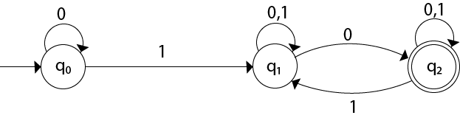
Conversion from NFA to DFA (cont’d...)
Example 1:
Convert the given NFA to DFA.

Slide 5
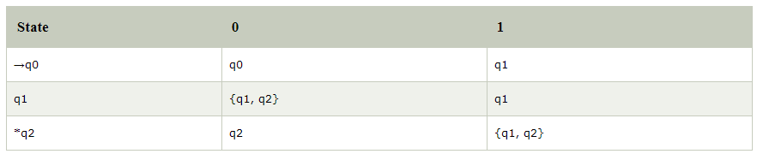
Conversion from NFA to DFA (cont’d...)
Solution: For the given transition diagram we will first construct the transition table.

Slide 6
Conversion from NFA to DFA (cont’d...)
Now we will obtain δ' transition for state q0.
δ'([q0], 0) = [q0]
δ'([q0], 1) = [q1]
The δ' transition for state q1 is obtained as:
δ'([q1], 0) = [q1, q2] (new state generated)
δ'([q1], 1) = [q1]
The δ' transition for state q2 is obtained as:
δ'([q2], 0) = [q2]
δ'([q2], 1) = [q1, q2]
Now we will obtain δ' transition on [q1, q2].
δ'([q1, q2], 0) = δ(q1, 0) ∪ δ(q2, 0)
= {q1, q2} ∪ {q2}
= [q1, q2]
δ'([q1, q2], 1) = δ(q1, 1) ∪ δ(q2, 1)
= {q1} ∪ {q1, q2}
= {q1, q2}
= [q1, q2]

Slide 7
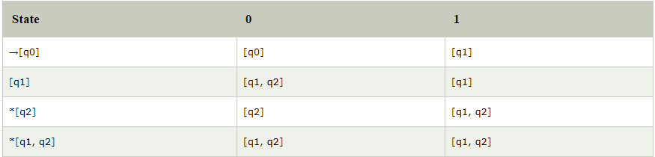
Conversion from NFA to DFA (cont’d...)
The state [q1, q2] is the final state as well because it contains a final state q2. The transition table for the constructed DFA will be:

Slide 8
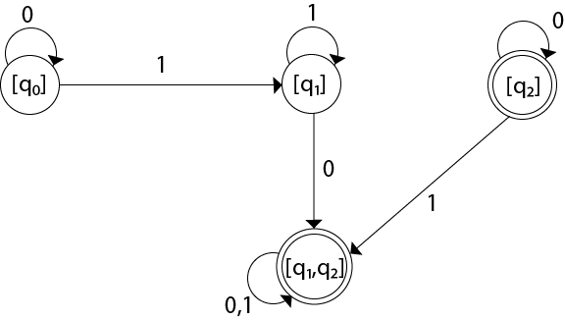
Conversion from NFA to DFA (cont’d...)
The Transition diagram will be:
The state q2 can be eliminated because q2 is an unreachable state.

Slide 9
NFA to DFA construction: Example
L = {w | w ends in 01}
1
0
NFA:
DFA:
[q₀]
0
[q₀,q₁]
1
[q₀,q₂]
0,1
0
0
1
1
q₀
q₁
q₂
δ_{N} | 0 | 1
q₀ | {q₀,q₁} | {q₀}
q₁ | Ø | {q₂}
*q₂ | Ø | Ø
Notes:
Cpt S 317: Spring 2009
School of EECS, WSU

Slide 10
A bad case where #states(DFA)>>#states(NFA)
L = {w | w is a binary string s.t., the k^{th} symbol from its end is a 1}
  NFA has k+1 states
  But an equivalent DFA needs to have at least 2^{k} states
(Pigeon hole principle)
  m holes and >m pigeons
    => at least one hole has to contain two or more pigeons
Notes:
Cpt S 317: Spring 2009
School of EECS, WSU

Slide 11
Discussion Questions
Please refer
TB_A2_NFA to DFA_Q.doc
TB_A2_NFA to DFA_Ans.doc

