Slide 1
Task-2
Vulnerability Assessment Report
Netsparker

Slide 2
Type of Vulnerability: Out of - date Version (openSSL)
URL: https://zero.webappsecurity.com/
Date of Discovery: 30-06-2021
CVSS Score: 4.3
Version: 0.9.8e
Tested Environment:
Testing Tool: Netsparker v4.8
OS: Windows10
Details/Impacts of Vulnerability:
1.OpenSSL Exposure of Sensitive Information to an Unauthorized Actor Vulnerability
when pretty printing is used, does not ensure the presence of '\0' characters, which allows context-dependent attackers to obtain sensitive information from process stack memory by reading output from X509_name_oneline, X509_name_print_ex, and unspecified other functions.

Slide 3
2. OpenSSL Resource Management Errors Vulnerability
Memory leak in d1_both.c in the DTLS implementation in OpenSSL 0.9.8 allows remote attackers to cause a denial of service (memory consumption) via zero-length DTLS fragments that trigger improper handling of the return value of a certain insert function.
d1_both.c in the DTLS implementation in OpenSSL 0.9.8 allows remote attackers to cause a denial of service (memory consumption) via crafted DTLS handshake messages that trigger memory allocations corresponding to large length values.
3.OpenSSL Cryptographic Issues Vulnerability
OpenSSL does not properly enforce the no-ssl3 build option, which allows remote attackers to bypass intended access restrictions via an SSL 3.0 handshake, related to s23_clnt.c and s23_srvr.c.
and many more..

Slide 4
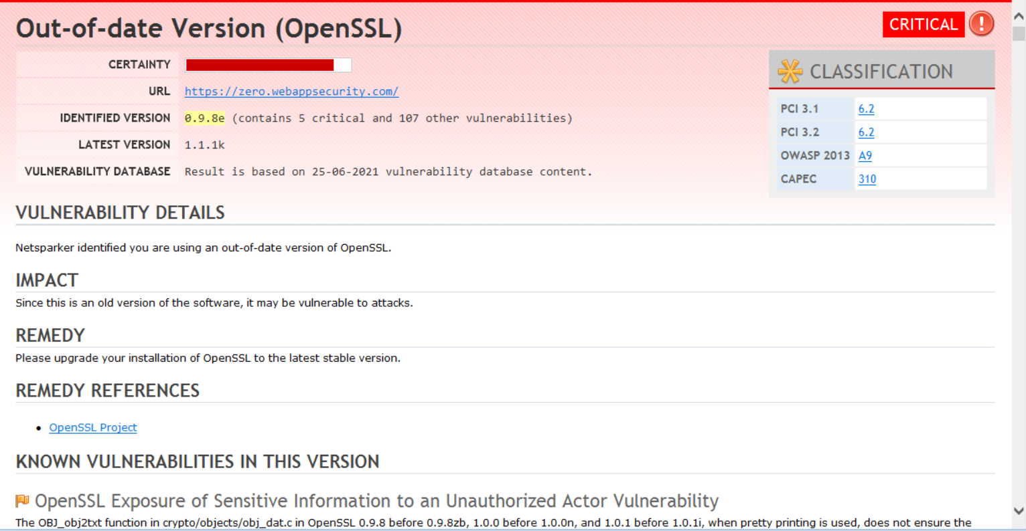
4.Details of the process to correct the vulnerability:
--upagrade your OpenSSL to latest stable version
5.proof of concept :

Slide 5
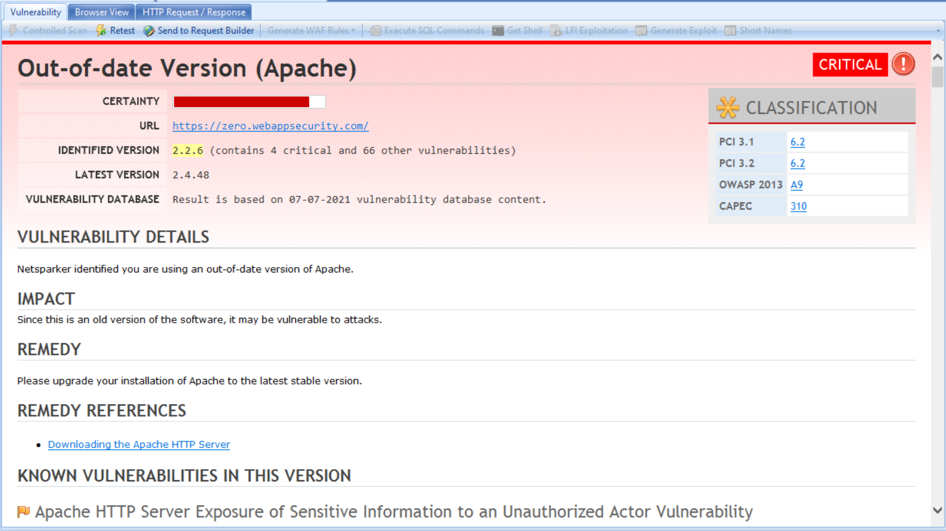
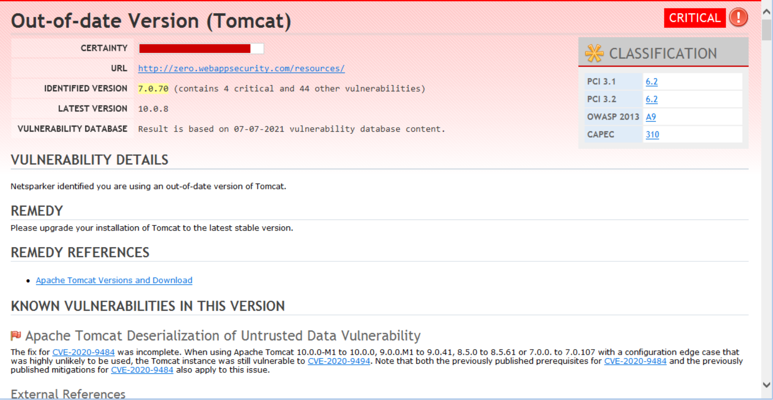
Other Critical Vulnerabilities :
-- out-of-date Version( Tomact)
-- out-of-date version (Apcahe)

