Slide 1
Task-3
Cross-Site-Scripting(Xss)
Report

Slide 2
Vulnerability : Cross-Site Scripting
Domain : vulnweb.com
Sub-Domain : http://testasp.vulnweb.com/Search.asp
Environment : tool - Burp suite
Os - Kali Linux
Critical : one of top 10 vulnerability by owasp
Cross-Site Scripting (XSS) attacks are a type of injection, in which malicious scripts are injected into otherwise benign and trusted websites. XSS attacks occur when an attacker uses a web application to send malicious code, generally in the form of a browser side script, to a different end user. Flaws that allow these attacks to succeed are quite widespread and occur anywhere a web application uses input from a user within the output it generates without validating or encoding it.

Slide 3
Imapact:
An attacker can use XSS to send a malicious script to an unsuspecting user. The end user’s browser has no way to know that the script should not be trusted, and will execute the script. Because it thinks the script came from a trusted source, the malicious script can access any cookies, session tokens, or other sensitive information retained by the browser and used with that site. These scripts can even rewrite the content of the HTML page.
Steps to Reproduce:
Step 1: Visit http://testasp.vulnweb.com/
Step 2: On the top menu you will find a search option.
Step 3: Click on it and you will be prompted with the Search box.
Step 4: You can intercept the request in Burp Suite
Step 5: Now you can find different payloads for XSS.
Ex:</script><script >alert(document.cookie)</script>
Step 6: Send the request to the intruder and paste all the payloads.
Step 7: Start Attack
Step 8: find a successful payload for XSS By performing Attack using Bruteforce checking its response , status code ,response length .

Slide 4
Mitigation:
Whenever possible, prohibit HTML code in inputs. Preventing users from posting HTML code into form inputs is a straightforward and effective measure.
Validate inputs. If you're going to accept form inputs, validating the data to ensure it meets specific criteria will be helpful
Secure your cookies. Setting rules for your web applications defining how cookies are handled can prevent XSS and even block JavaScript from accessing cookies.
Sanitize data. Similar to validation, sanitizing occurs after data has been posted but before it is executed. Look for online tools like HTMLSanitizer to sanitize HTML code online for XSS vulnerabilities.
Use a web application firewall (WAF). Rules can be created on a WAF to specifically address XSS by blocking abnormal server requests. A robust WAF should be a key component of your organization's security strategy, as it can also prevent SQL injection attacks, distributed denial-of-service attacks and other common threats.

Slide 5
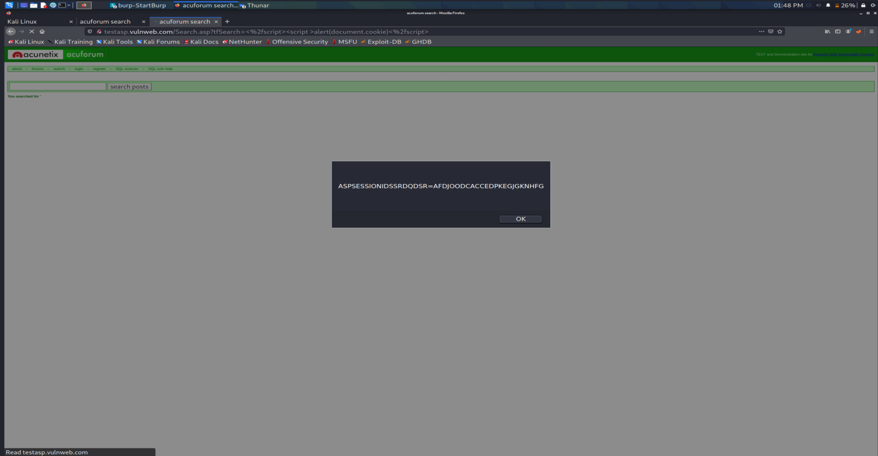
Payload : </script><script >alert(document.cookie)</script>
- provide the details user cookies.
Proof -Of -Concept:
Image1.jpg

Slide 6
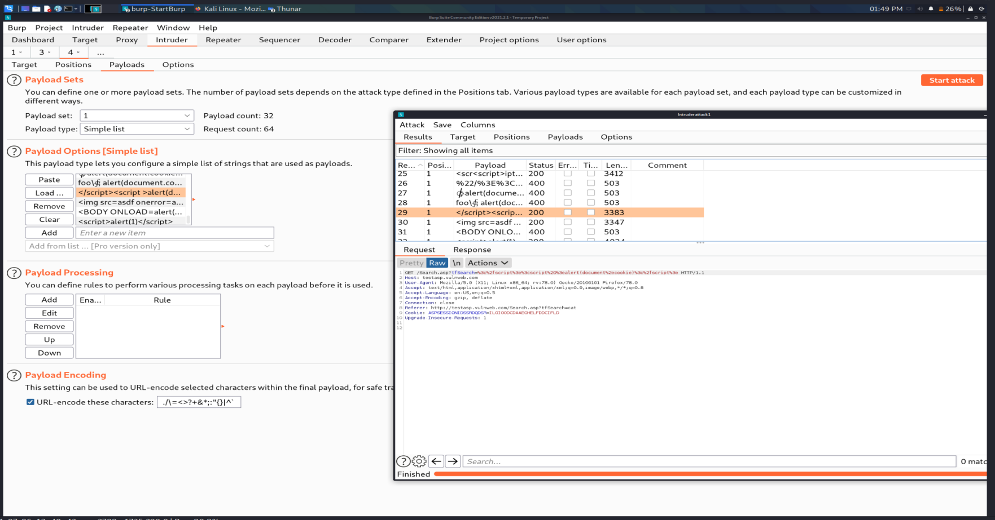

Slide 7
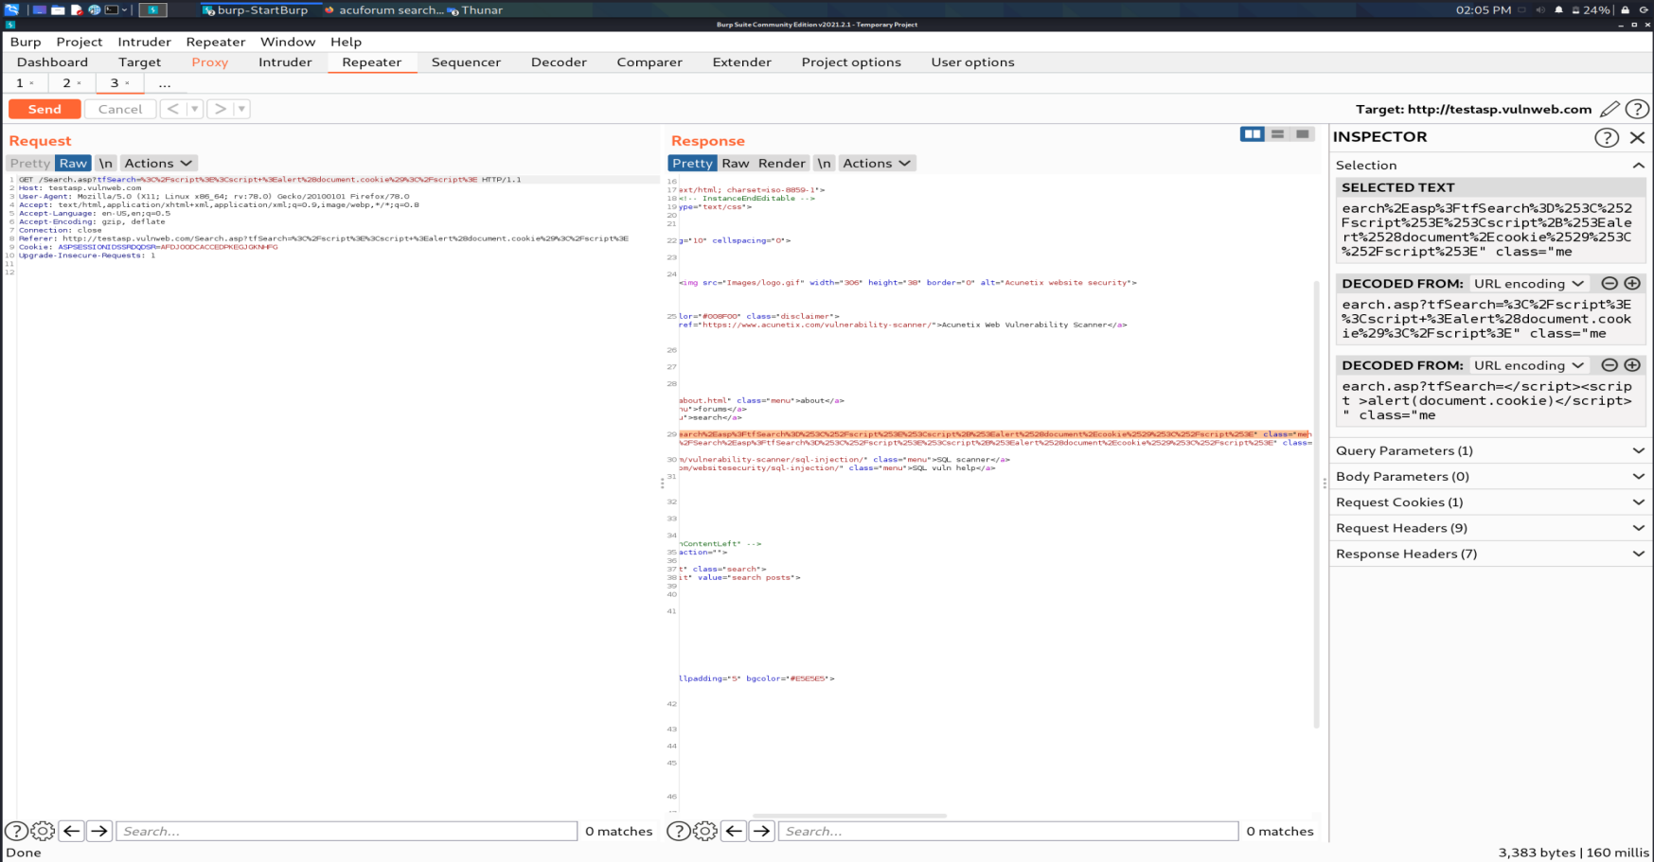

Slide 8
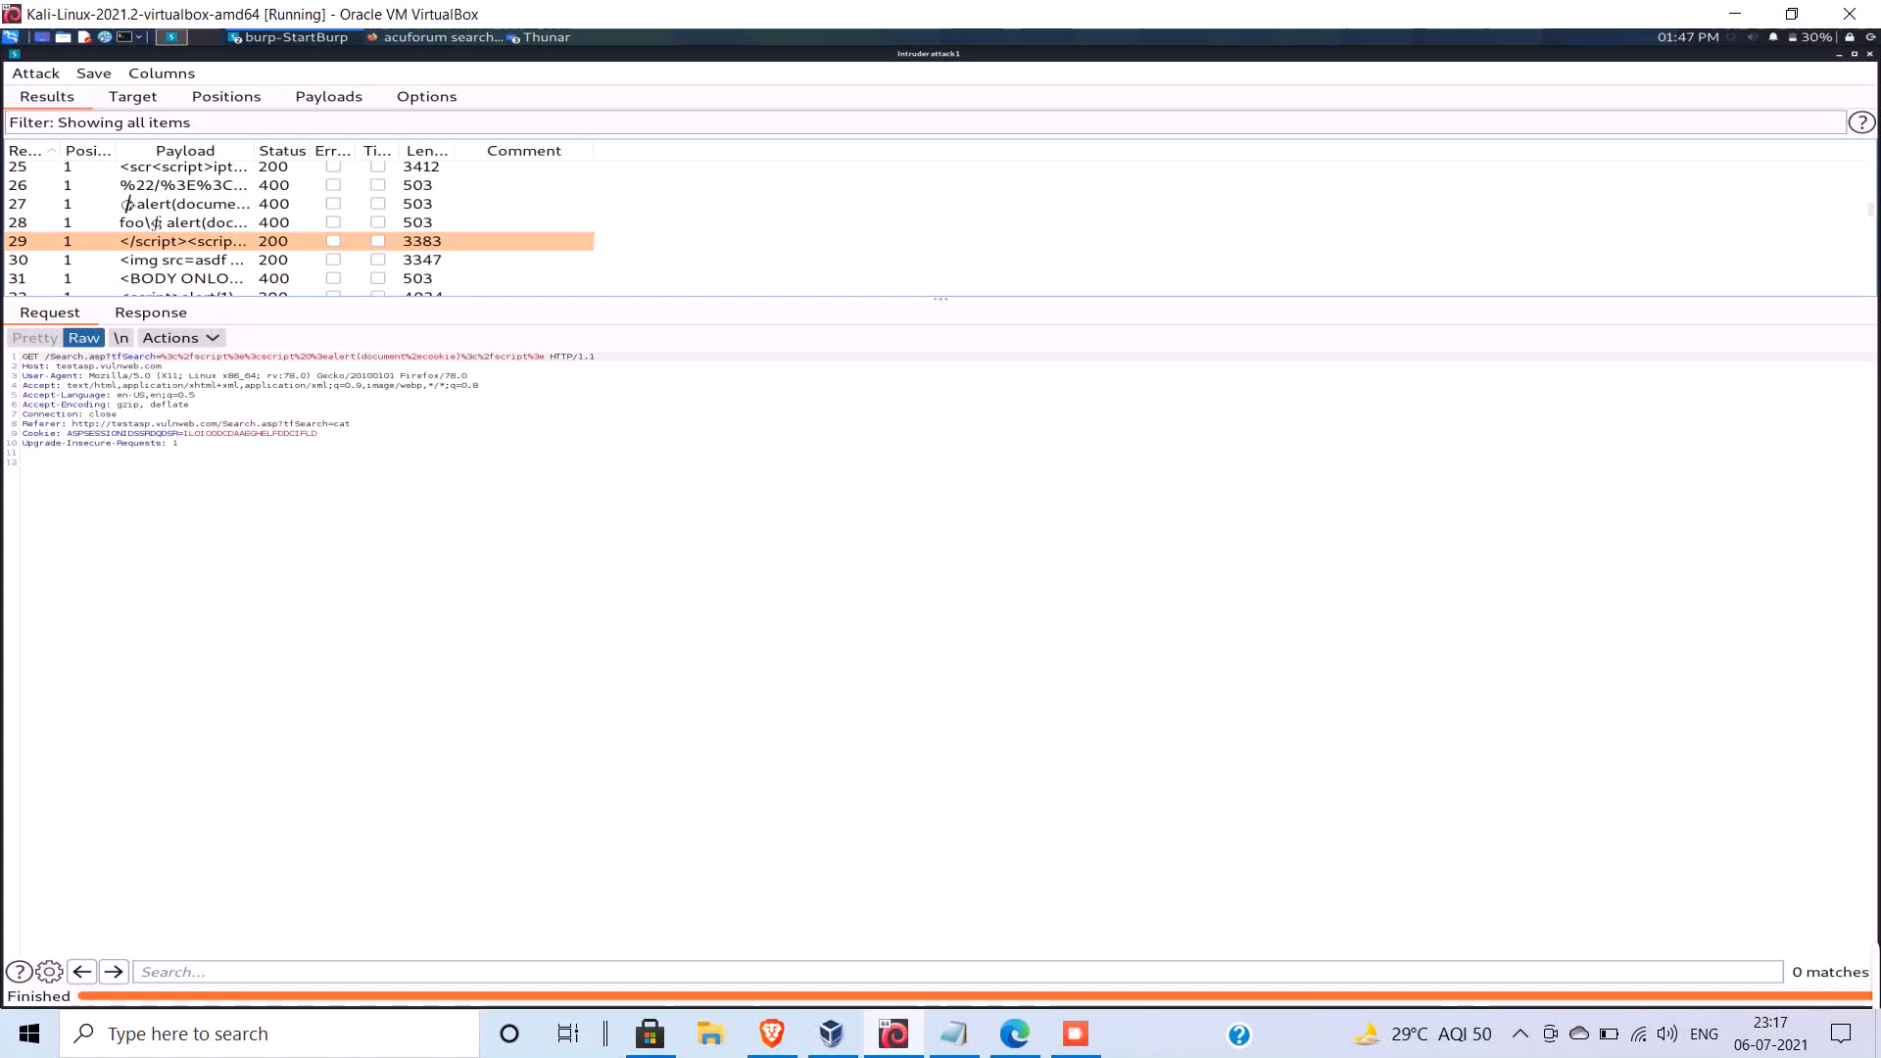
Video :

