Slide 1

Busniess Pitch Deck

Slide 2
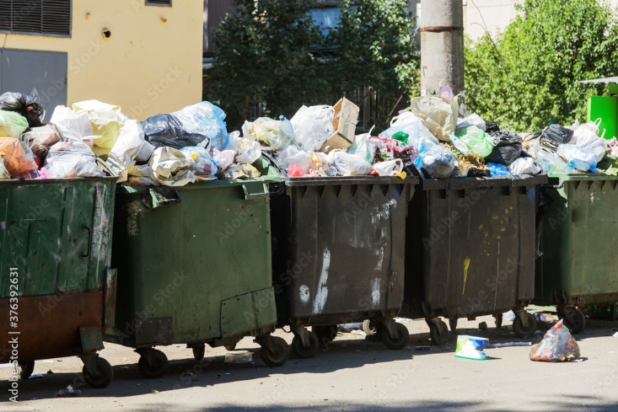
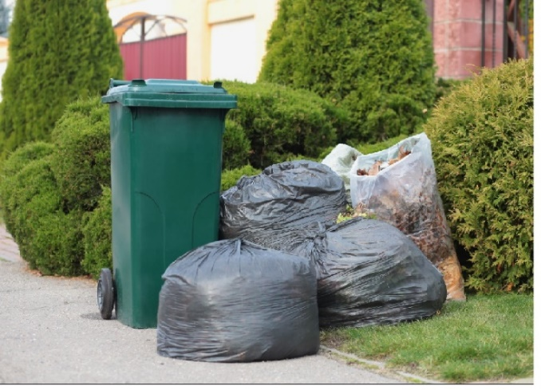
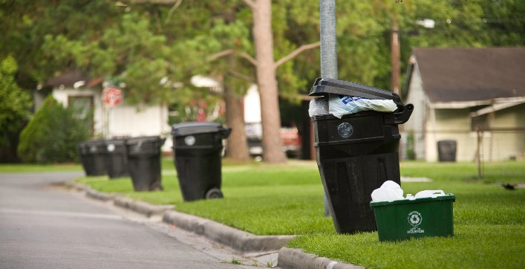
Problem Statement
Facility managers grapple with supervising waste disposal for multiple buildings due to unpredictable garbage collection schedules. The prolonged exposure of waste not only impacts operational efficiencies but also ruins the aesthetics and cleanliness of the facilities.

Slide 3
Driven Innovation
Addressing a critical real-world problem faced by facility managers.
Utilizing innovative sensor technology and machine learning for efficient waste management.
Creating a positive social and environmental impact by promoting sustainability.
Exploring potential business opportunities in the growing smart waste management market.

Slide 4
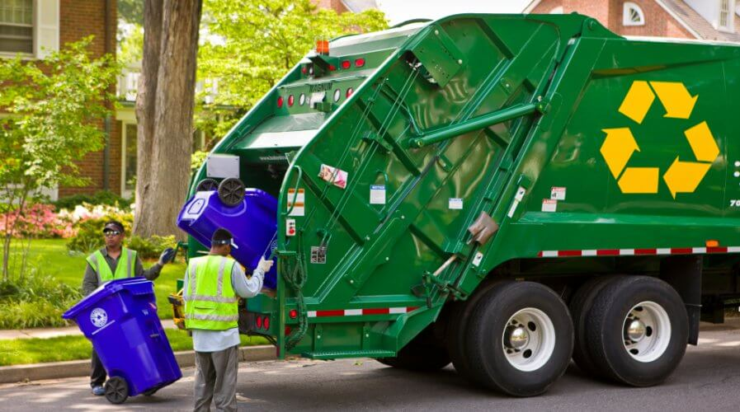
Existing Solution
May be a bit few words about this slide

Slide 5
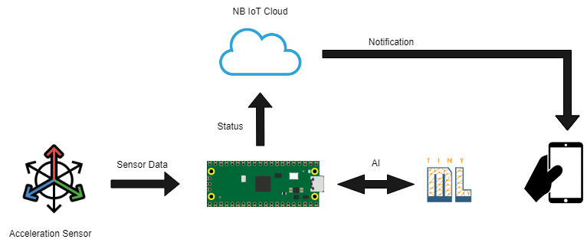
Our Solution
Leverages sensor technology and machine learning.
MPU6050 Sensor monitors garbage bin acceleration data.
Machine learning model detects emptied bins accurately.
Real-time notifications to facility managers.

Slide 6
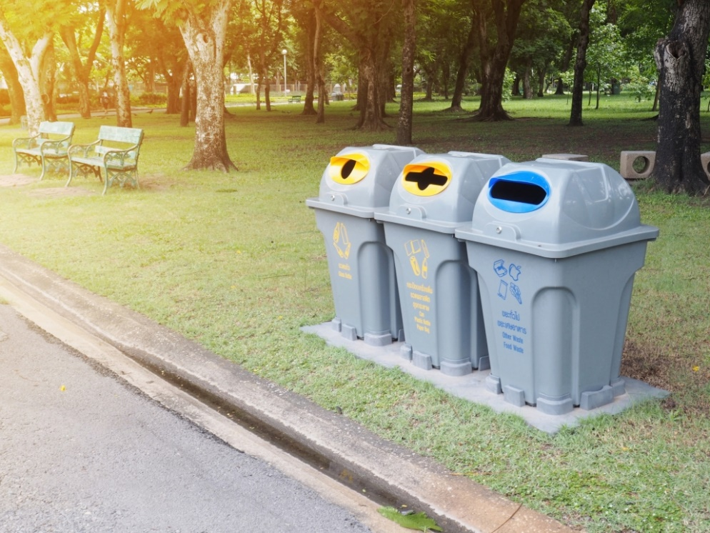
Empowering Solutions!
Cleaner sustainable environment
Automated bin notifications
Automated Route Planning

Slide 7
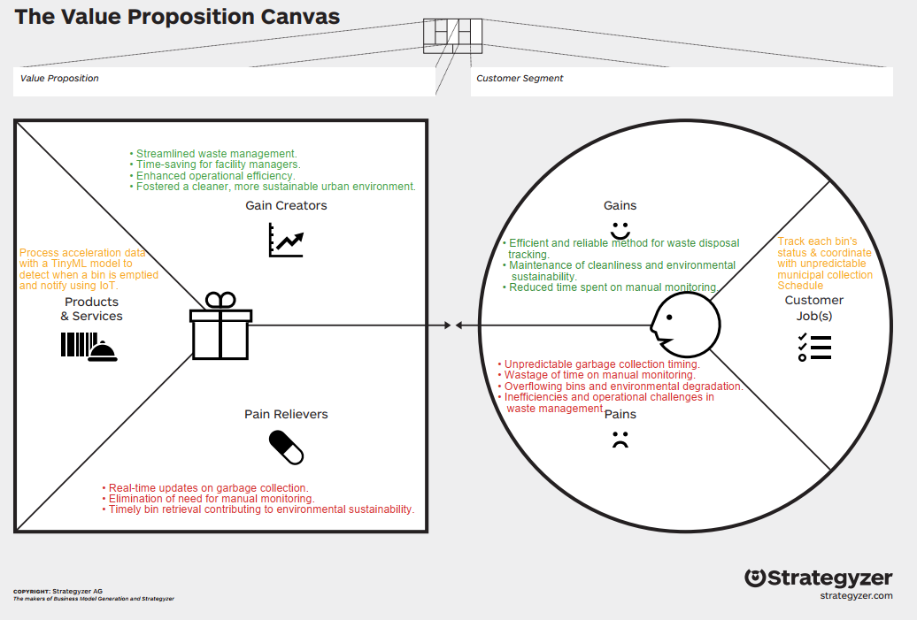
Source: Strategyzer

Slide 8
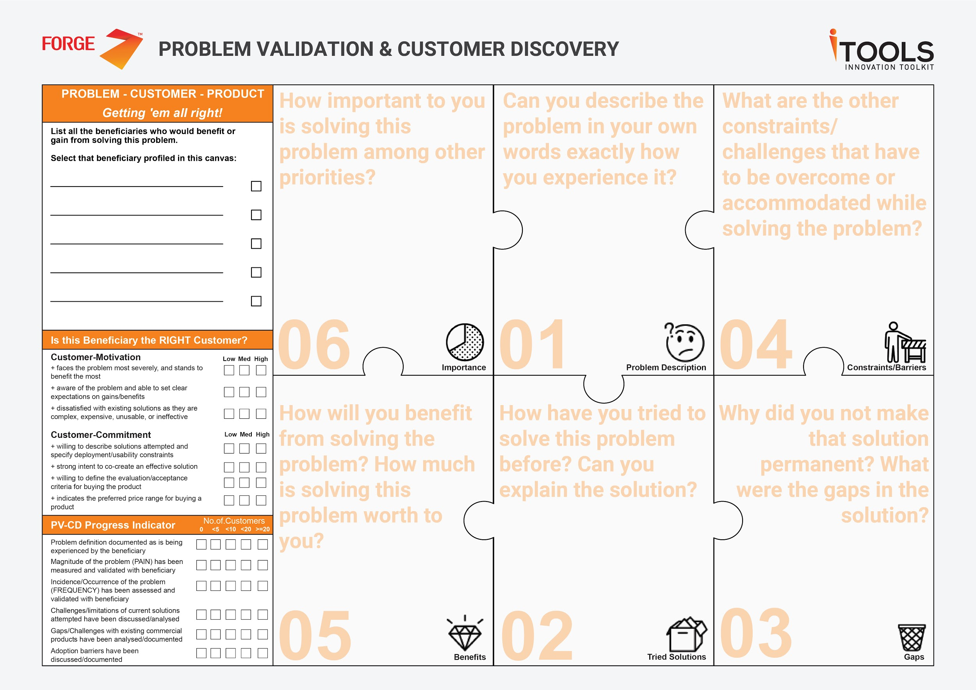
Facility Managers
Unpredictable schedules and waste exposure create inefficiencies.
Reduce labour cost
Supervising waste disposal for multiple buildings
Budget constraints Scalability
This slide could be removed
Manual Monitoring and Scheduling
Fixed collection days
Operational efficiency
Cost savings
Enhanced reputation
Manual labour intensive
Inconsistent schedules
Environmental impact
Source: Forge Accelerator

Slide 9
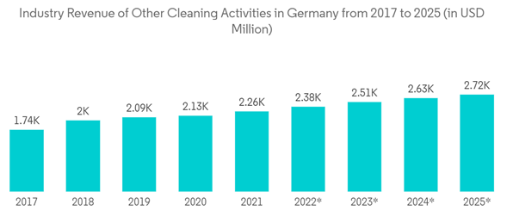
Market Size
Europe holds the third largest share of the global facility management market & is projected to grow from $290.4 billion in 2022 to $426.6 billion by 2030.
The Germany Facility Management Market is expected to register a CAGR above 3.58% from 2022 to 2027.
Smart Garbage Can system is applicable across diverse sectors.
Source: Research & Markets

Slide 10






Potential Customer Profiles from black forest
https://www.schwarzwaelder-service.de/
https://www.reppdienstleistungen.de/
http://www.abr-gm.de/
https://www.universal-dienstleistungen.de/
https://www.argus-dienstleistungen.de/
https://servicesystem.eu/

Slide 11








Competitors

Slide 12
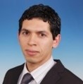
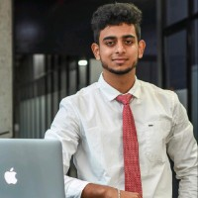

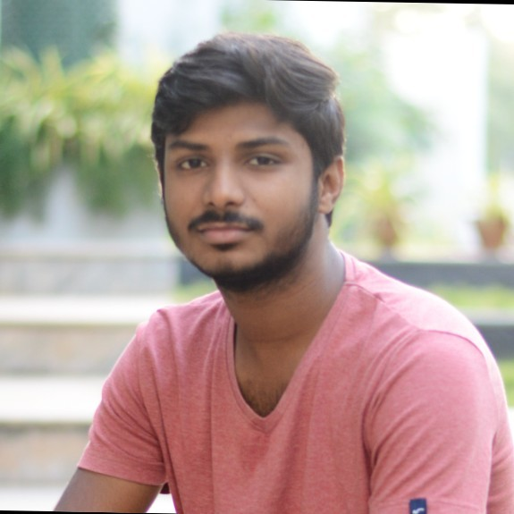
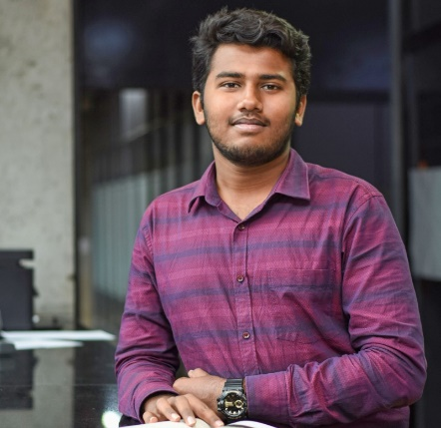
Team:
Mohamed Bourouah
Hahn-Schickard
Ajeeth V
Keerthana M
Sheren
Yaswanthkumar S K
M.Sc. Embedded Systems, University of Freiburg
M.Sc. Embedded Systems, University of Freiburg
M.Sc. Embedded Systems, University of Freiburg
M.Sc. Embedded Systems, University of Freiburg

Slide 13
Why US?

Slide 14
SWOT Analysis of our Team
Strengths Diverse skill set Strong ML and IoT knowledge Task distribution | Weakness Limited members on hardware: Potential for unbalanced workload:
Opportunities Cross-domain learning Innovating in IoT and ML | Threats Dependence on individual skills Fast-paced advancements in ML and IoT

Slide 15
Any Questions?
Thank you!

