Slide 1
LSTM Autoencoder-Based Persistent and Transient Anomaly Classification in Open RAN KPIs
Team Members
Omprakash Jena — 2520040057
Yaswanth Srikar Sattineni — 2520040026
Rishi Vardhan Motukuri - 2520040078
Guide: Mr. V. Venu Balaji
Department: ECE KL University, Hyderabad
Academic Year 2025–26

Slide 2
Problem Statement
Normal KPI sequence
Open RAN produces continuous radio KPI time-series data whose normal behavior changes over time.
Abnormal KPI behavior may be temporary (transient) or continue for a longer period (persistent).
Fixed threshold rules can miss temporal patterns and can generate unnecessary alarms.
The project aims to detect abnormal KPI windows using an LSTM autoencoder and then classify the detected event by duration.
92
95
91
94
90
96
93
Transient anomaly
92
95
30
93
96
94
Persistent anomaly
30
28
32
27
29
31
Open RAN KPI anomaly detection • Project status: in progress

Slide 3
Proposed Methodology / Algorithm
Open RAN
KPIs
Preprocess
& scale
20-sample
windows
LSTM
Autoencoder
Reconstruction
error
Threshold
Anomaly
window
Duration
analysis
Transient /
Persistent
Training
• 40 normal recordings
• LSTM AE learns normal reconstruction
Decision
• Selected threshold ≈ 0.02894
• 3 windows ≈ 9 s for persistence
Proposed pipeline implemented in the current repository; persistence is duration-based, not a second learned classifier.

Slide 4
Project Pipeline
Open RAN → KPI Data → Preprocessing → Time Windows
↓
LSTM Autoencoder → Reconstruction Error
↓
Error above threshold → Anomaly
↓
Short duration → Transient | Long duration → Persistent

Slide 5
Expected Output & Evaluation
Final output: NORMAL / TRANSIENT ANOMALY / PERSISTENT ANOMALY.
Evaluate using Precision, Recall and F1-score.
Also consider false-alarm rate, detection delay and persistent-anomaly classification accuracy.
Research direction: detect persistent problems as early as possible.

Slide 6
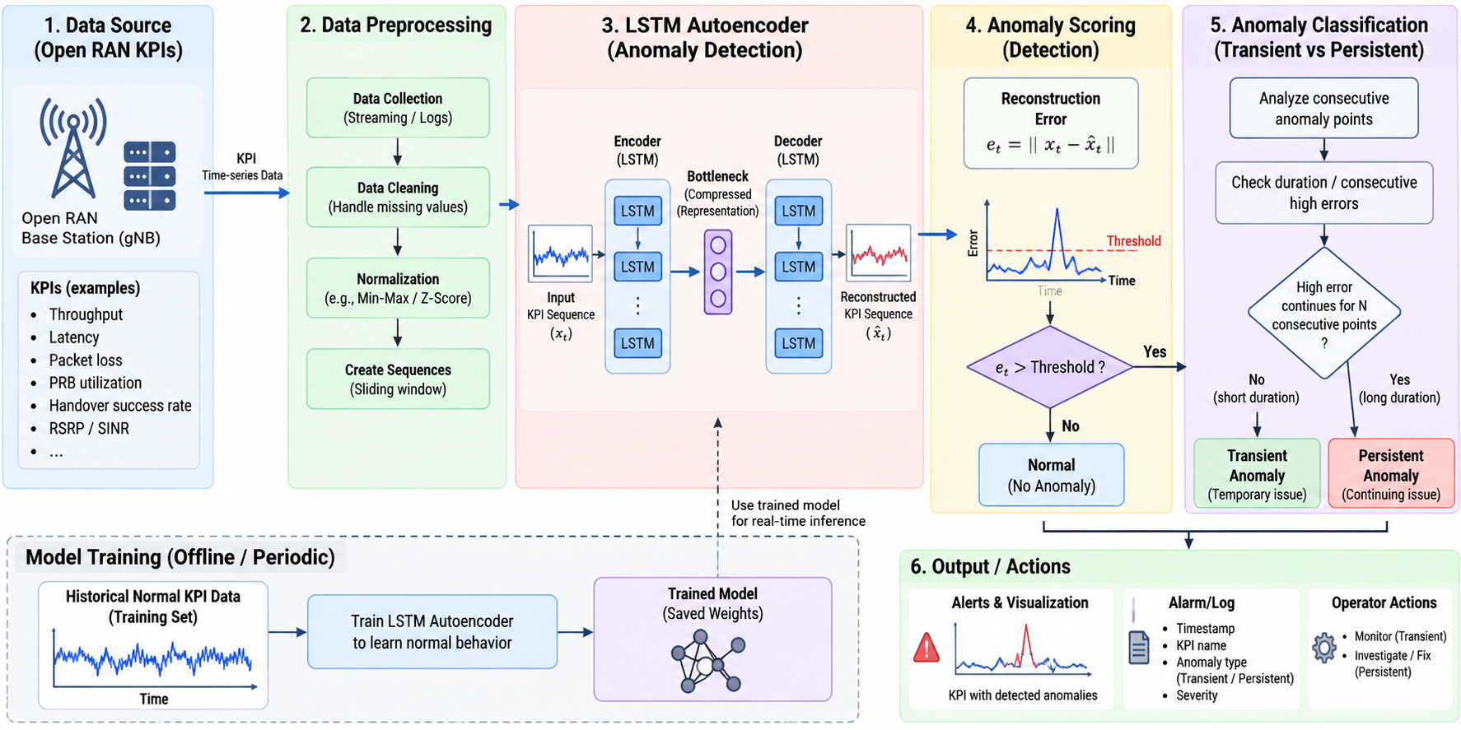

Slide 7
Project Workflow / Implementation
Data
57 baseline + 16 anomaly recordings
Current repository outputs
Preprocessing
timestamp handling, interpolation, scaling
Model + scaler + threshold
Available
Training history + figures
Available
Windowing
20 samples × 12 KPIs; step = 1
Window predictions
Available
Training
normal baseline recordings
Detection/event metrics
Available
Detection
reconstruction error > threshold
Robust persistence validation
Needs work
Event analysis
group windows + duration classification
12 selected radio KPIs • 100 training epochs completed
Open RAN KPI anomaly detection • Project status: in progress

Slide 8
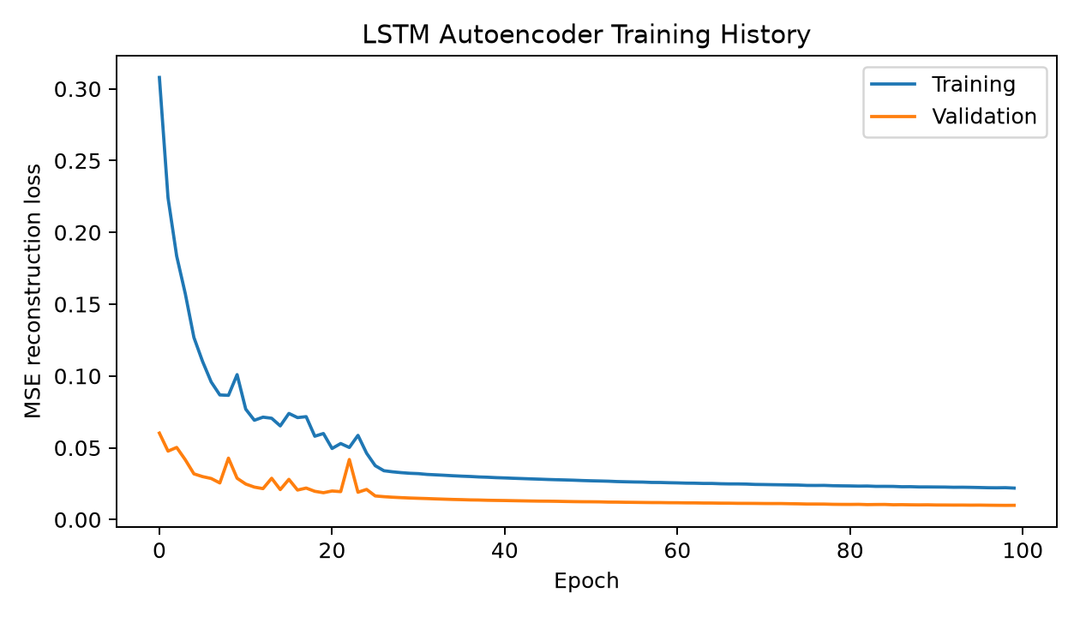
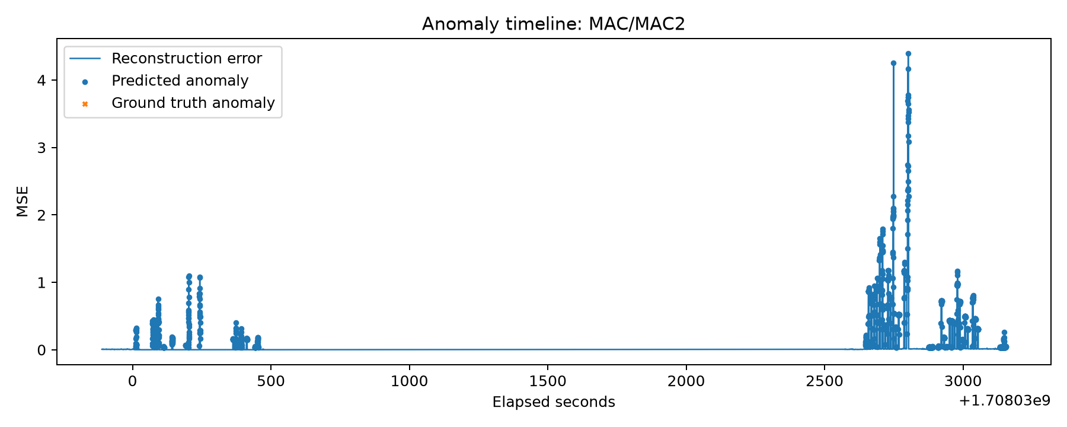
Simulation / Experimental Results
58.1%
Anomaly recall
28.6%
Anomaly precision
38.3%
Anomaly F1
68.8%
ROC-AUC
24.6%
Window false-alarm rate
3.9%
Event precision
Interpretation: anomalies are detected, but the large number of predicted events (1,719 vs 69 true events) shows substantial false-alarm/event-fragmentation issues.
Results taken from results/final_results.json and results/tables/*.csv in the supplied project.

Slide 9
Current Progress & Remaining Work
Completed / available in project
Remaining work / key loopholes
Data split and leakage-aware preprocessing pipeline
12-feature time-window generation
LSTM autoencoder model and saved trained weights
Normal-validation threshold selection and saved threshold
Prediction files, figures, and window/event-level metrics
Reduce false positives and improve event-level precision.
Strengthen transient vs persistent classification and validate the ~9 s criterion.
Test robustness across anomaly scenarios and recording conditions.
Resolve configuration/documentation consistency (e.g., threshold selection description).
Add stronger baselines/comparisons and repeat validation before claiming final performance.
Overall status: functional prototype with measurable results, but not yet a final validated research system.
Open RAN KPI anomaly detection • Project status: in progress

Slide 10
THANK YOU

