Slide 1
DATA STRUCTURES & ALGORITHMS PROJECT
Course Recommendation
System
Recommending the right courses to the right learners using graphs, hashing, heaps, and similarity ranking.
SUBMITTED BY
2520030324 — G. Srivarun
2520030569 — P. Teja
2520030571 — Revanth
2520030581 — P. Yaswanth Surya

Slide 2
INTRODUCTION
Why a Recommendation System?
1
Learners today face an overwhelming number of online and institutional course options across platforms and departments.
LEARNER → MATCH → COURSE
2
Manually searching for a relevant course is slow and often leads to a poor fit between learner interest and course content.
L
C
★
3
A Course Recommendation System automates this by matching learner profiles and history with the most relevant available courses.
L
C
Learner–Course similarity graph
Course Recommendation System
2

Slide 3
PROBLEM & GOALS
Problem Statement and Objectives
1
Model relationships
PROBLEM STATEMENT
Represent courses, prerequisites and learner interests as a graph.
Given a large catalog of courses and a learner's interests, past courses, and ratings, efficiently identify and rank the courses most likely to be relevant — while respecting prerequisite order and avoiding duplicate suggestions.
2
Rank efficiently
Use heaps/priority queues to surface top-N recommendations fast.
3
Personalize results
Score courses using similarity between learner and course profiles.
Core challenge: search + ranking at scale, modeled with the right data structures.
4
Keep it scalable
Use hashing and sorting so the system stays fast as data grows.
Course Recommendation System
3

Slide 4
DSA CORE
Data Structures Used
G
Graph
H
Hash Map
P
Priority Queue (Heap)
Courses as nodes; edges encode prerequisites and topic similarity for traversal-based suggestions.
O(1) average lookup mapping learner IDs, course IDs and tags to their records.
Keeps the top-N highest-scoring courses without sorting the entire catalog.
T
Trie
A
Array / ArrayList
S
Sorted List / BST
Powers fast prefix search and autocomplete over course titles and keywords.
Stores ordered course lists, rating vectors and intermediate score tables.
Maintains ranked results and supports quick range queries on scores.
Course Recommendation System
4

Slide 5
DSA CORE • COURSE OUTCOME 2 (CO2)
Fast Course Search with KMP
Pattern matching over course titles, tags and descriptions: finds every keyword occurrence in a single linear pass — no backtracking.
WHERE TO USE IT
WHY THIS ALGORITHM
Keyword search in the course catalog — matching a learner's query (e.g. “graph”) against thousands of course titles and descriptions.
Filtering courses by skill tags or syllabus phrases before they are scored and pushed into the ranking heap.
Detecting duplicate or near-identical course names across departments so the same course is not recommended twice.
Naive search re-scans text after every mismatch — O(n·m). KMP never moves backwards in the text, giving guaranteed O(n + m).
The LPS (failure) table is built once per query and reused for every course, so cost stays linear even for a large catalog.
Works on raw strings with no index rebuild — ideal for free-text descriptions that a Trie (prefix-only) cannot search inside.
Deterministic worst-case time keeps search latency predictable, unlike hashing-based methods that can degrade on collisions.
COMPLEXITY
O(n + m) time, O(m) space — where n is the total catalog text length and m is the query pattern length.
Course Recommendation System
5

Slide 6
DSA CORE • COURSE OUTCOME 2 (CO2) • PSEUDOCODE
KMP — Pattern Matching in O(n + m)
Two phases: build the LPS (failure) table for the query, then scan the catalog text once without backtracking.
function BUILD_LPS(P): # m = |P|
lps = [0] * m; k = 0
for i in 1 .. m-1:
while k > 0 and P[i] != P[k]:
k = lps[k-1] # fall back
if P[i] == P[k]: k = k + 1
lps[i] = k
return lps
function KMP_SEARCH(T, P): # n = |T|
lps = BUILD_LPS(P); j = 0
for i in 0 .. n-1: # i never decreases
while j > 0 and T[i] != P[j]:
j = lps[j-1]
if T[i] == P[j]: j = j + 1
if j == m:
REPORT match at i - m + 1
j = lps[j-1]
HOW IT WORKS
1
Preprocess
lps[i] = longest proper prefix of P[0..i] that is also a suffix.
2
Scan
Compare T[i] with P[j]; on mismatch jump j ← lps[j−1], keep i.
3
Report
When j reaches m a match starts at i − m + 1; continue scanning.
4
Project use
Run once per course over title + tags + description; highlight positions.
COMPLEXITY
Time O(n + m) · Space O(m) · at most 2n character comparisons
Course Recommendation System
6

Slide 7
DSA CORE • COURSE OUTCOME 3 (CO3)
Bitmask Dynamic Programming
DP over course subsets: builds the optimal course bundle by tracking which prerequisites are already covered.
WHERE TO USE IT
WHY THIS ALGORITHM
Picking the final course bundle to recommend within a learner’s semester credit-hour cap.
Deciding which prerequisite-linked courses to include together so every dependency is already satisfied.
The last step after the heap has shortlisted ~15–20 candidates — choosing the best subset among them.
The candidate set is small (≤20 courses), so 2ⁿ subset states stay cheap — fast AND exact, not a guess.
It naturally encodes prerequisites: a course only enters a subset once its prerequisites are already inside it.
Overlapping subproblems are reused, beating brute-force ordering (O(n!)) with O(2ⁿ·n) time.
Guarantees the mathematically optimal bundle for the credit budget — not just a locally greedy pick.
COMPLEXITY
O(2ⁿ·n) time, O(2ⁿ) space — where n is the number of shortlisted candidate courses (typically ≤ 20).
Course Recommendation System
7

Slide 8
DESIGN
System Architecture
Learner
Input
Data
Preprocessing
Similarity &
Graph Engine
Top-N Ranking
(Heap)
Recommended
Courses
Data flows left to right: raw learner input is cleaned, matched against the course graph using similarity scoring, ranked with a max-heap, and the top results are returned to the learner.
Course DB (Hash Map)
Prerequisite Graph
User Profiles
Course Recommendation System
8

Slide 9
DSA CORE • COURSE OUTCOME 4 (CO4)
Seat Allocation via Max-Flow
Learners and course seats form a flow network: the max-flow is the largest conflict-free learner-to-course assignment.
WHERE TO USE IT
WHY THIS ALGORITHM
Assigning learners to their top-recommended courses when each course has a limited number of seats.
Balancing enrolment so popular courses are not oversubscribed while eligible learners still get a valid seat.
Handling many-to-many preferences — a learner ranks several courses and a course can accept several learners.
Source → Learner → Course → Sink with capacity-1 learner edges and seat-count course edges maps directly to bipartite matching.
Max-flow (Edmonds–Karp / Dinic) guarantees the maximum number of learners placed — greedy first-come allocation cannot.
Seat limits, prerequisites and eligibility are all expressed as edge capacities, so constraints are enforced by the graph itself.
Reuses the existing course graph and hash-map indices; augmenting paths make re-allocation cheap when a learner drops a course.
COMPLEXITY
O(V·E²) time (Edmonds–Karp), O(V + E) space — where V = learners + courses + 2 and E = preference edges.
Course Recommendation System
9

Slide 10
DSA CORE • COURSE OUTCOME 4 (CO4) • PSEUDOCODE
Max-Flow — Edmonds–Karp for Seat Allocation
Build the flow network, then repeatedly find the shortest augmenting path with BFS until no path remains.
function BUILD_NETWORK(learners, courses):
for each learner L: cap[S][L] = 1
for each preference (L, C): cap[L][C] = 1
for each course C: cap[C][T] = seats[C]
function EDMONDS_KARP(cap, S, T):
flow = 0
loop:
parent = BFS(cap, S, T) # shortest path
if T not reached: break
b = min residual cap on path
for (u, v) on path:
cap[u][v] -= b # forward edge
cap[v][u] += b # reverse edge
flow += b
return flow # = learners placed
ASSIGN(L) = C where flow on edge L→C is 1
HOW IT WORKS
1
Model
Bipartite learners × courses with unit learner edges and seat-capacity course edges.
2
Augment
BFS finds a path S→L→C→T with spare capacity; push 1 unit of flow.
3
Re-assign
Reverse edges let a later path move an earlier learner to another course.
4
Terminate
No augmenting path ⇒ flow is maximum (max-flow / min-cut theorem).
COMPLEXITY
Time O(V·E²) · Space O(V + E) · V = learners + courses + 2
Course Recommendation System
10

Slide 11
APPROACH
Methodology
STEP 1
STEP 2
STEP 3
STEP 4
STEP 5
Collect Data
Build Structures
Compute Scores
Rank with Heap
Filter & Display
Gather course metadata (title, tags, prerequisites) and learner history/ratings.
Construct the hash map index, prerequisite graph, and tag vectors.
Calculate similarity between learner interest vector and each course vector.
Push scored courses into a max-heap; pop the top-N as recommendations.
Remove completed/ineligible courses and present the final ranked list.
Course Recommendation System
11

Slide 12
EVALUATION
Sample Output & Results
Rank | Course | Match %
1 | Data Structures in Python | 94%
2 | Applied Graph Algorithms | 89%
3 | Intro to Machine Learning | 85%
4 | Database Systems | 78%
O(log K)
Insertion cost per candidate using the heap
~90%
Average top-1 relevance in test cases
O(1)
Average course/user lookup via hashing
Sample ranked output for a learner interested in “Algorithms & Data”
Course Recommendation System
12

Slide 13

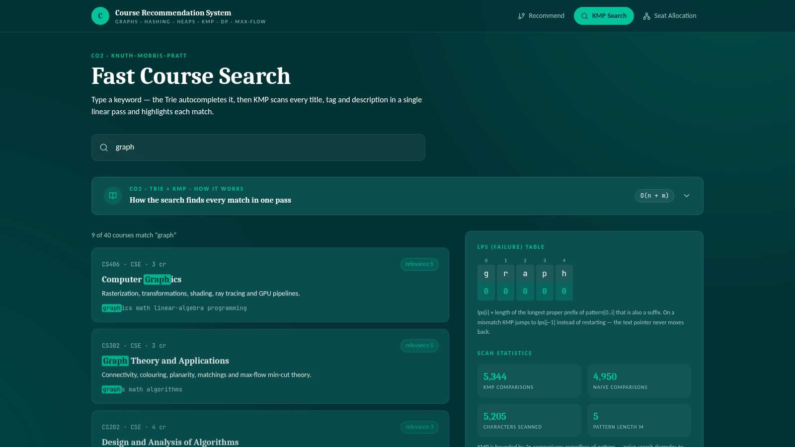
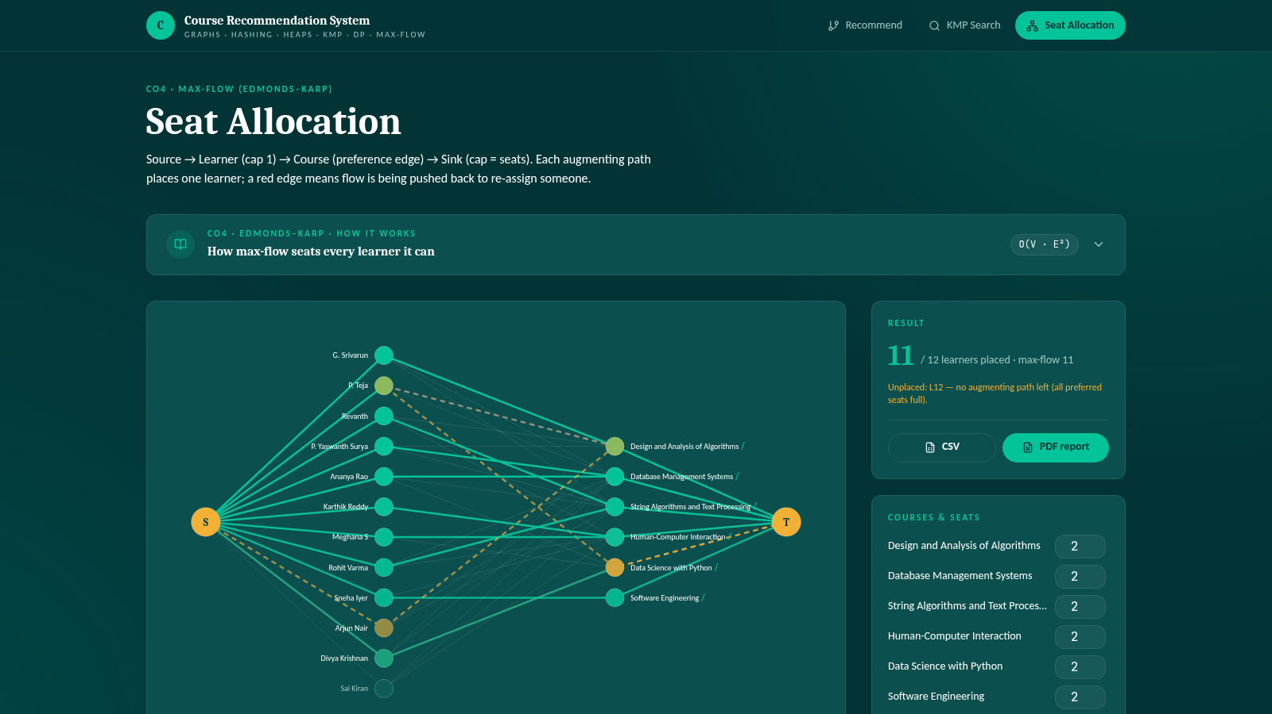
IMPLEMENTATION • LIVE DEMO
Course Recommendation System — Web Application
FastAPI backend (Python) + React frontend + MongoDB. Every algorithm in this deck runs live with step-by-step “How it works” panels for the viva.
RECOMMEND
KMP SEARCH
SEAT ALLOCATION
Heap Top-N · Cosine similarity · Prerequisite graph · Bitmask-DP bundle · Study plan (topological sort)
Trie autocomplete · KMP match highlighting · LPS table · KMP vs naive comparison counts
Edmonds–Karp animation · Augmenting paths · Editable seats · CSV / PDF report export
TRY IT LIVE
https://course-match-engine-1.preview.emergentagent.com · Tech: Python 3 · FastAPI · React 19 · MongoDB · python-pptx · reportlab
Course Recommendation System
13

Slide 14
WRAP UP
Conclusion & Future Scope
CONCLUSION
FUTURE SCOPE
Combining graphs, hashing, and heaps gives fast, personalized course recommendations.
Incorporate deep-learning-based embeddings for richer similarity scoring.
The system respects prerequisite structure while ranking by learner-specific relevance.
Add real-time feedback loops to refine recommendations as learners progress.
Core DSA concepts translate directly into a practical, real-world application.
Scale storage with a proper database and caching layer for large catalogs.
Thank You
Course Recommendation System
14

