Slide 1
Housing: Price Prediction
By : YATIKA TANEJA

Slide 2
Objective of the study
The objective of our project is to build a model using Machine Learning in order
to predict the actual value of the prospective properties and decide whether to
invest in them or not.
For this company wants to know:
• Which variables are important to predict the price of variable?
• How do these variables describe the price of the house?

Slide 3
BUSINESS MODEL
A US-based housing company named Surprise Housing has decided to enter the Australian market. The company uses data analytics to purchase houses at a price below their actual values and flip them at a higher price.
For the same purpose, the company has collected a data set from the sale of houses in Australia. You are required to model the price of houses with the available independent variables.
This model will then be used by the management to understand how exactly the prices vary with the variables. They can accordingly manipulate the strategy of the firm and concentrate on areas that will yield high returns. Further, the model will be a good way for the management to understand the pricing dynamics of a new market.

Slide 4
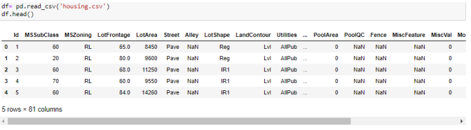
DATA SOURCES
The sample data is provided to us from our client database. The dataset has
1470 observations and 81 features. SalePrice is the target variable.
Dataset:

Slide 5
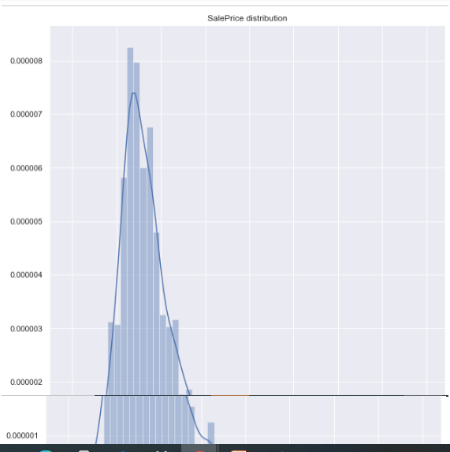
DATA PREPROCESSING
Distribution of ‘SalePrice’

Slide 6
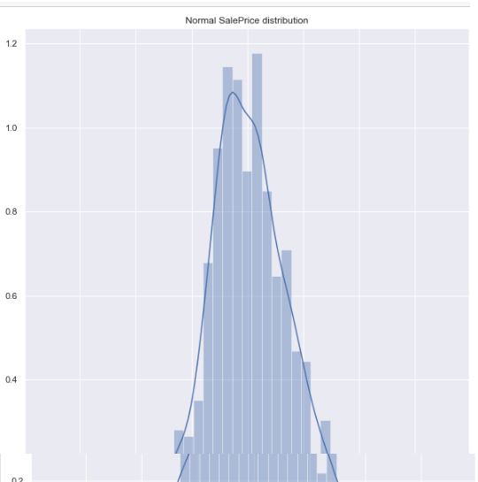
DATA PREPROCESSING
After Log Transformation:

Slide 7
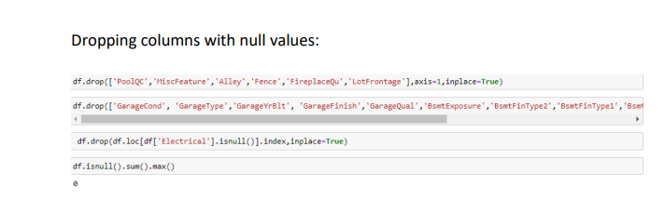
DATA PREPROCESSING
Dealing with null values

Slide 8
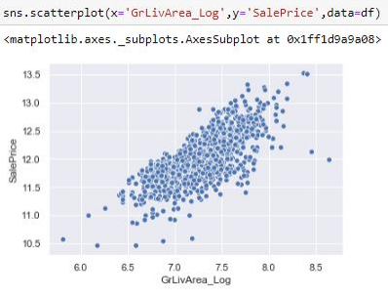
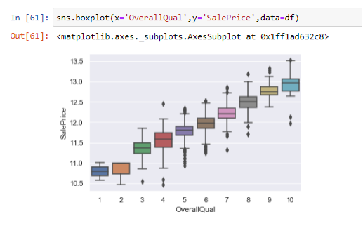
DATA PREPROCESSING
Dealing with outliers
outliers in ‘OverallQuall’ outliers in ‘GrLivArea_Log’
Outliers in ‘OverallQual’ Outliers in ‘GrLivArea_Log’

Slide 9
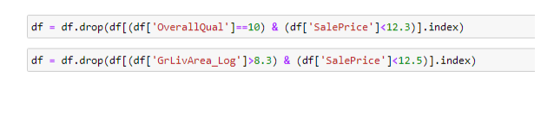
DATA PREPROCESSING
Removing outliers in ‘OverallQuall’ and ‘GrLivArea_Log’:

Slide 10
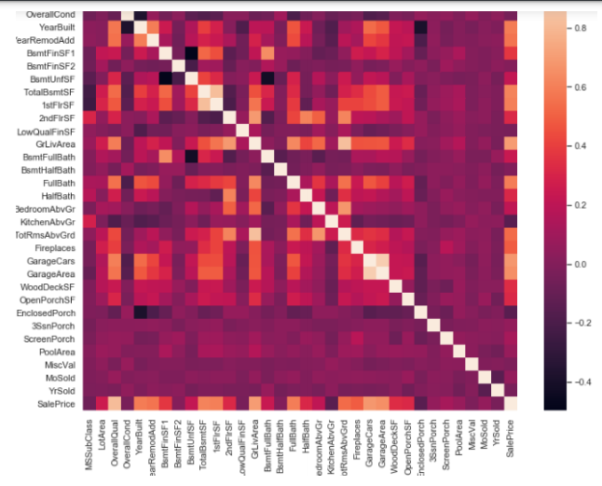
DATA PREPROCESSING
Feature Correlation with ‘SalePrice’

Slide 11
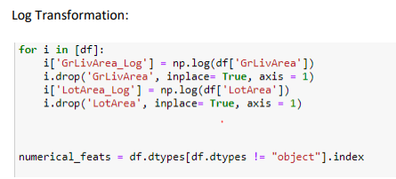
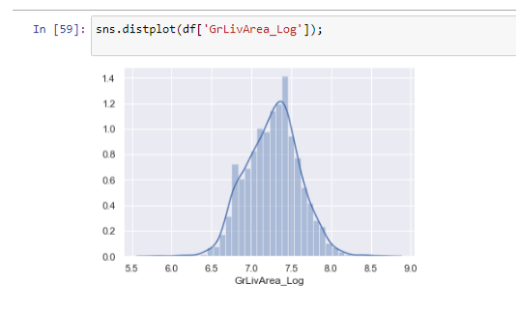
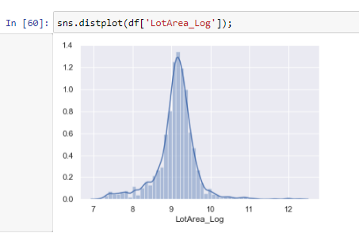
DATA PREPROCESSING
Data Transformation

Slide 12
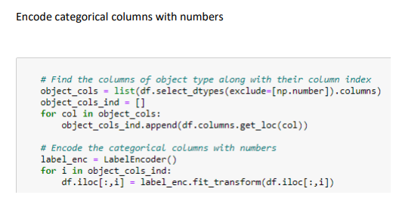
DATA PREPROCESSING
Label Encoding

Slide 13
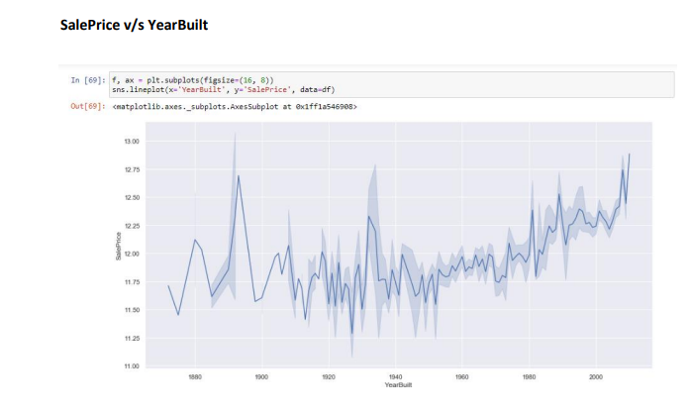
DATA VISUALIZATION
Relationship with numerical variables

Slide 14
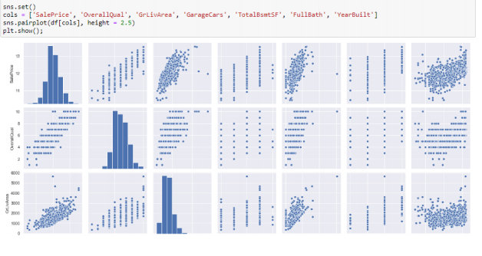
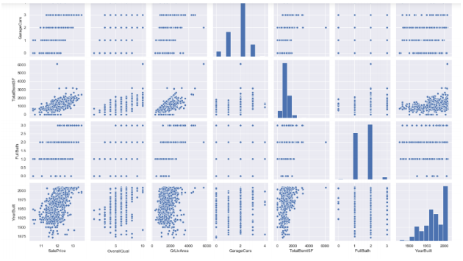
DATA VISUALIZATION
Pair Plot

Slide 15
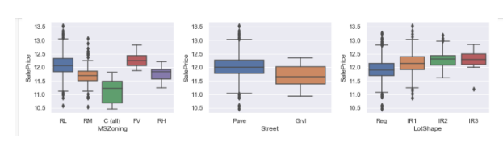
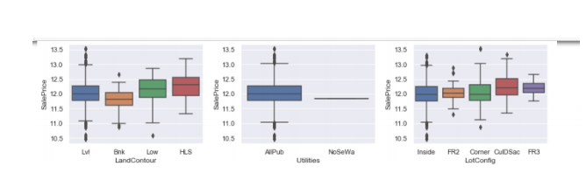
DATA VISUALIZATION
Relationship with categorical variables
Box Plot:

Slide 16
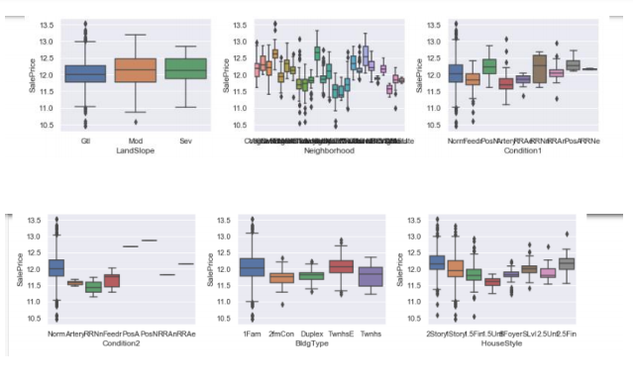
DATA VISUALIZATION
Box Plot:

Slide 17
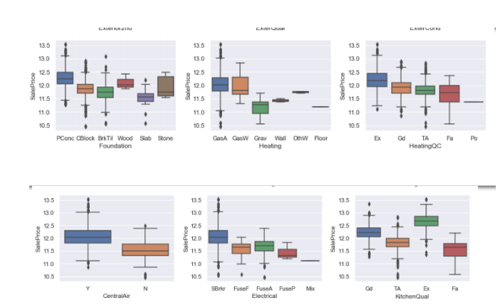
DATA VISUALIZATION
Box Plot:

Slide 18
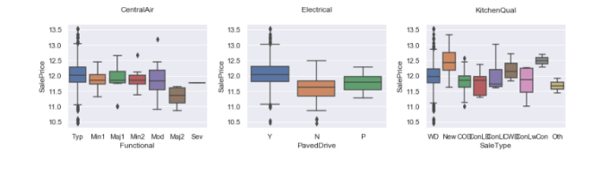
DATA VISUALIZATION
Box Plot:

Slide 19
MODELS APPLIED
Linear Regression
Gradient Boosting Regression
Random Forest Regression
Lasso Regression

Slide 20
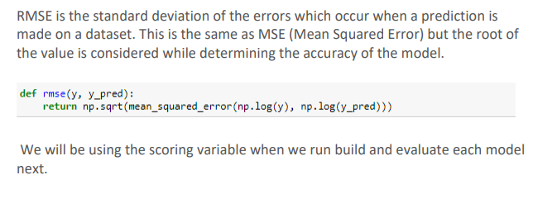
MODEL EVALUATION
We will use stratified 10-fold cross validation to estimate model accuracy.
EVALUATION METRIC: RMSE

Slide 21



RESULT
Random Forest Regressor
Linear Regression
Gradient Boosting Regressor
Lasso Regression

Slide 22
SELECT BEST METHOD
In this case, Gradient Boosting Regressor has the least estimated rmse value
of around 0.0025.
Gradient Boosting Regressor is the best fit for this Dataset and can be used
for deploying purposes.

Slide 23
CONCLUSION
In this study, Gradient Boosting Regressor was applied in order to predict the
actual value of the prospective properties and decide whether to invest in them or not.
Gradient Boosting Regressor was the best model as compared to the
other four models with a rmse value of approximately 0.0025.
It model the price of houses with the available independent variables
and can be used by the management to understand how exactly the prices vary with the variables.
They can accordingly manipulate the strategy of the firm and concentrate on
areas that will yield high returns. Further, the model will be a good way for the management to understand the pricing dynamics of a new market.

