Slide 1
Malignant Comment Classification
By : YATIKA TANEJA

Slide 2
Objective of the study
Cyberbullying is one of the biggest issues in the world of internet. Although researchers have found that hate is a problem across multiple platforms, there is a lack of models for online hate detection.
The goal of the study is to build a prototype of online hate and abuse comment classifier which can used to classify hate and offensive comments so that it can be controlled and restricted from spreading hatred and cyberbullying

Slide 3
BUSINESS MODEL
The proliferation of social media enables people to express their opinions widely online. However, at the same time, this has resulted in the emergence of conflict and hate, making online environments uninviting for users. Although researchers have found that hate is a problem across multiple platforms, there is a lack of models for online hate detection.
Online hate, described as abusive language, aggression, cyberbullying, hatefulness and many others has been identified as a major threat on online social media platforms. Social media platforms are the most prominent grounds for such toxic behaviour.
Internet comments are bastions of hatred and vitriol. While online anonymity has provided a new outlet for aggression and hate speech, machine learning can be used to fight it. The problem we sought to solve was the tagging of internet comments that are aggressive towards other users. This means that insults to third parties such as celebrities will be tagged as unoffensive, but “u are an idiot” is clearly offensive.

Slide 4
DATA SOURCES
The data set contains the training set, which has approximately 1,59,000 samples and the test set which contains nearly 1,53,000 samples.
All the data samples contain 8 fields which includes ‘Id’, ‘Comments’, ‘Malignant’, ‘Highly malignant’, ‘Rude’, ‘Threat’, ‘Abuse’ and ‘Loathe’.
The label can be either 0 or 1, where 0 denotes a NO while 1 denotes a YES. There are various comments which have multiple labels. The first attribute is a unique ID associated with each comment.

Slide 5
DATA PREPROCESSING
1. Cleaning the Raw Data
This phase involves the deletion of words or characters that do not add value to the meaning of the text.
Some of the standard cleaning steps are listed below:
• Lowering case
• Removal of special characters
• Removal of stop words
• Removal of hyperlinks
• Removal of numbers
• Removal of whitespaces

Slide 6

DATA PREPROCESSING
2. Tokenizing the Cleaned Data
Tokenization is the process of splitting text into smaller chunks, called tokens.
Each token is an input to the machine learning algorithm as a feature.

Slide 7
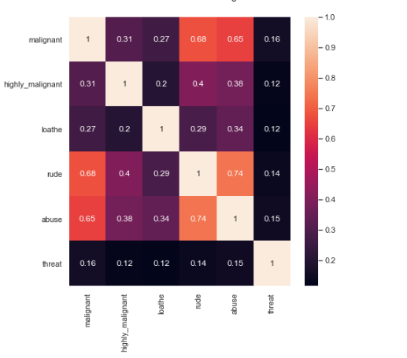
DATA PREPROCESSING
Feature Correlation with targets

Slide 8
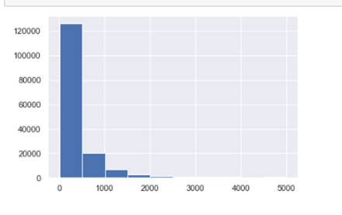
DATA VISUALIZATION
1. Comment distribution before cleaning

Slide 9
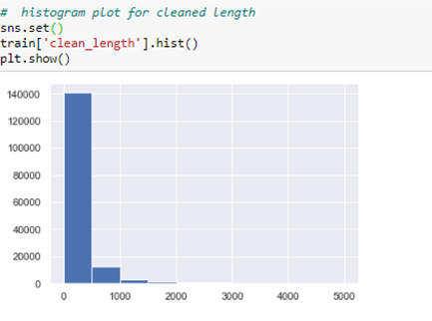
DATA VISUALIZATION
2. Comment distribution after cleaning

Slide 10
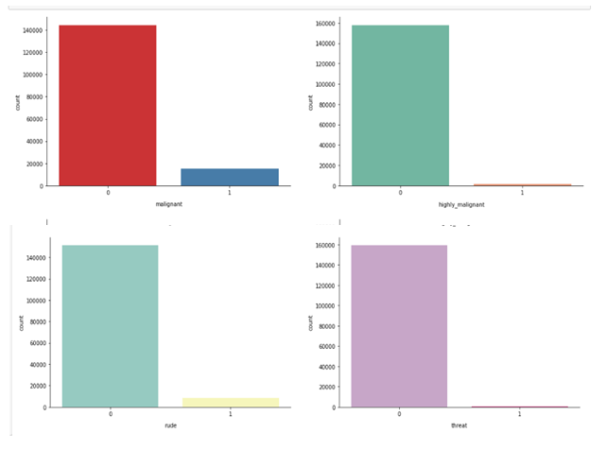
DATA VISUALIZATION
3. Count plot for each class

Slide 11
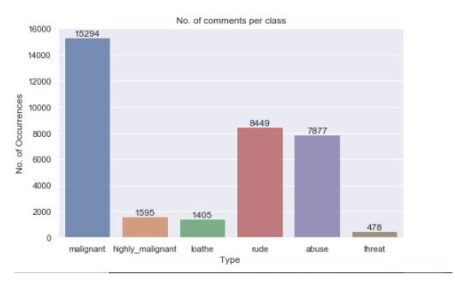
DATA VISUALIZATION
4. No. of Comments per Class

Slide 12
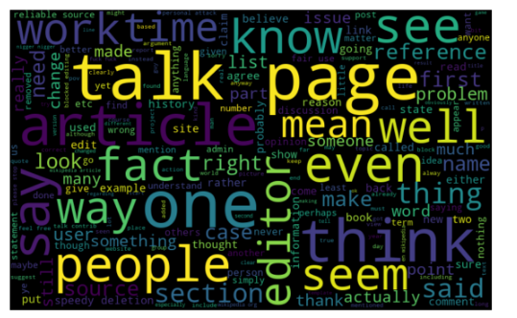
DATA VISUALIZATION
5. Word cloud for all comments

Slide 13
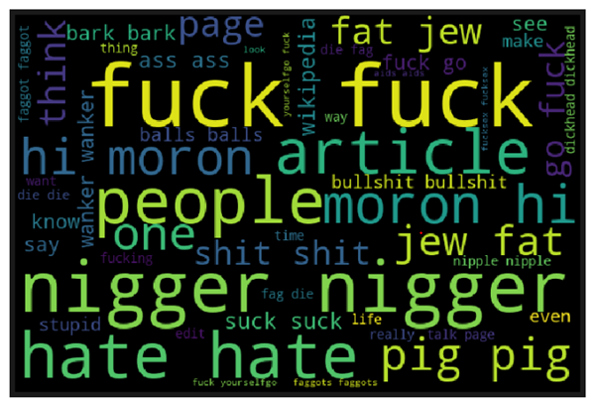
DATA VISUALIZATION
6. Word Cloud for malign comments

Slide 14
MODELS APPLIED
Naive Bayes Classification
Decision Trees Classification
Random Forest Classification

Slide 15
MODEL EVALUATION
Following are the metrics we used to evaluate the performance of ML techniques:
1. Precision
Precision refers to the closeness of two or more measurements to each other. In Machine Learning, precision is the fraction of relevant instances among the retrieved instances. Precision = TP / (TP + FP) (Where TP = True Positive, TN = True Negative, FP = False Positive, FN = False Negative).
2. Accuracy
Accuracy refers to the closeness of a measured value to a standard or known value. Accuracy = (TP+TN) / ALL
3. Recall
Recall is how many of the true positives were recalled (found), i.e. how many of the correct hits were also found. Recall = TP / (TP + FN)
4. F-Score
F-scores are a statistical method for determining accuracy accounting for both precision and recall. It is essentially the harmonic mean of precision and recall.

Slide 16
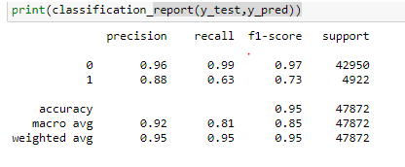
RESULT
Since Random Forest Classifier have highest accuracy, precision, recall and f-score. It is the best fit for Malign Comment Classification.

Slide 17
Conclusion
In this study, a Malign Comment Classification system is introduced which makes use of a NLP and Machine Learning for its implementation.
The classification algorithms used in this approach are Naïve Bayes, Decision Tree Classifier and Random Forest Classifier.
It was observed that Random forest Classifier is the best fit for Malign Comment Classification system with 95% accuracy.

