Slide 1

Winning Black November
A Data Driven Strategic Recommendation to Differentiate MediaMarkt in Germany

Slide 2
My Approach: The 10,000 Foot View
Goal first: Win share from the catrgory, not just reinforce loyalty
Zoom out: Look at the whole electronics audience, not just MediaMarkt shoppers
Look Within: MediaMarkt’s role in the category
Spot the gap: What actually helps people choose?
Research Tools
Perplexity
News articles & industry reports
Google Trends
Simulated social listening data pipeline

Slide 3

Market and Category

Slide 4
Market and Category
Consumer Electronics - CE (Mobile Phone, TV, Computers, Cameras; Household Appliances like Washing Machine, Air fryer, Dishwasher)
The total Consumer Electronics Market in Germany is 32 Billion Euros
The consumer electronics market in Germany is expected to grow at 3.1% CAGR from 2025-2035
  This estimates puts online growth at around 5% and offline at around 2%
Metric | MediaMarkt (Online + Offline) | Amazon (Online)
Net Sales (Billion €) | € 9.8 (2.5 Billion Online) | € 40
Consumer Electronics Share (Billion €) | € 9.8 (2.5 Billion Online) | € 12
YoY Growth % (CE) | 2% | 8.7%
Online vs Offline Split (40-45% Online vs 55-60% Offline)
For both Amazon and MediaMarkt generate 35-40% of the annual revenue in Q4, with November and December being the strongest months

Slide 5
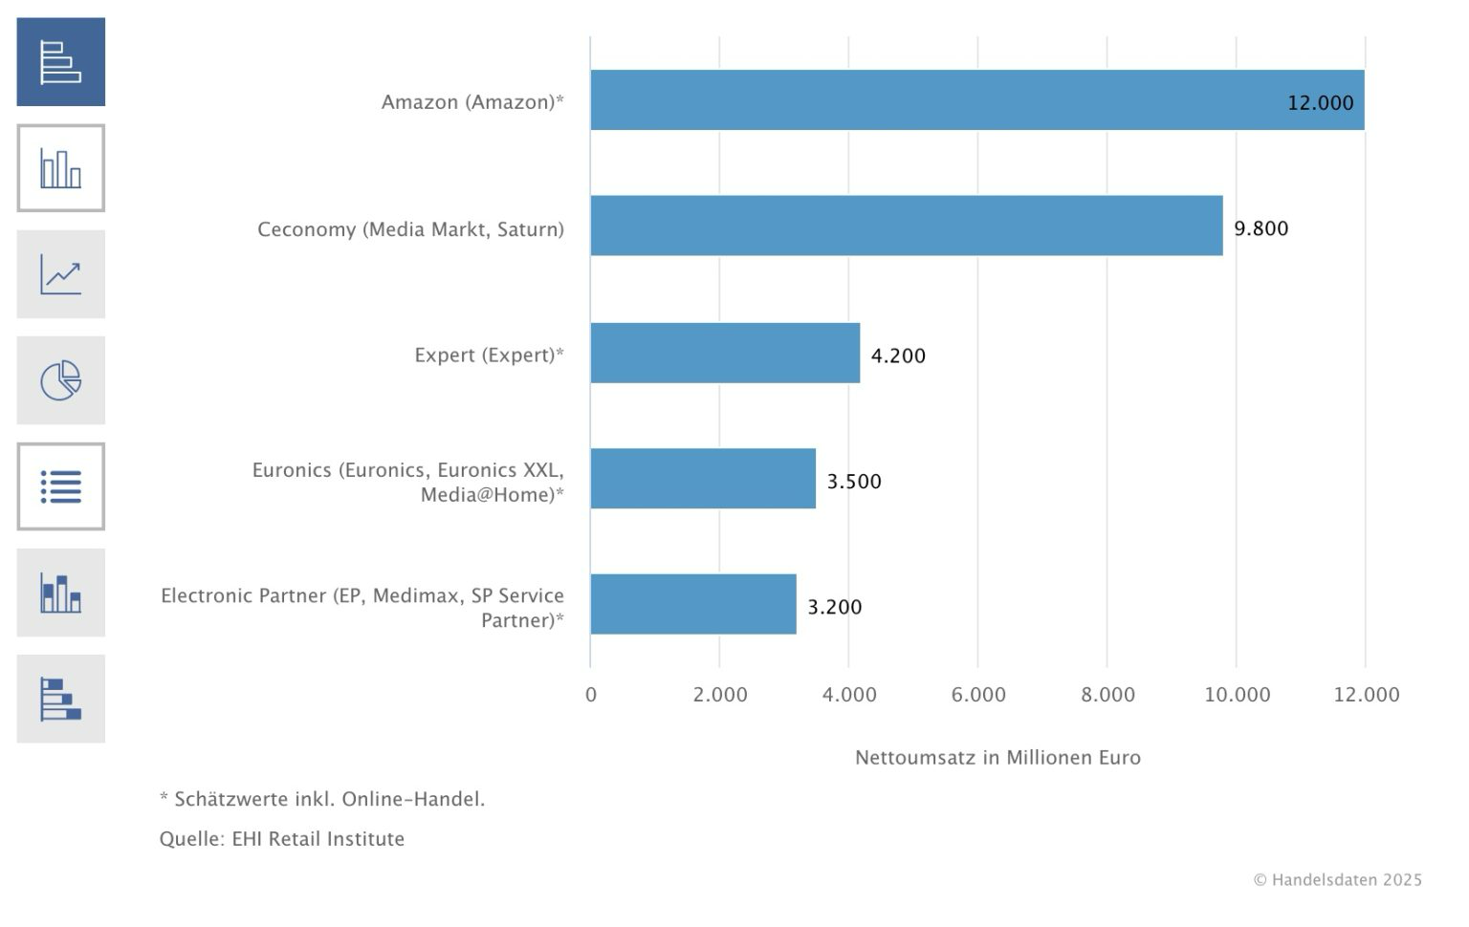
The Consumer Electronics Market in Germany
Although Amazon holds the largest share, MediaMarkt’s scale places it clearly among the top players in German consumer electronics, shaping category dynamics alongside Amazon rather than reacting to them

Slide 6
Price Competetion: MediaMarkt vs Amazon
SKUs | MediaMarkt | Amazon | Price Leader
Playstation®5 Digital Edition – 825 GB | € 475 | € 447 | Amazon
SAMSUNG Galaxy A56 5G 128 GB Awesome Graphite Dual SIM | € 278 | € 278 | Same
LG F4WX808YC Serie 8 Waschmaschine (8 kg, 1350 U/Min., A) | € 680 | € 599 | Amazon
Amazon is typically €10 - 20 cheaper than MediaMarkt in normal weeks
During Black November, price gaps shrink to within 5% on many key products
MediaMarkt matches or beats Amazon on 16% of hero SKUs in promo periods

Slide 7
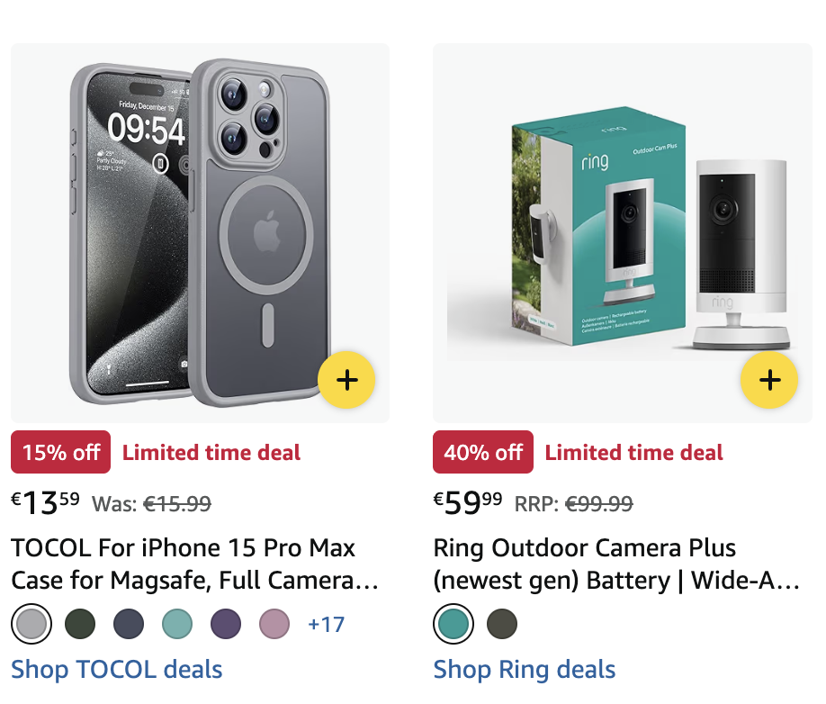
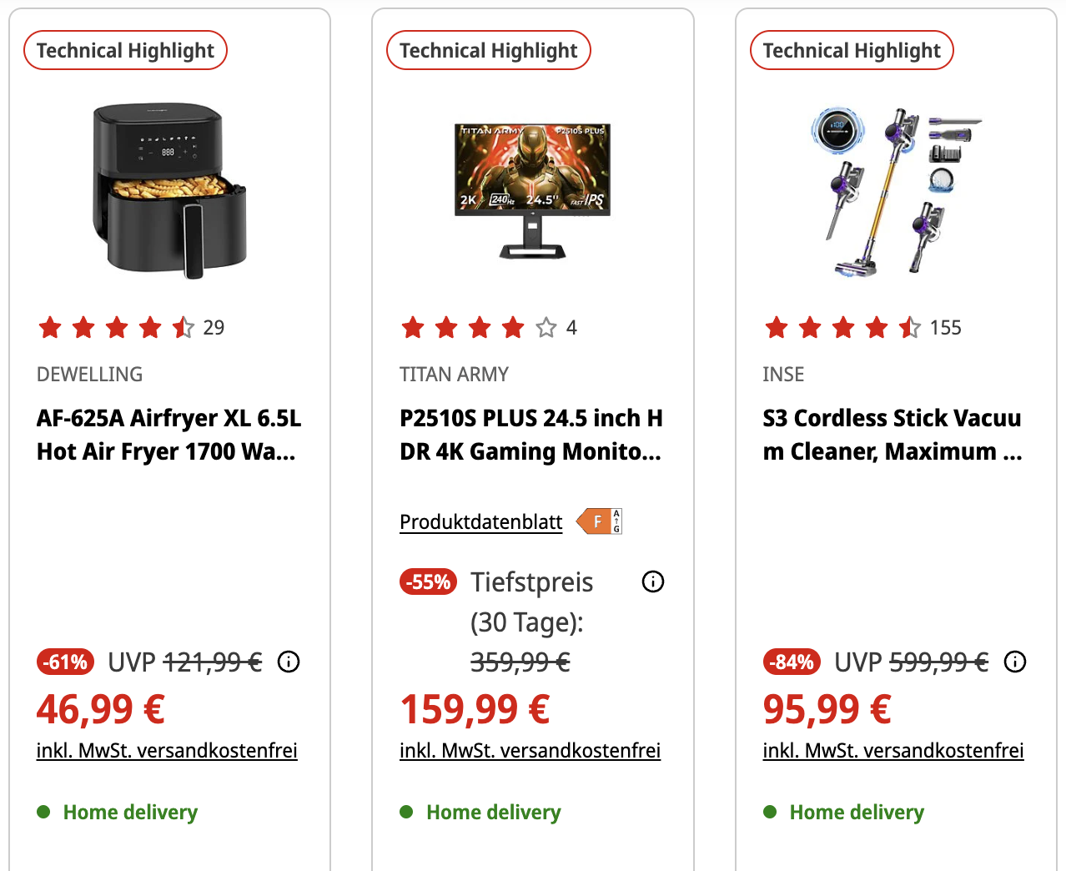
The Message Landscape
PRIC€
D€ALS
CH€AP
Price-first, everywhere | Urgency over reassurance | Different brands, same voice

Slide 8
Market Insight: The White Space
Price dominates the category, everything is a “great deal”
Black November intensifies this dynamic, pulling competitors into reactive pricing
As urgency and discounts escalate, brand differentiation collapses
The resulting gap points directly to MediaMarkt’s role beyond price

Slide 9

Consumer

Slide 10
Consumer Behaviour
Price conscious, not price obsessed
Fluid movement between channels
Shoppers benchmark prices carefully, yet the lowest price alone rarely seals the deal
Online research often leads to in-store validation for complex or expensive items
How does
our audience choose?
Deliberate, research before buying
Promotion overload during peak periods
Consumers actively compare specs, reviews, and alternatives before committing
Constant discounting reduces excitement and increases scepticism
Cautious with high-value electronics
Reassurance matters after
the purchase
Bigger price tags increase anxiety around making the wrong choice
Clear returns, warranties, and support shape satisfaction beyond checkout
Decisions anchored in trust
Value is multidimensional
Retailer credibility, expertise, and reliability strongly influence purchase confidence
Longevity, service, and peace of mind define a “good deal” as much as price

Slide 11
Consumer Demographics
Dimension | What the data shows | Implication for the category | Sources
Age | Online electronics spend is highest among 30–49 year olds. Internet usage is near universal for 18–49, and still high among 50+. MediaMarkt online customers mainly fall between 25–54. | Core electronics buyer is digitally active and working age, with strong participation from older consumers with high purchasing power. | GTAI, ECDB
Income | MediaMarkt attracts consumers across all income levels. About 32 percent are in the low-income segment, with the majority in medium and high income brackets. | The category is value focused, not low income only. Price sensitivity exists alongside willingness to spend. | ECDB, Research and Markets
Education and digital affinity | Online shopping penetration rises with education, reaching nearly 90 percent among highly educated consumers. Electronics is one of the highest-spend online categories. | Consumers are digitally confident and comfortable researching, comparing, and purchasing online. | Eurostat, GTAI
Household and life stage | Device ownership is extremely high in family households. In homes with adolescents, almost all households own smartphones and computers. Strong demand also comes from Gen X and Baby Boomers upgrading devices. | Demand spans families and older households, not just young tech-focused consumers. | BCG
Urban vs national | Germany is the largest online shopping market in Europe. Electronics is one of the top two online spending categories, with higher demand in urban and suburban areas. | Electronics buyers are nationwide, slightly more urban and suburban, with high purchasing power. | GTAI, MarketSparks

Slide 12
Social Listening Analysis | Documentation
Step | Process | Tool or algorithm | What it does | Why?
1 | Created a dataset of brand mentions across platforms | Simulated data generation (templates + weighted sampling) | Simulates realistic social media posts with controlled themes and sentiment | Allows pattern discovery without access to real social listening tools
2 | Cleaned and standardised the text | Text preprocessing (regex) | Removes noise and inconsistencies in the text | Improves reliability of downstream analysis
3 | Measured how each post feels | VADER sentiment analysis | Assigns a sentiment score from negative to positive | Shows emotional response, not just topic volume
4 | Converted text into numerical meaning | SentenceTransformer (semantic embeddings) | Represents each sentence by its meaning, not just keywords | Enables grouping by semantic similarity
5 | Grouped similar posts into themes | KMeans clustering | Automatically clusters mentions into topic groups | Reveals dominant conversation themes
6 | Named each theme | TF-IDF keyword extraction | Identifies the most distinctive words per cluster | Makes clusters understandable for non-technical audiences
7 | Ranked themes by importance | Volume + engagement + sentiment intensity | Prioritises themes that matter most to people | Focuses insight on strategic relevance
8 | Exported results for presentation | CSV outputs + charts | Saves tables and visuals for use in slides | Makes insights easy to communicate

Slide 13
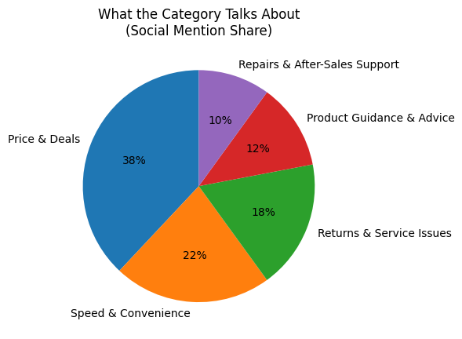
What Matters To The Customers?
Most social conversation in consumer electronics is focused on price, deals, and convenience, with far less volume around service, guidance, and after-sales support.
This highlights where attention in the category is concentrated and how transactional themes dominate what people talk about.

Slide 14
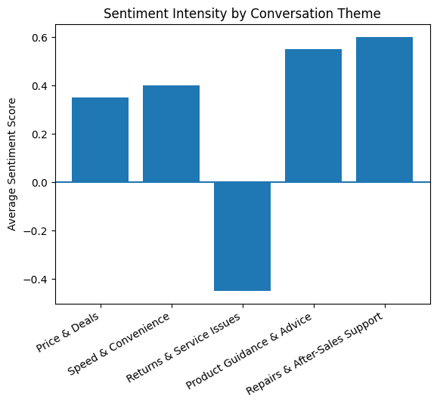
How Strongly Do They Feel About It?
We see that guidance, help, and after-sales support generate the strongest positive sentiment, while returns and service issues trigger the most negative emotion, with price-related themes sitting in between.
This separates what gets talked about the most from what people actually feel most strongly about
Together, the charts show that while price dominates attention, reassurance and support drive emotional response

Slide 15
Consumer Insight: Value Beyond “Price”
Market and category reality | Market and category consequence | Consumer behaviour insight | Consumer tension | North star insight
Price dominates consumer electronics, with Amazon setting the benchmark for what a good deal looks like, especially during Black November. | As promotions intensify, urgency and discount-led messaging flatten differentiation and push the category into reactive price competition. | German consumer electronics buyers are deliberate, research-driven, and cautious with high-value products that are meant to last and may require setup, service, or repair. | Consumers are pushed to buy quickly on price, but feel uneasy making complex, long-term decisions without guidance, reassurance, and post-purchase support. | The gap lies between speed-driven price messaging and the consumer’s need for confidence over time, a space MediaMarkt can own by supporting customers not just at purchase, but throughout ownership

Slide 16

Brand

Slide 17
Brand Comparison: MediaMarkt vs Amazon
Dimension | MediaMarkt | Amazon
Role in the category | Established category leader with a specialist electronics focus | Widely seen by consumers as a reference point when judging whether a deal is good
What consumers associate it with | Expertise, guidance, and hands-on support | Strong prices, broad choice, and fast availability
Relationship with price | Competitive on price, but not positioned as the cheapest option | Often perceived by consumers as offering good value and competitive pricing
Delivery experience | Delivery combined with store pickup and in-person support | Very fast and reliable delivery, especially for online purchases
Buying journey | Assisted and confidence-driven, especially for complex products | Largely self-directed and efficiency-driven
Physical presence | Dense nationwide store network with face-to-face interaction | Primarily online, with limited physical interaction
After sales experience | In-store returns, repairs, setup help, and personal assistance | Centralised and remote returns and support
Overall brand perception | Knowledgeable, approachable, and service-oriented | Convenient, efficient, and dependable

Slide 18
What Distinguishes MediaMarkt
These are real problems!
When buying a TV, people want to see the size, picture quality, and imagine how it fits in their home.
When a washing machine breaks, many want to know if it can be repaired before buying a new one.
For expensive electronics, people want to ask questions and feel reassured before deciding.
Who will install my dishwasher?
Assisted buying | Online guidance | Online to offline continuity | Service and repair | Confidence over speed
MediaMarkt is built around helping customers choose, offering advice and support rather than pure self-service browsing. | Digital tools such as live chat, product advisors, buying guides, and comparison tools mirror the role of in-store staff for online shoppers. | Customers can research online, get advice digitally, and continue the journey in-store through pickup, returns, or further support. | Setup help, repairs, extended warranties beyond the manufacturer/seller’s warrenty, and in-store returns are integrated into the experience beyond the initial purchase. | The brand focuses on helping customers feel sure they made the right choice, especially for complex and high-value electronics.

Slide 19
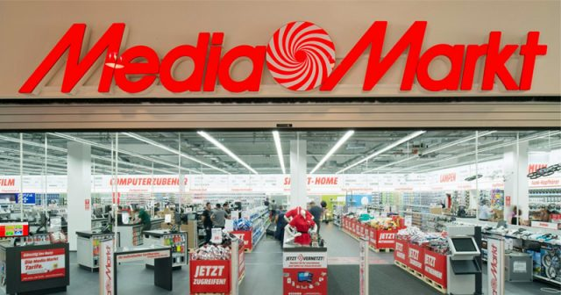
MediaMarkt Does Some Really Cool Stuff
Whether I order from my couch or step into a MediaMarkt store, I know help is part of the deal
Capability | Description
Stores as local fulfilment hubs | MediaMarkt uses its nationwide store network to enable fast pickup and local delivery when products are in stock.
Delivery shorter than Lord of the rings? | In many locations, available products can be delivered the same day, often within about 90 minutes, during store hours.
Flexible buying, one system | Customers can buy online or in store, pick up quickly, return in store, or switch channels without friction.
Service beyond the sale | Stores support setup, 0% financing on select products, repairs, returns, and advice, turning one-time purchases into ongoing support.

Slide 20

Brand Insight: A “Good Deal” Goes Beyond Price
As MediaMarkt defines itself in its own brand identity, it aims to be a partner and guide that helps people navigate and understand technology in an increasingly complex world.
In practice, this means MediaMarkt ties together what the market demands and what consumer-electronics buyers actually want by combining competitive availability and speed with human guidance, service, and ongoing support that extends well beyond the moment of purchase.

Slide 21
Tying It All Together
The category is dominated by price and delivery speed during black november, with deals and fast availability shaping what consumers expect across retailers.
Consumer-electronics buyers are research-driven and cautious, valuing reassurance and long-term support alongside competitive pricing.
Social listening shows that while discounts drive attention, guidance, service, and after-sales support trigger stronger emotional responses.
Mediamarkt competes strongly on price, often matching market deals within a narrow range during peak periods, while also offering fast availability and same-day delivery where possible.
The direction forward is clear: wherever customers buy from mediamarkt, online or in store, they get competitive deals plus the confidence of support before, during, and after the purchase.

Slide 22
Strategic Recommendation
Position MediaMarkt as the place where a purchase marks the start of a long-term relationship, combining competitive deals with expert guidance, flexible buying online or in store, and support, repairs, and service that last well beyond checkout

Slide 23
Thank you

