Slide 2
Agent Marketplace MVP

Slide 3
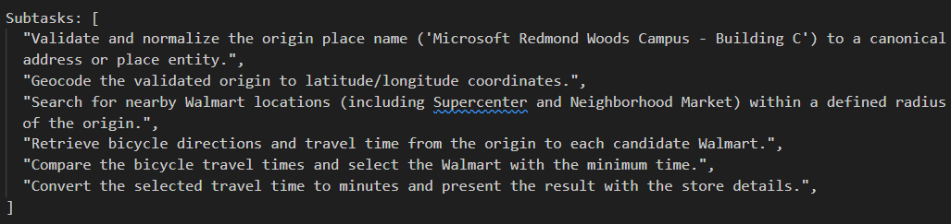
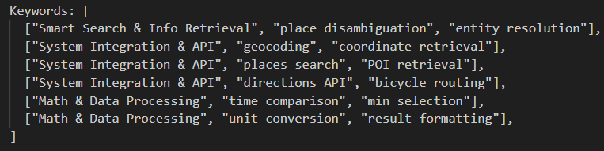
Agent Marketplace – Case 1
User Query
“How many minutes does it take to start off from Microsoft Redmond Woods Campus - Building C to the nearest Walmart by bicycle?”
Task breakdown
Keyword extraction
Keyword extraction (to support tool selection/matching)

Slide 4
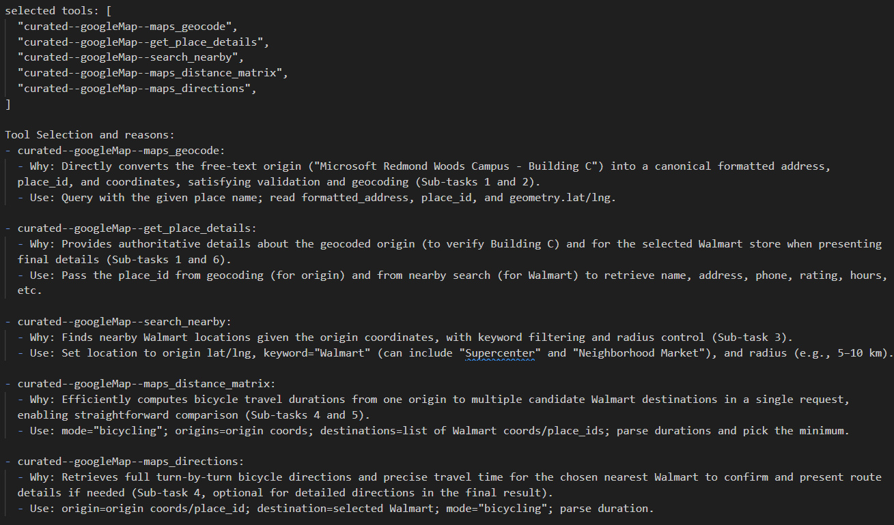
Agent Marketplace – Case 1
Final selected tools and explanation
Results:
- W/o marketplace, Aworld used Browse use instead w/ much lower success rate and much longer execution time

Slide 5
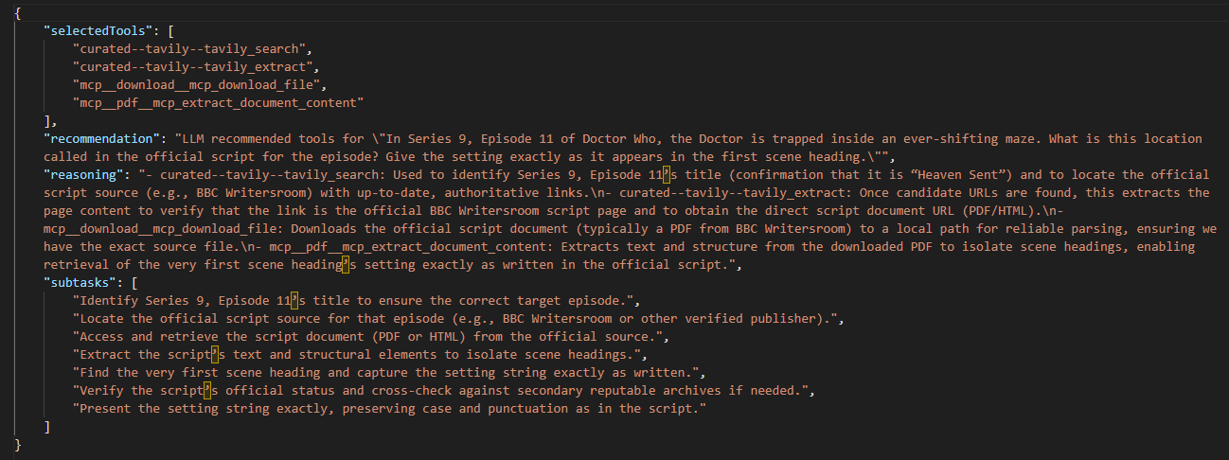
Agent Marketplace – Case 2
In Series 9, Episode 11 of Doctor Who, the Doctor is trapped inside an ever-shifting maze. What is this location called in the official script for the episode? Give the setting exactly as it appears in the first scene heading.
Notes:
Question about script, matched tools could have YouTube transcript, but eventually not selected by LLM as not fit in the task context.

Slide 6
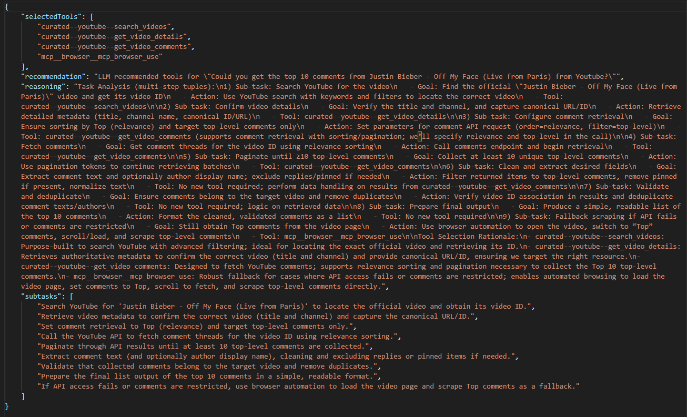
Agent Marketplace – case 3
Could you get the top 10 comments from Justin Bieber - Off My Face (Live from Paris) from YouTube?
Notes:
Multiple YouTube MCP in both Aworld and Tool Marketplace, based on the requirements which needs to get video comments details from a YouTube via just by song name, it is better to have a dedicated tools which focus on retrieve these details from API instead of using browser-use.

Slide 7
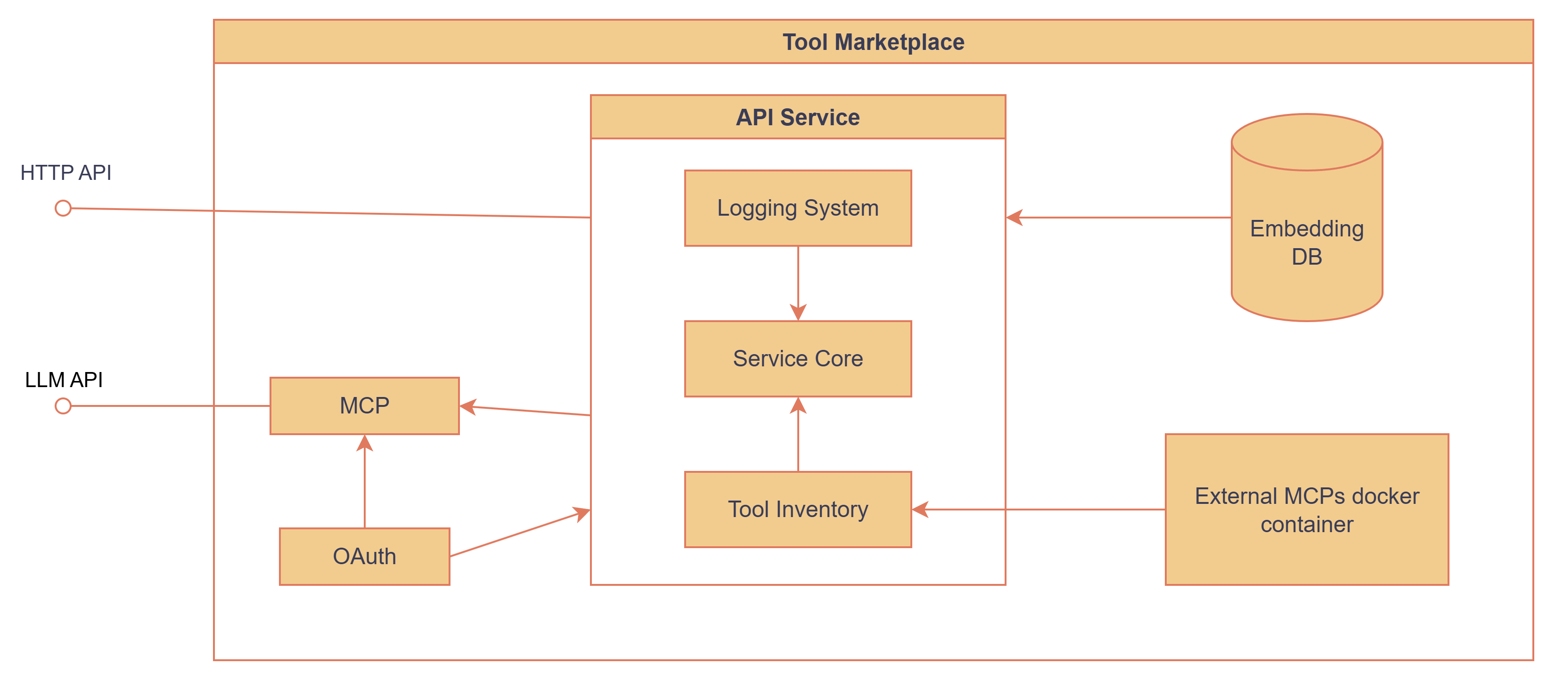
Service structure
Exposed HTTP API and MCP API
Hosted external MCP services as tool inventories
Introduced Text Embedding DB to filter tools by keywords

Slide 8
Evaluation of Marketplace Tool Selection
GAIA tasks with/without Marketplace tools
Key Takeaways
Marketplace adoption does not negatively affect GAIA task performance
Agents can tackle additional tasks effectively using Marketplace tools
L1 10 tasks, each 5 runs
Metrics | w/o Marketplace | w/ Marketplace | Diff
Accuracy | 82% | 76% | -7.3%
Execution Time | 1878s | 2917s | +55.3%
Avg. Steps | 6.2 | 9.2 | +48.4%
Tools | 5.3 | 8.2 | +54.7%
L2 10 tasks, each 5 runs
Metrics | w/o Marketplace | w/ Marketplace | Diff
Accuracy | 46% | 78% | +69.6%
Execution Time | 5319s | 4577s | -13.9%
Avg. Steps | 9.6 | 11.1 | +15.6%
Tools | 20 | 23.4 | +17%

Slide 9
What have accomplished
Area | Tasks | Comments
Services | Tool retrieval Express.JS endpoint | HTTP endpoint for Aworld direct use
 | MCP server for tool invocation | MCP layer for LLM calls
Tool management | Defined and implemented unified tool schema & registry
 | Onboarded top Smithery.ai tools and Aworld GAIA tools | Total: 34 MCP servers/133 tools (Smithery: 11/74 tools; Aworld: 23/59)
 | Service and tool invoke authentication | EntraID OAuth integration
Tool selection | Task breakdown & keyword extraction
 | Keyword text embedding search based on tool metadata
 | Prompt based tool selection using tool metadata & task context
 | API error handling
Telemetry & reporting | Telemetry schema design
 | Logging infrastructure | Aria events collector
 | Execution log collection
Notes:
Milestone 1. tool selection mvp
2. Benchmark
3. Protocol

Slide 10
Onboarded MCP tools
Tool Marketplace MCPs
YouTube Content:
YoutubeToolBox
YoutubeDownload
Terminal Automation:
DesktopCommander
Smart Search & Info Retrieval:
Exa
Tavily
DuckDuckGo
OpenWebSearch
GoogleMap
Finance & Analytics:
YahooFinance
Memory & Knowledge Graph:
Mem0
AI Native & Inference:
Think
Aword MCPs
Content processing:
Audio
Image
Video
Browser Automation:
Browser
Development:
Local-code
Office suites:
CSV
Xlsx
Docx
PDF
PPTX
System Integration & API:
Download – download from URLs
Smart Search & Info Retrieval:
Pubchem
Search
Wayback – Archives
Wikipedia
AI Native & Inference:
Reasoning
YouTube Content:
Youtube

Slide 11
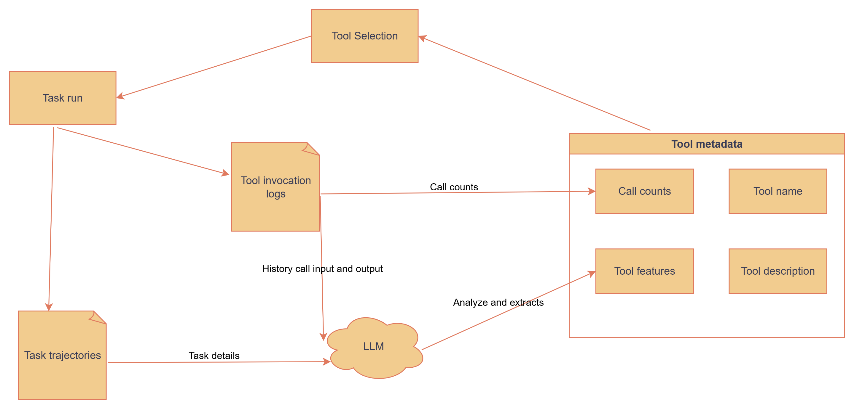
Collected logs
Breakdown tasks and extracted keywords from main task
Selected tools and reasoning from tool selections
Tool invocation input params and output results
Gaia task overall execution result
Gaia task execution trajectories
Agent side final task breakdown
Final tool calls in sequence and outcomes

Slide 12
How we plan to use logs
We could leverage LLM to extract tool usage and transform logs to metadata as tool features
Tool calls to enhance selection over other similar tools.
Tool features: based on historical data, add related keywords to better describe the tools in addition to the existing description provided.
Example:
maps_geocode: Turn the campus building name into coordinates
search_nearby: Find Walmart candidates near those coordinates.
Extracted features:
maps_geocode: Single place/address → precise coordinates (lat,lng) + formatted address/place_id. Triggers: “where is”, “coordinates”, building/campus/address pattern.
search_nearby: Find multiple places near a coordinate (radius + keyword/brand), returns list of POIs. Triggers: “nearest/closest/nearby/within”, brand + “near me”.
Before
maps_geocode: Convert addresses or place names to geographic coordinates (latitude and longitude)
search_nearby: Search for nearby places based on location, with optional filtering by keywords, distance, rating, and operating hours
After
Forward geocode a single address or place name (building, campus, office) into precise coordinates, formatted address, and place_id. Use for “where is” / “coordinates of” queries or explicit address strings. Avoid for “nearest/closest” comparisons (use search_nearby).
Discover multiple nearby places around a coordinate or address (auto-geocode if needed), producing a candidate list for ranking. Triggered by proximity terms (“nearest”, “closest”, “nearby”, “around”, “within X km”, “near me”) and brand/category words

Slide 13
Learnings
External MCP services are hosted in Marketplace for clean client setup
Different MCP will have their own API keys
Unified API quote handling
Introduced text embedding search to narrow down LLM tool selection candidate
Context length limitation of putting all tools into prompt
Extra layer to allow building tool profile when offline process logs to enhance tool matching
We need to create a feedback loop to enrich current tools metadata to give accurate tool suggestions

Slide 14
Agent Marketplace Next Steps
Tool selection
Leverage logs to build feedback loop for setting up tool profile and enhance tool selection performance
Subtask level tool selection
Iterate keyword extraction
Provide multiple plan to solve question
MCP servers/tools management
Separate external MCP server maintaining service
Onboard more MCP servers (how to selects?)

Slide 15
Tool Selection Benchmarks
Layer | Definition | Key Characteristics | Representative Benchmarks | Pros | Cons
Layer 1: Awareness & Invocation | Tests whether the agent can identify the right tool and invoke it correctly given a single-step task. | Single-turn- Tool relevance recognition- Invocation format accuracy- No sequencing | MetaTool ToolBench BFCL v4 (partial) | ✅ Easy to isolate tool usage ✅ Compatible with static tool APIs ✅ Fast evaluation | ❌ Doesn’t test tool chaining ❌ Limited agent autonomy ❌ Prone to overfitting via memorized templates
Layer 2: Tool Reasoning & Chaining | Tests whether the agent can select tools across multiple reasoning steps or choose between multiple tools dynamically. | Multi-turn- Tool sequence composition- Reasoning with intermediate outputs- Tool use optional but beneficial | ToolQA AgentEval Multi-Mission Tool Bench GAIA | ✅ Tests generalization ✅ Evaluates integration + sequencing ✅ Closer to real agent workloads | ❌ More ambiguous gold standards ❌ Requires accurate tool simulation or grounding ❌ Longer eval runtimes
Layer 3: Orchestration & Policy Learning | Evaluates long-horizon, real-time decision-making involving tool use, tool selection tradeoffs, and reward alignment. | Dynamic tool availability- Cost/latency/reward constraints- Online or interactive setting- Often supports RL training | ToolComp Agent Leaderboard v2 MCP Atlas LiveMCPBench | ✅ Closest to real deployment needs✅ Supports RL/self-play training✅ Encourages policy-level evaluation | ❌ Hard to replicate consistently ❌ Expensive to run (real tools or latency models) ❌ Evaluation can be noisy or goal-dependent

Slide 16
Prompt-Based and Dynamic Tool-Use Strategies (Non-Training)
Task | Dataset | Challenge | objective
Single Tool Selection | Query Analysis | Given a user query, the model must decide which search index tool to call and construct the correct parameters. | Evaluate whether the model can select the right tool and build correct parameters.
Multi-step Tool Calling / Agent Style | Multiverse Math | Requires multi-step reasoning and accurate tool invocation. | Assess how well the model follows tool-calling protocols in complex scenarios and avoids “skipping tools” by relying on its internal knowledge.
{
"question": [
HumanMessage(
"how many press releases mentioned chat-gpt in the month after October 2023?"
)
],
"tool_calls": [
{
"name": "BlogQuery",
"args": {
"subject": "chat-gpt",
"authors": None,
"start_date": datetime(2023, 11, 1),
"end_date": datetime(2023, 11, 30),
},
},
{
"question": (
"ecoli divides every 20 minutes. How many cells will be "
"there after 2 hours (120 minutes) if we start with 5 cells?"
),
"answer": multiply(5, power(2, divide(120, 20))),
"expected_steps": ["divide", "power", "multiply"],
},
Notes:
这个是langchain做的关于prompt的实验,主要分了两个task,第一个task是针对搜索的task,主要是为了验证使用工具的时候,参数是否填充正确.
第二个task是对于数学多步运算的,目的就是验证tool call的调用路径是否合理,正确.
下面两个分别是两个task的例子

Slide 17
Prompt-Based and Dynamic Tool-Use Strategies (Non-Training)
zero-shot: Only a basic system prompt and the question were provided to the model.
few-shot-static-msgs, k=3 : Three fixed examples were passed in as a list of messages between the system prompt and the human question.
few-shot-dynamic-msgs, k=3 : Three dynamically selected examples were passed in as a list of messages between the system prompt and the human question. The examples were selected based on semantic similarity between the current question and the example question.
few-shot-str, k=13 : All thirteen few-shot examples were converted into one long string which was appended to the system prompt.
few-shot-msgs, k=13 : All thirteen few-shot examples were passed in as a list of messages between the system prompt and the human question.
messages = [
{"role": "system", "content": "You are a helpful AI assistant that decides which tool to use."},
{"role": "user", "content": "What’s the weather in Paris?"},
{"role": "assistant", "content": 'Call WeatherTool(city="Paris")'},
{"role": "user", "content": "What’s Apple’s stock price?"},
{"role": "assistant", "content": 'Call StockTool(ticker="AAPL")'},
{"role": "user", "content": "What’s the weather like in Tokyo today?"}
]
response = client.chat.completions.create(
model="gpt-4o-mini",
messages=messages
)
messages = [
{"role": "system", "content": "You are a helpful AI assistant that decides which tool to use.examples_str = """
Here are some examples:
Example 1:
User: What’s the weather in Paris?
Assistant: Call WeatherTool(city="Paris")
Example 2:
User: What’s Apple’s stock price?
Assistant: Call StockTool(ticker="AAPL")
"""
"
},
{"role": "user", "content": "What’s the weather like in Tokyo today?"}
]
Notes:
在这次实验中,共分成了5组实验,第一个是baseline,也就是不会放入任何例子.不进行prompt优化.
第二个就是比较新型的prompt方式,是将一些调用tool的例子作为用户和llm交互的方式去进行优化的.
第三个就是在第二个的基础上,在所有的例子库中查找和quey语义相似的例子,然后再以用户和llm交互的方式去优化.
第4个是传统的prompt优化,也就是将所有的例子都放入system的内容中
第5个是第二个的plus版本,第二组实验只放了3个,第五组会放13个.

Slide 18
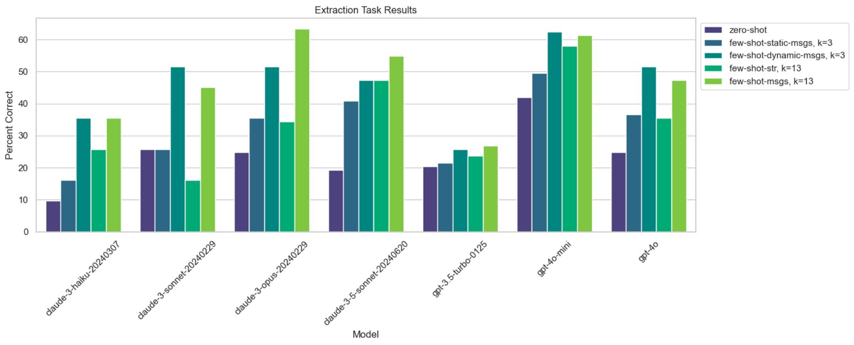
Notes:
这张图是实验的结果,实验结果显示,用消息传递的方式进行prompt的优化都与直接放入prompt中一样好甚至更好
而且在claude3和gpt4o系列的模型中,用动态消息传递方式的实验效果是最好的

Slide 19
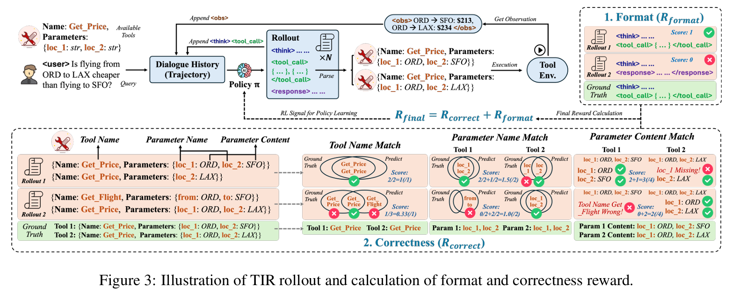
Learning-Based (RL and Fine-Tuning) Frameworks for Tool Selection
ToolRL: Reward is All Tool Learning Need
Notes:
响应模式按照RTO的方式去进行,也就是reasoning ,tool call,output的方式,每一个rto都是最小单元
用户的输入和可用的tool set会一起给到agent,然后agent先进行think,然后去调用对应的tool,产生response之后,对tool的调用进行奖励评估,主要是在tool name,tool的参数名字,和tool 参数的内容进行匹配评估,如果匹配成功,则奖励为1.此外,还有一个结果奖励,也就是每一个task的最终结果是否正确. 还有格式奖励,也就是<think> <tool_call><response>标签正确使用

Slide 20
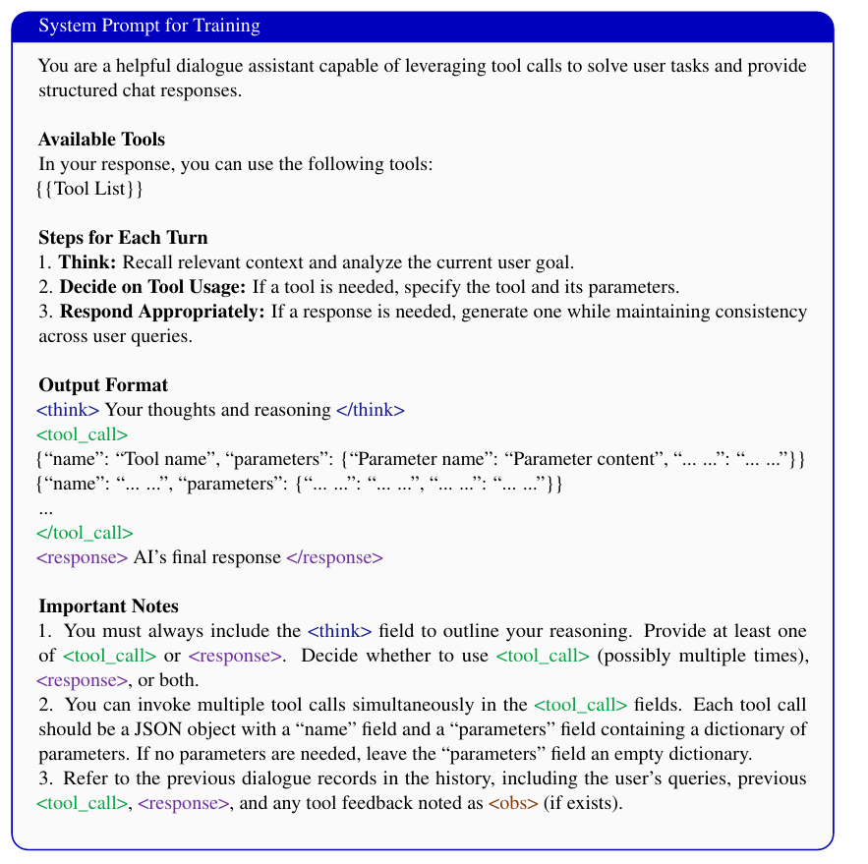
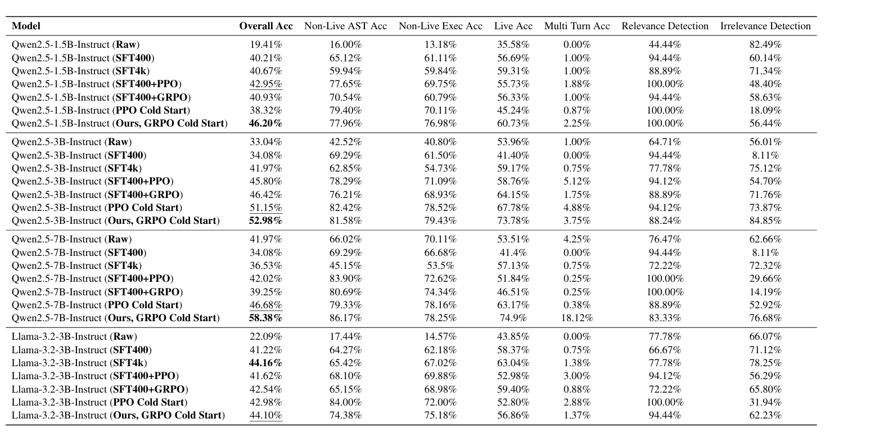
Learning-Based (RL and Fine-Tuning) Frameworks for Tool Selection
Experiment Group | Description
Qwen2.5-1.5B-Instruct(Raw) | The original Qwen2.5-1.5B-Instruct model, without any fine-tuning or RL, directly using the base model to test performance.
Qwen2.5-1.5B-Instruct(SFT+400/4000) | The model is fine-tuned with 400/4000 supervised learning (SFT) data, which is a small-scale SFT. It is used to teach the model some knowledge of formatting or tool invocation.
Qwen2.5-1.5B-Instruct(Ours, GRPOColdStart) | Cold start directly trained with GRPO RL, without any SFT initialization. Compared to PPOColdStart, GRPO improves stability and converges faster.
Notes:
Qwen2.5-1.5B-Instruct(Raw) 是baseline
Qwen2.5-1.5B-Instruct(SFT+400/4000) 后面的数字是SFT的数据集大小
Qwen2.5-1.5B-Instruct(Ours, GRPOColdStart) 直接使用GRPO,不进行任何其他处理

Slide 21
A2M Protocol
What:
A2M (Agent-to-Marketplace Protocol) defines how AI agents connect with a Tool Marketplace to discover, authenticate, and invoke external tools (MCP servers) dynamically. It acts as a universal layer enabling agents to access the right tools in real-time.
Why:
Current LLM systems are limited to static tool lists and lack interoperability. Credentialed tools (like Gmail, Slack) complicate auth flows, and large-scale environments need ranking, governance, and billing. A2M solves this by enabling dynamic discovery, secure proxy execution, and centralized control.
How:
Discovery – Agent sends a task to Marketplace, receives ranked tool matches.
Authentication – Marketplace handles OAuth or delegated credentials securely.
Execution – Agent calls tools via Marketplace proxy to MCP servers.
Governance – Marketplace logs, audits, and optimizes future selections.
Notes:
How to Achieve Autonomous Discovery and Use of MCP Services by AI Agents - Nacos MCP Router Deployment Best Practices - Alibaba Cloud Community
Marketplace act as a proxy/router between Agents and MCP Servers.

Slide 22
A2M & MCP/A2A
Tool #1
MCP
MCP
Agent A
A2M
Marketplace #1
Tool #2
A2M
Tool #3
A2A
Marketplace # 2
Agent B
Tool #N

