Slide 1
Linux Log Monitoring & Alert System
Project Team
P. Vamsi Chowdary | 2411021060894
Y. Yateesh Kumar Reddy | 2411021060654
Y. Shashank | 2411021060891
M. Santhosh | 2411021060397
Micro-Project Presentation | Linux System Administration (E1ITA307)
Alliance University
Alliance School of Advanced Computing
Department of Information Technology
Project Guide: Mr. Kusuma
October 2026
Notes:
Introduce the project, the team and the guide.

Slide 2
Problem Statement and Aim
Logs matter. Linux logs record system events, errors and login attempts.
Manual checking is hard. Log files grow quickly, and reading them line by line is slow and error-prone.
Detection is useful. Errors and critical events show faults; repeated failed logins can indicate unauthorized access attempts.
2026-10-14 09:00:00 INFO System started
2026-10-14 09:05:12 ERROR Disk usage warning
2026-10-14 09:10:20 FAILED Failed login for user admin
2026-10-14 09:15:45 CRITICAL Service unavailable
Example entries from sample.log: each line must be read and classified
Aim
To build a Linux-based tool that analyses log files, detects errors, critical events and failed logins, generates alerts and reports, and shows the results through a terminal menu and a local web dashboard.
Notes:
Logs are valuable but hard to read manually. This project automates inspection and highlights errors, critical events and failed logins.

Slide 3
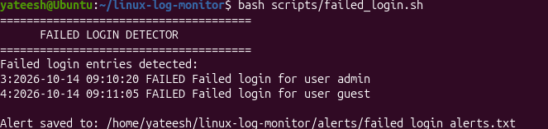
Objectives and Key Features
Log viewing
Keyword-based log searching
Error and critical-event analysis
Failed-login detection
Alert generation
Summary report generation
Viewing real Linux system logs
Web dashboard
Fig. 1: Failed login detector lists failed attempts for users admin and guest and saves an alert file
Security feature
The detector scans the log for failed-login entries, lists them, and saves the result as an alert file.
Notes:
Eight features. The screenshot shows two failed attempts (admin and guest) detected and an alert file saved.

Slide 4
Tools and Technologies
Technology | Used for
Ubuntu Linux | Operating system used to run and test the project
Bash scripting and Linux commands | Terminal menu and scripts for log analysis, search, failed-login detection and alerts
Python | Local HTTP server / API that serves data to the web dashboard
HTML, CSS and JavaScript | Web dashboard: statistics, search, controls and alert history
VirtualBox | Virtual machine used as the development environment
Notes:
Only technologies actually used are listed.

Slide 5
System Architecture
Log Sources
Bash Scripts and Python API
Log Analysis and Event Detection
Alert and Report Generation
Terminal Interface and Web Dashboard
sample.log
Real Linux system logs
Bash scripts: menu, analysis
Python: local HTTP server
Count entries
Find ERROR, CRITICAL and failed logins
Alert files
Summary report
Menu-driven terminal
Local web dashboard
Bash scripts provide the terminal menu and the log analysis; a Python script serves data to the dashboard over local HTTP.
No database is used: logs and alerts are stored as plain files.
Notes:
Logs flow through the Bash scripts and Python API, are analysed for events, produce alerts and reports, and are shown in the terminal and dashboard. Not all processing is in Python and there is no database.

Slide 6
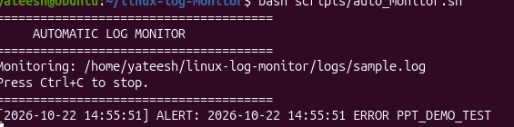
Monitoring Workflow
1. Read the log source
2. Process and inspect log entries
3. Identify error, critical or failed-login events
Fig. 2: Automatic log monitor detecting a test ERROR entry (PPT_DEMO_TEST)
Monitors logs/sample.log and prints an ALERT for the new ERROR entry
Started manually (menu option 10 or dashboard Start Monitoring)
Stopped with Ctrl+C or the dashboard Stop Monitoring button
4. Generate and save alerts
5. Display results in terminal or dashboard
Notes:
Five-step workflow. Monitoring is started manually and stopped with Ctrl+C or the dashboard control; no scheduled service exists.

Slide 7
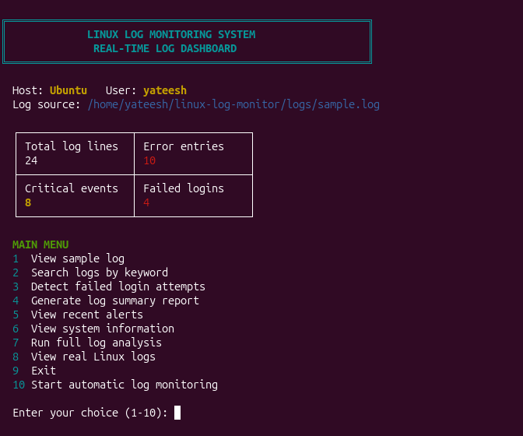
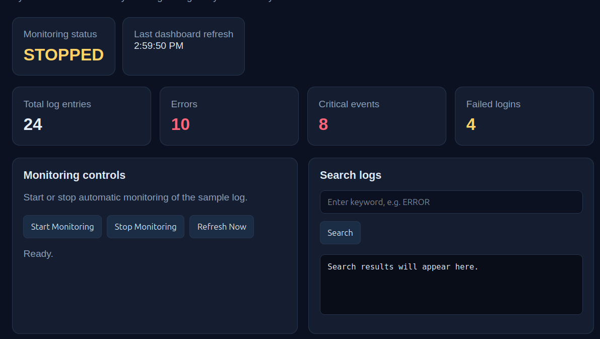
User Interfaces
Fig. 4: Web dashboard with statistics, controls and search
Fig. 3: Terminal main menu (10 options)
Terminal interface: menu-driven; view, search, analyse and monitor logs.
Local web dashboard: statistics, keyword search, start/stop controls, alert history and access to real system logs.
Notes:
Menu option 8 and the dashboard give access to real Linux system logs.

Slide 8
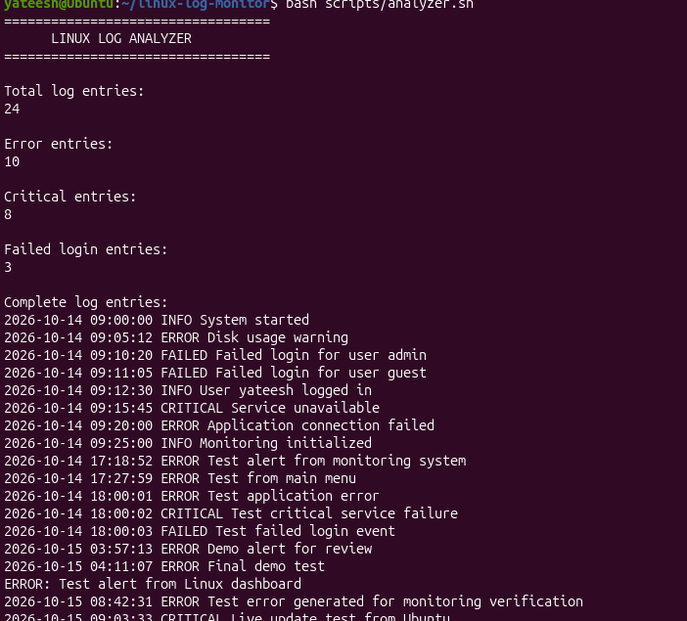
Implementation, Testing and Results
Results from the analyzer output (Fig. 5)
Metric | Count
Total log entries | 24
Error entries | 10
Critical entries | 8
Failed-login entries | 3
Features demonstrated
Full log analysis (Fig. 5)
Failed-login detection: admin and guest flagged (Fig. 1)
Automatic monitoring: test ERROR alert detected (Fig. 2)
Fig. 5: Full log analysis (analyzer script output)
Notes:
Figures are read directly from the analyzer screenshot.

Slide 9
Limitations and Future Scope
Current limitations
Future scope (not yet implemented)
Monitoring must be started manually
No database-backed storage
No email notifications
The dashboard runs locally only
Scheduled monitoring
Database-backed historical log storage
Email or messaging alerts
More advanced log filtering and reporting
Remote monitoring across multiple Linux systems
Notes:
Left: current limitations. Right: possible improvements that are not implemented.

Slide 10
Conclusion
The system lets users view, search and analyse sample and real Linux logs.
It identifies errors, critical events and failed logins.
It generates alerts and summary reports.
Results are available through a terminal menu and a local web dashboard.
Thank You
Notes:
Summarise the four outcomes, then invite questions.

