Slide 1
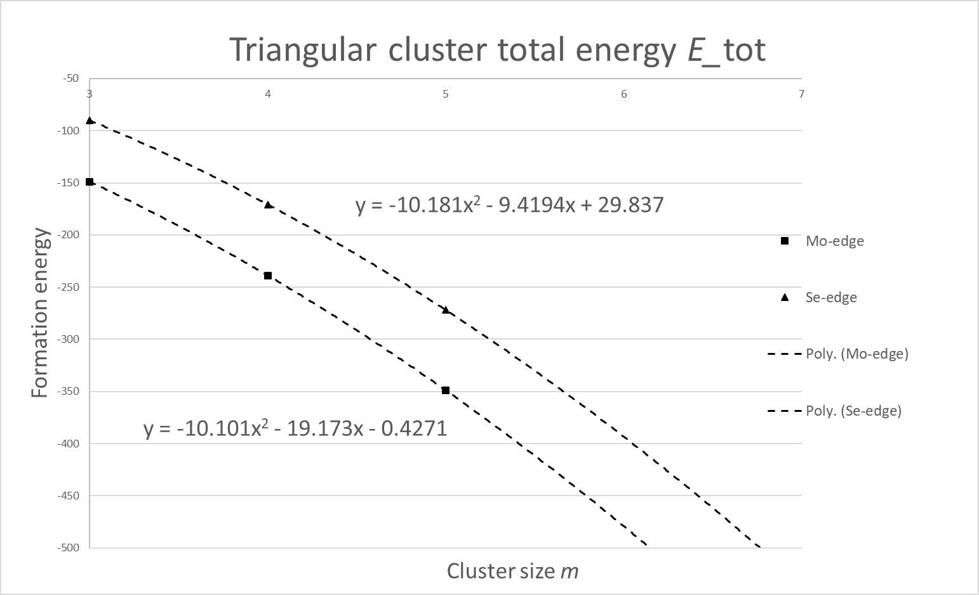
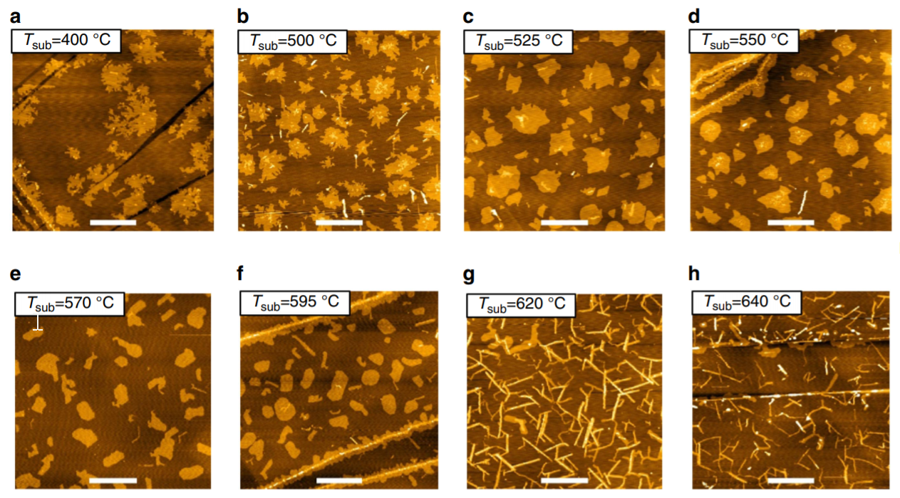
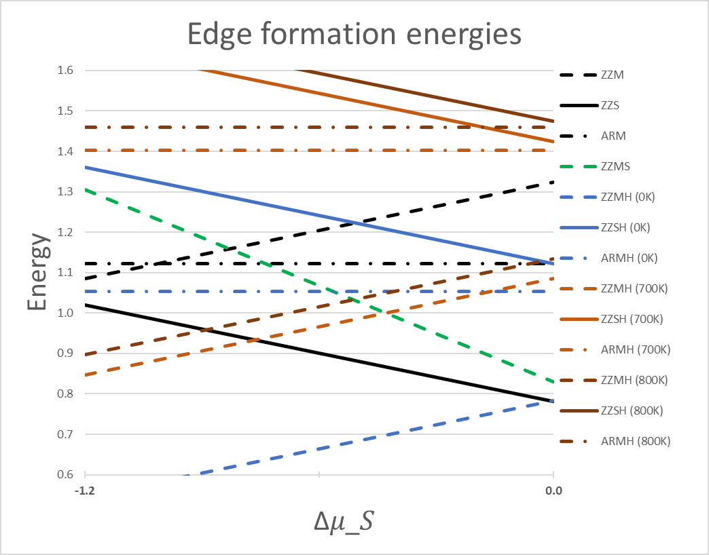
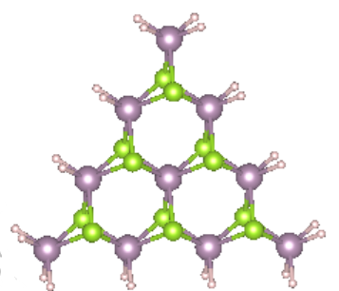
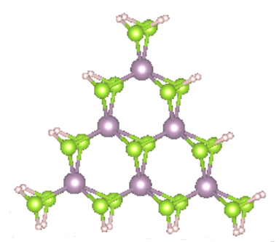
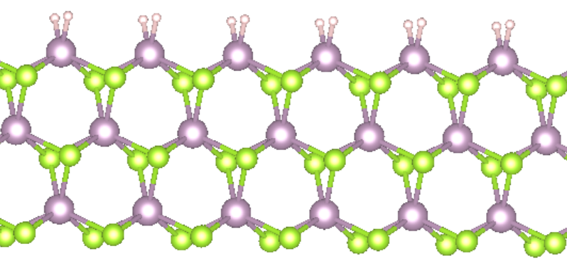
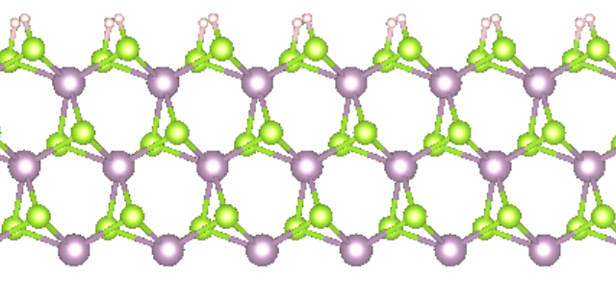
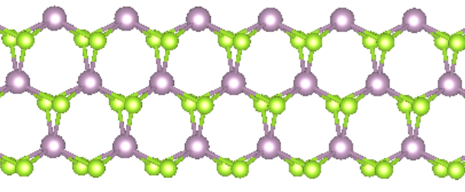

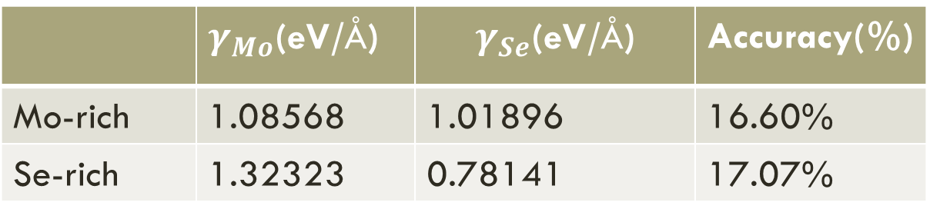
Molybdenum diselenide: edge passivation scheme and equilibrium shape prediction
Lau Yat Fan, Yeung Chun Yat
Abstract
Wulff construction
A method to determine the equilibrium shapes based on minimizing the total edge energies
There is large discrepancy between the experimental observations and theoretical predictions in the morphology of materials. In this project we reproduced literature results of BN morphology. However, quasi-2d systems are more challenging due to the complexity of the edge. We developed a working passivation scheme that satisfies electron counting model for MoSe2. Then, we calculated the stable chemical potential range and studied the edge stability of unreconstructed and reconstructed configurations with temperature effects considered. In the future, Wulff construction will be done and a systematic comparison with the experimental observations will be performed.
Introduction
Results
Molybdenum diselenide (MoSe₂)
A 2D Transition metal dichalcogenides material.
A promising material for technological applications
Previous work on hexagonal boron nitride(h-BN)[1]
We have repeated the result of h-BN
Motivations of this project
Edge reconstructions
Stability analysis
Morphology [3]
Highlights
Develop a passivation scheme
ECM[2]: H-0.66 for Se and H-1.33 for Mo
Maintain the semi-conducting property
Open band gap
Complexity of edges → challenge we face
The passivation itself is difficult for quasi-2D materials
The search of reconstruction edges-a lot of them
No direct observation on the edge formation during the growth
The growth conditions are complicated, different choices of precursors, diffusion problems etc.
Fitting result
Formation energies for edge reconstructions
 | 700K | 800K | 900K
Gibbs free energy (kJ/mol) | -97.175 | -112.937 | -129.070
ZZMH
ZZSH
ZZMS
The following graph shows the fitting result of the triangular clusters.
Conclusion
The equilibrium shapes of h-BN are successfully constructed
Formation energies of ZZM and ZZS edges
Methodology
 | $γ_{Mo}$(eV/$\text{Å}$) | $$γ_{Se}\text{(}\text{eV}\text{/}\text{Å}\text{)}$$ | Accuracy(%)
Mo-rich | 1.08568 | 1.01896 | 16.60%
Se-rich | 1.32323 | 0.78141 | 17.07%
Chemical potential of the passivated-H atom
Total energy
$E_{tot}^{cluster}=\frac{m^{2}+m}{2}μ_{Mo}+(m^{2}−m)$ $μ_{Se}+\left(6m−12\right)μ_{H_{Mo}}+12μ_{H_{Mo}}^{cor}$
$=\left(\frac{μ_{Mo}}{2}+μ_{Se}\right)m^{2}+\left(\frac{μ_{Mo}}{2}−μ_{Se}+6μ_{H_{Mo}}\right)m+(12μ_{H_{Mo}}^{cor}−12μ_{H_{Mo}})$
Edge formation energy
$γ_{edge}=\frac{1}{l}(E_{tot}−n_{Mo}μ_{Mo}−n_{Se}μ_{Se}−n_{H_{Mo}}μ_{H_{Mo}}$)
Future work
Resolve the convergence problem for large m and obtain more data points for fitting
Do the Wulff construction based on better fitting result
References
[1] J Zhang, W Zhao, J Zhu, Nanoscale 10 (37), 17683-17690
[2] Lixin Zhang, E. G. Wang, Q. K. Xue, S. B. Zhang, and Zhenyu Zhang, Phys. Rev. Lett. 97, 126103
[3] Chen, Y., Cui, P., Ren, X., Zhang, C., Jin, C., Zhang, Z., & Shih, C. K, Nature communications, 8, 15135.
Acknowledgement
We thank the department of physics for giving us such an opportunity on this project and thank Prof. Zhu Junyi and Ken’s help and guidance throughout the whole project.

