Slide 1
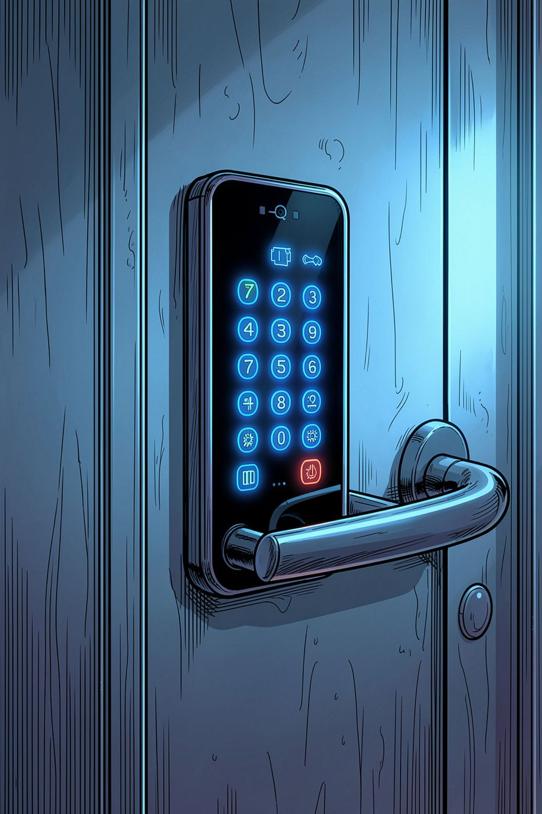
Digital Door Access System Using Combinational Logic
A combinational logic-based security solution for controlled entry
Rishitha
2620030420
Avanthika
2620030327
Mohan Kumar
2620030537
Yashwanth Reddy
2620030553

Slide 2



What is a Digital Door Access System?
Security Through Digital Logic
Controls entry into restricted areas using digital electronics and combinational logic circuits
Logic Gates at the Core
Uses AND, OR, NOT gates to process binary inputs and produce the required access output
Binary Decision Output
ACCESS GRANTED when the correct combination is entered — ACCESS DENIED otherwise

Slide 3
Why Combinational Logic?
⚡ No Memory Needed
🚀 Instant Decisions
Output depends only on the current inputs — no state storage required
No delays in access control — logic output is immediate
🔧 Simple Design
🛡️ Real-Time Security
Easier to build and troubleshoot than sequential circuits
Ideal for real-time access control and security applications

Slide 4

Hardware Components Required
Logic & Processing
Input & Output Devices
Logic Gates: AND, OR, NOT ICs
Breadboard for circuit assembly
Power Supply for the ICs
Input: Push buttons or switches
Output: LEDs to indicate access status
Support: Resistors and connecting wires

Slide 5




Design Tools & Implementation
Truth Tables
Boolean Expressions
Map all input combinations to expected outputs
Simplify logic using Boolean algebra
Karnaugh Maps
Simulation
Minimize the number of logic gates needed
Test circuits using Logisim, Proteus, or Multisim

Slide 6
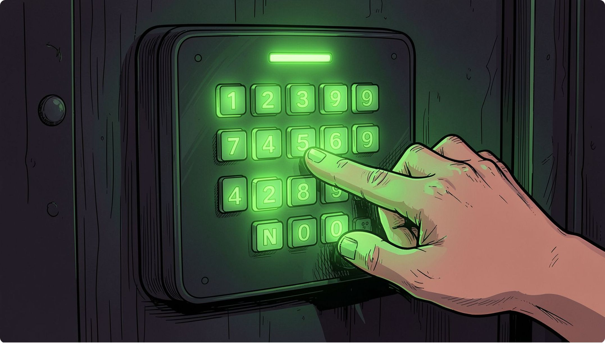
How Does It Work?
1
Binary Input Entry
Switches represent the digital password — each providing a binary value of 0 or 1
2
Logic Gate Processing
Gates evaluate the input combination in real time against the programmed access logic
3
Output Signal
ACCESS GRANTED → output HIGH | ACCESS DENIED → alarm LED activated

Slide 7

System Design: Truth Table & Logic
Inputs & Output Logic
V (ID) | P (PIN) | A (Alarm) | U (Unlock)
0 | 0 | 0 | 0
0 | 1 | 0 | 0
1 | 0 | 0 | 0
1 | 1 | 0 | 1
1 | 1 | 1 | 0
Inputs: Valid ID (V), Correct PIN (P), Alarm Status (A)
Output: Door Unlock (U)
U = (V AND P AND NOT A) — Door unlocks only when ID is valid, PIN is correct, and no alarm is active
Combine AND, OR, NOT gates to implement this Boolean equation in hardware.

Slide 8
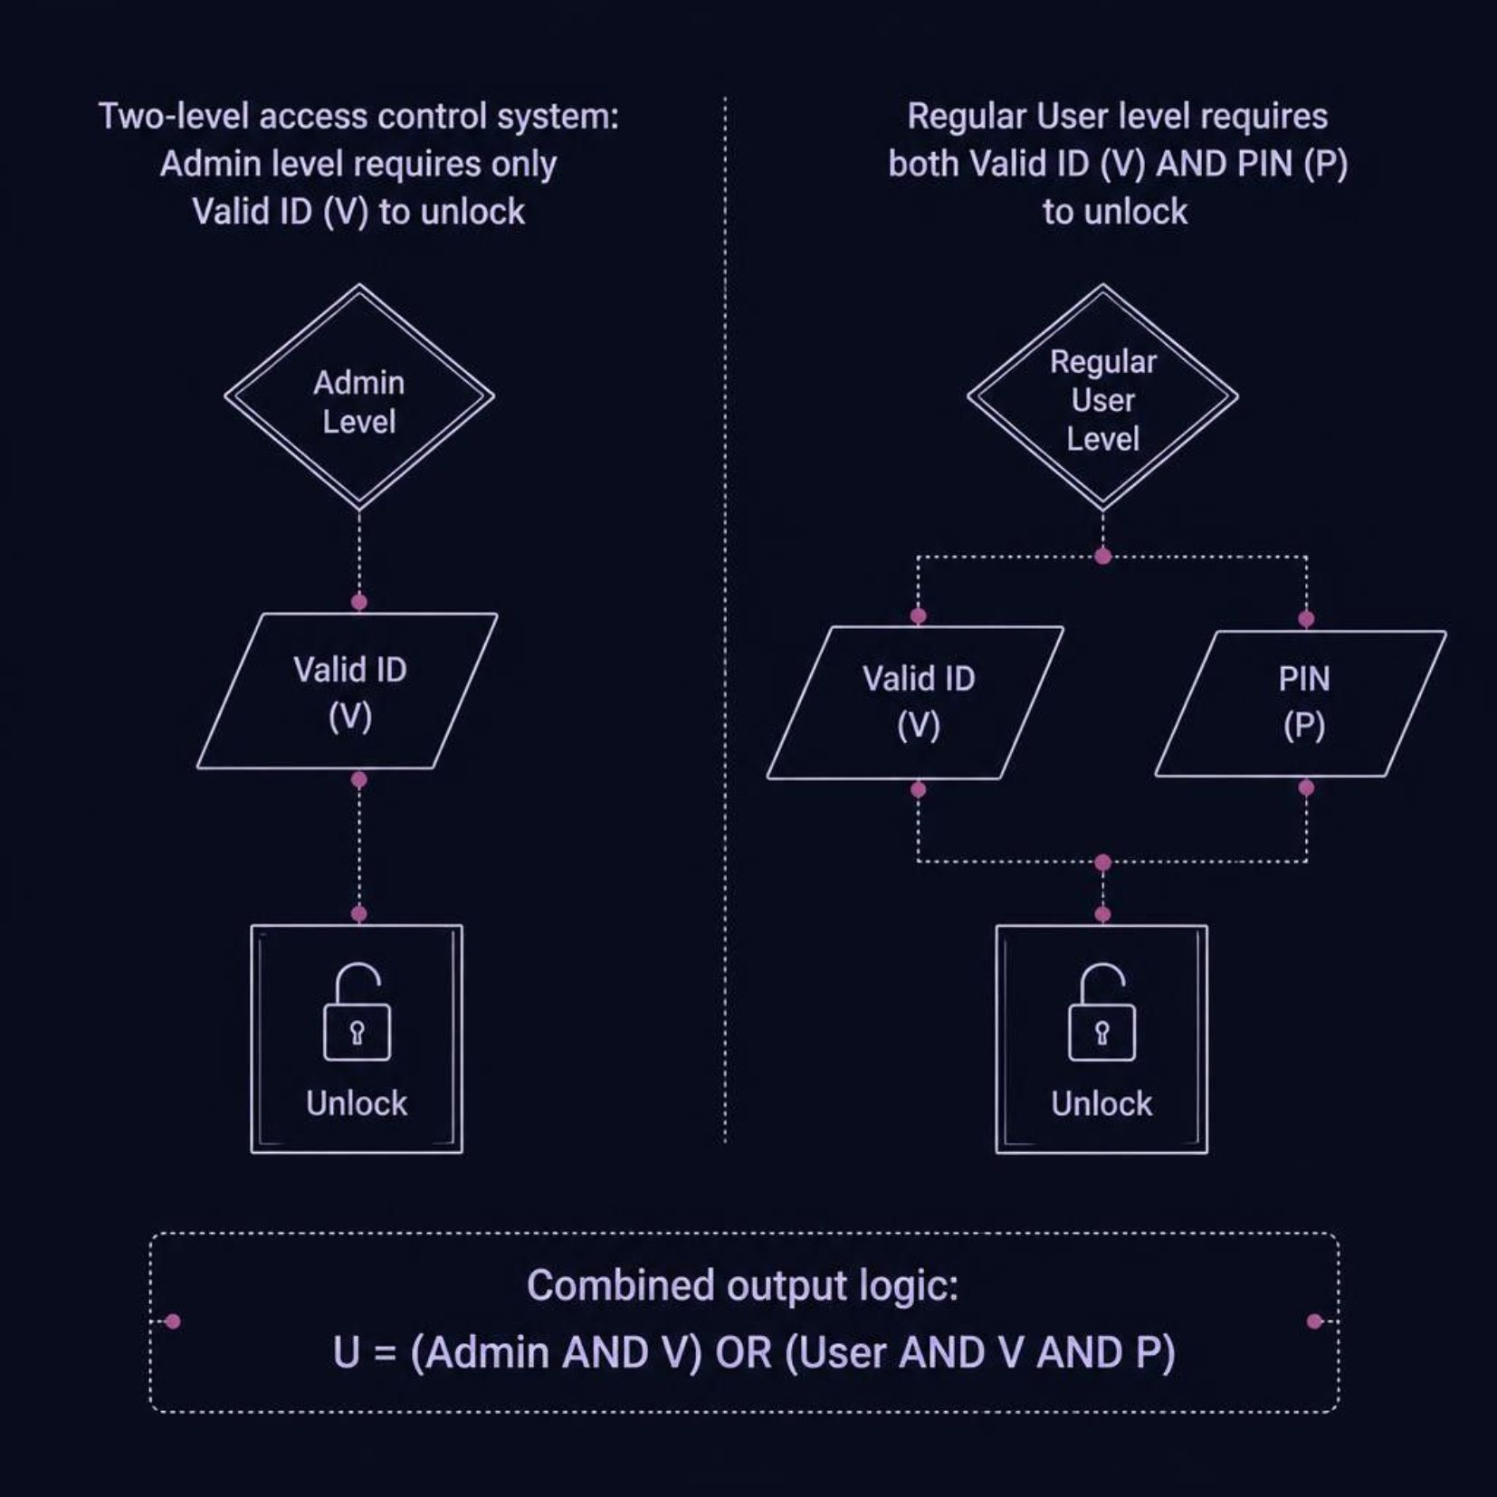

Real-World Example: Multi-Level Access
Boolean Logic
The combined unlock equation:
U = (Admin AND V) OR (User AND V AND P)
Admin: Unlocks with Valid ID alone — highest privilege level
Regular User: Requires both Valid ID AND correct PIN
OR gate combines both access paths into a single unlock signal

Slide 9


Advantages & Limitations
✅ Advantages
⚠️ Limitations
Fast — instant real-time response
Reliable — deterministic logic output
Low power consumption
Simple to design and build
No memory — cannot store past events
No audit log — entry history not recorded
Brute force vulnerable — fixed combination can be guessed

Slide 10






Applications
Residential Security
Office Access Control
Digital door locks for homes and apartments
Workplace and corporate entry management
Laboratory Control
Locker & Storage
Restricted lab and research facility access
Securing cabinets, lockers, and storage rooms
Small Business
Restricted Zones
Affordable security for small business premises
Controlled entry to sensitive or restricted areas
Thank You for Your Attention! 🙏
Presented by: Rishitha · Avanthika · Mohan Kumar · Yashwanth Reddy

