Slide 1

Name of product/solution
Nxt Gen Communication
Name: YATHARTH BHARDWAJ Regn no: 21BCE0869 Dept: Technical

Slide 2
Overview of project
NXT Gen Communication is all about the advancement in the communication systems that we use in our day to day lives. Here we connect vehicles to vehicles via HMI concept so that all the vital and critical information from one vehicle gets transmitted over other vehicles in range. This project is basically V2V Communication i.e. Vehicle To Vehicle Communication.
Inspiration for this project
I get inspired for this project because itself this project has utmost importance:
Vehicle to vehicle communication has many advantages in modern fleet management, with safety the most prominent. With so many motor crashes occurring daily on the road, claiming many fatalities, safety naturally becomes a priority concern.
The technology behind inter-vehicle communication allows vehicles to receive multi-directional messages, These messages are used by cars to determine potential threats such as crashes.

Slide 3
Product Description block by block:
Arduino boards are able to read inputs - light on a sensor, a finger on a button, or a Twitter message - and turn it into an output - activating a motor, turning on an LED, publishing something online.
Human machine interfaces (HMIs) are used as an operator control panel to PLCs and RTUs.
HMIs replace manually activated switches, dials, and other controls with graphical representations of the control process and digital controls to influence that process.
It allows operators to start and stop cycles, adjust set points, and perform other functions required to adjust and interact with a control process.
The signal from the roof antenna goes to the transceiver & it enters the baseband. PIR Motion sensors then detects the infrared rays from different vehicles in range.
DHT-11/DHT-22 are the temperature and humidity sensors which tell us about the weather conditions.
01

Slide 4
After processing data from HMI Interface, it uses VANETs (vehicular ad hoc networks), which consists of a wireless network whereby vehicles can communicate with one another and share information about their driving behaviors.
Ultrasonic ranging module HC - SR04 provides 2cm - 400cm non-contact measurement function, the ranging accuracy can reach to 3mm. The modules includes ultrasonic transmitters, receiver and control circuit.
Using IO trigger for at least 10us high level signal.
The Module automatically sends eight 40 kHz and detect whether there is a pulse signal back.
IF the signal comes back, through high level , time of high output IO duration is the time from sending ultrasonic to returning. Test distance = (high level time×velocity of sound (340M/S) / 2.
Finally, after primary and secondary regulation, the Allpication processor finally produces the output which goes through operator switch to produce sound from audio codec via buzzer, speaker and mic.

Slide 5
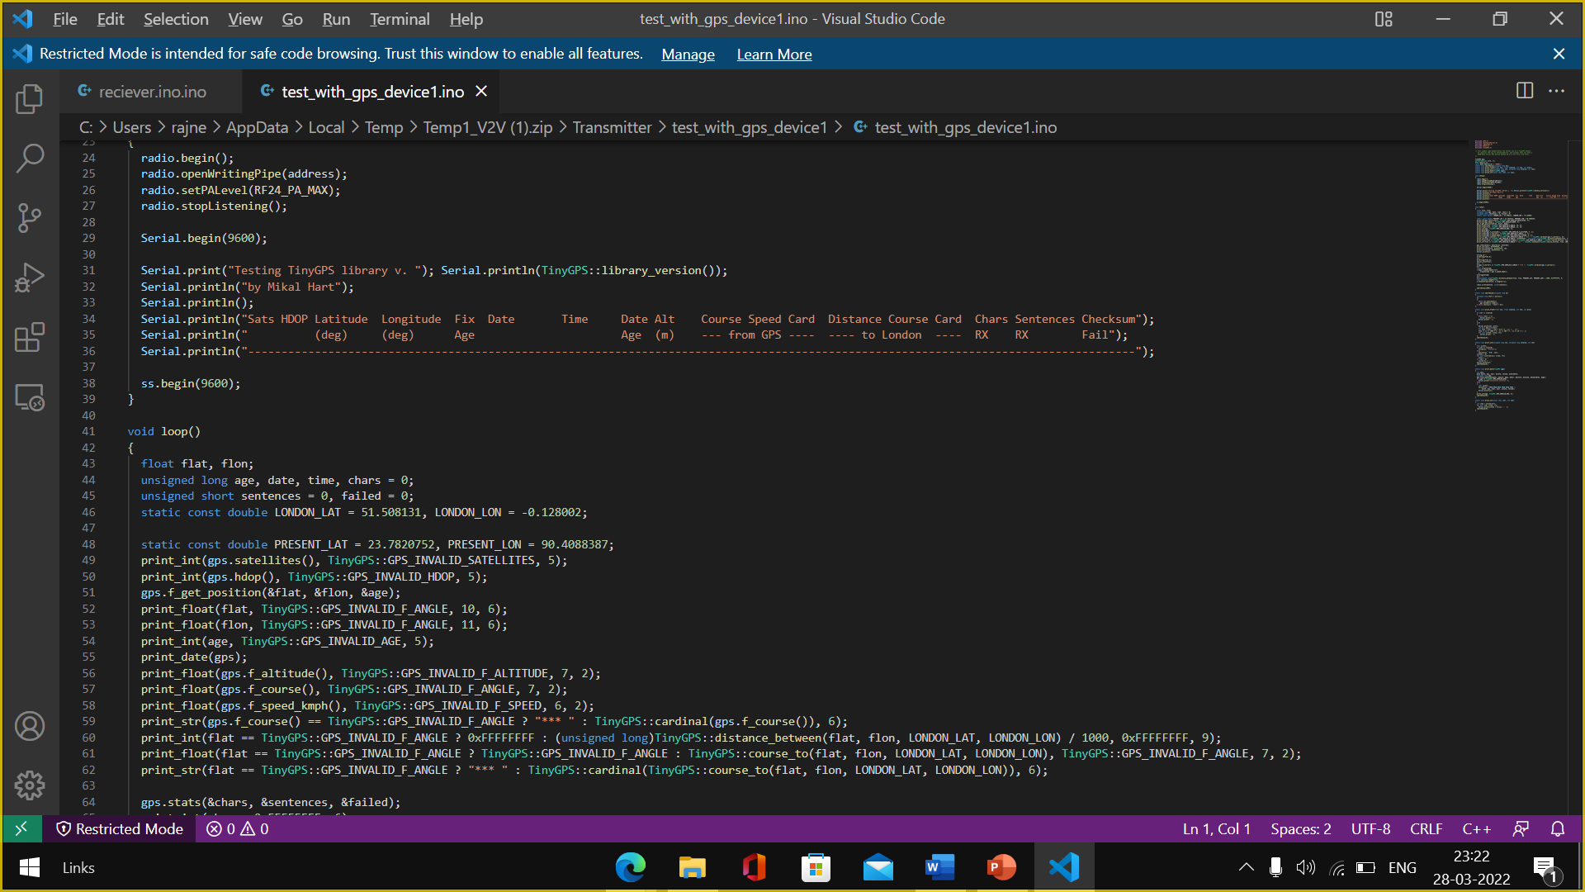
Implementation
Algorithm for blind spot detection:

Slide 6
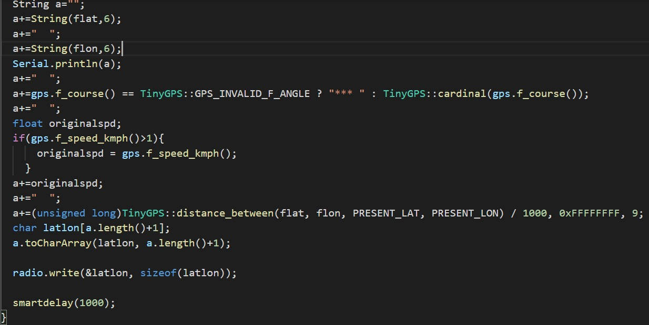
Algorithm for prevention of Collison:

Slide 7
Components/tools used
Hardware to be used:
GSM_GPS Module
Ultrasonic Sensor HC-SR04
NRF Sensor
DHT11/DHT22- Humidity and Temperature sensor
RF Diplexer- Transmitter/Receiver Module
Arduino
PIR Motion Sensor
Buzzer(Audio Signaling device)
Speaker, Mike, etc.
Software to be used:
HMI-Human Machine Interface
VsimRTI [1]
VANET
DSRC
NRF24L01(Wireless Transceiver)
SPI
RF-24
Tiny GPS
01

Slide 8
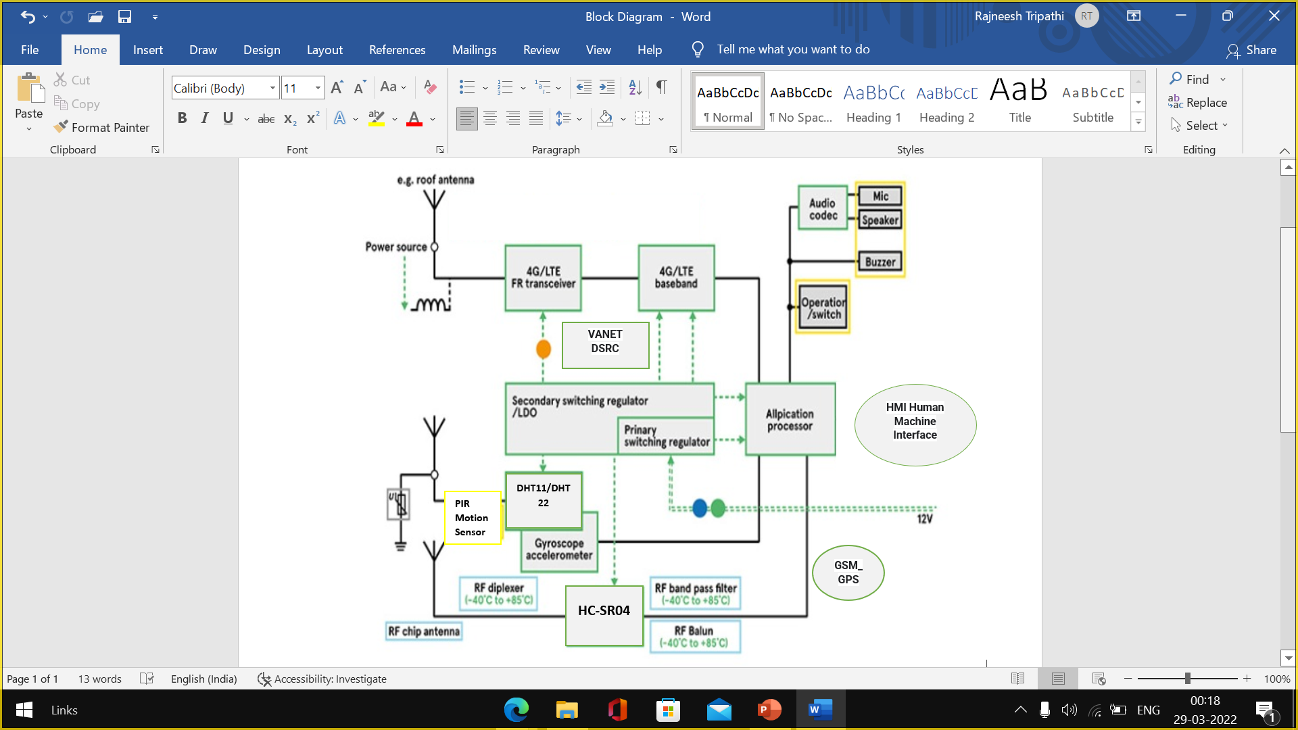
Tentative block diagram/architecture of the product(High level)
01

Slide 9
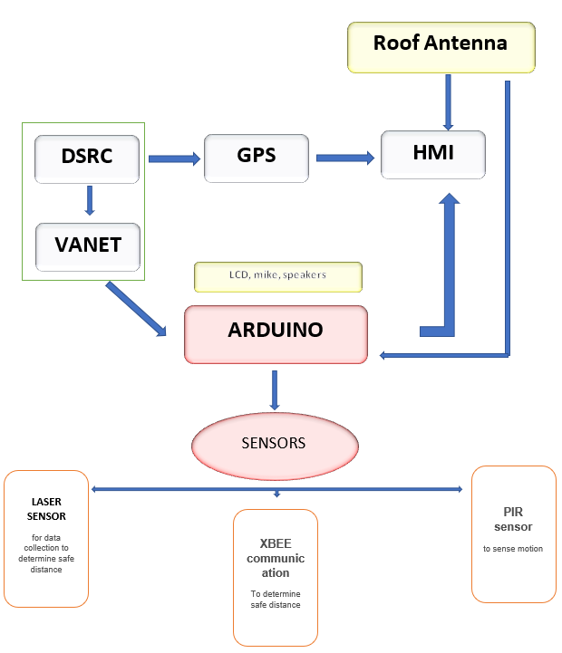
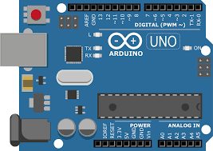

Slide 10
Things learnt while making:
About the Arduino boards
Learnt about HMI-concept
Various type of motor sensors- PIR motor sensor, Ultrasonic sensor
DSRC ,Tiny GPS
Connections of sensors, Code for Tiny GPS
Tech Stack Used:
Various types of software used here:
Human Machine interface
DSRC, Vanet, Tiny GPS,SPI ,etc
PIR Motion Sensor, Buzzer(Audio Signaling device), Speaker, Mike, etc.
Various python libraries used

Slide 11
FEATURES-[Modules implemented]
This tech provides us various warnings
Approaching emergency vehicle warning
Curve speed, blind merge warning.
Cooperative Collision warning .
It provides blind spot detection .
It provides 360 degree awareness.
The importance of the V2V technology is to improve the road safety , by providing incident alerts before a driver sees or detects them.

Slide 12
Modules wished to implement for improvement in this tech:
Security Risks: For vehicle communication to be fully integrated, there is a need for comprehensive security measures. Potential risks include losing control of a car to someone else due to a hacked system, which could result in the car doors locking up, or the engine passing the speed limit.
We need more tech-[modules] for data encryptency.
Privacy Issues: The vehicle to vehicle integrated network processes private data about individual drivers. With the absence of concrete regulations governing the technology, private companies and the government can easily track vehicles. At the same time they can monitor drivers and driving habits. In the event that this data is hacked, it could compromise personal privacy among other security concerns.
Driver Distraction: The driver is required to take some action, like texting, or speaking on the phone to operate the system. It is still in the early stages of development, but there is a lot of work to do to ensure minimal driver distraction, as an act of distraction could be a cause of an accident.
We have to concise our tech on single screen.
Liability Concern: Incidents involving vehicles installed with V2V could bring about liability concerns

Slide 13
Thank you!

