Slide 1
MSCIT -3 CS-15 Programming with R for Data Science
Prepared by :Vaishali Sanghvi

Slide 2
Overview of Data Analytics
Data has been the buzzword for ages now.
Either the data being generated from large-scale enterprises or the data generated from an individual.
Each and every aspect of data needs to be analyzed to benefit yourself from it.
But how do we do it? Well, that’s where the term ‘Data Analytics’ comes in.

Slide 3
Why is Data Analytics important? (Need of Data Analytics)
Data Analytics has a key role in improving your business as it is used to gather hidden insights, generate reports, perform market analysis, and improve business requirements.
Data analytics is important because it helps businesses optimize their performances. Implementing it into the business model means companies can help reduce costs by identifying more efficient ways of doing business and by storing large amounts of data.
A company can also use data analytics to make better business decisions and help analyze customer trends and satisfaction, which can lead to new—and better—products and services.

Slide 4
What is the role of Data Analytics?
Gather Hidden Insights – Hidden insights from data are gathered and then analyzed with respect to business requirements.
Generate Reports – Reports are generated from the data and are passed on to the respective teams and individuals to deal with further actions for a high rise in business.
Perform Market Analysis – Market Analysis can be performed to understand the strengths and weaknesses of competitors.
Improve Business Requirement – Analysis of Data allows improving Business to customer requirements and experience.

Slide 5
What are the tools used in Data Analytics?
R Programming
Python
Tableau Public
QlikView
SAS (Statistical Analysis System)
Microsoft Excel
RapidMiner
KNIME (Konstanz Information Miner )
OpenRefine
Apache Spark.

Slide 6
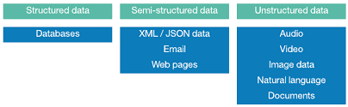
Classification of Data
Structured Data :
Information stored in databases is known as structured data because it is represented in a strict format.
The DBMS then checks to ensure that all data follows the structures and constraints specified in the schema.
Semi-structured Data :
In some applications, data is collected in an ad-hoc manner before it is known how it will be stored and managed.
This data may have a certain structure, but not all the information collected will have identical structure. This type of data is known as semi- structured data.
Examples of semi-structured data are : JSON,XML,.csv file,tab delimited files.

Slide 7
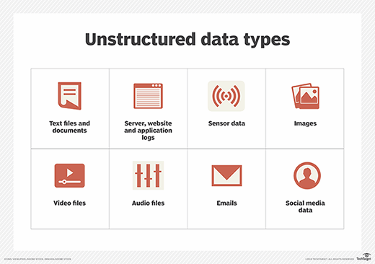
Classification of Data
Unstructured Data :
A third category is known as unstructured data, because there is very limited indication of the type of data.
A Typical Example would be a text document that contains information embedded within it.
Web pages in HTML that contains some data are considered as unstructured data.
Difference between Structure ,semi structured and unstructured data.

Slide 8
Characteristics of Data
Consistency
Accuracy
Completeness
Auditability
Validity
Uniqueness
Timeliness
Refer to document

Slide 9

Application of Data Analytics
There are various areas where data analytics applications have been employed such as :
Policing/Security
Transportation
Fraud and Risk Detection
Manage Risk
Delivery Logistics
Web Provision
Proper spending
Customer Interaction
City Planning
HealthCare
Travel
Energy Management
Internet/web search
Digital Advertisement

Slide 10
Set Up with R Studio
To Install RStudio
Go to www.rstudio.com and click on the "Download RStudio" button.
Click on "Download RStudio Desktop."
Click on the version recommended for your system, or the latest Windows version, and save the executable file. Run the .exe file and follow the installation instructions.

Slide 11
R Basic Command
Once you have R environment setup, then it’s easy to start your R command prompt by just typing the following command at your command prompt (>).
myString <- "Hello, World!"
print ( myString)
[1] "Hello, World!"

