Slide 1
KernelTune
An on-chip kernel autotuner driven by two small models
Team Skywalker · Hack the Chip, NYU × Annapurna Labs · Kernel optimisation track
Notes:
A hand-written chip kernel has settings that decide how fast it runs. Pick wrong and it is up to seven times slower, and the right answer changes with every shape and precision. We built KernelTune: a loop where two 8-billion-parameter models tune those settings, with every attempt measured on a real Trainium2 core.

Slide 2
A hand-written kernel is only fast if its settings are right
Three settings decide how much data the kernel loads per trip and how much it keeps on the chip.
The right values change with every shape and precision. There is no formula.
Today an engineer finds them by trial and error.
7.1x
slower at the worst setting than at the best, at an adapter-style shape
4 of 96
settings are within 2% of the best at that shape
0 of 4
Qwen3-8B layer shapes where AWS's suggested settings run at 512 tokens
Notes:
Before a kernel can compute it has to move data from the chip's large memory into a small on-chip buffer. The three settings say how much to move per trip and how much to keep for reuse. We measured every legal setting: at the 2048 square it barely matters, at an adapter-style shape on Qwen3-8B's layer widths the worst is 7.1 times slower than the best and only 4 of 96 are good. AWS's suggested settings do not run on any of Qwen3-8B's four layer shapes at 512 tokens.

Slide 3
How it works: a loop in which the chip is the judge
1 Kernel
2 Trainium2 core
run it
AWS's blocked matmul, with three block-size settings (M, N, K)
Compile, run, verify against a reference, profile: time, engine busy, bytes moved
10 attempts per run
Keep the fastest setting found
Nothing larger than 8B in the loop
new setting
measurements
4 Optimiser
3 Checker
one instruction
Qwen3-8B edits the setting. The edit is checked before any chip time is spent
Code builds a menu of untried moves with their measured record. Qwen3-8B picks one
Notes:
Three roles, as our mentor asked for. The workload is AWS's blocked matmul kernel. The checker is code that runs the kernel on the chip and first asks whether the answer is still right, then a small model reads the measurements and says what to change. The optimiser is a second small model that edits the setting. Then we measure again. The models choose three numbers; they do not write kernel code.

Slide 4
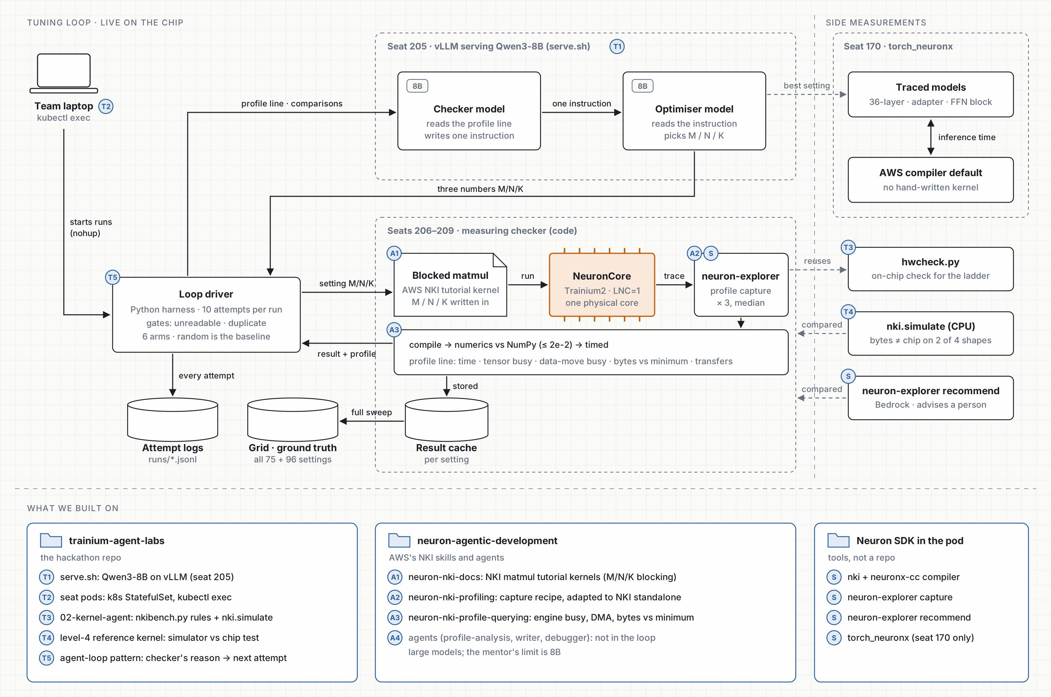
Architecture: the tuning loop, the side measurements, and what we built on
Notes:
The full picture. On the left, the loop driver on our laptop starts runs. Seat 205 serves Qwen3-8B, which plays both the checker and the optimiser. Seats 206 to 209 are the measuring checker: the blocked matmul kernel runs on a NeuronCore and neuron-explorer profiles it. Every attempt is logged, and the full sweep gives the ground truth. On the right are the side measurements: traced models against the AWS compiler default, the simulator comparison, and AWS's own recommend tool. At the bottom is what we built on.

Slide 5
The AWS profiling tools behind every number
1
neuron-explorer capture
One profile, in numbers
Records a hardware trace of the compiled kernel on one NeuronCore. We take the median of three captures.
AWS's fully optimised matmul at 2048, on the chip
2
neuron-explorer view
Turns the trace into a 115-field summary. We read time, engine busy, data-movement busy, bytes and transfers.
905.8 µs
time on the chip
3
NKI and neuronx-cc
Compile and run the kernel standalone on the chip. The CPU simulator, nki.simulate, was our comparison.
97.5%
tensor engine busy
4
Neuron agentic skills
21.7%
data movement busy
AWS's NKI profiling recipe and profile-querying guide, adapted because the pods lack torch_neuronx.
5
neuron-explorer recommend
67.1 MB
moved in 96 transfers
AWS's Bedrock-powered advisor. Read in print-only mode (a 155,604-character prompt); not used in the loop.
Notes:
Every time in this deck comes from AWS's own profiler. neuron-explorer capture records a hardware trace of the compiled kernel on one core, and neuron-explorer view turns it into a summary with 115 fields; we read time, how busy the tensor engine and data movement were, and bytes and transfers. NKI and the neuronx-cc compiler build and run the kernel standalone. We followed the profiling recipe from AWS's agentic skills, adapted because the pods have no torch_neuronx. We also looked at neuron-explorer recommend, AWS's Bedrock-powered advisor, in print-only mode: it sends a 155,604-character prompt and advises a person, so it is not in our loop. The pods expose no power reading, so we have no energy figures.

Slide 6
What we tried: five checker designs, one model
v1
v2
v3
v4
v5
Raw profile numbers
Comparisons worked out in code
A menu of measured moves
v3, and the edit is checked first
v4, with far moves; names its move
2,285 µs
1,553 µs
1,492 µs
1,495 µs
1,494 µs
median final time
median final time
median final time
median final time
median final time
66 of 100
70 of 100
25 of 100
2 of 100
0 of 100
attempts with no measurement
attempts with no measurement
attempts with no measurement
attempts with no measurement
attempts with no measurement
Each design fixes a failure we read in the previous one's log. The model, Qwen3-8B, never changed. Adapter-style shape, 10 starting points: best possible 1,361 µs, random guessing 1,467 µs.
Notes:
Version one showed the model the raw profile. It lost badly to random guessing. The checker said 'increase N to 24, that reduces data movement', the chip came back two and a half times slower, and it said it again. So we changed the message, not the model. Version two showed it comparisons worked out in code. Version three gave it a menu of moves with the measured record for each. Version four caught the second model editing a line it was not asked to touch. Version five had no wasted attempts at all.

Slide 7
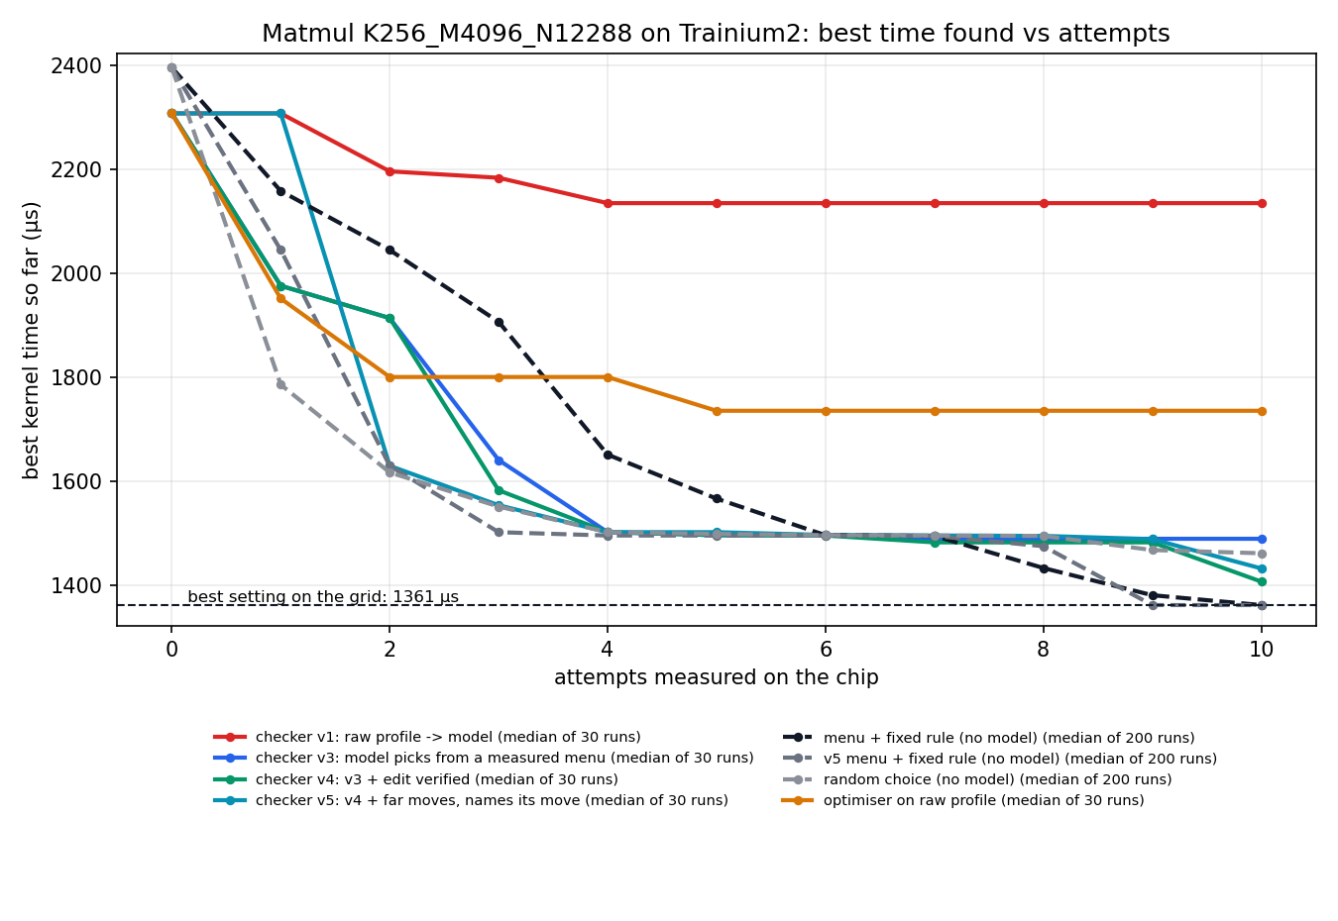
What we got: the checker decides, not the model
3 → 29 of 30
runs within 10% of the best, first checker to last, same model
73%
of runs within 10% of the best for random guessing
71% vs 50%
runs that find the best: a one-line rule on our menu against the 8B model (random 38%)
Notes:
Same model, same chip, same budget: by redesigning only what the checker says, we went from 3 good runs out of 30 to 29 out of 30. Random guessing gets 73%. Here is the part we did not expect: replace the model with a one-line rule on the same menu and it finds the best setting in 71% of runs. The 8B model manages 50%, random 38%. So the value is in the measured menu. Do not say the model beats random at finding the best: 50% against 38% is not conclusive at 30 runs.

Slide 8
Tuned, the kernel is level with AWS's compiler
Left: sums of standalone kernel times, one loop run per layer shape. Right: a small model with random weights at Qwen3-8B's sizes; tuned bar is the median of five loop runs (2.86 to 2.89 ms). Level with the compiler at 32-bit, 4% to 5% behind at 16-bit.
Notes:
We ran the loop on every linear-layer shape in Qwen3-8B and compared it with AWS's own compiler doing the same multiply with no hand-written kernel. Untuned, a hand-written kernel is 12 to 30 percent slower than the compiler. Tuned by the loop it is level with it on every layer. Then we ran the loop at 16-bit, the precision real models use, scored on real inference time. From as slow as 8.6 milliseconds, all five runs ended at about 2.9, within 5% of the compiler at 2.75. Say 'level with the compiler', never 'faster than'.

Slide 9
What we do not claim, and what comes next
Not claimed
Next
We do not beat AWS's compiler. Tuned, the kernel ties it at 32-bit and is 4% to 5% behind at 16-bit.
The 8B model does not beat a one-line rule on the same menu.
The loop chooses three numbers. It does not write kernel code.
One operation tested: matmul, which nobody needs to hand-write.
Point KernelTune at the kernels people do write by hand: fused attention, quantised multiplies, custom normalisation.
It needs three things from any kernel: named settings, a reference answer, and the rule for which values are legal.
Notes:
What are we handing over? An on-chip checker this track did not have. Full ground truth at two shapes. And measured evidence of what a small-model loop needs: tell it what the chip measured, not what to think. We do not beat your compiler, and for matmul nobody needs to. The next step is to point KernelTune at the kernels people do write by hand, where there is no compiler version to fall back on.

