Slide 1



HACK MATRIX HACKATHON
Problem- HM10
PROJECT TITLE : CodeMind– Intelligent Debugging Copilot with Thinking Pattern Detection
TEAM NAME : Ctrl Alt Elite
TEAM MEMBERS :
Yathartha Rastogi (24BCE10410)
Harsh (24BSA10054)
Roshan Gayakawad (24BCG10086)
Shaili Berchha(24BAC10064)

Slide 2

PROBLEM STATEMENT
The problem
Current debugging tools restrict beginner programmers because they only deliver solutions. This situation leads to multiple errors which result in limited knowledge and users needing outside assistance.
Who is affected by this problem .
Why this problem is important ?
Students learning programming
Beginner developers
Competitive coders
Self-taught programmers
Slows down learning process
Creates frustration and low confidence
Leads to repeated mistakes
Reduces coding efficiency

Slide 3
EXISTING SOLUTIONS AND GAPS
List of existing Solutions (if any)
Their Limitations
Stack Overflow
ChatGPT / AI tools
Compiler error messages
Online tutorials
Generic explanations (not personalized)
No tracking of user mistakes
No longitudinal tracking of user error patterns
Learning is passive, not adaptive
Complex solutions rather than basic explanation
The gap our project will address:
There is no system that understands how a user thinks, tracks their mistakes over time, and actively prevents future errors.
Our project aims to help the user grasp the basics of the program they are creating so that they don’t need to use different tools for basic problems and enable them to think like a programmer

Slide 4
PROPOSED SOLUTION
Our solution:
An AI-powered debugging copilot that not only explains errors but also:
Tracks user mistake patterns
Predicts future errors
Adapts explanations based on user level
Helps the user strengthen their grasp on a programming language
Key features:
How it solves the problem
Cognitive Error Pattern Modeling
Error Prediction System
Personalized Learning Mode
Error Simulation
Fix vs Learn Mode
User Coding Profile
Converts debugging into a learning process
Prevents repeated mistakes
Improves coding skills faster
Provides personalized guidance

Slide 5
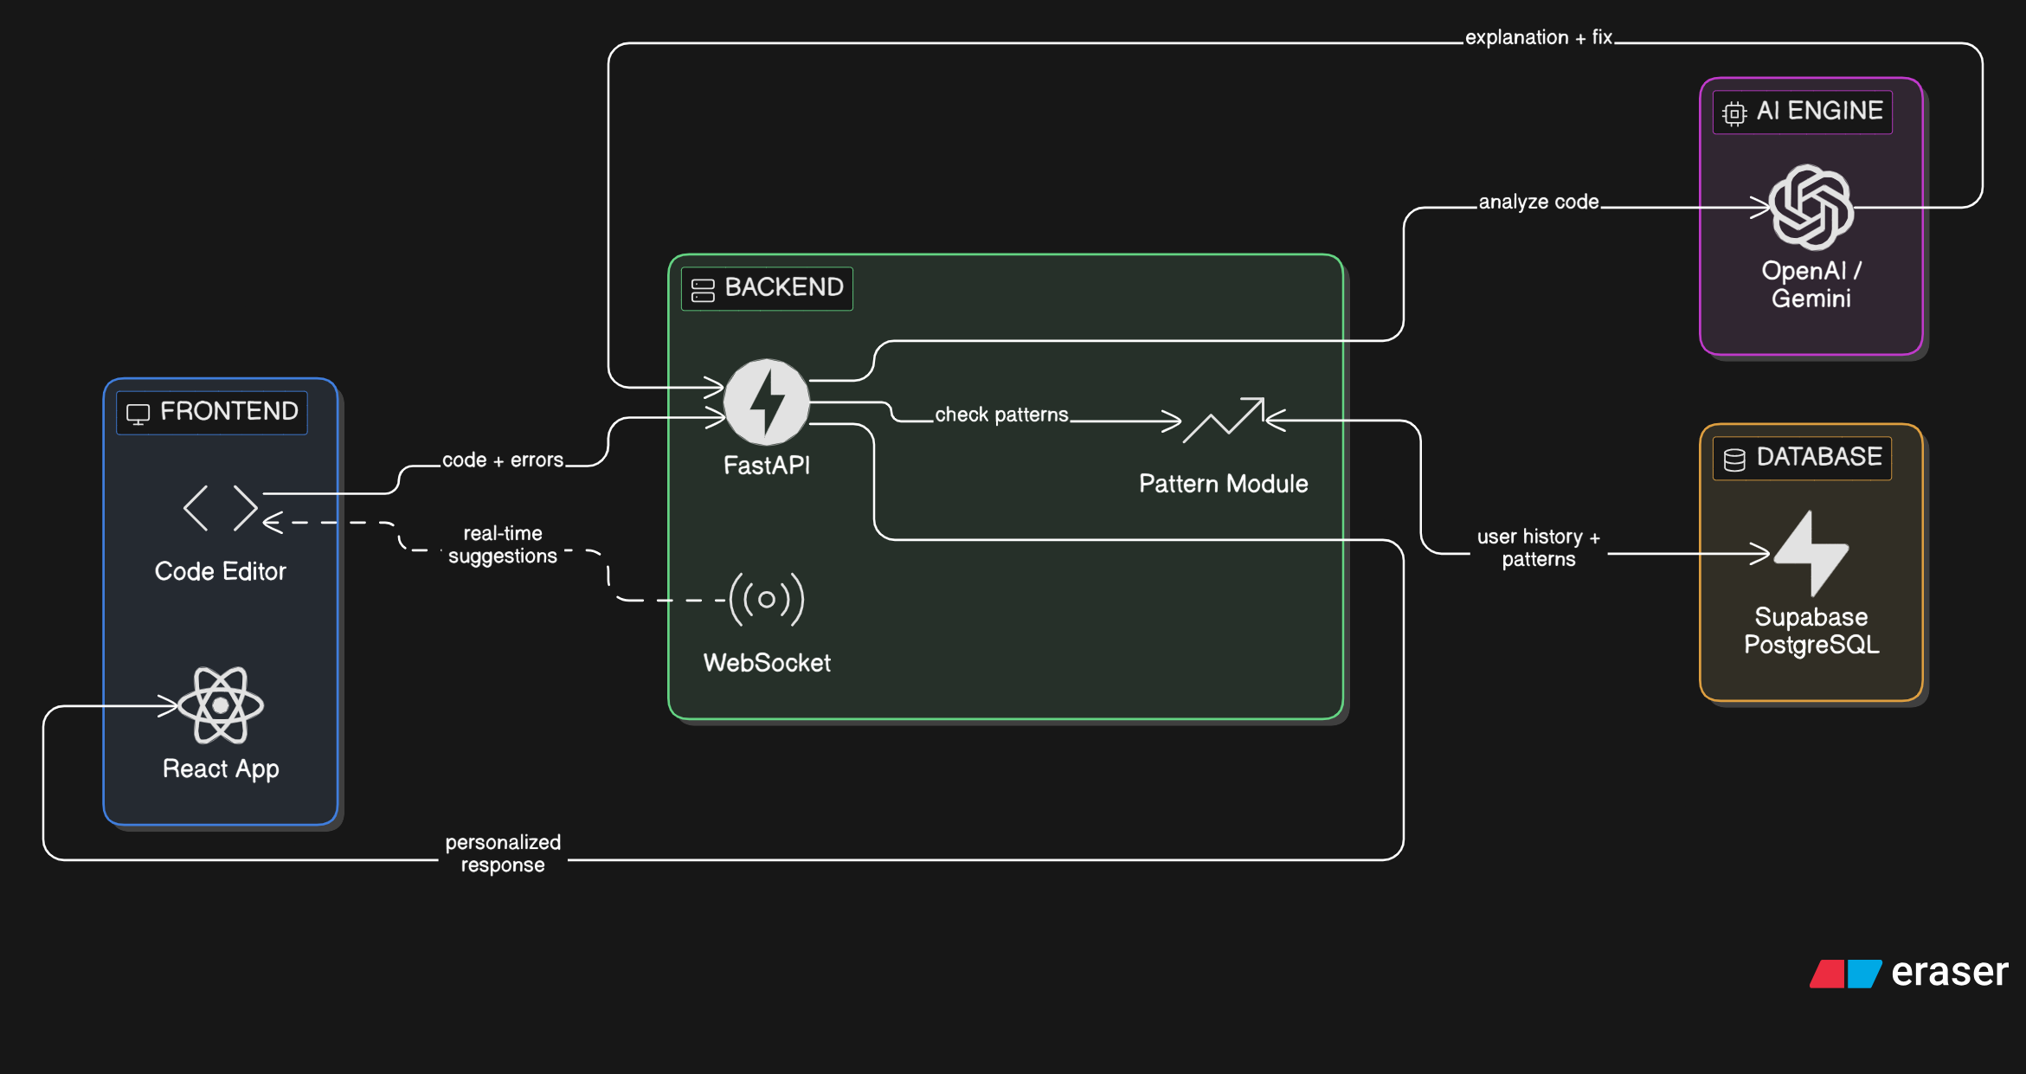

SYSTEM ARCHITECTURE
Main components
Frontend: React
Backend: FastAPI
Database: Supabase (PostgreSQL + Auth + Storage)
AI Engine: LLM API (Gemini)
Pattern Analysis Module: Custom logic to track user mistakes
Data flow
User writes code → sent to backend → backend sends to LLM API → AI returns explanation → pattern module analyses past errors → Supabase stores/updates user data → response sent back to frontend in real-time

Slide 6
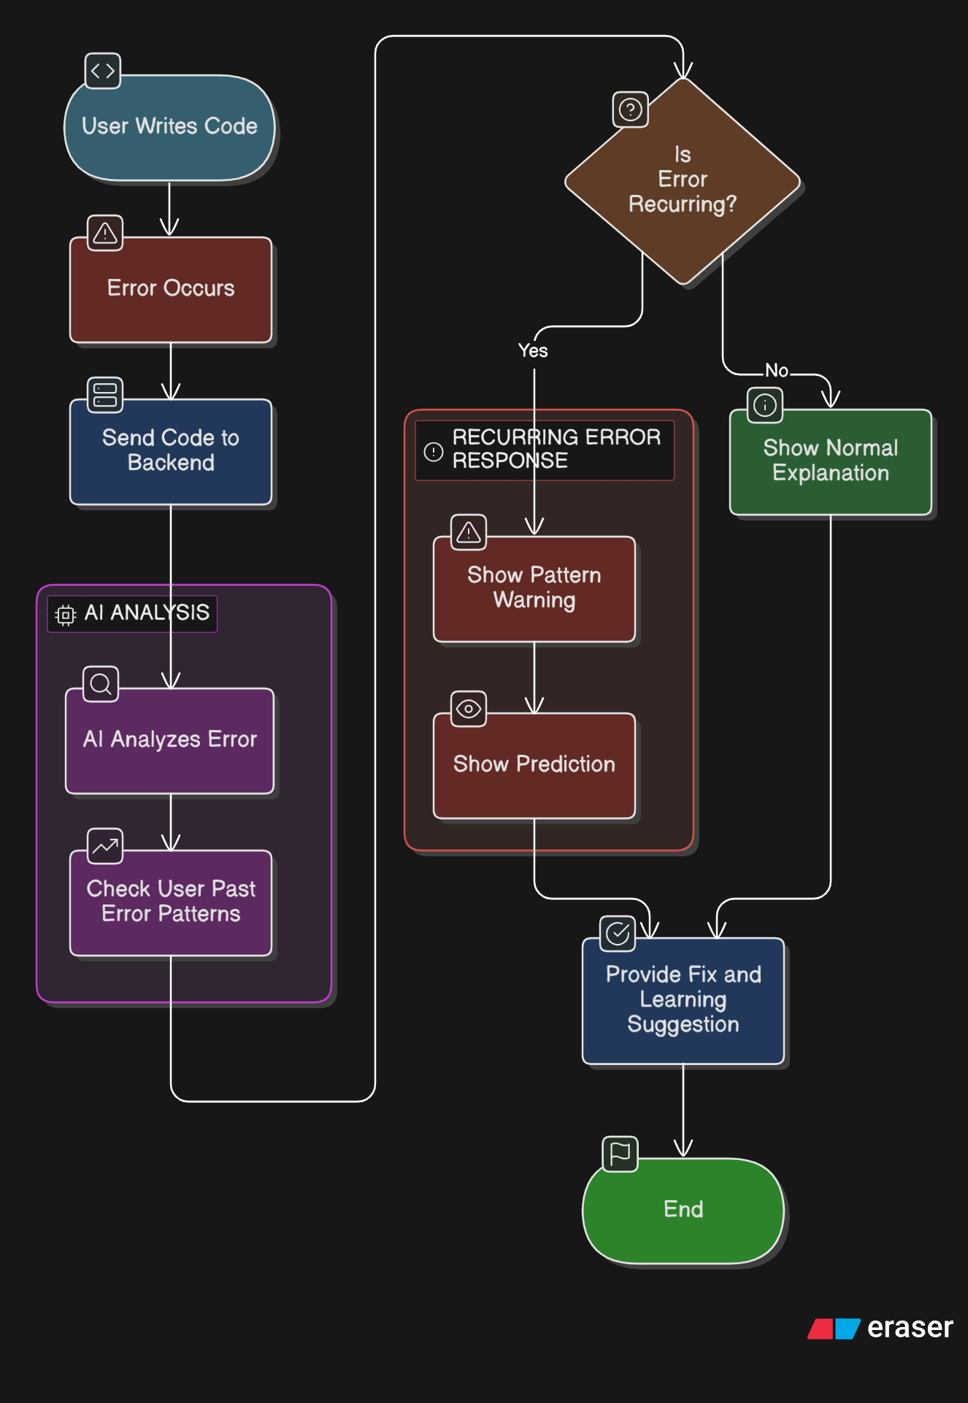

FLOWCHART / WORKING PROCESS
Step-by-step working
User writes code
Error detected
Code sent to backend
AI analyses error
Pattern system checks history
Prediction + explanation generated
Result shown to user
User flow or system flow
User → Code Input → Error Detection → AI Processing → Pattern Analysis → Output

Slide 7
TECH STACK
Technologies:
Frontend: React
Backend: FastAPI
Database: Supabase
Tools and APIs used:
Gemini API → Error explanation

Slide 8
IMPLEMENTATION PLAN
Step-by-step development plan
Modules or features to be built
Error Analyzer
AI Response Engine
Pattern Tracker
User Profile System
Phase 1:
Setup frontend editor
Create backend API
Integrate AI API
Build error detection module
Phase 2:
Add pattern tracking system
Connect database
Phase 3:
Add UI features
Testing & deployment

Slide 9
EXPECTED OUTCOME / IMPACT
Expected results of the project
Faster debugging
Better learning
Reduced repeated errors
Benefits to users
Personalized coding help
Improved confidence
Efficient learning
Real-world impact
Helps millions of beginner developers
Can be integrated into IDEs
Improves coding education

Slide 10
FUTURE SCOPE AND CONCLUSION
Future improvements
Multi-language support
IDE plugin (VS Code extension)
Bookmark & Revisit Mistakes
Team collaboration features
Final summary
CodeMind transforms debugging from a fixing process into a learning system
Scalability of the project
Cloud-based architecture
Can scale to millions of users
Extendable to enterprise developer tools

