Slide 1
SMART CAR PARKING SYSTEM USING ARDUINO

Slide 2
Team Members
Jessica Mahilary
19BCE1852
Ayan Kumar
19BCE1828
Yatharth Gera
19BCE1379
Guide Name
M. Sindhuja
MICROPROCESSOR AND INTERFACING FACULTY
SENIOR PROFESSOR

Slide 3
OBJECTIVE OF THE PROJECT
Smart car parking project aims at providing a confusion free and easy parking. This project helps the drivers of the cars to park their vehicles with minimum wastage of time with accurate information of the availability of the space to park. It includes an Arduino Uno as the microcontroller unit to which the servo motors, LCD display ultrasonic sensors (HC-05) are interfaced

Slide 4
APPLICATION OF THE SENSOR
The application of which consists off -
It is used to measure the obstacle distance.
Used in automotive parking sensors and obstacle warning systems.
Used in terrain monitoring robots.
It can also be designed to measure the range of the object in small embedded projects.

Slide 5
DESIGN PROCESS
The system will provide the user better services. The system counts the number of cars in the garage and checks if there’s any vacancy. There’s an entry and exit path. When vehicle enters, the display shows the number of cars inside. When any vehicle leaves, the count decreases and shown on display. If the garage is full. The display will show a message regarding that. This whole process includes the use of Arduino, Display and sonar. The sonar detects whether the vehicle is entering or leaving. The report then showed on display.

Slide 6
TOOLS REQUIRED
Arduino UNO
Solderless Breadboard
IR Sensor x 2
Servo Motor SG-90
16x2 LCD Display
100R Resistor,4.7k Resistor,1k Resistor
Male to Male Jumper Wires
18650 Battery Holder - 2 Cell, 18650 Battery Cell 3.7V x 2
Power on off switch

Slide 7
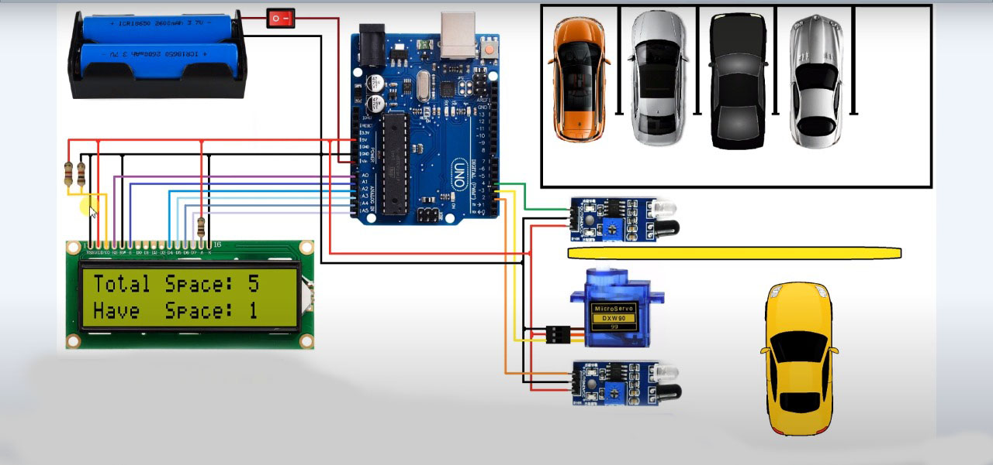
SCHEMATIC DIAGRAM

Slide 8
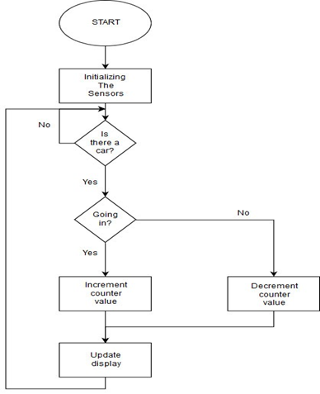
BLOCK DIAGRAM

Slide 9
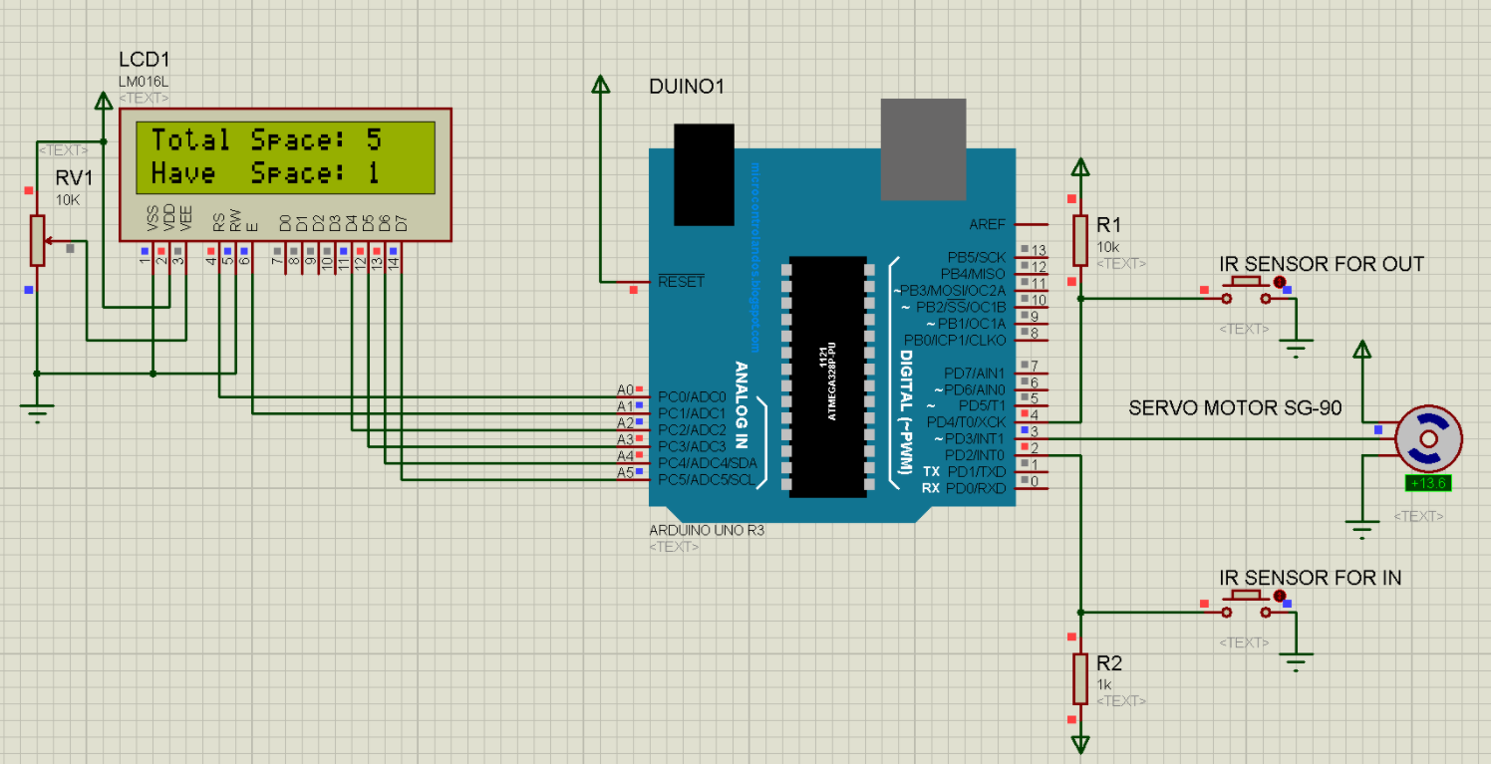
SOFTWARE SIMULATION (PROTEUS)

Slide 10
REFRENCES
1.Thanh Nam Pham1, Ming-Fong Tsai1, Duc Bing Nguyen1, Chyi-Ren
Dow1 and Der-Jiunn Deng2. “A Cloud- Based Smart-Parking System Based on Internet-of-Things Technologies”. IEEE Access, volume 3, pp.
1581 – 1591, september 2015.
2. Yanfeng Geng and Christos G. Cassandras. “A New Smart Parking System
Based on Optimal Resource Allocation and Reservations”. IEEE Transaction on Intelligent Transportation Systems , volume 14, pp. 1129
-1139, April 2013.

Slide 11
REFRENCES
3. M. Fengsheng Yang, Android Application Development Revelation,
China Machine Press, 2010.
4. Cui Shiyao, Wu Ming, Liu Chen, Rong Na . “The Research and Implement of
the Intelligent Parking Reservation Management System Based on ZigBee
Technology”. Measuring Technology and Mechatronics Automation (ICMTMA) ,
pp. 741-744, January 2014.
5. K.Ashokkumar a, Baron Sam , R.Arshadprabhu , Britto. "Cloud Based
Intelligent Transport System". Procedia Computer Science, volume 50, pp. 58-63, 2015.

Slide 12
THANK YOU

