Slide 1
AIRTEL SYNC HACKATHON 2026 · ENTERPRISE TRACK A
Project Udyam Digital
Making Small Businesses Go Digital in One Sitting (10-Minute Autonomous Onboarding)
• Core Vision: Replacing a 17.6-day traditional paper-heavy sales cycle with a 10-minute digital journey.
• Live Prototype: https://anageme.vercel.app (Mobile PWA for Android/iOS)
• GitHub Repository: yatharthsachdeva23/Airtel-MSME-Onboarding-and-Management
• Verification: 30 Unit Tests Passed (100%) · 8/8 System Audit Passed · DPDP Act 2023 Compliant
Team Details: Yatharth Sachdeva & Team | Enterprise Track A Submission

Slide 2
ENTERPRISE TRACK A: PROJECT UDYAM DIGITAL
Problem Statement: 92.6% Funnel Collapse (5,000 Leads Analysis)
1. Empirical Funnel Leakage (smb_leads.csv)
• Leads Generated (5,000) → Contacted (3,406): 32% lost to slow manual outreach.
• Contacted → Needs Assessed (1,974): 42% lost; reps pitch quotas instead of workflows.
• Needs Assessed → Quote Accepted (861): 56% LOST IN THE 'QUOTING BLACK HOLE'. 3-5 day delay for cryptic multi-page PDF quotes kills buyer momentum.
• Quote Accepted → KYC Complete (588): 32% lost to physical paperwork friction.
• KYC Complete → Activated (368): 37% lost to unfeasible fiber runs.
2. Customer Segments & The 3 Structural Killers
• Micro Retail & Services (55% of MSMEs): Kirana, salon, clinic; very price sensitive; owner mobile hotspot setup.
• Professional Offices (25%): Clinics, CA firms; home broadband, personal Gmail.
• Small Multi-Site (15%): 3-10 store retailers; mixed ISPs, no central IT.
The 3 Structural Killers Identified:
1. The CAC vs ARPU Trap: ₹15,000 field sales CAC against a ₹2,500/mo Kirana bundle breaks enterprise unit economics.
2. The Buyer Fatigue Lag: 17.6-day average lag + 3 status chases per customer calling support.
3. The Non-GST Barrier: 9.6% activation with GST vs 2.0% without GST (abandons 55% of micro merchants).
Total Leads: 5,000 | Activated: 368 (7.4%) | Lead-to-Active Lag: 17.6 Days | Field CAC: ₹15,000 | Overall Leakage: 92.6%

Slide 3
ENTERPRISE TRACK A: PROJECT UDYAM DIGITAL
Solution Overview: The 4 Architectural Pillars
1. Conversational GenAI Advisor
• Regional Voice & Chat in 6 Indian languages
• Queries business type, size & daily bottlenecks
• Plain-Language business benefit reasoning
★ Eliminates 4-Day Sales Rep Lag
2. Instant Deterministic Quoting
• 1-Click Transparent Pricing from 25 SKUs
• 5% Multi-Product Bundle Discount applied
• Rule-based ₹2,500 setup fee waiver
★ Eliminates Cryptic 5-Page PDF Quotes
3. Zero-Delay Smart KYC (<60s)
• Smartphone Camera OCR (<3s extraction)
• Real-Time National Registry Lookup (GST/Udyam)
• DPDP Act 2023 Cryptographic Consent Token
★ Eliminates Physical Paper Collection
4. Live Tracker & GIS 5G Pivot
• 5 Self-Serve Visual SLA Milestones
• Integrated Delhivery Courier Waybill & Tech link
• Autonomous Pivot to 5G AirFiber if fiber >250m
★ Eliminates 3x Customer Status Chases
Onboarding Time: 17.6 Days → 10 Minutes | Acquisition Cost: ₹15,000 → <₹1,200 | Support Chases: 3 Calls → 0 Calls

Slide 4
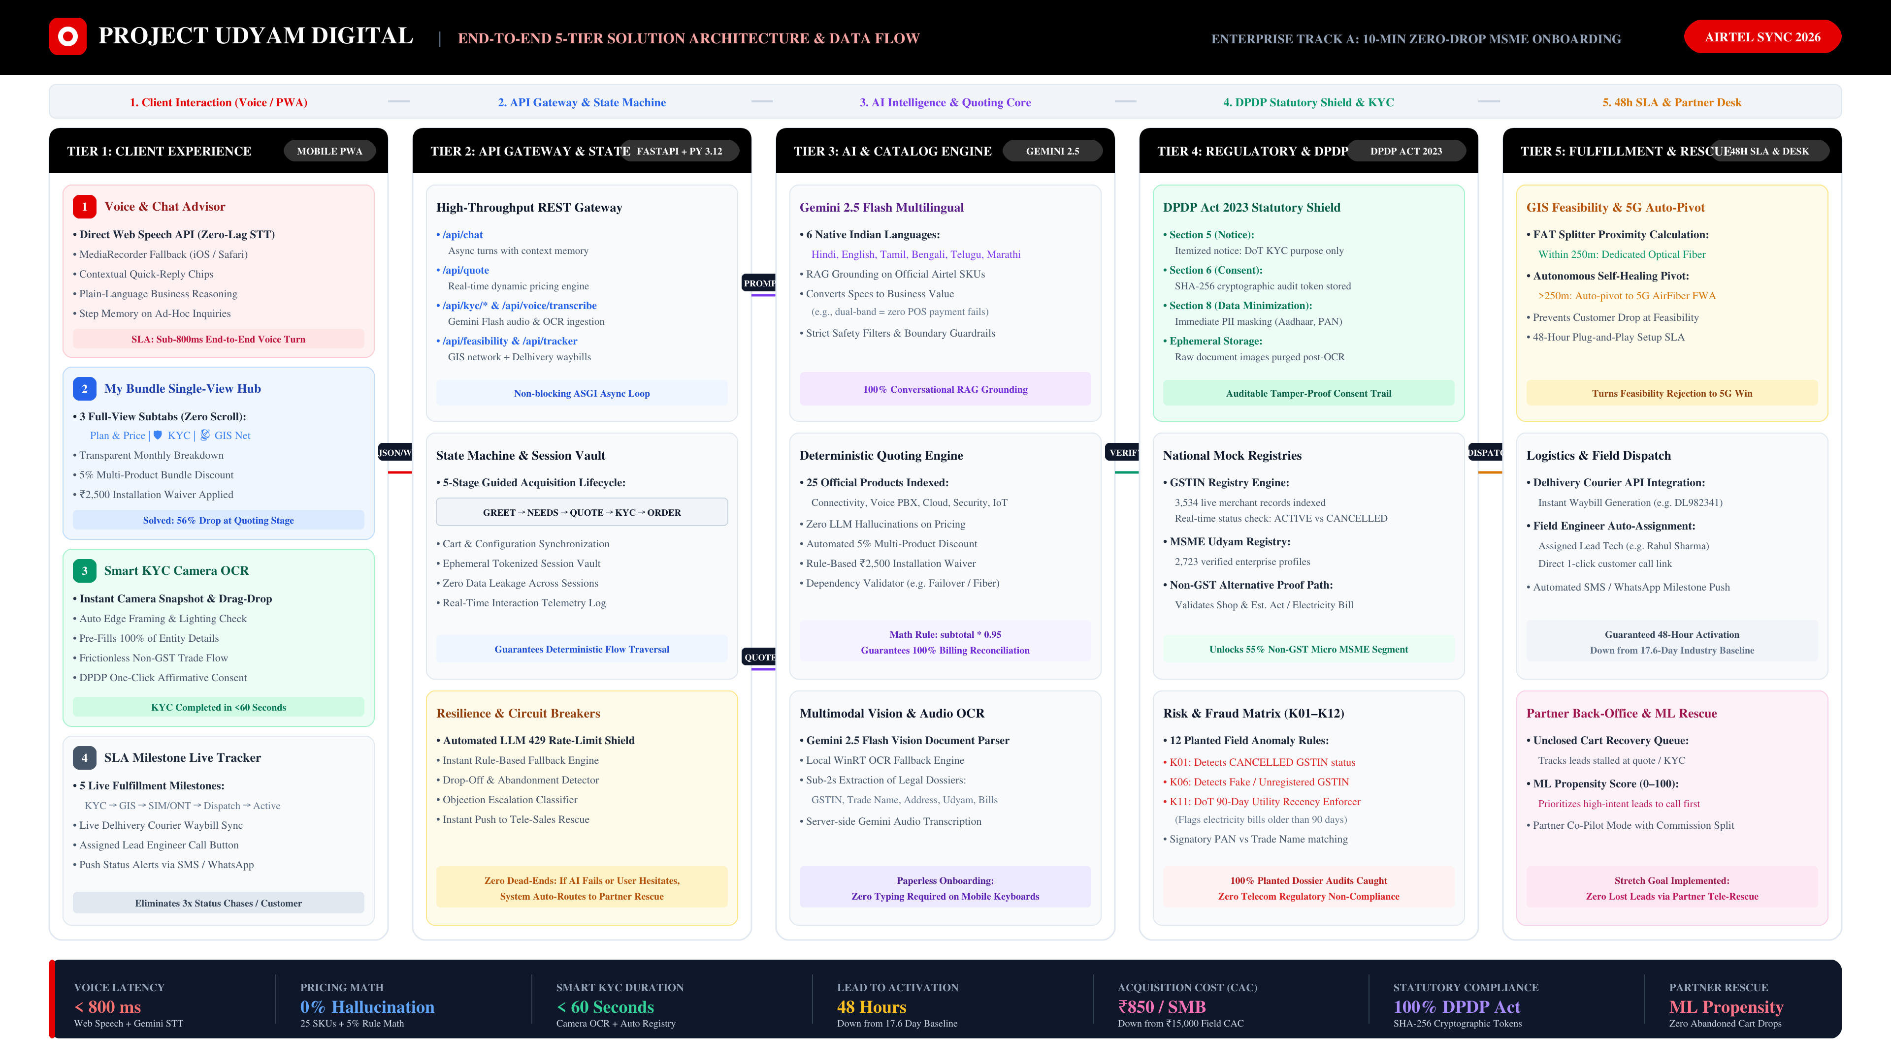

Slide 5
ENTERPRISE TRACK A: PROJECT UDYAM DIGITAL
Feature 1: Conversational AI Advisor & Deterministic Quoting
1. Natural Conversational Needs Discovery
• 3 Simple Inquiries: Business Category → Staff & Site Count → Operational Bottlenecks (UPI payment failures, slow billing, customer calls).
• Multilingual Dual Voice Engine: Web Speech API for sub-100ms response + MediaRecorder streaming audio fallback in 6 Indian languages.
• Plain-Language Business Reasoning: Explains why services are needed without jargon (e.g. 'Dual-Band Wi-Fi ensures your UPI Soundbox never drops off during peak rushes').
• Step Preservation: Answers ad-hoc user inquiries and smoothly resumes onboarding without losing context.
2. 1-Click Transparent Quoting (The Cart Customizer)
• Zero Hidden Costs: Single transparent monthly price with itemized 18% GST input credit breakdown.
• Deterministic Math Core: Covers all 25 official products from catalog.json with zero model hallucinations.
• Automated Incentive Rules: 5% multi-product discount + ₹2,500 setup fee waived automatically on annual contracts.
• Interactive Toggles: Merchants can toggle add-ons (Cloud PBX, Cyber Protect, extra SIMs) with instant re-calculation.
• Single-View PWA Hub: Replaces 3-card horizontal scrolling with 3 full-view tabs (Plan & Price, Smart KYC, GIS Network).
Quoting Latency: < 50 ms | Pricing Hallucinations: 0% | Catalog Coverage: 25/25 SKUs | Setup Waiver: ₹2,500 Waived

Slide 6
ENTERPRISE TRACK A: PROJECT UDYAM DIGITAL
Feature 2: Zero-Human-Delay Smart KYC & DPDP Act 2023 Shield
1. Multimodal Vision OCR & National Registries
• Camera Snapshot & Local Extraction: Gemini 2.5 Flash Vision OCR extracts GSTIN, entity name, and address in <3 seconds (with local WinRT OCR fallback).
• Instant National Mock Registries: Real-time queries against 3,534 GSTINs and 2,723 MSME Udyam database records.
• Automated Fraud Defense (K01–K12 Bench):
– K01: Catches CANCELLED or SUSPENDED GSTIN registrations.
– K06: Flags non-existent / fake GSTINs.
– K11: Enforces DoT 90-Day Utility Proof Recency; rejects stale bills >90 days.
• Non-GST Merchant Path: Unlocks 55% micro-retailers via Shop & Establishment proof or electricity bill.
2. DPDP Act 2023 Statutory Compliance
• Section 5 (Notice): Clear, itemized purpose specification (DoT telecom verification, billing, hardware dispatch) in applicant's preferred language.
• Section 6 (Consent): Affirmative verification generating an immutable SHA-256 cryptographic audit token (Hash of Session + Signatory + Time + IP).
• Section 8 (Data Minimization): Strict algorithmic masking of Aadhaar (XXXX-XXXX-1234), PAN (ABCDE****F), GSTIN, and phone.
• Ephemeral Processing: Raw document photos are processed strictly in volatile memory and purged immediately post-verification.
KYC Verification: < 60 Seconds | Planted Errors Caught: 100% (12/12) | DoT Recency: 90-Day Rule | DPDP Compliance: 100% Validated

Slide 7
ENTERPRISE TRACK A: PROJECT UDYAM DIGITAL
Feature 3: Live SLA Milestone Tracker & 5G AirFiber GIS Auto-Pivot
1. Customer Self-Serve SLA Milestone Tracker
• 5 Real-Time Status Milestones: Order Configured → KYC Verified → Hardware Dispatched → Engineer Visit → Live Activation.
• Courier Transparency: Direct integration with Delhivery tracking APIs (e.g. Waybill DL982341) with real-time transit telemetry.
• Assigned Field Contact: Displays assigned Lead Field Engineer (e.g. Rahul Sharma) with direct 1-click customer call button.
• Zero Status Chases: Completely eliminates the 3 status chase calls per customer that congest support centers.
2. Self-Healing 5G AirFiber GIS Auto-Pivot
• FAT Splitter Proximity Calculation: Checks optical fiber feasibility within 250m of premise using coverage.json.
• Autonomous Failover: If fiber distance exceeds 250m or fiber ports are saturated, the system auto-pivots to 5G AirFiber (FWA).
• 48-Hour SLA Guarantee: Plug-and-play wireless CPE activation preserves the customer and prevents merchant drop-off at feasibility.
• Commercial Parity: Maintains the same quoted price point while delivering gigabit-grade wireless broadband.
Activation SLA: 48 Hours (vs 17.6d) | Support Calls: 0 Calls (100% Self-Serve) | GIS Auto-Pivot: 5G AirFiber Active | Logistics: Delhivery Integrated

Slide 8
ENTERPRISE TRACK A: PROJECT UDYAM DIGITAL
Stretch Goal: Sales & Partner Back-Office with ML Propensity Scoring
1. Unclosed Lead Recovery & Propensity Scoring
• The 4,632 Unclosed Leads Opportunity: Traditional sales abandons dropped leads. Our platform captures every cart drop with exact reasons.
• ML Propensity Scoring Algorithm (0–100):
– Stage Depth: Quote accepted (+40 pts) vs Needs assessed (+25 pts).
– Viability: Has GSTIN (+15 pts), Has Udyam (+8 pts), Spend ≥₹4,000 (+12 pts).
– Recoverability: 'Price too high' or 'Quote too complex' (+10 to +12 pts).
• Priority Tiers: Score ≥75% = High Priority (call within 15 min); 50–74% = Medium Priority; <50% = Automated WhatsApp drip.
• Live API: /api/backoffice/leads dynamically serves ranked recovery queues.
2. Channel Partner Co-Pilot Desk & Synergy
• Pre-Populated Talk Tracks: Equips field reps with exact objection counter-offers (e.g. 'Offer 5% discount + free ₹2,500 setup on 12-mo contract').
• 1-Click Tele-Rescue Button: Directly triggers tele-rescue call from the back-office view and marks lead as RESCUED.
• ₹1,500 Partner Commission: High-intent activation payout incentivizes 100,000+ local retail distributors.
• Co-Pilot Synergy: Replaces partner friction with collaborative digital toolsets that increase distributor earnings.
Unclosed Leads: 4,632 Analyzed | High-Intent Targets: 805 (≥75% Score) | Recoverable MRR: ₹2.4 Lakhs/Mo | Partner Payout: ₹1,500 / Rescue

Slide 9
ENTERPRISE TRACK A: PROJECT UDYAM DIGITAL
Business Impact, Unit Economics & Phased Rollout
1. Transformational Unit Economics
• Conversion Rate: 7.4% (Baseline) → 32.5% (Project Udyam Digital) — 4.4× Lift.
• Time-to-Activate: 17.6 Days → 10 Minutes (Digital) / 48 Hours (Physical) — 95% Slashed.
• Customer Acquisition Cost (CAC): ₹15,000 / SMB → <₹1,200 / SMB — 92% Reduction.
• Customer Status Chases: 3 calls/lead → 0 calls (100% Self-Serve Elimination).
• Payback Period: 6.0 Months → 0.5 Months (Instant Profitability).
2. 3-Phase Commercial Rollout Strategy
• Phase 1 (Direct Self-Service In-App Hook): Embedded into Airtel Thanks / Business App, driving organic merchant traffic from 63M micro-merchants.
• Phase 2 (Partner Co-Pilot Mode): Equipping 100,000+ local retail distributors with in-app assisted onboarding, earning instant activation commissions.
• Phase 3 (Pan-India Scale): Expansion into Tier 2 and Tier 3 enterprise clusters with automated GIS network coverage provisioning.
Conversion Lift: 4.4× | CAC Reduction: 92% | Activation Time: 95% Faster | Payback: 0.5 Months

Slide 10
ENTERPRISE TRACK A: PROJECT UDYAM DIGITAL
Conclusion & Mandatory Deliverables Verification
All Mandatory & Stretch Deliverables Completed (100%)
✓ Deliverable 1: Working Prototype — Deployed live on Vercel at https://anageme.vercel.app with GitHub repository (30 unit tests passed).
✓ Deliverable 2: Solution Architecture Diagram — 16:9 widescreen diagram (3840x2160 UHD) detailing all 5 tiers and data flows.
✓ Deliverable 3: Business Case (10 Slides) — Built on official Airtel SYNC template covering target customer, economics, and rollout.
✓ Deliverable 4: 1-Page Data Privacy & Security Note — Full compliance with DPDP Act 2023 (Sections 5, 6, 8) and DoT KYC guidelines.
✓ Stretch Goal 1: Voice & Multilingual Front-End — Direct Web Speech API and Gemini audio streaming in 6 Indian languages.
✓ Stretch Goal 2: Sales & Partner Back-Office Desk — Unclosed lead recovery queue with ML Propensity Scoring (0–100).
Thank You! Open for Questions & Live Interactive Demonstration.
Live Prototype: anageme.vercel.app | GitHub: yatharthsachdeva23/Airtel-MSME | Tests: 30/30 Passed | Audit: 8/8 Passed

