Slide 1
Descriptive Statistics
PARTICIPANTS
CampusX Learners

Slide 2
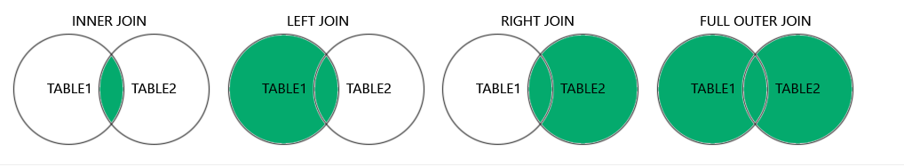
SQL Joins
Difference between SQL joins

Slide 3
Measures of Dispersion
Tells how spread the dataset is
Spread = Dispersion around the mean value
More dispersion means the dataset is widely distributed
Less dispersion means the dataset is narrowly distributed
Variance, Standard Deviation, Range, IQR
Example (in Excel)

Slide 4
Measures of Dispersion
Real world example
Choosing college based on average package?
Choosing train based on average late hours?
When should we choose a higher std dev?
Range
Max value – Min value
Tells you some idea about the dispersion but Std Dev is the best measure

Slide 5
Measures of Dispersion
IQR
Interquartile Range
Extensively used in data cleaning step of Machine Learning
Used to identify and remove outliers

Slide 6
Measures of Dispersion
IQR
IQR = Q3 – Q1
Upper bound = Q3 + (1.5*IQR)
Lower bound = Q1 - (1.5*IQR)
Eliminate records outside the lower/upper bound
Example (in Excel)
Q0 (0 %ile)
Q1 (25 %ile)
Q2 (50 %ile)
Q3 (75 %ile)
Q4 (100 %ile)

Slide 7
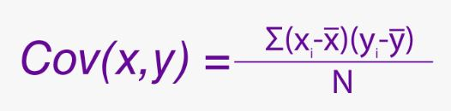
Measures of Association
Covariance
Tell the relationship between two variables
Tells only the sign, not the intensity
Ranges from -infinity to +infinity

Slide 8
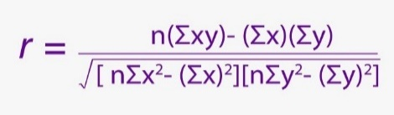
Measures of Association
Correlation
Tell the relationship & intensity between two variables
Tells how strong the relationship is
Ranges from -1 to +1

Slide 9
Measures of Association
Correlation vs Causation
Important concept to identify the root cause behind movement of a variable
Correlation doesn’t really mean causation

Slide 10
Measures of Association
Correlation vs Causation
Examples
Length of a rectangle vs Area of a rectangle
No. of hours studied vs Failure probability
Ice cream sales vs Hill station tourism
Sweaters sales vs Production of carrots
More examples?

Slide 11
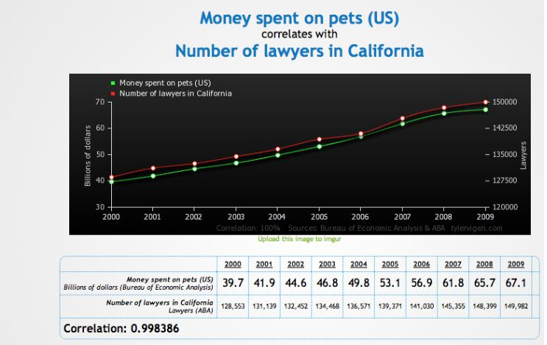
Measures of Association
Correlation vs Causation (Some funny examples #1)

Slide 12
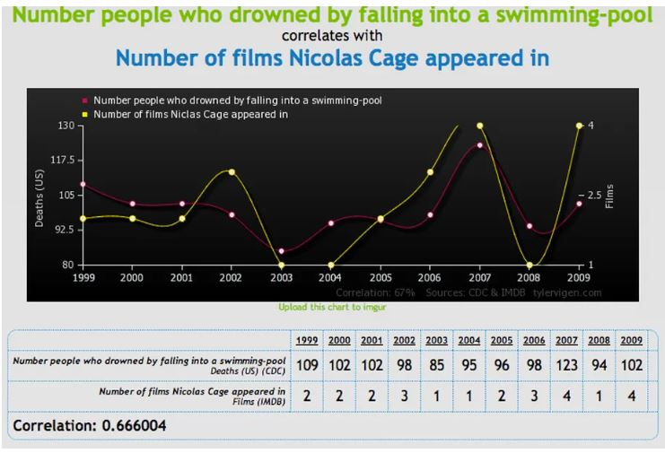
Measures of Association
Correlation vs Causation (Some funny examples #2)

Slide 13
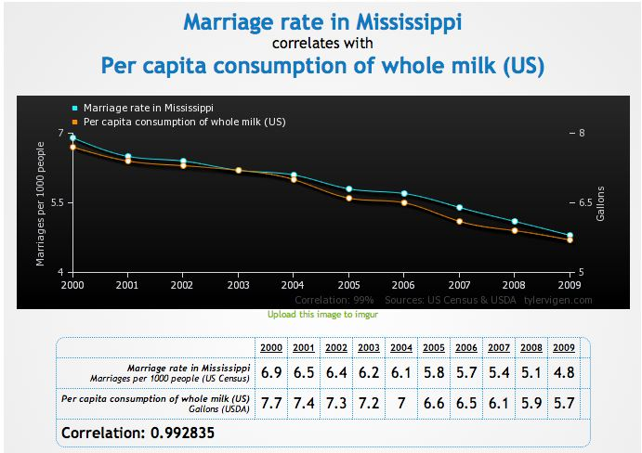
Measures of Association
Correlation vs Causation (Some funny examples #3)

Slide 14
Measures of Association
Correlation vs Causation (Quiz)
Correlation
Causation
Income vs Savings
Positive
Yes
Ice cream sales vs Shark attacks
Positive
No. Warm temperature.
Masters degrees vs Box office revenue
Positive
No. Population increase.
Exercise vs Body weight
Negative
Yes
Smoking vs Lifespan
Negative
Yes
TV time vs Better health
Negative
No. More sleep time.

Slide 15
Stats specific to ML
MAE: Mean Absolute Error
MSE: Mean Squared Error
RMSE: Root Mean Squared Error
MAPE: Mean Absolute Percentage Error
R-squared
Example (In Excel)

Slide 16
Multicollinearity
Happens when two or more IV are correlated
Problems with multicollinearity-
Interpretation of IV goes wrong
Coefficient of IV become misleading
Needs to be removed by some method (eg- VIF)

Slide 17
Multicollinearity
Examples
It becomes difficult to reward/penalize the components
Just an equation but the implications are huge!
House Price = (3 x Floor_Area) – (4 x Distance_City_Centre) – (8 x House_Age)
House Price = (3 x Floor_Area) – (4 x Distance_City_Centre) + (7 x Carpet_Area)

Slide 18
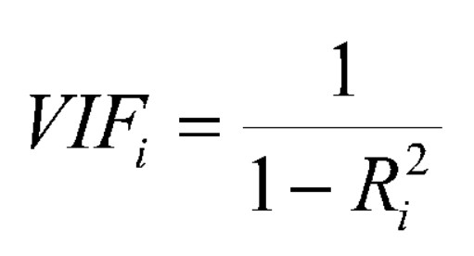
VIF
Variance Inflation Factor
Used to identify multicollinearity among IVs
Takes R-squared value for each IV and eliminate if crosses a threshold

Slide 19
VIF
VIF ranges from 1 from infinity
VIF = 1 : No multicollinearity
VIF between 1 and 5 : Low multicollinearity
VIF between 5 and 10 : Moderate multicollinearity
VIF above 10 : High multicollinearity

Slide 20

Confusion Matrix
Accuracy, Recall, Precision, F1 score
Balanced vs Imbalanced dataset

Slide 21
Bias in ML
A type of error. Error is the difference between the actual and predicted values.
Model works badly on the training and the testing data
In other words, when there are less relevant features
Leads to underfitting. Occurs due to wrong assumption in the model.
Overly simplistic model
Model makes strong assumptions not backed by the data

Slide 22
Variance in ML
Another type of error
Model works well on the training data but not on the testing data
In other words, when there are more than the required relevant features. Also called noise in the data.
Leads to overfitting. It means model is overly influenced by the training data.
Overly complex model
Model becomes sensitive to small fluctuations in the data, does not generalize well

Slide 23
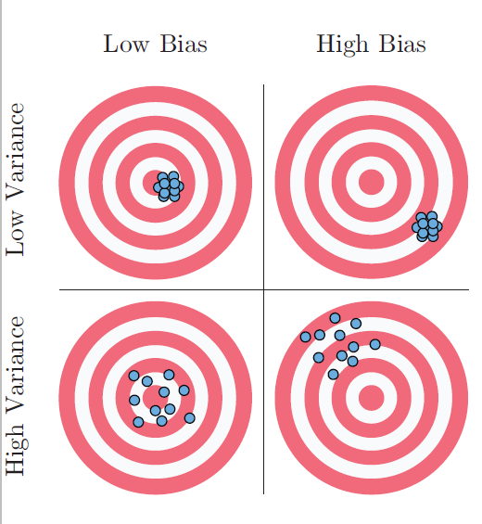
Bias-Variance Trade-off
Bias = Accuracy
Variance = Consistency

Slide 24
Real Life Examples of Bias-Variance Trade-off
Gym (Less vs More)
Parenting (Lenient vs Strict)

