Slide 1



APPETITE
An online platform for ordering, managing, and delivering food efficiently
Submitted By
Soham Bhowmick (1RVU23CSE459)
Gunashree P (1RVU23CSE173)
Yathish R (1RVU23CSE549)
Section (H)

Slide 2

Introduction
The Food Delivery System is a web-based platform that connects customers, restaurants, and delivery agents on a single digital ecosystem. Users browse menus, select items, and pay securely. Administrators manage food items and monitor orders in real time. Backend automation and online payment integration ensure faster service, accuracy, and convenience for all stakeholders.
Customers
Restaurants
Browse, order, and track deliveries seamlessly
Manage menus, prices, and orders efficiently
Delivery Agents
Real-time order tracking and route optimization

Slide 3

Five Core Objectives
User-Friendly Design
Develop an efficient web application for seamless food ordering
Secure Access
Implement authentication and role-based permissions for customers, admins, and delivery personnel
Automated Operations
Streamline order placement, payment processing, and delivery tracking
Admin Control
Enable easy management of menus, prices, and order data
Scalable Database
Centralize all records for better performance and growth

Slide 4





System Architecture
User
Frontend
Backend API
Interacts with the application
React/Vite Admin Panel, User Webpage
Node.js + Express logic
Database
Payment Gateway
MongoDB / MySQL equivalent storage
Stripe or UPI integration

Slide 5




System Modules
User Module
Admin Module
Registration, Login, Browse Menu, Place Order
Manage Food Items, View Orders, Track Users
Delivery Module
Payment Module
Update Order Status
Secure payment and confirmation

Slide 6
Implementation Technologies
Frontend
Frontend
Backend
HTML5, CSS3, JavaScript
React.js / Vite
Node.js
Foundation for designing and styling the user interface of the website.
Modern frontend framework for building fast, dynamic, and responsive web pages.
Server-side runtime environment for executing JavaScript, handling logic and APIs.
Backend
Database
Payment Integration
Express.js
MongoDB
Stripe / Razorpay API
Web application framework used to efficiently handle routes, requests, and responses.
Flexible NoSQL database for efficiently storing user, order, and food data.
Provides secure and reliable online payment processing capabilities.
Authentication
JWT (JSON Web Token)
Ensures secure login and session management for all users and roles.

Slide 7
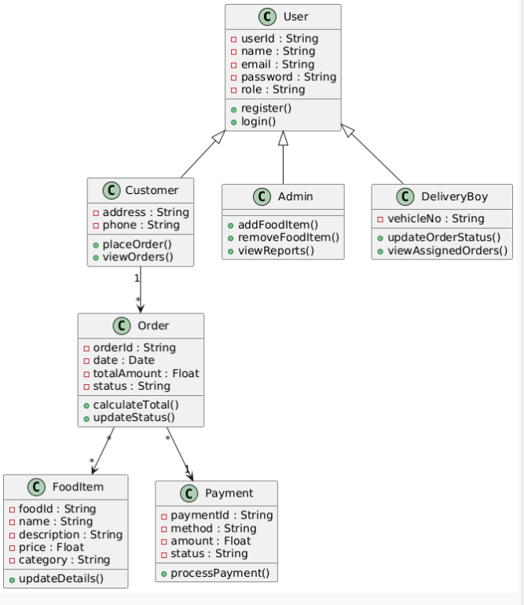
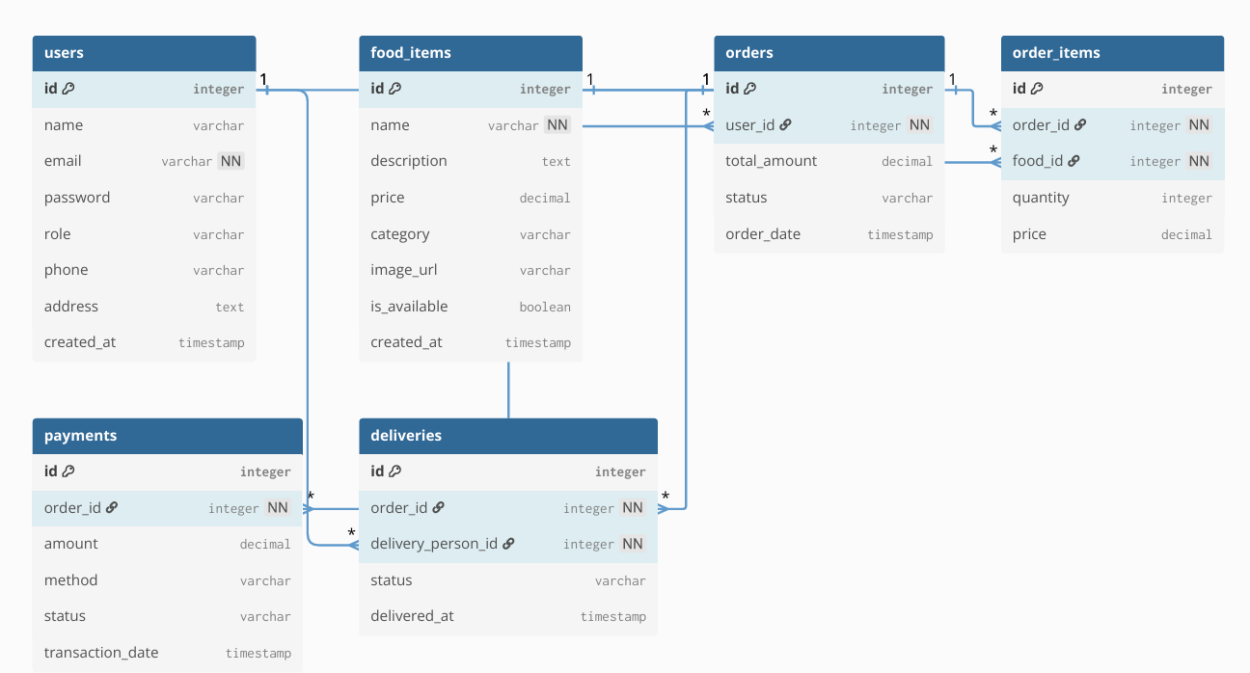
Diagrams

Slide 8





Key Features
User authentication and role-based access
Search and filter menu
Secure online payment system
Order tracking and delivery updates
Responsive UI (works on mobile and desktop)

Slide 9
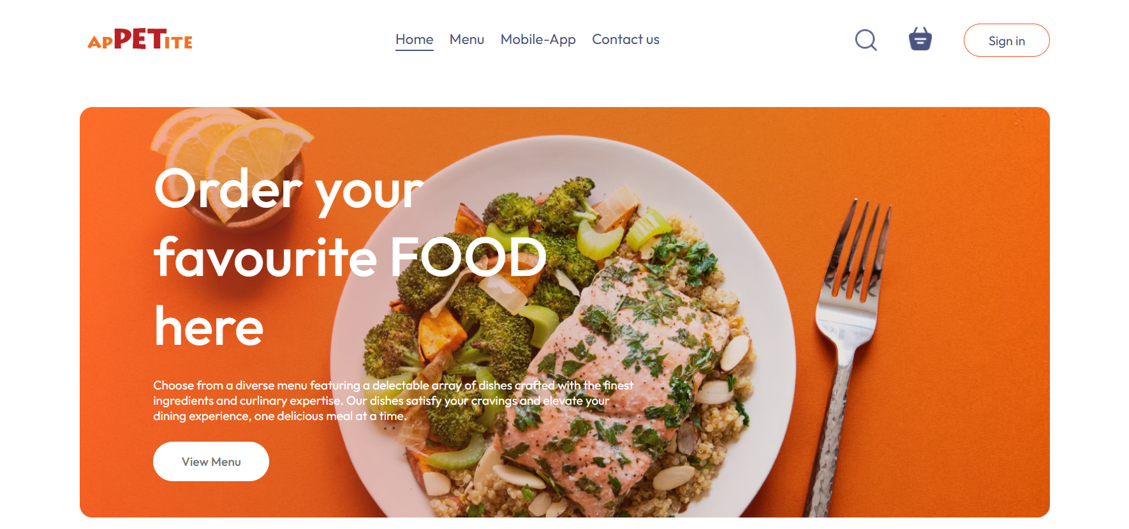
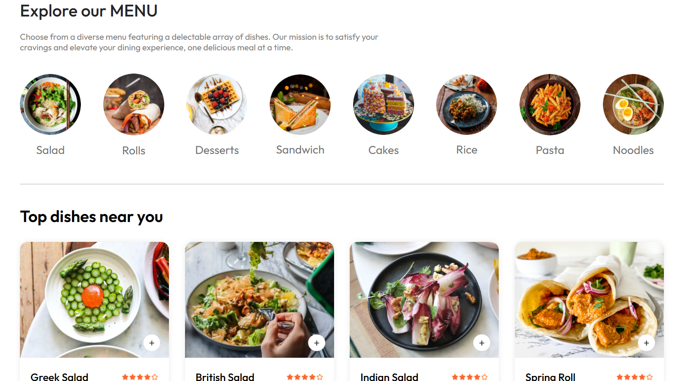
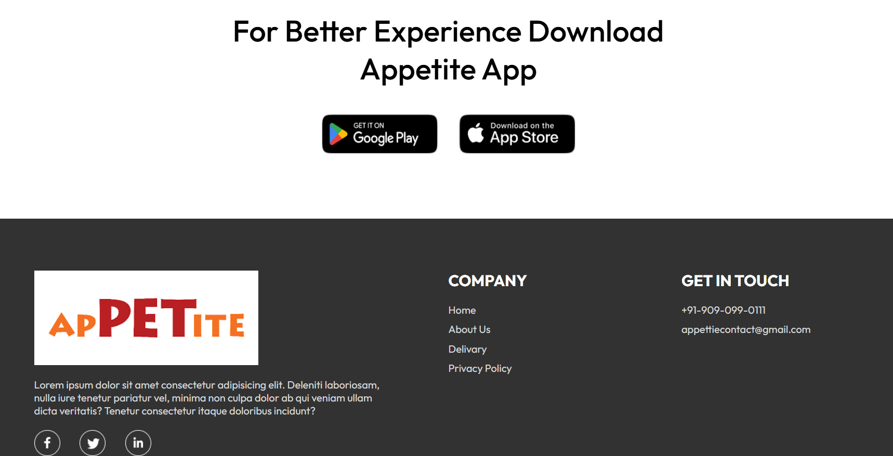
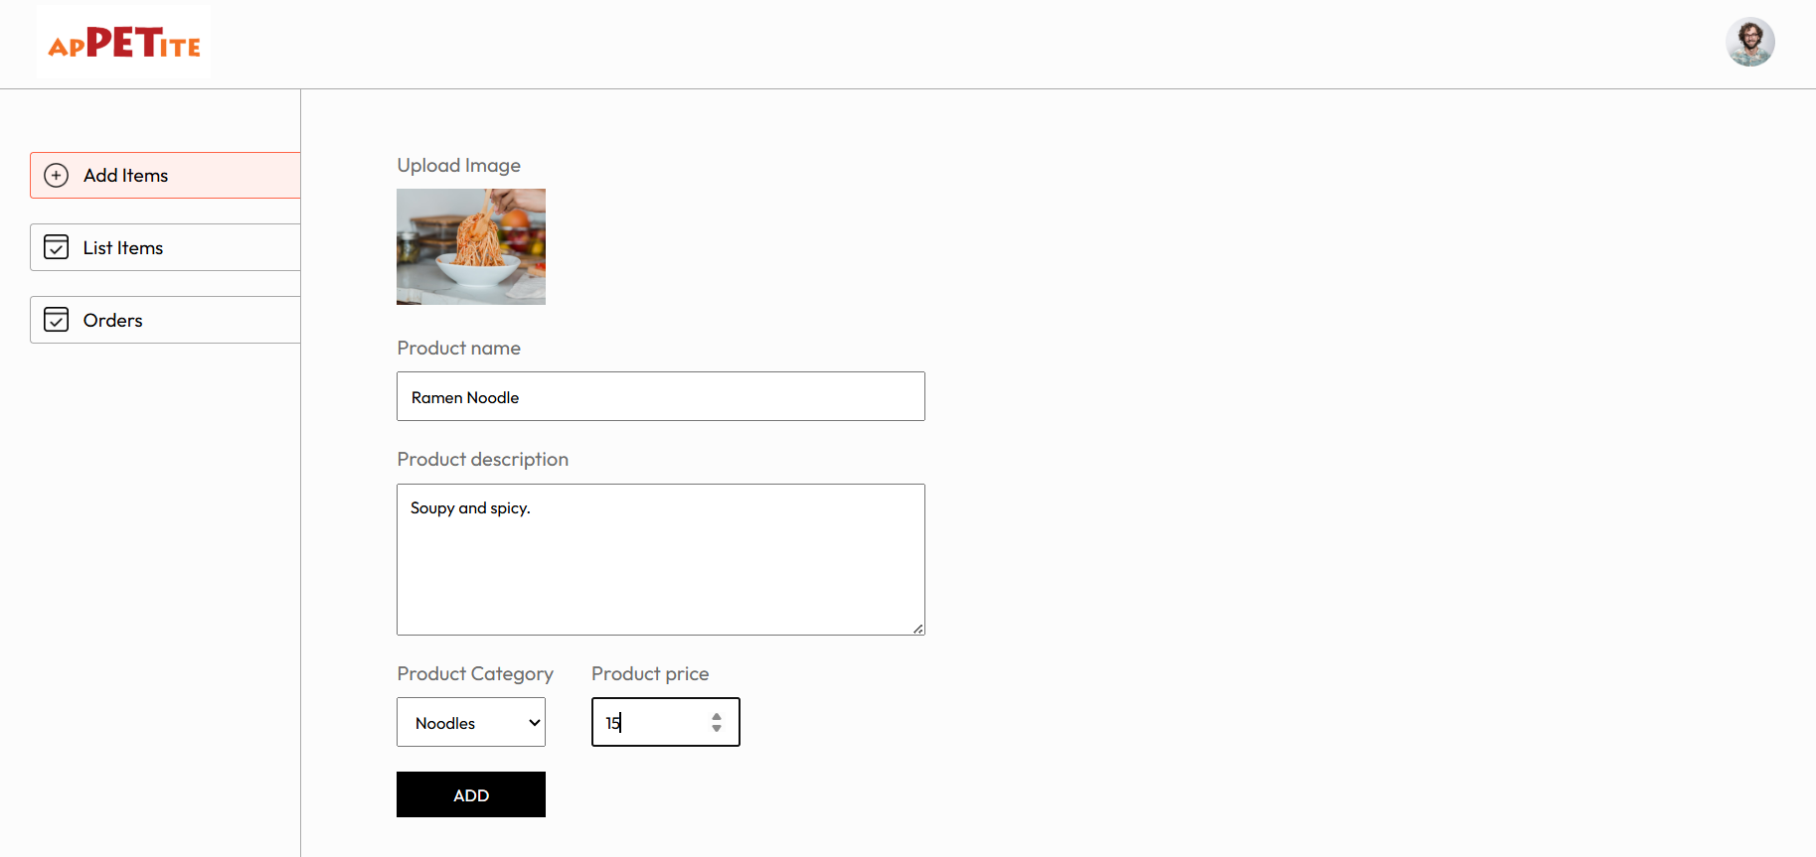
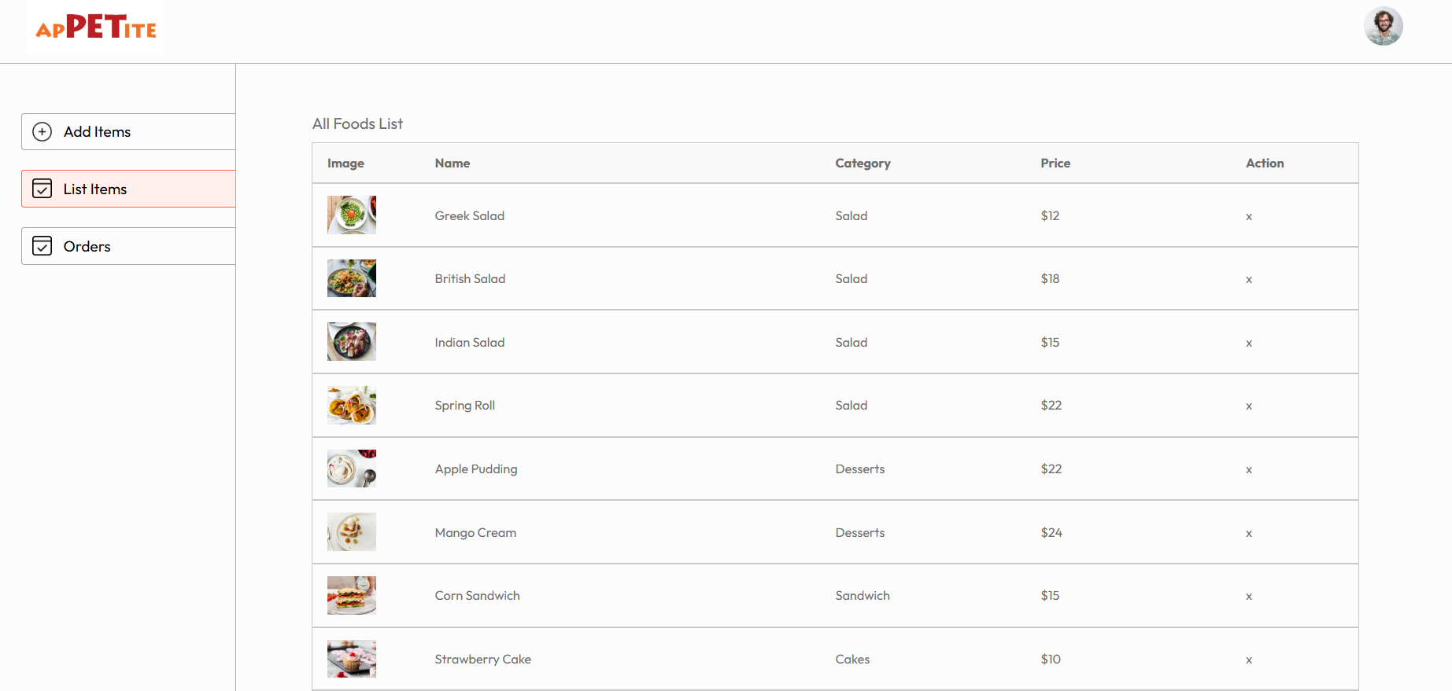
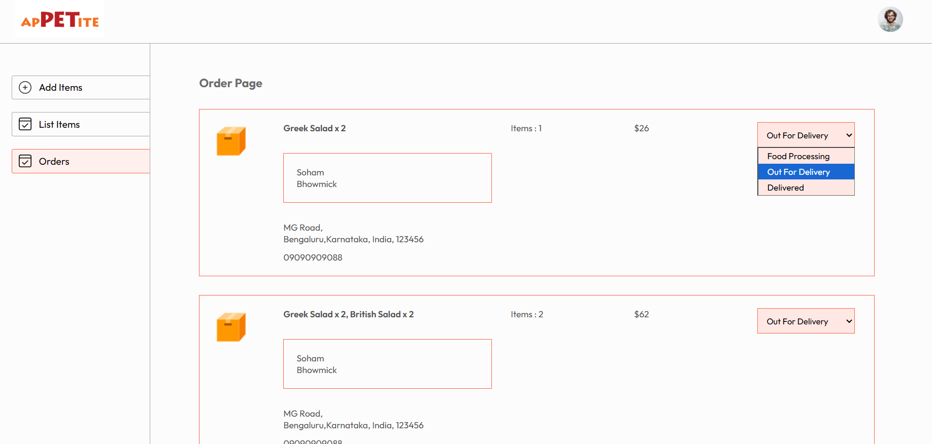
Results

Slide 10

Conclusion
The APPETITE Food Delivery System efficiently manages online food orders, payments, and deliveries, automating interactions between customers, restaurants, and delivery personnel. This reduces errors, improves service speed, and enhances convenience through secure authentication and real-time tracking. Built with a robust MERN stack, it ensures scalability and reliability, demonstrating how technology can streamline the food delivery process for everyone.

Slide 11



